Slide 1
In pairs, predict what the following code does
1 2 3 4 5 6 7 8 9 | def read_text_file(text_file): text=[] file = open(text_file, 'r') for line in file.readlines(): text.append(line.strip("\n")) file.close() return text text=read_text_file("shopping.txt") print(text)
Shopping.txt contains the following:
Bananas
Apples
Milk
Bread
Chocolate biscuits

Slide 2
Reading Text files

Slide 3
Learning objectives
Write programs that can read text files

Slide 4
Download and run the following code:
1 2 3 4 5 6 7 8 9 | def read_text_file(text_file): text=[] file = open(text_file, 'r') for line in file.readlines(): text.append(line.strip("\n")) file.close() return text text=read_text_file("shopping.txt") print(text)
Download the code from
read.py
Download the file to read
shopping.txt
Does the code do as you expected?

Slide 5
Reading text files
Previously we looked at writing data to text files.
Now we need to be able to retrieve that stored information by reading data from text files
There are three steps to reading a file
Open the file to read
Read the file
Close the file

Slide 6
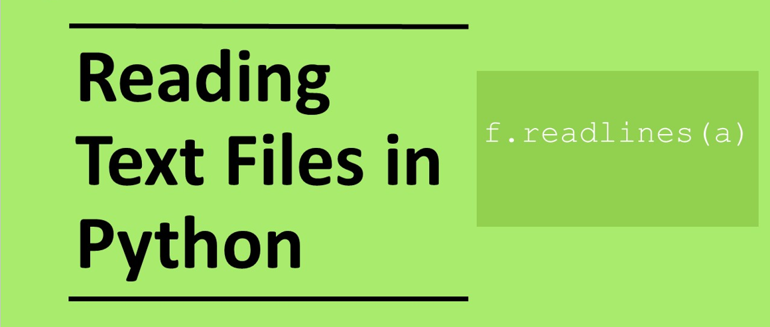

Slide 7
Open file for reading
file = open(“file.txt”, 'r')
This is the name of the file object

Slide 8
Open file for reading
file = open(“file.txt”, 'r')
Built in function that opens a file

Slide 9
Open file for reading
file = open(“file.txt”, 'r')
Name of the file you want to read

Slide 10
Open file for reading
file = open(“file.txt”, 'r')
Access specifier, indicating that we wish to read the file.
If the file does not exist that an error will occur

Slide 11
Reading methods
There are three methods that we can use for reading in text files:
read()- Reads in the whole file into a single string variable
readline()- Reads in one line at a time
readlines()- Reads in the whole file into a list

Slide 12
Using the read()method
file=open(“shopping.txt","r")
text=f.read()
print(text)
file.close()
Advantage: Reads the whole file in at once
Disadvantage: Reads into a single variable including the end of line character (\n) so difficult to do anything with without further processing
Output string: “Bananas\nApples\nMilk\nBread\nChocolate biscuits”

Slide 13
Using the readline()method
file=open(“shopping.txt","r")
print(file.readline())
print(file.readline())
print(file.readline())
file.close()
Advantage: Can easily process a single line
Disadvantage: Need more code to read in the whole file
Output:
Bananas
Apples
Milk

Slide 14
Using the readlines()method
file=open(“shopping.txt","r")
text=f.readlines()
print(text)
file.close()
Advantage: Reads the whole file into a list that is much easier to process
Disadvantage: Need to strip away the end of line character (\n)
We recommend using readlines()as the method of choice
Output: [‘Bananas\n’,’Apples\n’,’Milk\n’,’Bread\n’,’Chocolate biscuits\n’]

Slide 15
Close file
Once we have read the file we need to close the file using the close method
file.close()

Slide 16
Read text file function
This function is a general function that you can use in lots of situations for reading text files.
Call the function
read_text_file
Put the name of the file you want to read in the brackets
Set the name of the list that you want the contents of file copied to
1 2 3 4 5 6 7 8 9 | def read_text_file(text_file): text=[] file = open(text_file, 'r') for line in file.readlines(): text.append(line.strip("\n")) file.close() return text text=read_text_file("shopping.txt") print(text)

Slide 17
Read text file function
1 2 3 4 5 6 7 8 9 | def read_text_file(text_file): text=[] file = open(text_file, 'r') for line in file.readlines(): text.append(line.strip("\n")) file.close() return text text=read_text_file("shopping.txt") print(text)
Create an empty list for writing the contents of the file to

Slide 18
Read text file function
1 2 3 4 5 6 7 8 9 | def read_text_file(text_file): text=[] file = open(text_file, 'r') for line in file.readlines(): text.append(line.strip("\n")) file.close() return text text=read_text_file("shopping.txt") print(text)
Open the file for reading

Slide 19
Read text file function
1 2 3 4 5 6 7 8 9 | def read_text_file(text_file): text=[] file = open(text_file, 'r') for line in file.readlines(): text.append(line.strip("\n")) file.close() return text text=read_text_file("shopping.txt") print(text)
Reads each line at a time and puts into variable line

Slide 20
Read text file function
1 2 3 4 5 6 7 8 9 | def read_text_file(text_file): text=[] file = open(text_file, 'r') for line in file.readlines(): text.append(line.strip("\n")) file.close() return text text=read_text_file("shopping.txt") print(text)
Strip the newline character (\n) from the end of the line that has been read in and then append this to the text list

Slide 21
Read text file function
1 2 3 4 5 6 7 8 9 | def read_text_file(text_file): text=[] file = open(text_file, 'r') for line in file.readlines(): text.append(line.strip("\n")) file.close() return text text=read_text_file("shopping.txt") print(text)
Close file

Slide 22
Read text file function
1 2 3 4 5 6 7 8 9 | def read_text_file(text_file): text=[] file = open(text_file, 'r') for line in file.readlines(): text.append(line.strip("\n")) file.close() return text text=read_text_file("shopping.txt") print(text)
Return the list that we have added all the values in the file to

Slide 23
Modify
1 2 3 4 5 6 7 8 9 | def read_text_file(text_file): text=[] file = open(text_file, 'r') for line in file.readlines(): text.append(line.strip("\n")) file.close() return text text=read_text_file("shopping.txt") print(text)
Make the following modifications. In each case explain what happens and why by adding comments to the code
Line 5: remove .strip(“\n”)
Line: 8: Change the name of file from shopping.txt to shopping_list.txt
Line 3: Change the access specifier from ‘r’ to ‘w’

Slide 24
Make
Write a program that reads a set of number from a text file and adds them up.
Create a text file called numbers.txt with the following numbers.
13
19
21
15
17
16
Make sure there is one number on each line.
Use the read_text_file() routine to read the in the file.
Add up all the numbers in the file.

Slide 25
Make
Solution:
total=0
data=read_text_file(“numbers.txt")
for i in range(len(data)):
total=total+int(data[i])
print(total)

