Slide 1
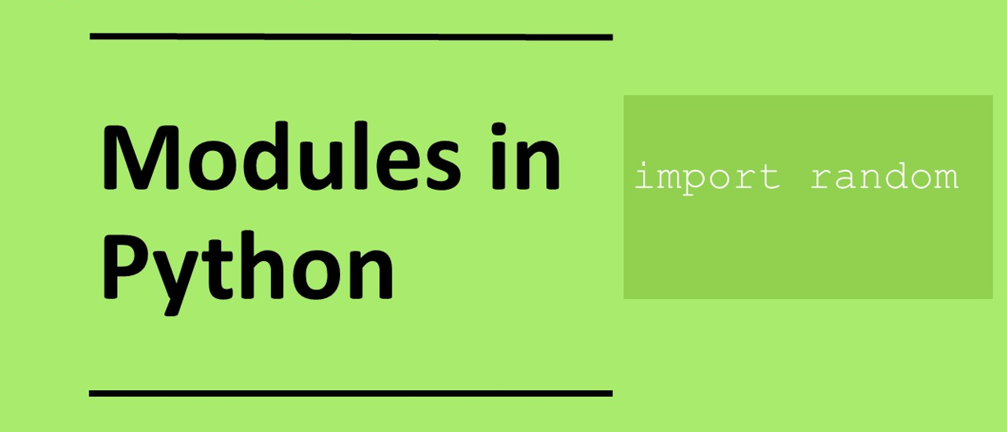

Slide 2
Python Modules and Packages

Slide 3
Learning objectives
Use the math, time and datetime Python modules

Slide 4
Modules and Packages
In Python modules are prewritten code that developers can use to speed up development so they do not have to write the code themselves.
We have already used the random package.
To remind you, to use a package we use
import package
Or
from package import *

Slide 5
Useful Modules
math – package that contains lots of mathematical functions including sin, cos, square root
datetime – package that contains lots of date and time routines.
time – for timing running of programs for instance

Slide 6
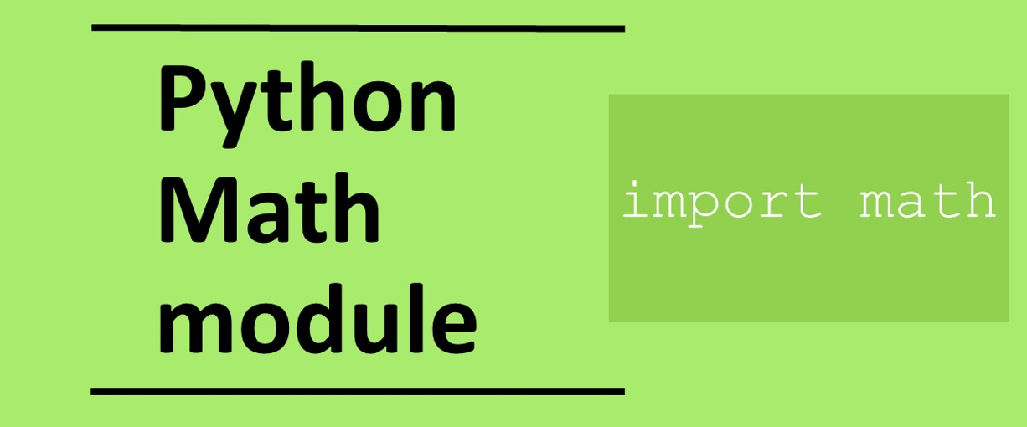

Slide 7
Math package
Some common maths function. Need to ensure values are given in radians not degrees for sin, cos and tan functions.
pi sin(x) cos(x) tan(x) Pow(x,y) sqrt(x) fabs(x) ceil(x) floor(x) degrees(x) radians(x) | Value of pi Sine of x Cosine of x Tangent of x x raised to the power y Square root Absolute (positive) value of x Round x up to nearest integer Round x down to nearest integer Convert x from radians to degrees Convert x from degrees to radians | math.pi math.sin(math.radians(45)) math.cos(math.radians(45)) math.tan(math.radians(45)) math.pow(5,2) math.sqrt(25) math.fabs(-5) math.ceil(5.5) math.floor(5.5) math.degrees(90) math.radians(math.pi/2) | 3.14159265 0.707 0.707 1.0 25 5 5 6.0 5.0 1.57079 90

Slide 8
What values are returned?
math.pi
math.pow(3,3)
math,sqrt(81)
math.fabs(-8)
math.floor(8.2)
math.ceil(8.2)

Slide 9
What values are returned? (Answers)
math.pi | 3.14159265
math.pow(3,3) | 27
math,sqrt(81) | 9
math.fabs(-8) | 8
math.floor(8.2) | 8
math.ceil(8.2) | 9

Slide 10
Predict what the following output
def pythagoras(x,y):
hypotonus = math.sqrt( math.pow(x,2) + math.pow(y,2) )
return hypotonus
print(pythagoras(3,4))
def area(x):
return math.pi * math.pow(x,2)
print(area(6))

Slide 11
Datetime and Time packages
How to get current date and time in Python using datetime package
import datetime
t=datetime.datetime.today()
print(t.hour)
print(t.year)
print(t.month)
print(t.day)
How pause a program:
import time
Time.sleep(1)
import time
Start_time=time.time()
# main code here
print(start_time-time.time()

Slide 12
Time packages
For timing how long a program takes to run
import time
start_time=time.time()
# main code here
print(start_time-time.time()
Pausing a program for 1 second
import time
time.sleep(1)

Slide 13
Time packages
For timing how long a program takes to run
import time
x=10000000
start_time=time.time()
for i in range(x):
pass
print(time.time()-start_time)
Download the code from: timing_code.py
Run the program with different values of x and record how long the program takes to run

Slide 14
Code timing
X | Time taken
100000
1000000
5000000
10000000
50000000

Slide 15
Display current date and time
from datetime import *
now=datetime.now()
print(now)
Example Output: 2022-04-07 22:31:11.296526

Slide 16
Create a date string
from datetime import *
year=2022
month=4
day=7
hour=22
minute=30
seconds=12
my_datetime=datetime(year,month,day,hour,minute,seconds)
print(my_datetime)
Output: 2022-04-07 22:30:12

Slide 17
Format data output as string
from datetime import *
now=datetime.now()
print(now)
print(now.strftime("%m/%d/%Y: %H:%M:%S"))
Output: 04/07/2022: 22:31:11

Slide 18
Common Directives
Directive | Description | Example
%a | Weekday abbreviated | Mon
%A | Weekday full | Monday
%b | Month abbreviated | Jan
%B | Month Full | January
%m | Month | 01
%d | Day of month | 10
%y | Year no century | 19
%Y | Year with century | 2019
%H | Hour (24 hour clock) | 16
%I | Hour (12 hour clock) | 04
%M | Minute | 05
%S | Second | 13
from datetime import *
year=2022
month=4
day=7
hour=22
minute=30
seconds=12
now=datetime(year,month,day,hour,minute,seconds)
print(my_datetime)
What do the following output:
print(now.strftime("%A %d %B %Y"))
print(now.strftime("%a %d &b %y"))
print(now.strftime("%I %M %S"))
print(now.strftime("%Y%m%d"))

