Slide 1
Knowledge retrieval questions
State two functions of the cell-surface membrane (3 marks)
State two functions of the internal membranes (2 marks)
Give one other name we use for the cell surface membrane (1 mark)
Acts as barrier / separates the internal contents of the cell from the external environment
Regulates transport of substances into and out of cell.
Contains receptors for chemical signalling:
Contains antigens used for self recognition
Releases chemicals for cell signalling
Compartmentalisation - Allows each organelle to function separately to the cell
Increase surface area – for enzyme catalyse reactions / attachment for ribosomes
Plasma membrane
Notes:
Function of membrane
Answer: contain / location of , (named) proton pumps ✓
(provide , site / location / surface ) for , chemiosmosis – moving protons across membrane to create electrochemical gradient / ATP synthesis / oxidative phosphorylation ✓
allow , formation / maintenance , of , H+ / proton / hydrogen ion , gradient ✓
outer membrane is highly permeable to allow movement of (named) molecules ✓

Slide 2
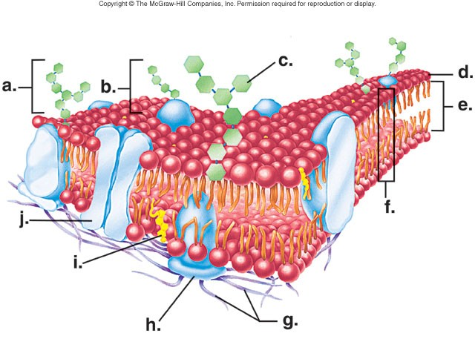
NAME IT!

Slide 13
Final slide

Slide 15
Knowledge retrieval questions
State two functions of the cell-surface membrane (3 marks)
State two functions of the internal membranes (2 marks)
Give one other name we use for the cell surface membrane (1 mark)
Acts as barrier / separates the internal contents of the cell from the external environment
Regulates transport of substances into and out of cell.
Contains receptors for chemical signalling:
Contains antigens used for self-recognition
Releases chemicals for cell signalling
Compartmentalisation - Allows each organelle to function separately to the cell
Increase surface area for more efficient chemical reactions
Plasma membrane
*Plasma membrane can also be found around internal organelles

Slide 16
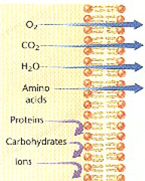
Discuss: Can all molecules cross the plasma membrane?
So why do some cross freely not others?

Slide 17
Facilitated diffusion
Not every molecule can cross the cell membranes. Only molecules that are small and non-polar can cross the membrane.
For example:
glucose is a large molecule that cannot diffuse across the cell membrane.
Ions like sodium, potassium, and calcium are charged and are repelled by the cell surface membrane.
Amino acids and nucleic acids are polar and too large to cross the cell membrane.
Even water at times requires proteins to cross the membrane (aquaporins)
To facilitate these transfer of substances across the plasma membrane, certain integral proteins are required.

Slide 18

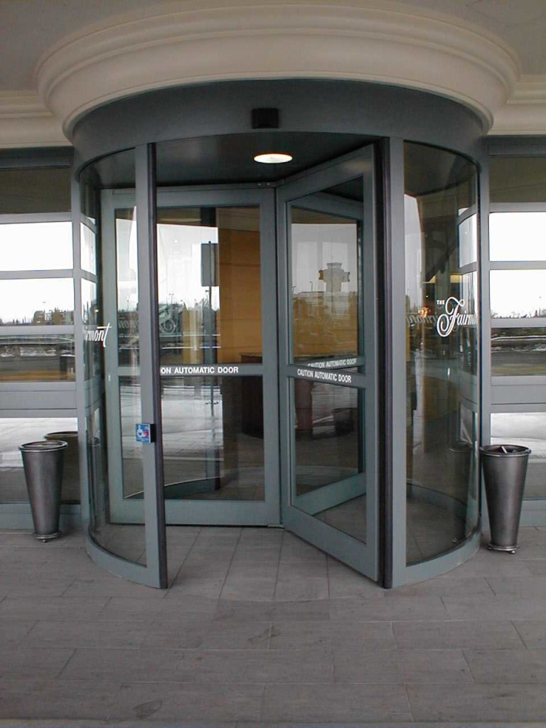
Types of proteins used transport of substances

Slide 19
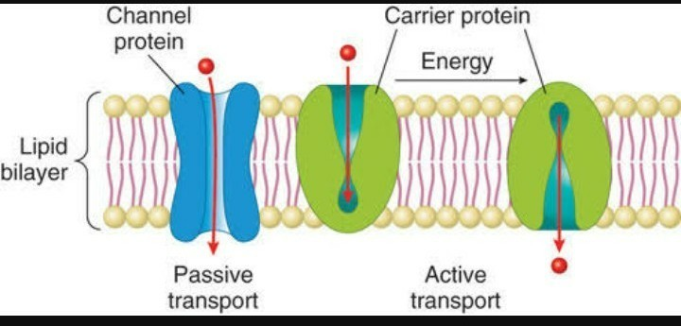
Types of intrinsic (integral) proteins

Slide 20
Channel and carrier proteins (both intrinsic proteins)
Channel proteins
form a channel through the membrane, to allow smaller ions (polar) through
this is called facilitated diffusion (high to low concentration)
Carrier proteins
transports larger molecules (proteins and some ions) into/out of the cell via active transport
active transport – (low to high concentration) requiring energy in the form of ATP.

Slide 21
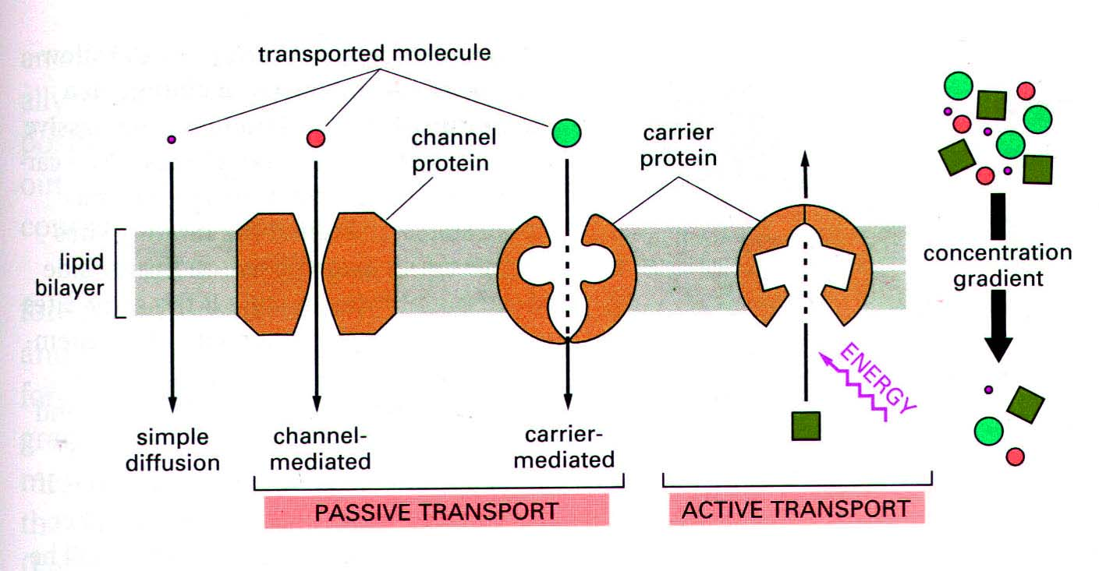
Careful!
Carrier proteins – can facilitate the diffusion of molecules down the concentration gradient.
High concentration gradients can force them open to facilitate diffusion!
But can also move molecules against the concentration gradient using active transport

Slide 22
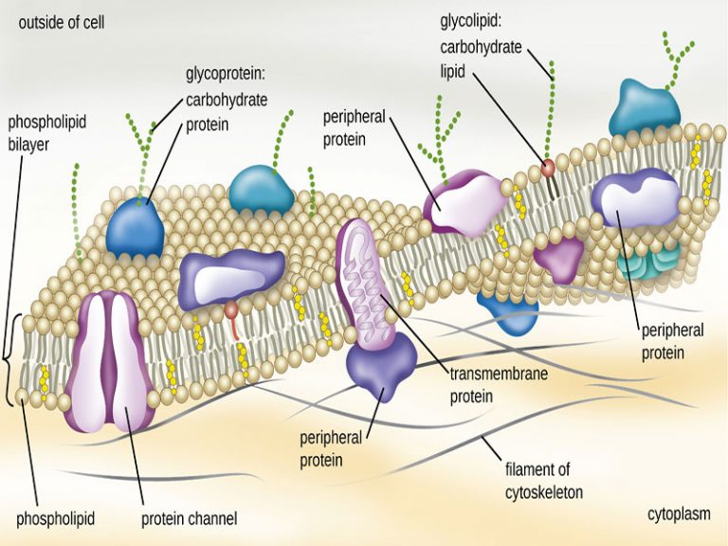
External/peripheral proteins
Some act as enzymes to catalyse reactions
Some act as receptors for molecules (like hormones)
Molecules bind to them and cause chemical reactions to occur inside the cell
They also offer support to the cell surface membrane

Slide 23
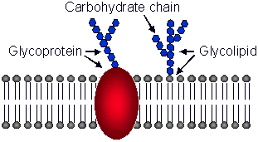
Peripheral structures you need to know!

Slide 24
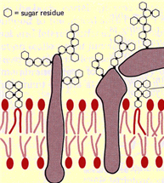
Glycolipids and glycoproteins
glycoproteins (polysaccharide + protein)
Stabilise the cell
Receptors for neurotransmitters
Contain antigens for recognition
glycolipid (polysaccharide + fatty acid tails)
Contain antigens for cell recognition (particularly for immune response)
Help to adhere to other cells forming tissue
One type of glycolipid contains the antigen for your ABO blood type
Both glycoproteins & glycolipids form antigens (role in cell recognition by immune system)

Slide 25
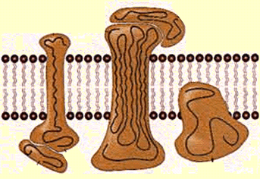
SUMMARY
Plasma membranes also contain proteins:
Functions of membrane proteins:
receptors – form docking sites for hormones
channels – allow ions & polar molecules to cross membrane
carriers – transport molecules across the membrane
Some membrane proteins and lipids have sugars attached to them:
glycoproteins (carbohydrate + protein)
glycolipid (carbohydrate + fatty acid tails)
glycoproteins & glycolipids form antigens (role in cell recognition by immune system)

Slide 26
NAME IT!

Slide 37
Final slide

Slide 39
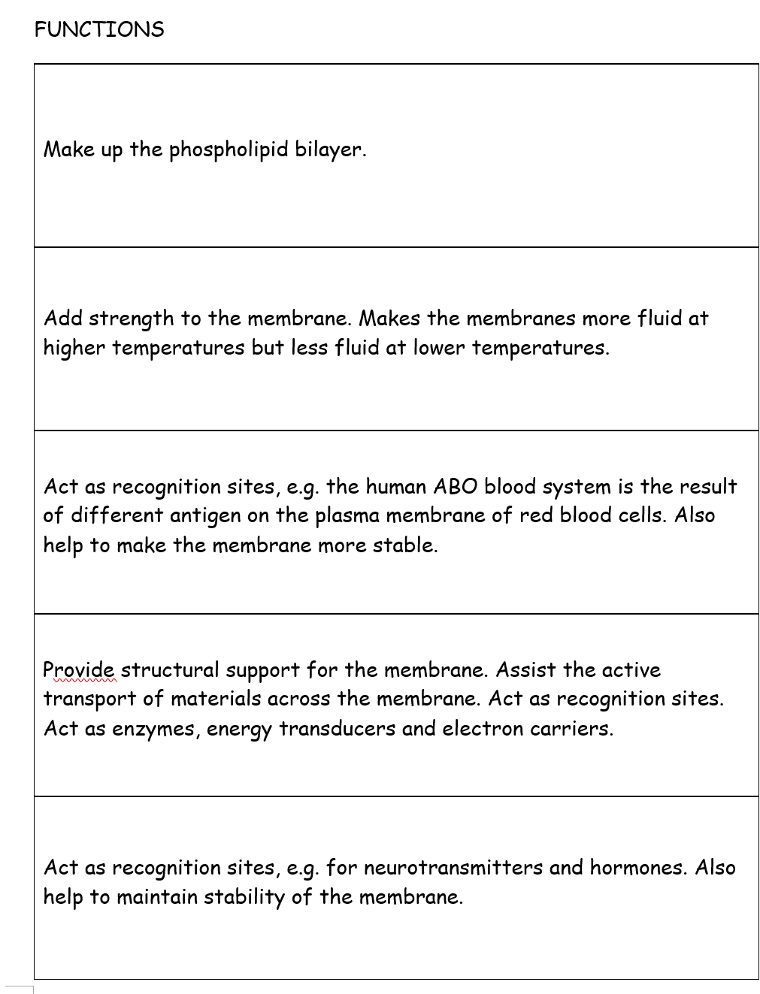
Write which part of the plasma membrane each function is for.
Phospholipids
Cholesterol lipids
Glycolipids
Proteins (channel/carrier)
Glycoproteins

Slide 40
NL below
+ PAG

Slide 41
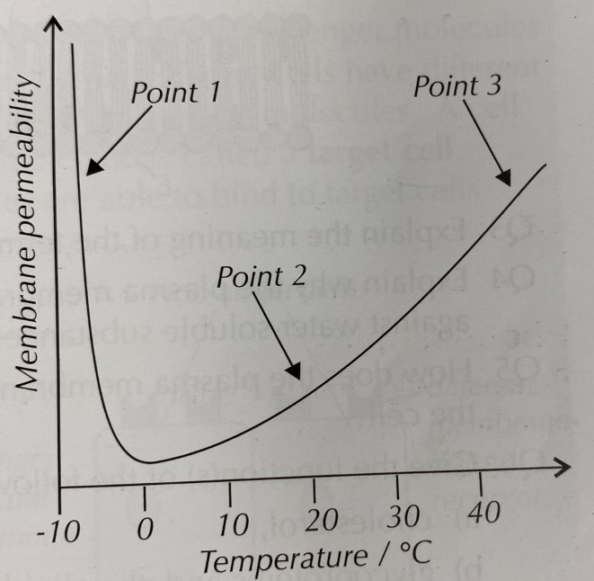
Discuss the permeability of the plasma membrane at different temperatures.
Explain why the permeability change with temperature? (6 marks)
Point 1:
Point 2:
Point 3:

Slide 42
Discuss the permeability of the plasma membrane at different temperatures.
Explain why the permeability change with temperature? (6 marks)
Point 1:
Ice crystals form and pierce the membrane when thawing.
Point 2:
Phospholipids can move around and are not tightly packed.
Plasma membrane is partially permeable.
As temperature rises, the phospholipids gain kinetic energy and move more - increasing permeability
Point 3:
Phospholipids at highest temperature start to melt (break down), increasing permeability.
Water inside the cell expands putting pressure on the membranes
Channel/carrier proteins denature and are unable to regulate what enters/leaves - increasing permeability

Slide 43
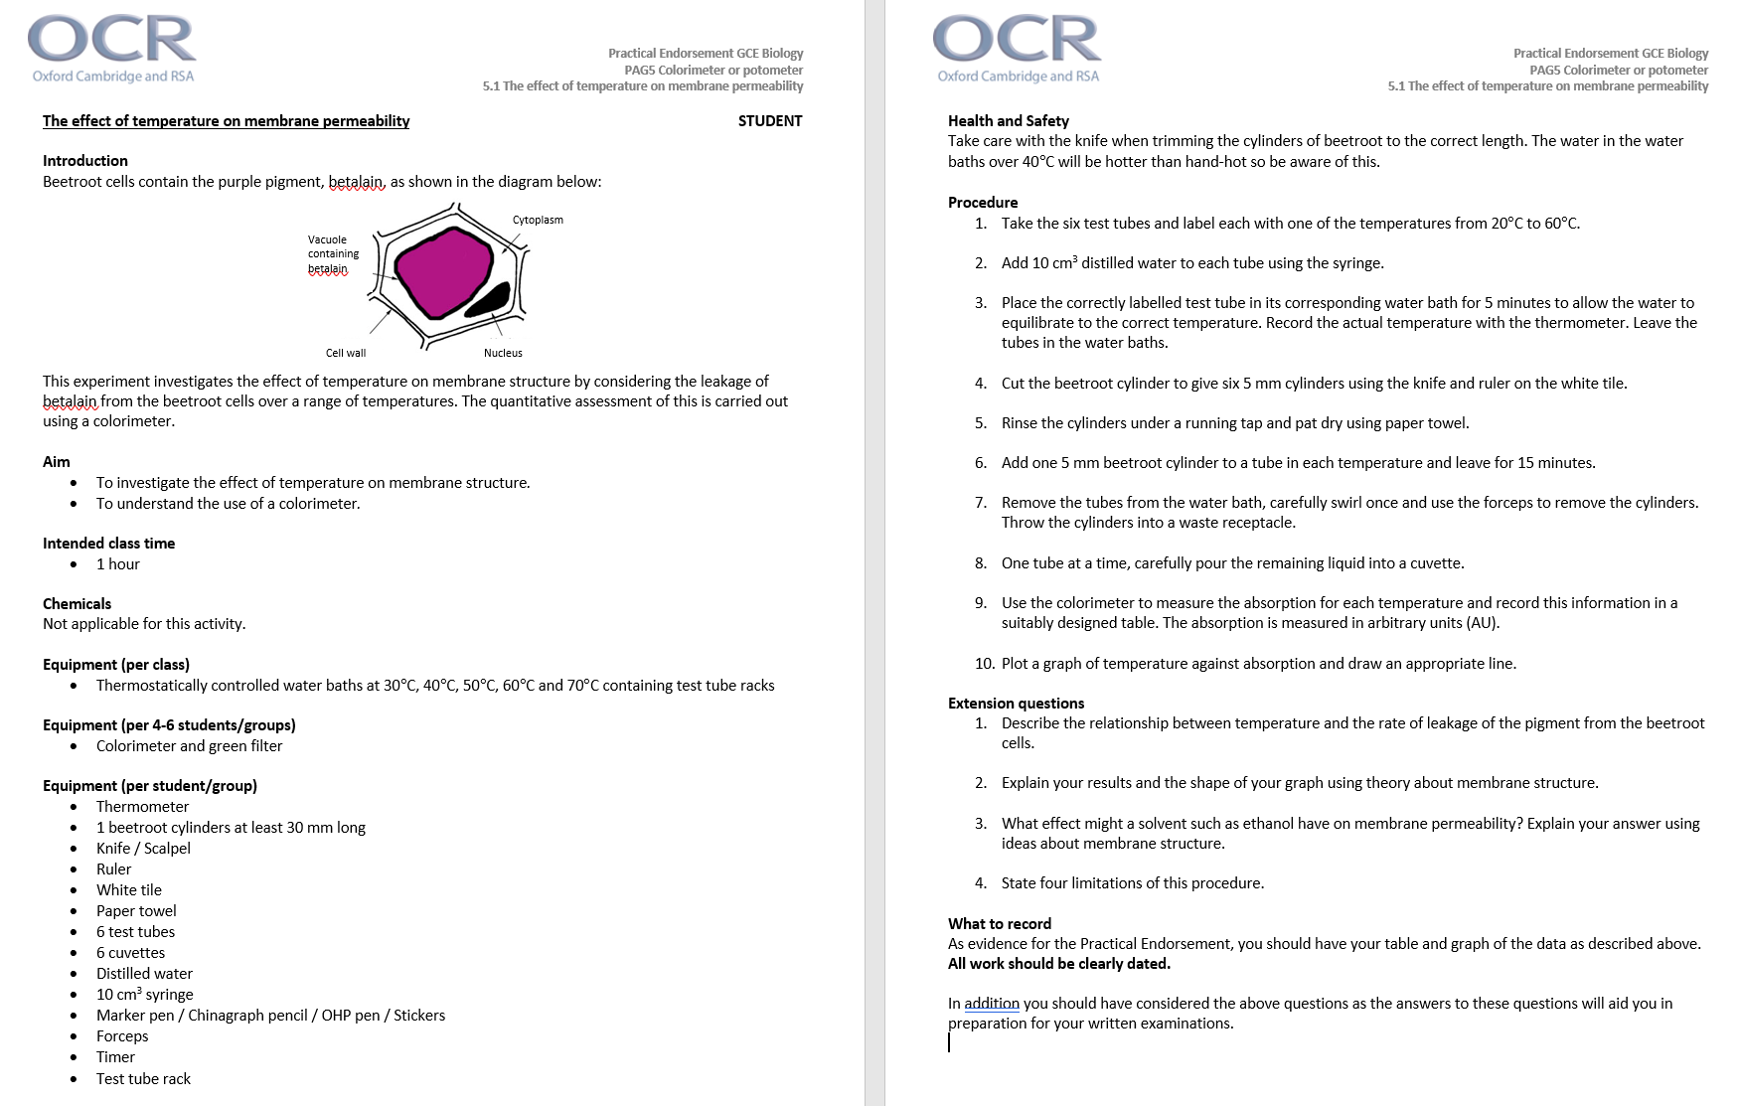
OPEN PAG 5.1 PPt

Slide 44
But why…The fluid mosaic model?
  Fluid: because it is made of water.
  Mosaic: because its made of different components, tiles in a mosaic.
  Fluid: because molecules move in and out of the bilayer. This makes membranes flexible structures and able to change shape
  Mosaic: because its made of different components, tiles in a mosaic.
A
B
  Fluid: because individual phospholipid molecules can move relative to one another (within one layer). This makes membranes flexible structures and able to change shape
  Mosaic: because proteins vary in shape, size and pattern, like tiles in a mosaic.
  Fluid: because individual phospholipid molecules can move between the layers. This makes membranes flexible structures and able to change shape
  Mosaic: because proteins vary in shape, size and pattern, like tiles in a mosaic.
C
D

Slide 45
In 1972, Singer and Nicholson proposed the fluid mosaic model.
  Fluid: because individual phospholipid molecules can move relative to one another (within one layer). This makes membranes flexible structures and able to change shape
  Mosaic: because proteins vary in shape, size and pattern, like tiles in a mosaic.
C

Slide 46
FILL IN THE GAPS
Membranes have a variety of functions in cells. All membranes are ....................... permeable. This means that they allow the passage of certain substances by processes such as active transport or ............................... through the membrane. The cell surface membrane, also known as the ............................... membrane, surrounds the cytoplasm. The cell surface membrane consists of a bilayer of .............................. . To stabilise the structure of the membrane and keep it fluid, molecules of ................................ are also found in this bilayer.
[Total 5 marks]
partially / selectively;
DO NOT ACCEPT semi
ACCEPT differentially
(facilitated) diffusion OR osmosis;
plasma;
phospholipids;
cholesterol;
ACCEPT plasma cell

Slide 47
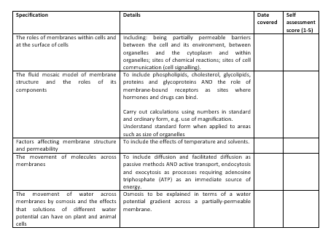

Learning Outcomes
Identify the components of cell membranes.
Describe the roles of each of the components of the cell membrane.

