Slide 1
Factors Affecting Enzymes
Tuesday, 22 July 2025
You need to draw today!

Slide 2
Quick 10 quiz
What is a catalyst?
What term is used to describe an enzyme that acts within the cell
3. What determines the shape of an enzyme’s active site?
4. What is formed when a substrate binds to an active site?
5. What is the main difference between the ‘lock and key’ and ‘induced fit’ model?
6. What stops a substrate from binding to the active site?
7. Which enzyme acts on sucrose?
8. Name the products when sucrose is hydrolysed.
9. What type of protein are enzymes?
10. Where does a non-competitive inhibitor bind to an enzyme?

Slide 3
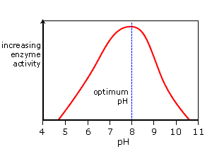
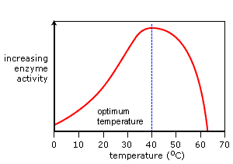
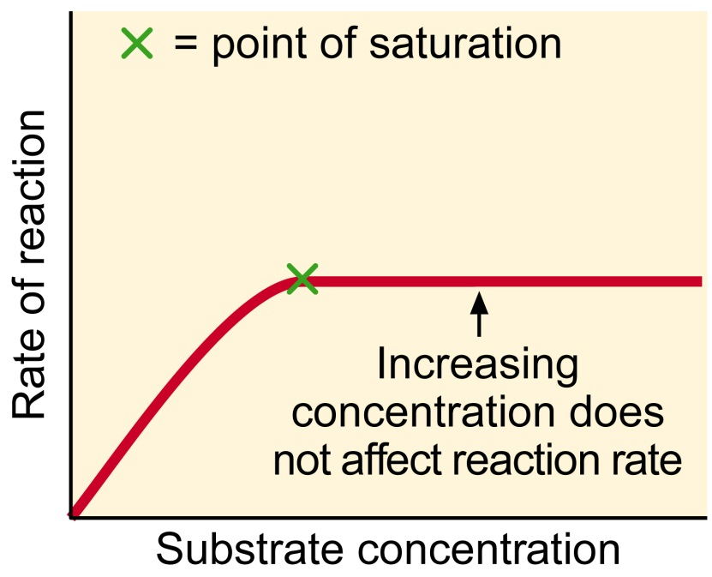
Factors affecting enzyme activity.
Describe and explain the effects of temperature, pH, enzyme concentration and substrate concentration on enzyme activity.
Describe and explain how these effects can be investigated experimentally
Back to back drawing
Now together try and draw the effect of substrate concentration on rate of reaction

Slide 4
Effect of temperature on enzymes
Draw the graph and explain using these terms:
Energy
Successful collisions
Enzyme-substrate complexes
Optimum value
Denature
Notes:
Teacher notes
Students could be asked if they can deduce the equation for calculating the Q₁₀ of this reaction based on the data from this graph.
Q₁₀ = rate of reaction at x + 10 °C / rate of reaction at x °C

Slide 5
Effect of pH on enzymes
Now do the same for pH
Extra explanation:
More acidic – excess H⁺
The COOH group which normally drops H to form an ionic bond with the substrate cannot do this therefore the bond cannot be made.
More alkaline – excess OH⁻
The NH2 group is unable to drop H to form a bond.

Slide 6
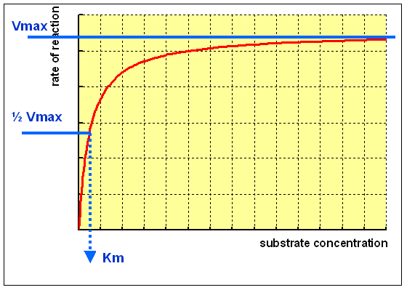
Rate of reaction experiment
For substrate concentration we can use the catalase example breaking down hydrogen peroxide.
There is a new term to add to your graph here.
Vmax is the maximum rate that an enzyme can catalyse a reaction.

Slide 7
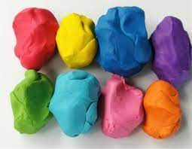
Cofactors, coenzymes and prosthetic groups – all activators
(red terms are spec points)
Cofactors are not proteins but rather help proteins.
They can transfer atoms or form part of the active site.
Cofactors are simple molecules or inorganic ions
They are thought to alter the enzyme shape so that it can bind more effectively to the substrate or help to transfer a particular group of atoms from molecule to the other
Obtained via the diet as mineral ions
E.g. Cl⁻ are cofactors for salivary amylase, they help form the correct shape of the active site.
Ca²⁺ are cofactors for prothrombin
Make a model of this and leave it in front of you.

Slide 8
Co-enzymes (type of cofactor)
A co-enzyme that is an organic non-protein molecule that is loosely associated with the enzyme molecule (not attached)
Many coenzymes are derived from vitamins. B1 acts as a co-enzyme in the oxidation of glucose. B3 synthesises NAD. They play a central role in metabolism, regulating biochemical pathways by switching enzymes on and off
E.g. NAD, FAD and coenzyme A in respiration (you will learn a lot about these next year!)
Make a model of this and leave it in front of you.
Challenge:
Can you represent this information in a diagram?

Slide 9
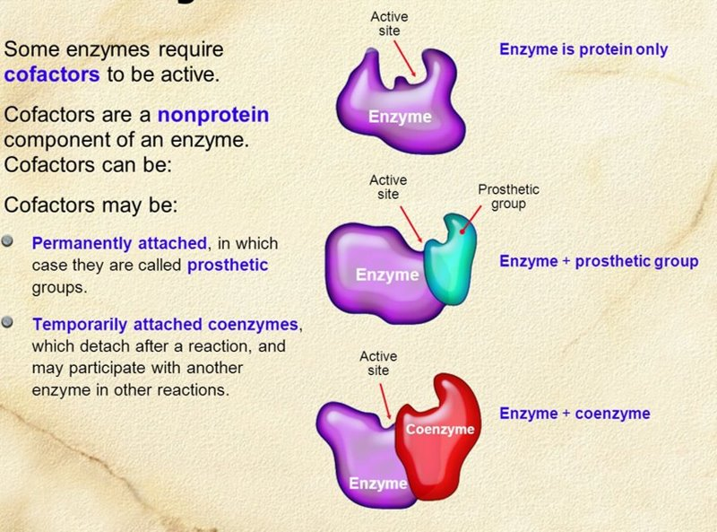
Prosthetic Groups (another type of cofactor)
These are organic or inorganic cofactors, non-protein molecules that bind tightly and permanently to the enzyme by covalent bonds.
It's important to note, though, that these prosthetic groups can also bind to proteins other than enzymes.
Zn²+ is a prosthetic group for carbonic anhydrase (helps transport carbon dioxide out of the blood)
Haem group is the prosthetic group in haemoglobin (Fe²+, protoporphyrin ring)
Challenge:
Can you represent all this information in a diagram?

Slide 10
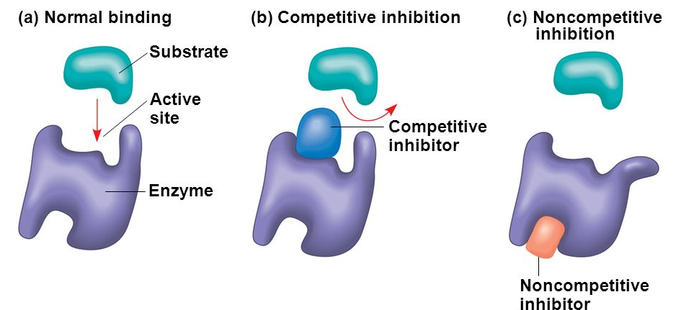
Now inactivators:
Enzyme inhibition, molecules that prevent enzymes from catalysis.
the inhibitor directly competes with the substrate
binds at the allosteric site causes change in the tertiary structure
And now draw this
Covered in detail next lesson

Slide 11
Temperature coefficient
Measurement of the rate of change of a reaction when you raise the temperature by 10 degrees C
It expresses the temperature dependence of a biological process
It is written as Q₁₀
Ratio between the rates of the process at two different temperatures.
Calculated using:
temp coefficient = rate at (x + 10)ºC
rate at x ºC

Slide 12
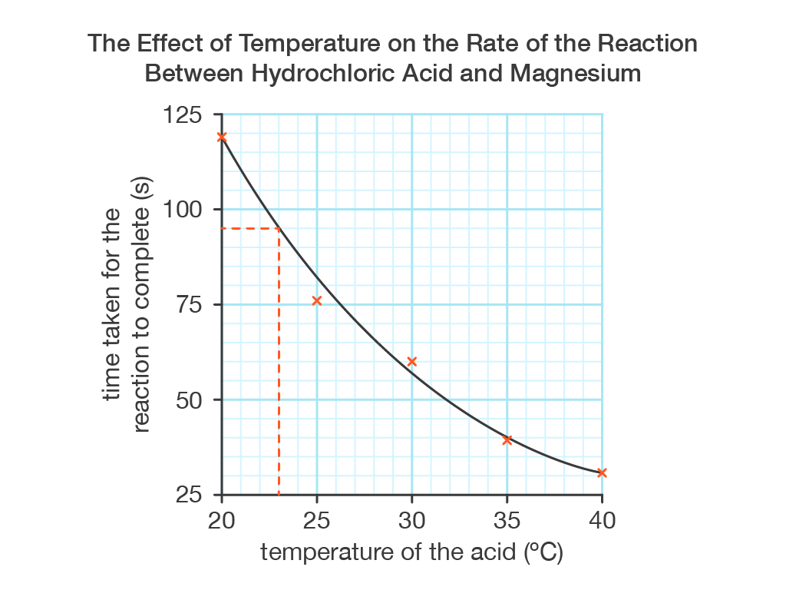
Temperature coefficient
To calculate the values for Q₁₀ from a graph:
  Use intercepts at two temperatures 10ºC apart.
  Read off the rate of reaction.
  Substitute the figures into the equation.
There is no unit for Q₁₀ because it is a ratio.
  NB: If there is no scale given on the vertical axis for this rate, you can still calculate Q₁₀ by measuring the distances on the vertical axis with a ruler and using these as equivalent to the rates.
Be careful here – this graph shows time so it must first be converted to rate before calculating Q10
Calculate the temperature coefficient for this reaction.

