Slide 1
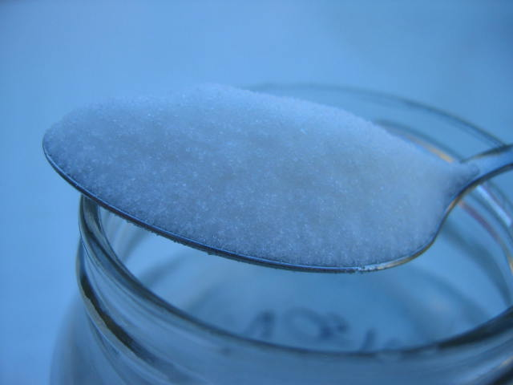
Carbohydrates – what do they look like?
Get thinking:
What are carbohydrates used for in the body?
Name 2 different types
What elements do they contain?
What’s the plant and animal carbohydrate storage molecule?
Which 2 hormones are involved in the conversion of glucose?

Slide 2
Carbo
hydr
ates
Carbon
Oxygen
Hydrogen
By the end of the lesson you should be able to:
Recall what a carbohydrate is
Draw the structure of glucose
Understand how monosaccharides link to form glycosidic bonds
Recall the constituent monosaccharides of some common disaccharides

Slide 3

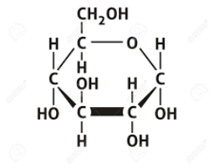
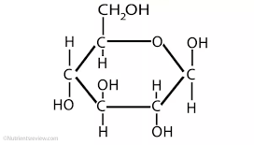
Back to back describing

Slide 4
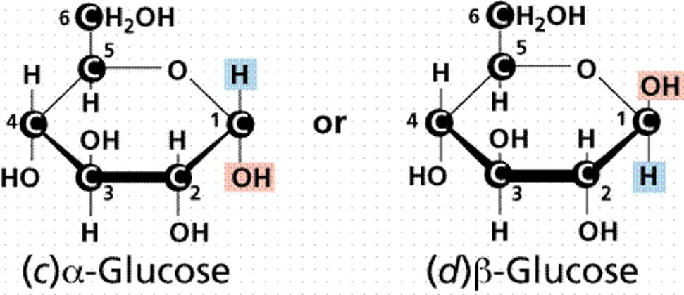
α-glucose and β-glucose spot the difference
The only difference between α glucose and β glucose is the orientation of the H and OH of the first carbon atom.
These are known as structural isomers.​
Another sugar fructose also has the chemical formula C6H12O6.
You need to remember the position of the OH groups on 1 and 4

Slide 5
Next:
Use your diagrams and come up with some rules for carbohydrates
1. Sugars have the basic formula (CH₂O)_{n} where n = number of carbon atoms in the molecule
2. The carbon atoms are arranged in rings, also containing an oxygen atom
3. The C on the right of the ring is always number 1
4. The number of carbon atoms determines the group name
5. Each carbon has a hydrogen and a hydroxide (OH) group attached to it.
6. The final carbon atom has a CH₂OH branch
The basic monosaccharide building block is alpha glucose, it is a hexose – 6 carbons.
It is polar and will therefore dissolve in water.

Slide 6
Carbohydrates can be divided into 3 main categories:
“Simple Sugars”
or MONOSACCHARIDES
“Double Sugars” or DISACCHARIDES
POLYSACCHARIDES (which includes starch)
These can be 3 carbon molecules called trioses
E.g. glyceraldehyde
5 carbon molecules called pentoses
E.g. Deoxyribose, ribose
6 carbon molecules called hexoses
E.g. glucose, fructose and galactose
These are formed when two monosaccharides join together
E.g. Sucrose
Maltose
Lactose
These are formed when many monosaccharides join together
How are you going to remember this?

Slide 7

The challenge:
Use the molymod kits to make a molecule of α- glucose.
Once you have completed your model, team up with another group and try to join the two molecules together (Hint: You WILL have to remove some of the atoms to achieve this). The structure of α- glucose is shown to help you.
Questions:
Which atoms did you remove?
Which number carbons (ref diagram) did you join together?

Slide 8
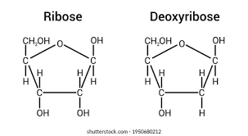
Ribose and deoxyribose – spot the difference

Slide 9
Monosaccharide bonding challenge:
Use the information to try and draw how 2 alpha glucose molecules would bond.
1. The two closest OH groups will interact and form a bond.
2. A strong covalent bond is formed.
3. The product of this reaction is water.

Slide 10
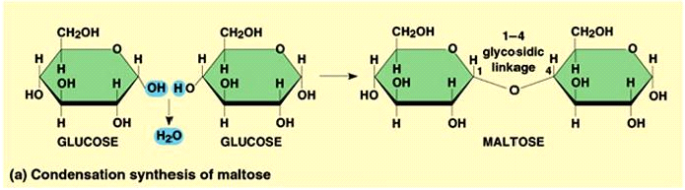
Glycosidic Bonding
When two monosaccharides join together, water is released. The reaction is therefore called a condensation reaction. The bond that is formed between the two monosaccharides is called a glycosidic bond, this is covalent therefore very strong.
The OH groups on carbon 1 and 4 are attracted to each other (note the orientation).
We describe this as an alpha 1-4 gylcosidic bond. YOU MUST USE THE CORRECT TERMINOLOGY TO GET THE MARK HERE.
Splitting a disaccharide or polysaccharide back into monosaccharides requires water. It is called a hydrolysis reaction.

