Slide 1
Make
Don't Quit
by Edgar A. Guest
When things go wrong, as they sometimes will,
When the road you're trudging seems all uphill,
When the funds are low and the debts are high,
And you want to smile but you have to sigh,
When care is pressing you down a bit -
Rest if you must, but don't you quit.
Life is queer with its twists and turns.
As everyone of us sometimes learns.
And many a fellow turns about when he
Might have won had he stuck it out.
Don't give up though the pace seems slow -
You may succeed with another blow.
Often the goal is nearer than it seems
To a faint and faltering man;
Often the struggler has given up when he
Might have captured the victor's cup;
And he learned too late when the night came down,
How close he was to the golden crown.
Success is failure turned inside out -
The silver tint of the clouds of doubt,
And when you never can tell how close you are,
It may be near when it seems afar;
So stick to the fight when you're hardest hit -
It's when things seem worst,
You must not quit.
Download the poem Don’t Quit by Edgar A. Guest.
Output this poem, including all the formatting (spaces between verses etc).

Slide 2
Input

Slide 3
Learning Objectives
Write programs that can accept user input

Slide 4
In pairs, predict what the following code does
1 2 3 4 5 6 7 | print(“What is your name?”) name=input() print (“hello”, name) print(“What is your favourite subject in school?”) subject=input() print(“So your favourite lesson is”, subject) print(“I like computer science”)

Slide 5
Download the code and then run. Does the code do what you expect?
1 2 3 4 5 6 7 | print(“What is your name?”) name=input() print (“hello”, name) print(“What is your favourite subject in school?”) subject=input() print(“So your favourite lesson is”, subject) print(“I like computer science”)
You can download a copy of the code from: 2-chatbot.py

Slide 6
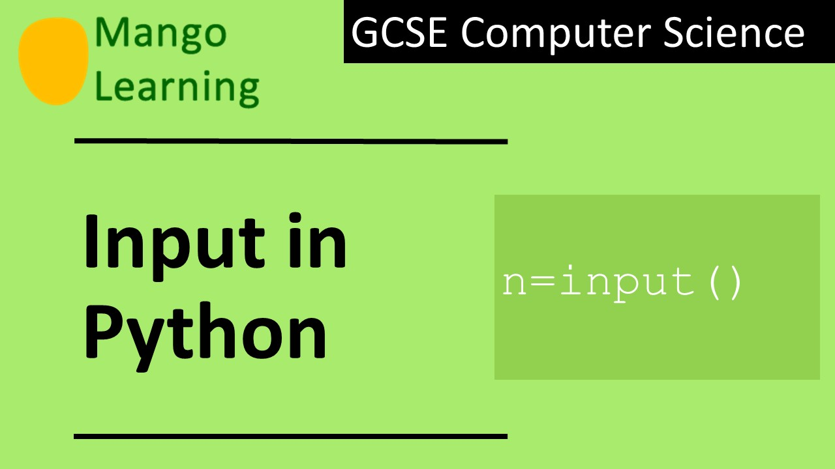

Slide 7
Input function
Input is data that is sent from an input device (e.g. keyboard, mouse, camera) to be processed on the computer
So far we have written programs that output text using the built-in print function. To make our programs more interactive they need to take in user input. This is done using the input function.
print(“What is your name?”)
name=input()
When the input function is called the program waits until the user enters their data.
The second line assigns the variable called name to whatever the user input is. This value is stored in the computer’s memory.
There will be more on assignment and variables in the next lesson.

Slide 8
Investigate the code
1 2 3 4 5 6 7 | print(“What is your name?”) name=input() print(“hello”, name) print(“What is your favourite subject in school?”) subject=input() print(“So your favourite lesson is”, subject) print(“I like computer science”)
Add comments into the code and answer the following questions
Identify the two built-in functions
Identify two variables
Explain what is happening on lines 2 and 5?

Slide 9
Investigate the code
1 2 3 4 5 6 7 | print(“What is your name?”) name=input() print(“hello”, name) print(“What is your favourite subject in school?”) subject=input() print(“So your favourite lesson is”, subject) print(“I like computer science”)
Add comments into the code and answer the following questions
Identify the two built-in functions
Identify two variables
Explain what is happening on line 2 and 5?

Slide 10
Investigate the code
1 2 3 4 5 6 7 | print(“What is your name?”) name=input() print(“hello”, name) print(“What is your favourite subject in school?”) subject=input() print(“So your favourite lesson is”, subject) print(“I like computer science”)
Add comments into the code and answer the following questions
Identify the two built-in functions
Identify two variables
Explain what is happening on lines 2 and 5?

Slide 11
Modify the code
Continue to add more conversation to the chatbot.
Get the chatbot to output your answers
Some questions you could get the chatbot to ask might include:
  What is your birthday?
  How old are you?
  What is your favourite movie?
  What is your favourite football team?
  What is your favourite band?
  Any other questions that you can think of

