Slide 1

AQA English Language Paper 2 Section A: Q2 - Summary
no more of that black bread, in consistency and flavour suggesting rancid peat;
This is a short quotation from Source A.
What does the writer mean?
How can we infer more information from this quote than what is written?
Why is inference such an important skill when writing a summary?
Words on the page
Meaning
Inference: Reaching a conclusion based on evidence and reason.

Slide 2
Learning outcomes
To describe the key facts about the trains from the two sources.
To explain how we can improve our summaries in Q2
To apply our understanding of Q2 skills to our own answers

Slide 3
We will be using inference icebergs to help us see what the writer implies
no more of that black bread, in consistency and flavour suggesting rancid peat;
Discuss:
Why is it useful to think of icebergs when trying to infer meaning from a text?
The words the writer uses.
What the writer means.
The writer thought the food on the train tasted disgusting.

Slide 4
We’ll re-read part of Source A
For more than a week she had bullied us. She had knocked us about when we went to clean our teeth in the little bathroom, she had jogged our elbows when we wrote, and when we read, she made the print dance tiresomely before our eyes. Her windows we might not open on account of the dust, and when closed they had proved a perpetual attraction to small, sabotaging boys with stones. She had annoyed us in a hundred little ways: by spilling tea in our laps, by running out of butter, by regulating our life. She had been our prison. We had not liked her. Now she was down and out. We left her lying there, a broken, buckled toy, a thick black worm without a head, awkwardly twisted: a thing of no use.
Read through the text.
Highlight or circle up to five ideas the writer shares with us.
Look at the parts you have highlighted and make notes on what the writer is suggesting (icebergs).
Using the examples you have chosen, explain why using implication can be more powerful than simply saying something directly.

Slide 5
We can infer that The train journey had been frustrating, violent and eventful.
We can infer that trying to perform any simple task on the bumpy train was incredibly difficult.
For more than a week she had bullied us. She had knocked us about when we went to clean our teeth in the little bathroom, she had jogged our elbows when we wrote, and when we read, she made the print dance tiresomely before our eyes. Her windows we might not open on account of the dust, and when closed they had proved a perpetual attraction to small, sabotaging boys with stones. She had annoyed us in a hundred little ways: by spilling tea in our laps, by running out of butter, by regulating our life. She had been our prison. We had not liked her. Now she was down and out. We left her lying there, a broken, buckled toy, a thick black worm without a head, awkwardly twisted: a thing of no use.
We can infer that the movement of the train blurred words on the page when trying to read.
We can infer that the movement of the train blurred words on the page when trying to read.
We can infer that the passengers wouldn’t open the windows because of the dust from outside and because small boys would often throw stones at the train, which could enter into it from the open windows.
We can infer that the writer did not enjoy the journey or like the train because of all the problems it brought him, including tea being spilt, supplies running out and how the train was in charge of their lives.
We can infer that the writing felt trapped on the train.
We can infer that the writer is quite pleased to see the train having crashed because of all the misery it caused him previously. We can infer that the writer takes pleasure in seeing the train now out of service and useless.

Slide 6
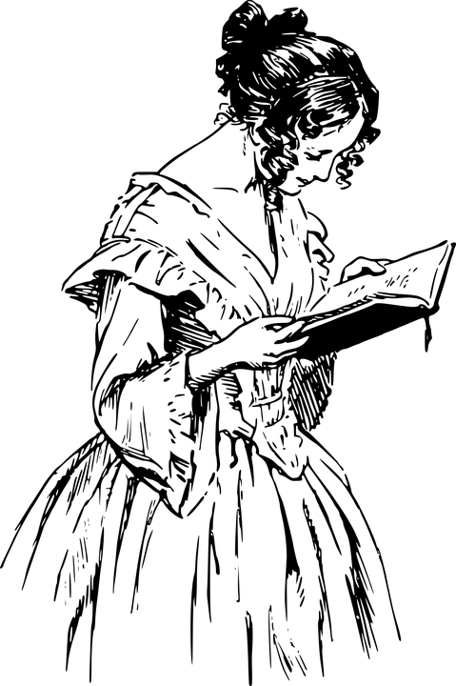

It’s important to remember in your analyses…
A reader infers.
A writer implies.
If you struggle to remember this, you could say: “this suggests to the reader” or “the writer suggests that”.
Inferring
Implying

Slide 7
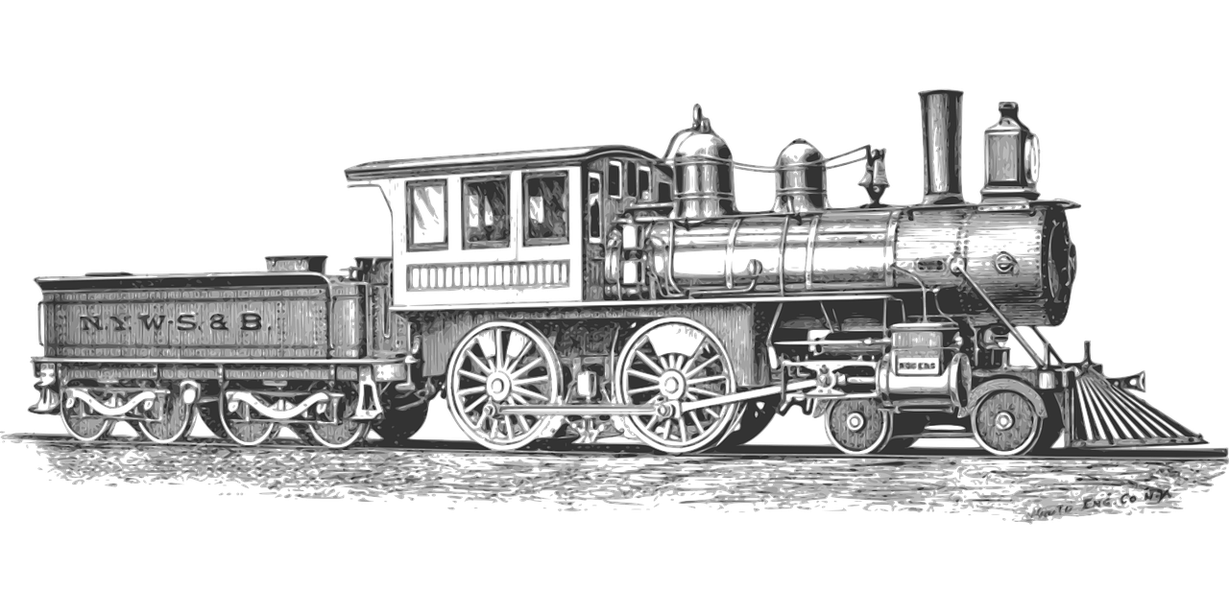
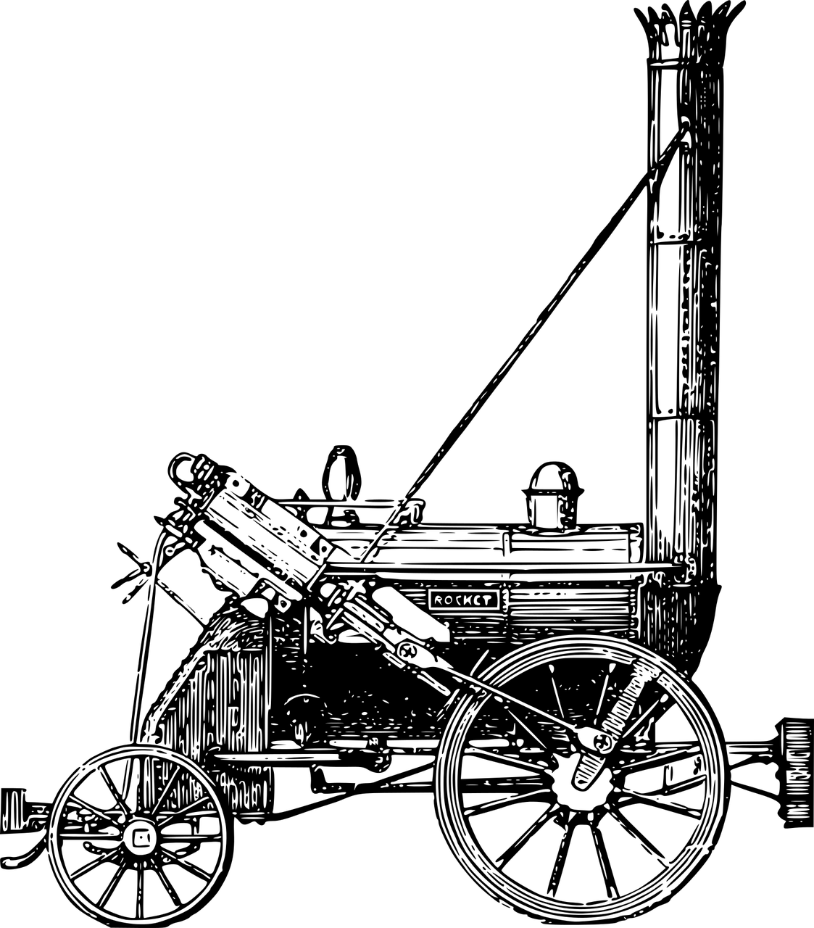
You need to refer to Source A and Source B for this question.
The writers in Source A and Source B are travelling on different types of trains.
What can you infer about the differences between the two trains?
Complete your table.
Include examples to support your ideas.
Infer the writer’s thoughts and feelings about the trains.
Areas to consider | Source A | Source B
What do the trains look like? | It has a mail van and a dining car and five sleeping cars. It is designed for long journeys. | It has a boiler, a stove, a small platform, a bench and a barrel containing water. It has wheels and has steel pistons. It has a small steel handle for speed, the coals are under the bench. It is a simple machine.
How do the trains move?
What is it like on board the trains?
What are the journeys like?

Slide 8
Areas to consider | Source A | Source B
What do the trains look like? | It has a mail van and a dining car and five sleeping cars. It is designed for long journeys. | It has a boiler, a stove, a small platform, a bench and a barrel containing water. It has wheels and has steel pistons. It has a small steel handle for speed, the coals are under the bench. It is a simple machine.
How do the trains move?
What is it like on board the trains?
What are the journeys like?
Areas to consider | Source A | Source B
What do the trains look like? | It has a mail van and a dining car and five sleeping cars. It is designed for long journeys. | It has a boiler, a stove, a small platform, a bench and a barrel containing water. It has wheels and has steel pistons. It has a small steel handle for speed, the coals are under the bench. It is a simple machine.
How do the trains move?
What is it like on board the trains?
What are the journeys like?

Slide 9
Areas to consider | Source A | Source B
What do the trains look like? | It has a mail van and a dining car and five sleeping cars. It is designed for long journeys. | It has a boiler, a stove, a small platform, a bench and a barrel containing water. It has wheels and has steel pistons. It has a small steel handle for speed, the coals are under the bench. It is a simple machine.
How do the trains move? | Quickly, causing the train journey to be bumpy and violent. It covers 9,000km in over a week. | Slowly at 10mph to begin with. It cannot move uphill. The motion is as smooth as possible. It can reach a maximum speed of 35mph.
What is it like on board the trains? | There is a dining car for eating and sleeping cars for passengers to rest. There are facilities for brushing teeth and drinking tea. There are many passengers because there are five sleeping cars. | It has an uncovered carriage with six benches to sit on. There are sixteen people on the journey.
What are the journeys like? | The writer was frustrated at the violent movements of the train that caused him many problems. The journey took more than a week to complete lasts over 9,000km. | The writer feels a sense of security and no fear at all. The journey lasts for only 15 miles.

Slide 10
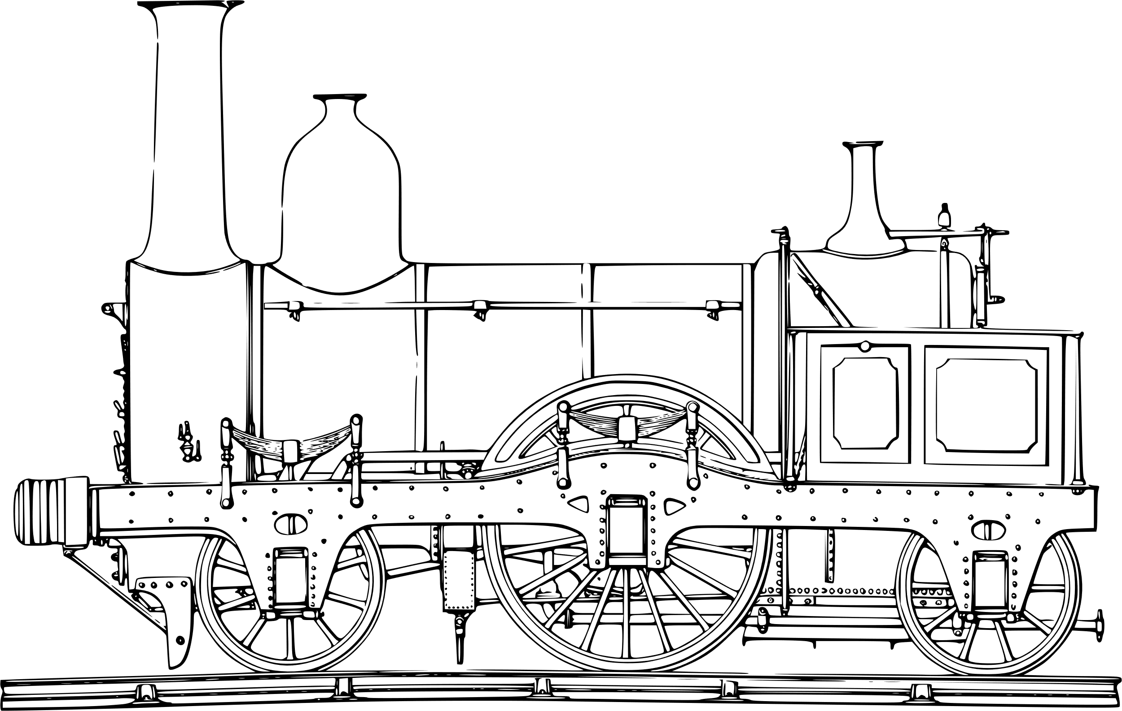


Q2) Summary
10 minutes to answer!
Q2) You need to refer to Source A and Source B for this question:
Use details from both Sources. The writers in Source A and Source B are explaining the differences between the two trains.
Use details from both sources to write a summary of what can you infer about the differences between the two trains.[8 marks]
Exam tip
Remember that this is a summary, so you need to include the following elements:
Relevant information on the same topic (the differences between the trains).
Quotation to support your ideas.
Connectives to link your paragraphs.
Inference icebergs (what does each piece of information suggest to us).
Only facts, not your opinions.
Go through both sources quickly and find all the info related to the two trains only. Any other information is not relevant to the task.
Plan and write your answer now.

Slide 11
Let’s take a look at a good answer for Q2:
The train in Source A travels across Siberia, taking in thousands of miles on its journeys. The writer describes it as “the fastest train”, and “luxury”. In contrast, the train in Source B is relatively new technology that “would drag us along the rails” and it travels at “about ten miles an hour”.
Moreover, the train in Source A is designed for journeys that can take over a week or more: “For more than a week she had bullied us”. It includes a dining car for meals, compartments for passengers, racks for suitcases and beds for passengers to sleep in. As for the train in Source B, it is described as “little”, enough seating room with “six of these benches” and no cover for the carriage. It is designed for short journeys, with this one covering “fifteen miles” for a few passengers.
In addition, the train in Source A has its windows shut for the majority of its journey owning to dust: “Her windows we might not open on account of the dust”. In Source B, the train is entirely open air and “and with my bonnet off, drank the air before me.” Whilst the train crashes in Source A, “followed by a crash”, the train in Source B reaches its destination without incident: “It was lovely and wonderful beyond words.”
Read through this answer and think about:
How the student has included:
Quotations
Inference icebergs
Connectives.

Slide 12
Can you see how the student has mixed together quotations, inferences and connectives into a detailed and concise summary?
The train in Source A travels across Siberia, taking in thousands of miles on its journeys. The writer describes it as “the fastest train”, and “luxury”. In contrast, the train in Source B is relatively new technology that “would drag us along the rails” and it travels at “about ten miles an hour”.
Moreover, the train in Source A is designed for journeys that can take over a week or more: “For more than a week she had bullied us”. It includes a dining car for meals, compartments for passengers, racks for suitcases and beds for passengers to sleep in. As for the train in Source B, it is described as “little”, enough seating room with “six of these benches” and no cover for the carriage. It is designed for short journeys, with this one covering “fifteen miles” for a few passengers.
In addition, the train in Source A has its windows shut for the majority of its journey owning to dust: “Her windows we might not open on account of the dust”. In Source B, the train is entirely open air and “and with my bonnet off, drank the air before me.” Whilst the train crashes in Source A, “followed by a crash”, the train in Source B reaches its destination without incident: “It was lovely and wonderful beyond words.”
Read through this answer and think about:
How the student has included:
Quotations/references
Inferences
Connectives.

Slide 13

Plenary: Before and After
What did you know about inference, implication writing summaries before the lesson began? What have you learnt by the end of the lesson?
Before the lesson | After the lesson
To describe the key facts about the trains from the two sources.
To explain how we can improve our summaries in Q2
To apply our understanding of Q2 skills to our own answers

