Slide 1
Quadratics

Slide 2



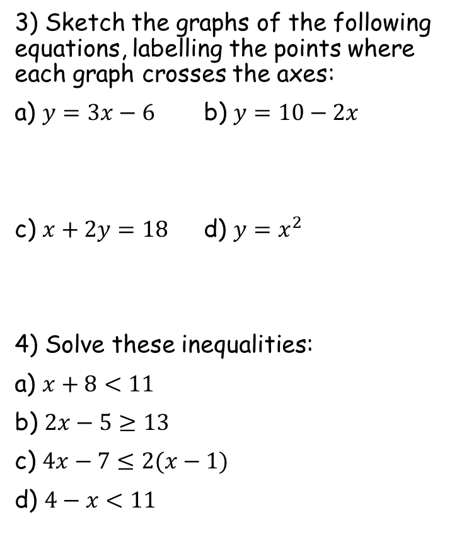




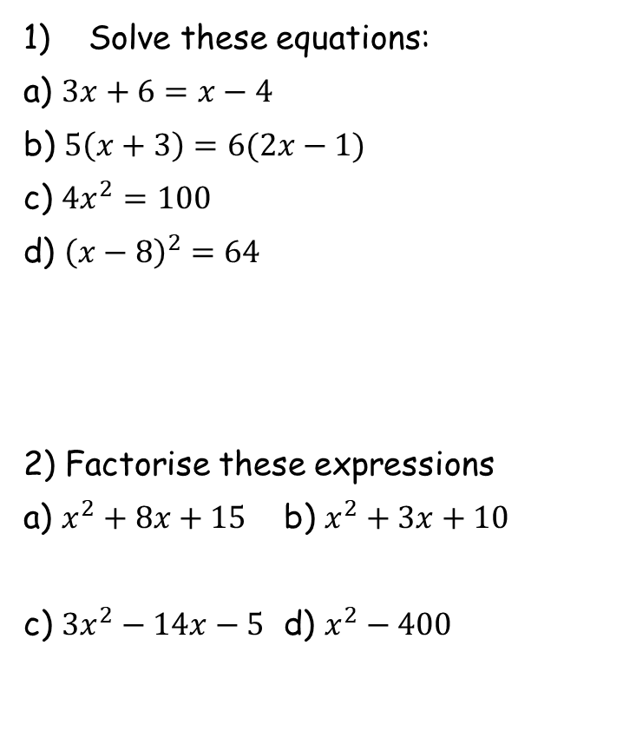












Prior Knowledge Check
Solve these equations:
a) $3x+6=x−4$
b) $5\left(x+3\right)=6(2x−1)$
c) ${4x}^{2}=100$
d) ${\left(x−8\right)}^{2}=64$
2) Factorise these expressions
a) $x^{2}+8x+15$ b) $x^{2}+3x+10$
c) $3x^{2}−14x−5$ d) $x^{2}−400$
3) Sketch the graphs of the following equations, labelling the points where each graph crosses the axes:
a) $y=3x−6$ b) $y=10−2x$
c) $x+2y=18$ d) $y=x^{2}$
4) Solve these inequalities:
a) $x+8<11$
b) $2x−5≥13$
c) $4x−7≤2(x−1)$
d) $4−x<11$
$$x=−5$$
$$x=3$$
$$x=5 or −5$$
$$10$$
$$x=0 or 16$$
$$2$$
$$5$$
$$−6$$
$$9$$
$$18$$
$$0$$
$$x<3$$
$$(x+3)(x+5)$$
$$(x−2)(x+5)$$
$$x≥9$$
$$x≤2.5$$
$$(3x+1)(x−5)$$
$$(x+20)(x−20)$$
$$x>−7$$

Slide 3
Teachings for
Exercise 2A and 2B

Slide 4
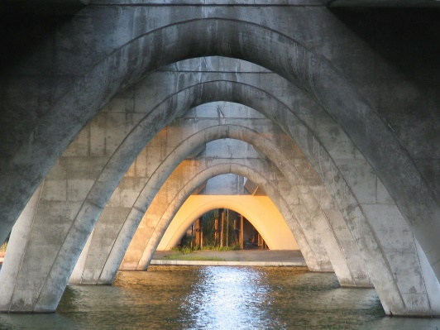

Quadratics
A quadratic equation can be written in the form ${ax}^{2}+bx+c=0$ where $a$, $b$ and $c$ are real constants, and $a≠0$. They can have 0, 1 or 2 real solutions.
Example
Solve the equation…
a)
Subtract 9x
Factorise
Either ‘x’ or ‘x-9’ must be equal to 0
2A/B

Slide 5
Quadratics
A quadratic equation can be written in the form ${ax}^{2}+bx+c=0$ where $a$, $b$ and $c$ are real constants, and $a≠0$. They can have 0, 1 or 2 real solutions.
Example
Solve the equation…
b)
Factorise
2A/B

Slide 6
Quadratics
A quadratic equation can be written in the form ${ax}^{2}+bx+c=0$ where $a$, $b$ and $c$ are real constants, and $a≠0$. They can have 0, 1 or 2 real solutions.
Example
Solve the equation…
c)
Factorise
Factorising this is slightly different.
There must be a ‘2x’ at the start of a bracket
The numbers in the brackets must still multiply to give ‘-5’
The number in the second bracket will be doubled when they are expanded though, so the numbers must add to give ‘-9’ WHEN ONE HAS BEEN DOUBLED
Using -5 and +1
They multiply to give -5
If we double the -5, they add to give -9
So the -5 goes opposite the ‘2x’ term
2A/B

Slide 7
Quadratics
Example
A quadratic equation can be written in the form ${ax}^{2}+bx+c=0$ where $a$, $b$ and $c$ are real constants, and $a≠0$. They can have 0, 1 or 2 real solutions.
Solve the equation…
d)
Factorise
Factorising this is even more difficult
The brackets could start with 6x and x, or 2x and 3x (either of these would give the 6x² needed)
So the numbers must multiply to give -5
And add to give 13 when either;
  One is made 6 times bigger
  One is made twice as big, and the other 3 times bigger
Using 3x and 2x at the starts of the brackets
And -1 and +5 inside the brackets…
They multiply to give -5
They will add to give 13 if the +5 is tripled, and the -1 is doubled
So +5 goes opposite the 3x, and -1 opposite the 2x
2A/B

Slide 8
Quadratics
A quadratic equation can be written in the form ${ax}^{2}+bx+c=0$ where $a$, $b$ and $c$ are real constants, and $a≠0$. They can have 0, 1 or 2 real solutions.
Example
Solve the equation…
e)
Subtract 2 Subtract 3x
Factorise
2A/B

Slide 9
Quadratics
A quadratic equation can be written in the form ${ax}^{2}+bx+c=0$ where $a$, $b$ and $c$ are real constants, and $a≠0$. They can have 0, 1 or 2 real solutions.
Example
Solve the equation…
Square root both sides (2 possible answers!)
f)
2A/B

Slide 10
Quadratics
A quadratic equation can be written in the form ${ax}^{2}+bx+c=0$ where $a$, $b$ and $c$ are real constants, and $a≠0$. They can have 0, 1 or 2 real solutions.
Example
Solve the equation…
Square root both sides (2 possible answers!)
g)
2A/B

Slide 11
Quadratics
The Quadratic Formula
You will have used the Quadratic Formula at GCSE level.
You can also use it at A-level for Quadratics where the solutions are not rational numbers
We are going to see where this formula comes from in the next section…
2A/B

Slide 12
Quadratics
The Quadratic Formula
You need to be able to recognise when the formula is better to use.
Examples would be when the coefficient of x² is larger, or when the 3 parts cannot easily be divided by the same number.
Example
Solve 4x² – 3x – 2 = 0 by using the formula.
a = 4
b = -3
c = -2
2A/B

Slide 13
Teachings for
Exercise 2C and 2D

Slide 14
Quadratics
It is often useful to rewrite quadratic expressions by completing the square.
Example
Complete the square for the following expression…
a)
If we check by expanding our answer…
‘So ^{b}/₂ is half of the coefficient of x’
2C/D

Slide 15






Quadratics
It is often useful to rewrite quadratic expressions by completing the square.
$$x^{2}−4x$$
Write using a squared bracket
Half
$${\left(x−2\right)}^{2}$$
$$− (4)$$
Square
$$x^{2}+12x$$
Write using a squared bracket
Half
‘So ^{b}/₂ is half of the coefficient of x’
$${\left(x+6\right)}^{2}$$
$$− (36)$$
Square
In both cases, the first and second expressions are equal!
2C/D

Slide 16






Quadratics
It is often useful to rewrite quadratic expressions by completing the square.
$$x^{2}+8x$$
Write using a squared bracket
Half
$${\left(x+4\right)}^{2}$$
$$− (16)$$
Square
$$x^{2}−2x$$
Write using a squared bracket
Half
‘So ^{b}/₂ is half of the coefficient of x’
$${\left(x−1\right)}^{2}$$
$$− (1)$$
Square
In both cases, the first and second expressions are equal!
2C/D

Slide 17




Quadratics
It is often useful to rewrite quadratic expressions by completing the square.
$${2x}^{2}+16x$$
Take out 2 as a factor
$$2\left(x^{2}+8x\right)$$
Complete the square for the inner part
Half
$$2\left({\left(x+4\right)}^{2}−(16)\right)$$
Multiply both of the inner parts by the 2
Square
$$2{\left(x+4\right)}^{2}−32$$
‘So ^{b}/₂ is half of the coefficient of x’
2C/D

Slide 18











Quadratics
It is often useful to rewrite quadratic expressions by completing the square.
$$x^{2}+4x−3=0$$
Half
Complete the square for the first 2 terms
$${\left(x+2\right)}^{2}$$
$$− (4)$$
$$− 3$$
$$=0$$
Collect like terms
Square
$${\left(x+2\right)}^{2}−7$$
$$=0$$
Add 7 to both sides
$${\left(x+2\right)}^{2}=7$$
Square root both sides
$$x+2=±\sqrt{7}$$
Subtract 2 from both sides
$$x=−2±\sqrt{7}$$
‘So ^{b}/₂ is half of the coefficient of x’
Finally, you can calculate the answers (or in some cases you can just leave them like this!)!
$$=0.65 or −4.65$$
2C/D

Slide 19











Quadratics
It is often useful to rewrite quadratic expressions by completing the square.
$$x^{2}−6x+4=0$$
Half
Complete the square for the first 2 terms
$${\left(x−3\right)}^{2}$$
$$− (9)$$
$$+ 4$$
$$=0$$
Collect like terms
Square
$${\left(x−3\right)}^{2}−5$$
$$=0$$
Add 5 to both sides
$${\left(x−3\right)}^{2}=5$$
Square root both sides
$$x−3=±\sqrt{5}$$
Add 3 to both sides
$$x=3±\sqrt{5}$$
‘So ^{b}/₂ is half of the coefficient of x’
Finally, you can calculate the answers (or in some cases you can just leave them like this!)!
$$=5.24 or 0.76$$
2C/D

Slide 20





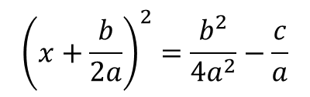






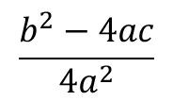






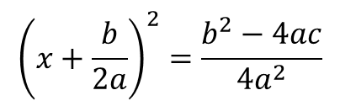


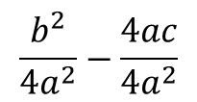
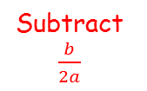
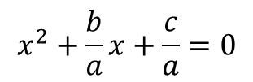

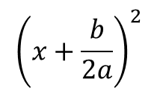
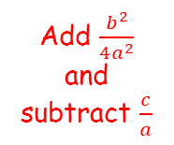

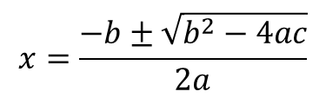
Quadratics
$$2x^{2}+12x−10=0$$
$$ax^{2}+bx+c=0$$
Divide by 2
Divide by a
$$x^{2}+\frac{b}{a}x+\frac{c}{a}=0$$
$$x^{2}+6x−5=0$$
Complete the square
Half
Half
Complete the square
$${\left(x+\frac{b}{2a}\right)}^{2}$$
$$−\frac{b^{2}}{{4a}^{2}}$$
$$+ \frac{c}{a}$$
$${\left(x+3\right)}^{2}$$
$$− 9$$
$$− 5$$
$$=0$$
$$=0$$
Add $\frac{b^{2}}{4a^{2}}$ and subtract $\frac{c}{a}$
Add 9 and add 5
Square
$${\left(x+\frac{b}{2a}\right)}^{2}=\frac{b^{2}}{{4a}^{2}}−\frac{c}{a}$$
Square
$${\left(x+3\right)}^{2}=9+5$$
Group terms
Group terms
$${\left(x+\frac{b}{2a}\right)}^{2}=\frac{b^{2}−4ac}{{4a}^{2}}$$
$${\left(x+3\right)}^{2}=14$$
Square root
$$\frac{b^{2}}{{4a}^{2}}−\frac{c}{a}$$
Square root
$$x+\frac{b}{2a}=$$
$$±\frac{\sqrt{b^{2}−4ac}}{}$$
$$x+3=±\sqrt{14}$$
Multiply by 4a to make the denominators equal
$$\sqrt{4a^{2}}$$
$$2a$$
Subtract $\frac{b}{2a}$
Subtract 3
$$\frac{b^{2}}{{4a}^{2}}−\frac{4ac}{{4a}^{2}}$$
$$−\frac{b}{2a}±\frac{\sqrt{b^{2}−4ac}}{2a}$$
$$x=−3±\sqrt{14}$$
$$x=$$
Group together
Group together
$$\frac{b^{2}−4ac}{{4a}^{2}}$$
$$x=\frac{−b±\sqrt{b^{2}−4ac}}{2a}$$

Slide 21
Teachings for Exercise 2E

Slide 22
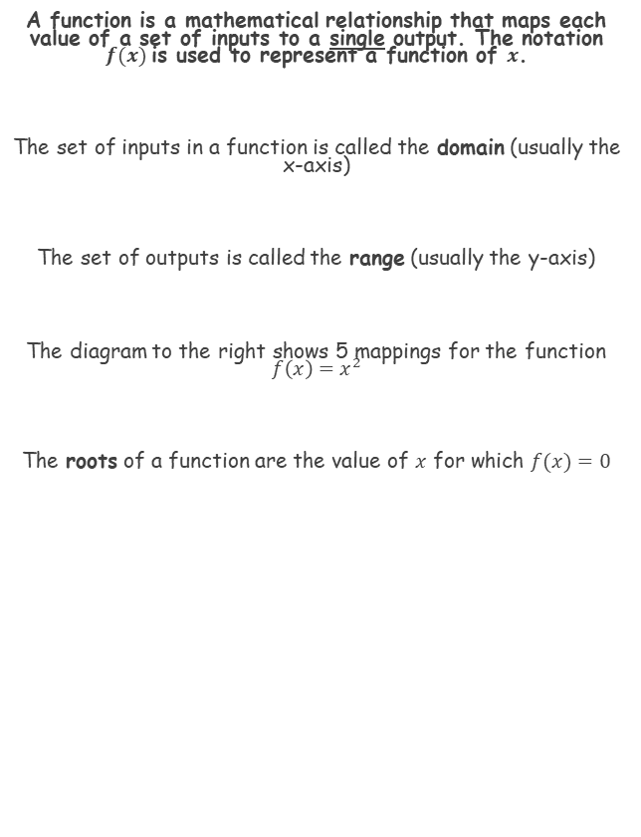



Quadratics
A function is a mathematical relationship that maps each value of a set of inputs to a single output. The notation $f(x)$is used to represent a function of $x$.
The set of inputs in a function is called the domain (usually the x-axis)
The set of outputs is called the range (usually the y-axis)
The diagram to the right shows 5 mappings for the function $f\left(x\right)=x^{2}$
The roots of a function are the value of $x$ for which $f(x)=0$
$$f\left(x\right)=x^{2}$$
Domain
Range
$$3$$
$$7$$
$$−7$$
$$0.25$$
$$\sqrt{2}$$
$$9$$
$$49$$
$$49$$
$$0.125$$
$$2$$
2E

Slide 23














Quadratics
A function is a mathematical relationship that maps each value of a set of inputs to a single output. The notation $f(x)$is used to represent a function of $x$.
The function f and g are given by $f\left(x\right)=2x−10$ and $g\left(x\right)=x^{2}−9$, $x∈ℝ$.
Find the values of $f(5)$ and $g(10)$
Find the value of $x$ for which $f(x)=g(x)$
a)
$$f\left(x\right)=2x−10$$
Replace $x$’s with 5’s
$$f\left(5\right)=2(5)−10$$
Calculate
$$f\left(5\right)=0$$
$$g\left(x\right)=x^{2}−9$$
Replace $x$’s with 10’s
$$g\left(10\right)={(10)}^{2}−9$$
This means that x is any real number
Literally, ‘x is a member of the set of real numbers’
Calculate
$$g\left(10\right)=91$$
b)
$$f\left(x\right)=g(x)$$
Replace with the corresponding expressions
$$2x−10=x^{2}−9$$
Subtract 2x, add 10
$$0=x^{2}−2x+1$$
Factorise
$$0=(x−1)(x−1)$$
Solve
$$x=1$$
2E

Slide 24


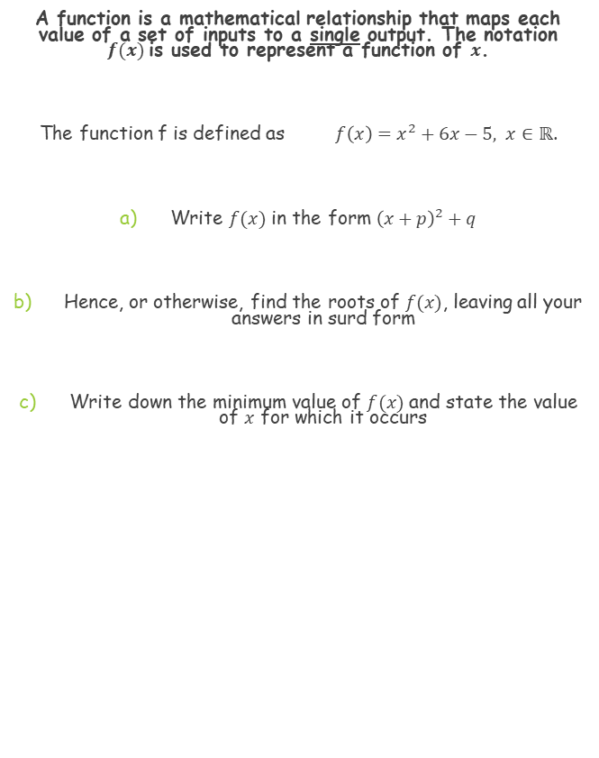



Quadratics
A function is a mathematical relationship that maps each value of a set of inputs to a single output. The notation $f(x)$is used to represent a function of $x$.
The function f is defined as $f\left(x\right)=x^{2}+6x−5, x∈ℝ$.
Write $f(x)$ in the form ${\left(x+p\right)}^{2}+q$
Hence, or otherwise, find the roots of $f(x)$, leaving all your answers in surd form
Write down the minimum value of $f(x)$ and state the value of $x$ for which it occurs
a)
$$f\left(x\right)=x^{2}+6x−5$$
Half
Write using completing the square
$$={(x+3)}^{2}$$
$$−9$$
$$−5$$
Square
Simplify
$$={(x+3)}^{2}−14$$
2E

Slide 25






Quadratics
A function is a mathematical relationship that maps each value of a set of inputs to a single output. The notation $f(x)$is used to represent a function of $x$.
The function f is defined as $f\left(x\right)=x^{2}+6x−5, x∈ℝ$.
Write $f(x)$ in the form ${\left(x+p\right)}^{2}+q$
Hence, or otherwise, find the roots of $f(x)$, leaving all your answers in surd form
Write down the minimum value of $f(x)$ and state the value of $x$ for which it occurs
The roots are the values of x which make the function equal to 0
b)
$${(x+3)}^{2}−14=0$$
Add 14
$${(x+3)}^{2}=14$$
Square root
$$x+3=±\sqrt{14}$$
Subtract 3
$$x=−3±\sqrt{14}$$
$${(x+3)}^{2}−14$$
$$x=−3±\sqrt{14}$$
2E

Slide 26



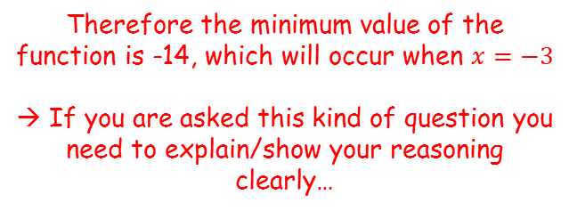
Quadratics
A function is a mathematical relationship that maps each value of a set of inputs to a single output. The notation $f(x)$is used to represent a function of $x$.
The function f is defined as $f\left(x\right)=x^{2}+6x−5, x∈ℝ$.
Write $f(x)$ in the form ${\left(x+p\right)}^{2}+q$
Hence, or otherwise, find the roots of $f(x)$, leaving all your answers in surd form
Write down the minimum value of $f(x)$ and state the value of $x$ for which it occurs
Is there a part of the function that has a minimum value?
c)
$$f\left(x\right)={\left(x+3\right)}^{2}−14$$
A squared value must be equal to or greater than 0
$${\left(x+3\right)}^{2}≥0$$
Subtract 14
$${\left(x+3\right)}^{2}−14≥−14$$
$${(x+3)}^{2}−14$$
Therefore the minimum value of the function is -14, which will occur when $x=−3$
→ If you are asked this kind of question you need to explain/show your reasoning clearly…
$$x=−3±\sqrt{14}$$
2E

Slide 27







Quadratics
A function is a mathematical relationship that maps each value of a set of inputs to a single output. The notation $f(x)$is used to represent a function of $x$.
Find the roots of the function $f\left(x\right)=x^{6}+7x^{3}−8, x∈ℝ$
You should look out for this kind of pattern. Although it is not a quadratic, this can be solved in the same way:
$$f\left(x\right)=x^{6}+7x^{3}−8$$
Factorise
$$f\left(x\right)=\left(x^{3}+8\right)\left(x^{3}−1\right)$$
$$x^{3}=−8$$
$$x^{3}=1$$
$$x=−2$$
$$x=1$$
2E

Slide 28
Teachings for Exercise 2F

Slide 29

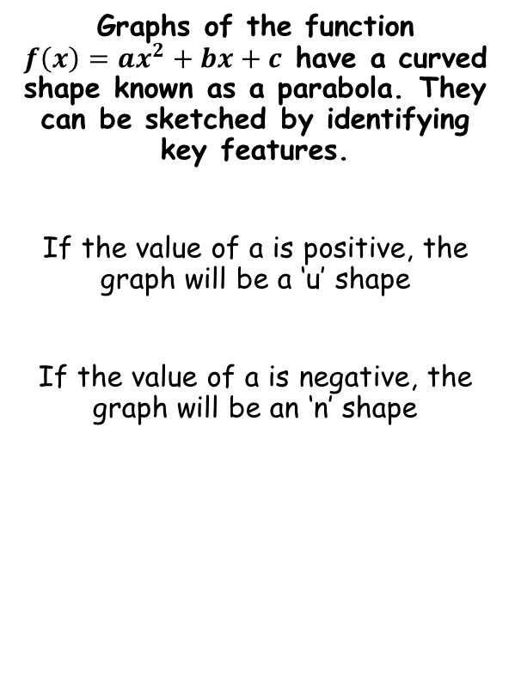



Quadratics
$$y$$
Graphs of the function $f\left(x\right)=ax^{2}+bx+c$ have a curved shape known as a parabola. They can be sketched by identifying key features.
If the value of a is positive, the graph will be a ‘u’ shape
If the value of a is negative, the graph will be an ‘n’ shape
$$x$$
1
2
3
4
1 and 2 – The roots, found when $f\left(x\right)=0$
3 – The y intercept, found when $x=0$
4 – The minimum point, found by completing the square, or by the fact it will be half-way between the roots
→ An ‘n’ shape would have a maximum point instead
2F

Slide 30

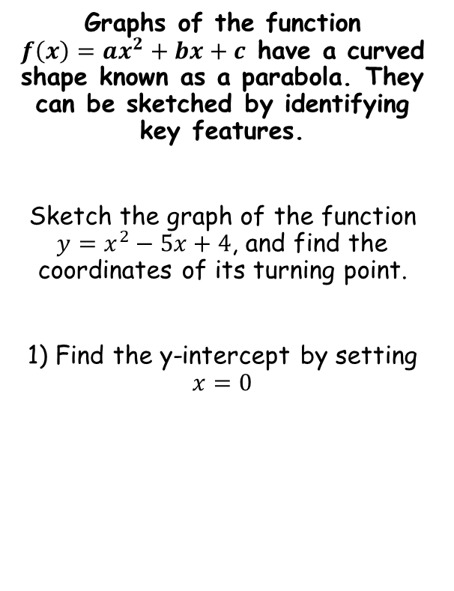




Quadratics
$$y$$
Graphs of the function $f\left(x\right)=ax^{2}+bx+c$ have a curved shape known as a parabola. They can be sketched by identifying key features.
Sketch the graph of the function $y=x^{2}−5x+4$, and find the coordinates of its turning point.
1) Find the y-intercept by setting $x=0$
4
$$x$$
$$y=x^{2}−5x+4$$
$$y={(0)}^{2}−5(0)+4$$
$$y=4$$
2F

Slide 31

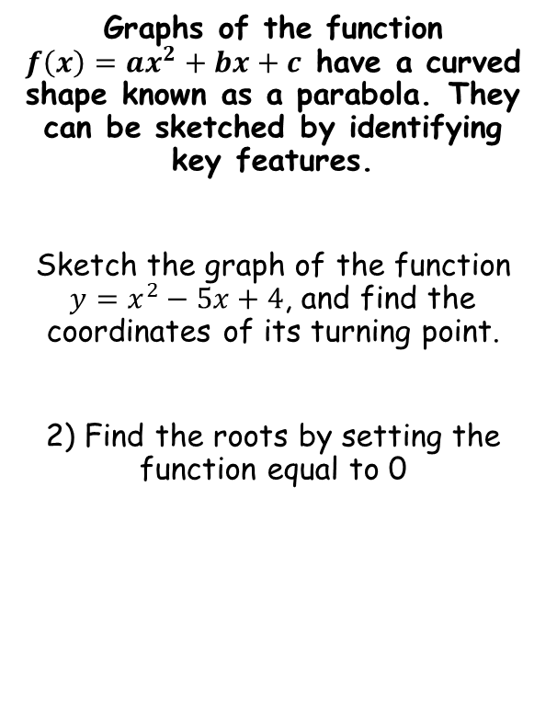


Quadratics
$$y$$
Graphs of the function $f\left(x\right)=ax^{2}+bx+c$ have a curved shape known as a parabola. They can be sketched by identifying key features.
Sketch the graph of the function $y=x^{2}−5x+4$, and find the coordinates of its turning point.
2) Find the roots by setting the function equal to 0
4
$$x$$
1
4
$$0=x^{2}−5x+4$$
$$0=(x−4)(x−1)$$
$$x=1 or 4$$
2F

Slide 32

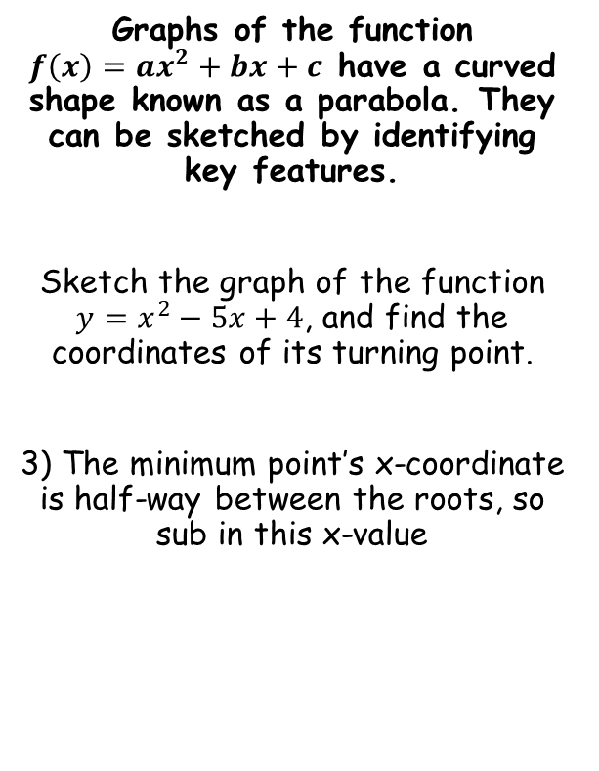


Quadratics
$$y$$
Graphs of the function $f\left(x\right)=ax^{2}+bx+c$ have a curved shape known as a parabola. They can be sketched by identifying key features.
Sketch the graph of the function $y=x^{2}−5x+4$, and find the coordinates of its turning point.
3) The minimum point’s x-coordinate is half-way between the roots, so sub in this x-value
4
$$x$$
1
4
(2.5,-2.25)
$$y=x^{2}−5x+4$$
$$y={(2.5)}^{2}−5(2.5)+4$$
$$y=−2.25$$
2F

Slide 33

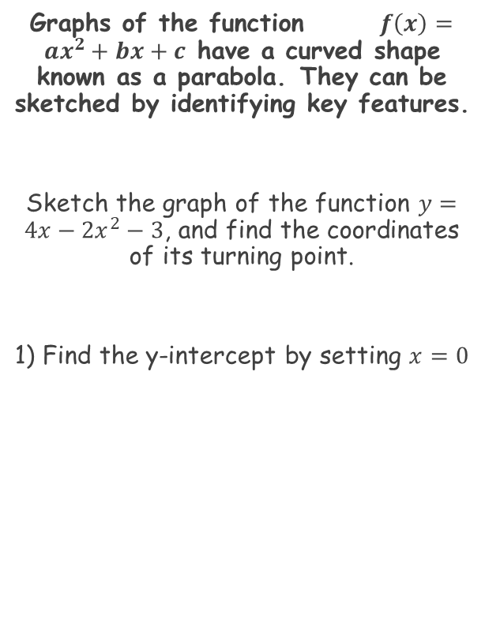


Quadratics
$$y$$
Graphs of the function $f\left(x\right)=ax^{2}+bx+c$ have a curved shape known as a parabola. They can be sketched by identifying key features.
Sketch the graph of the function $y=4x−2x^{2}−3$, and find the coordinates of its turning point.
1) Find the y-intercept by setting $x=0$
$$x$$
-3
$$y=4x−2x^{2}−3$$
$$y=4(0)−2{(0)}^{2}−3$$
$$y=−3$$
2F

Slide 34
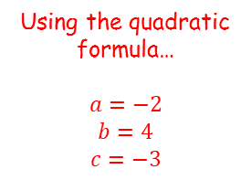
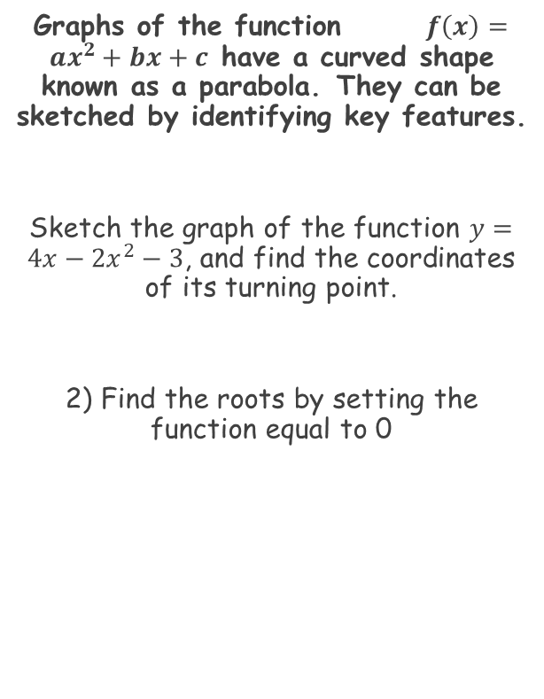




Quadratics
$$y$$
Graphs of the function $f\left(x\right)=ax^{2}+bx+c$ have a curved shape known as a parabola. They can be sketched by identifying key features.
Sketch the graph of the function $y=4x−2x^{2}−3$, and find the coordinates of its turning point.
2) Find the roots by setting the function equal to 0
$$x$$
-3
Using the quadratic formula…
$$a=−2$$
$$b=4$$
$$c=−3$$
$$x=\frac{−b±\sqrt{b^{2}−4ac}}{2a}$$
Sub in values
$$x=\frac{−4±\sqrt{{(4)}^{2}−4(−2)(−3)}}{2(−2)}$$
$$0=4x−2x^{2}−3$$
Simplify
$$x=\frac{−4±\sqrt{−8}}{−4}$$
This equation cannot be solved though…
→ This means the graph does not cross the x-axis
2F

Slide 35

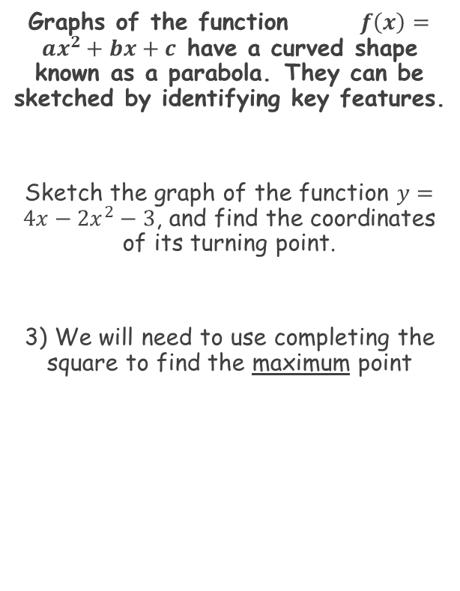




Quadratics
$$y$$
Graphs of the function $f\left(x\right)=ax^{2}+bx+c$ have a curved shape known as a parabola. They can be sketched by identifying key features.
Sketch the graph of the function $y=4x−2x^{2}−3$, and find the coordinates of its turning point.
3) We will need to use completing the square to find the maximum point
(1,-1)
$$x$$
-3
$$−2x^{2}+4x−3$$
Take -2 out as a factor of the first 2 terms
$$−2\left(x^{2}−2x\right)−3$$
Complete the square for just the bracketed part
$$−2\left[{\left(x−1\right)}^{2}−1\right]−3$$
Multiply out the squared bracket
The maximum point will be at (1,-1)
$$−2{\left(x−1\right)}^{2}+2−3$$
Simplify
$$−2{\left(x−1\right)}^{2}−1$$
2F

Slide 36
Teachings for Exercise 2G

Slide 37
Quadratics
The discriminant is a part of the quadratic formula and can be used to find how many roots a function has.
y
y
y
x
x
x
b² – 4ac is known as the ‘discriminant’
→ Its value determines how many solutions the equation has
y
y
y
x
x
x
2G

Slide 38

Quadratics
The discriminant is a part of the quadratic formula and can be used to find how many roots a function has.
Example
Find the values of k for which;
x² + kx + 9 = 0
has equal roots.
You need to remember;
‘real roots’ → b² - 4ac > 0
‘equal roots’ → b² – 4ac = 0
‘no real roots’ → b² – 4ac < 0
Sub in a, b and c from the equation (b = k)
Work out the bracket
Add 36
Square Root
2G

Slide 39





Quadratics
The discriminant is a part of the quadratic formula and can be used to find how many roots a function has.
Example
Find the values of k for which;
x² + 4x + k = 0
has two distinct real solutions.
You need to remember;
‘real roots’ → b² - 4ac > 0
‘equal roots’ → b² – 4ac = 0
‘no real roots’ → b² – 4ac < 0
$$b^{2}−4ac>0$$
Sub in a, b and c from the equation (c = k)
$${(4)}^{2}−4(1)(k)>0$$
Simplify
$$16−4k>0$$
Add 4k
$$16>4k$$
Divide by 4
$$4>k$$
2G

Slide 40
Teachings for Exercise 2H

Slide 41
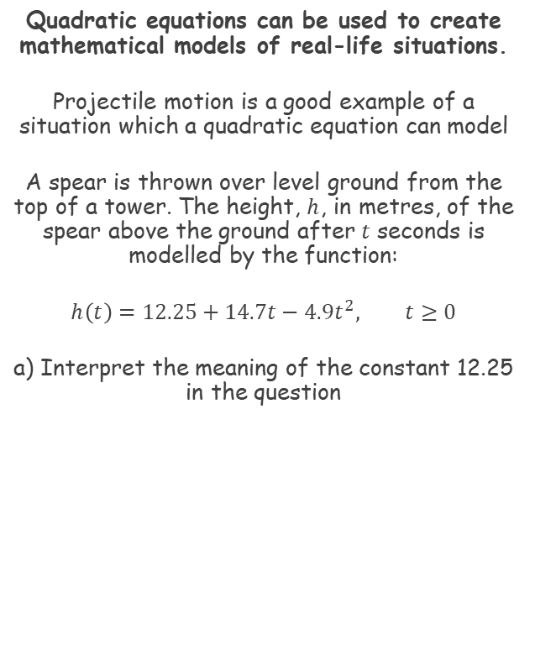
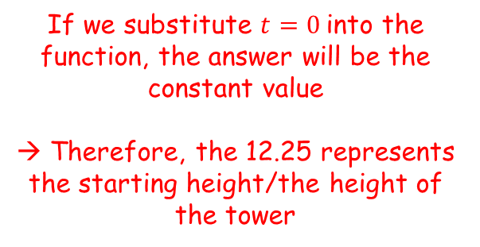
Quadratics
Quadratic equations can be used to create mathematical models of real-life situations.
Projectile motion is a good example of a situation which a quadratic equation can model
A spear is thrown over level ground from the top of a tower. The height, $h$, in metres, of the spear above the ground after $t$ seconds is modelled by the function:
$$h\left(t\right)=12.25+14.7t−4.9t^{2}, t≥0$$
a) Interpret the meaning of the constant 12.25 in the question
If we substitute $t=0$into the function, the answer will be the constant value
→ Therefore, the 12.25 represents the starting height/the height of the tower
2H

Slide 42


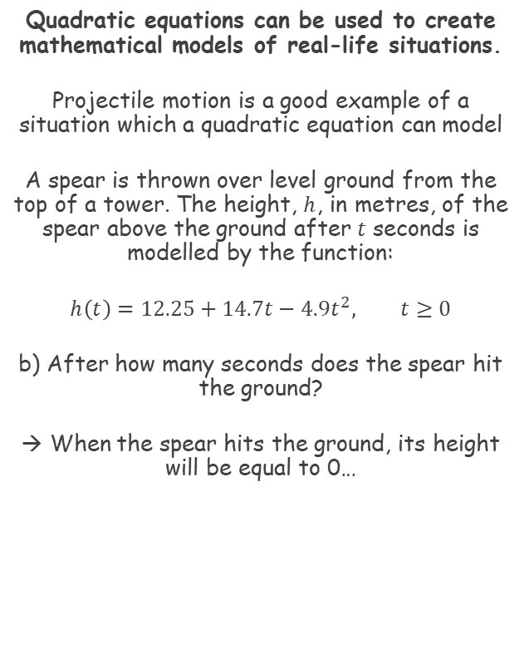
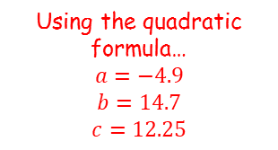

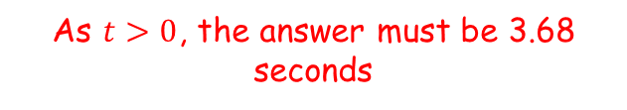


Quadratics
Quadratic equations can be used to create mathematical models of real-life situations.
Projectile motion is a good example of a situation which a quadratic equation can model
A spear is thrown over level ground from the top of a tower. The height, $h$, in metres, of the spear above the ground after $t$ seconds is modelled by the function:
$$h\left(t\right)=12.25+14.7t−4.9t^{2}, t≥0$$
b) After how many seconds does the spear hit the ground?
→ When the spear hits the ground, its height will be equal to 0…
$$h\left(t\right)=12.25+14.7t−4.9t^{2}$$
Set the height equal to 0
$$0=12.25+14.7t−4.9t^{2}$$
Using the quadratic formula…
$$a=−4.9$$
$$b=14.7$$
$$c=12.25$$
$$t=\frac{−b±\sqrt{b^{2}−4ac}}{2a}$$
Sub in values
$$t=\frac{−14.7±\sqrt{{(14.7)}^{2}−4(−4.9)(12.25)}}{2(−4.9)}$$
Calculate
$$t=−0.679 or 3.68$$
As $t>0$, the answer must be 3.68 seconds
2H

Slide 43







Quadratics
Quadratic equations can be used to create mathematical models of real-life situations.
Projectile motion is a good example of a situation which a quadratic equation can model
A spear is thrown over level ground from the top of a tower. The height, $h$, in metres, of the spear above the ground after $t$ seconds is modelled by the function:
$$h\left(t\right)=12.25+14.7t−4.9t^{2}, t≥0$$
c) Write $h(t)$ in the form $A−{B(t−C)}^{2}$, where $A$, $B$ and $C$ are constants to be found.
d) Using your answer to part c), or otherwise, find out the maximum height of the spear, and when it reaches this height
$$h\left(t\right)=12.25+14.7t−4.9t^{2}$$
Rearranging
$$=−4.9t^{2}+14.7t+12.25$$
Take -4.9 out as a factor of the first 2 terms
$$=−4.9\left(t^{2}−3t\right)+12.25$$
Complete the square, using a square bracket
$$=−4.9\left[{\left(t−1.5\right)}^{2}−2.25\right]+12.25$$
Multiply out the square bracket
$$=−4.9{\left(t−1.5\right)}^{2}+11.025+12.25$$
Simplify
$$=−4.9{\left(t−1.5\right)}^{2}+23.275$$
So the maximum height of the spear will be 23.275m, 1.5 seconds after it is thrown
2H

