Slide 1
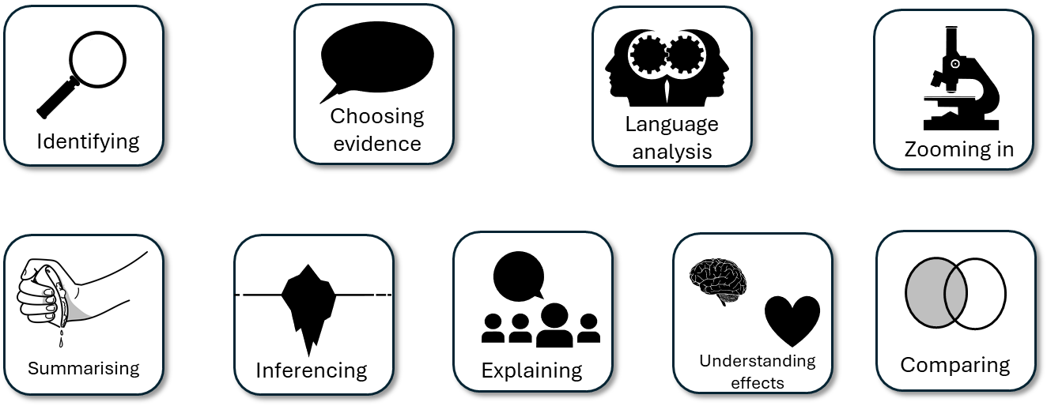
AQA English Language Paper 2 Section A Mock
Last lesson we explored Q1 for two texts on the theme of London life.
Today we are going to go through Q2, Q3 and Q4 in exam conditions and peer assess our own answers.
You may use any of the notes you have made from previous lessons to help you.
Before we answer these questions, re-read the two sources.
Make notes on the purposes, audiences and types of text for both sources.
Make notes on the use of language in both sources.
Make notes on how the two sources are different to each other.

Slide 2
Learning outcomes
To describe how we can improve our Q2, Q3 and Q4 answers
To explain how the writers use language for effect in the sources
To evaluate the effectiveness of our Q2, Q3 and Q4 answers using success criteria

Slide 3


Q2) Summary
10 minutes to answer!
Q2) You need to refer to Source A and Source B for this question:
Use details from both Sources. The writers in Source A and Source B are explaining the differences between the two cities.
Use details from both sources to write a summary of what can you infer about the differences between the two cities.[8 marks]
Exam tip
Remember that this is a summary, so you need to include the following elements:
Relevant information on the same topic (the differences between the cities).
Quotation to support your ideas.
Connectives to link your paragraphs.
Inference icebergs (what does each piece of information suggest to us).
Only facts, not your opinions.
Go through both sources quickly and find all the info related to the two cities only. Any other information is not relevant to the task.
Plan and write your answer now.

Slide 4
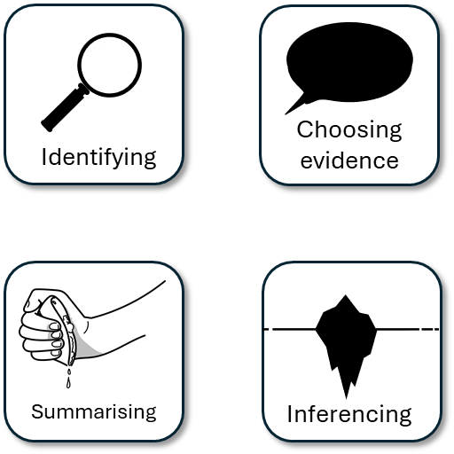
Your answer for Q2 |  | What could they add or change to improve their answer?
Made inferences from both texts
Included quotes or examples to support inferences and summary
Showed perceptive differences between texts
Bonus criteria:
Included connectives in your summary

Slide 5
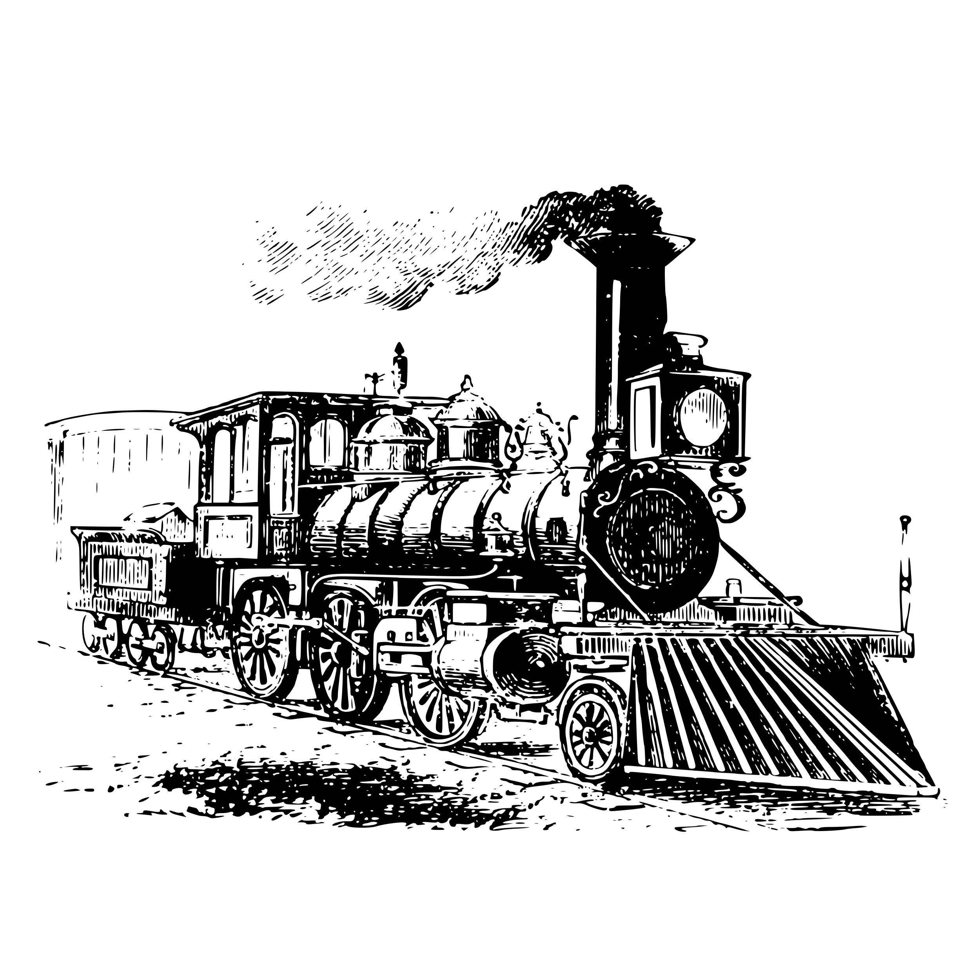

Q3) Language Analysis
15 minutes to answer!
Q3) You now need to refer only to Source A from lines 11 to 21.
The task asks you to explain how the writer uses language to describe London.
[12 marks]
Exam tip
Make your point clear.
Use a quotation to support your idea.
Explain what technique the writer uses
Analyse how that technique describe London.
Zoom in on a particular word or phrase and explain its impact on the reader.
Link back to the question, e.g. Therefore the adjectives help to create a vivid description of the restaurants.
Plan and write out your answer to this question
Timed conditions: 15 minutes

Slide 6
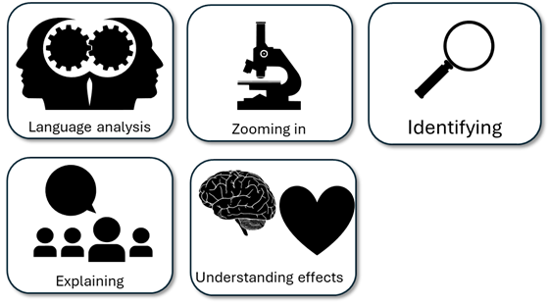
Student’s Q3 answer: |  | What could they add or change to improve their answer?
Analysed the effects of the language
Included quotes to support ideas
Included subject terminology (devices) to support ideas
Bonus criteria:
Included analytical verbs
Used a range of quotes to support your ideas

Slide 7
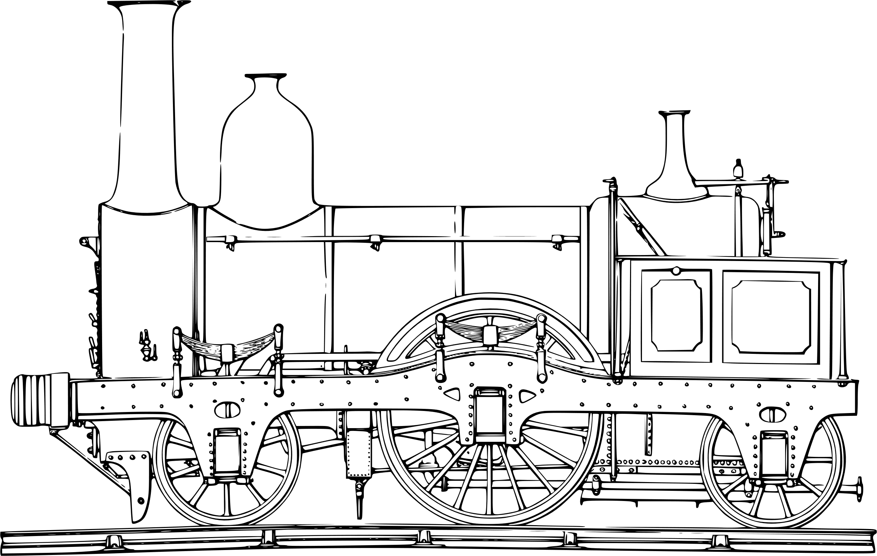
Q4) Comparison
20 minutes to answer!
Q4) For this question, you need to refer to the whole of Source A, together with Source B.
The task asks you to compare how the writers convey their different experiences and feelings about being in London.
In your answer, you could:
• compare their different thoughts and feelings and perspectives
• compare the methods they use to convey their thoughts and feelings and perspectives
• support your response with references to both texts.[16 marks]
Exam tip
This is the comparison question, so you must compare the two texts and how they convey their thoughts and feelings.
Compare the writers’ thoughts and feelings
Compare the use of language techniques to convey their thoughts and feelings
Include quotes or examples to support your comparison
Explain the effects of their methods on their readers

Slide 8
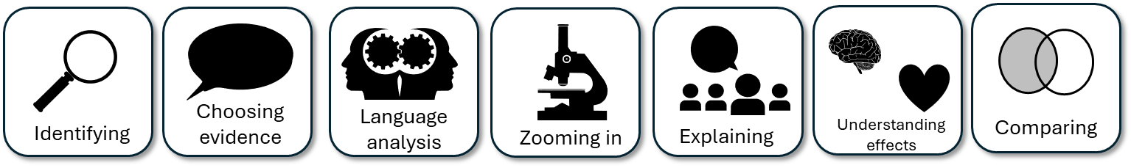
Your answer for Q4 |  | What could they add or change to improve their answer?
Compared the thoughts and feelings of the writers
Included examples to support ideas
Compared the methods (language) used to convey their thoughts and feelings
Bonus criteria:
Included contrast connectives and linking sentences
Included cherry-picked evidence

Slide 9

Plenary: Connect Game
Using your new understanding and learning from today’s lesson, work in pairs to ask each other questions from the lesson.
Each correct answer earns a circle on the connect board. You have to get four in a row to win!
To describe how we can improve our Q2, Q3 and Q4 answers
To explain how the writers use language for effect in the sources
To evaluate the effectiveness of our Q2, Q3 and Q4 answers using success criteria

