Slide 1

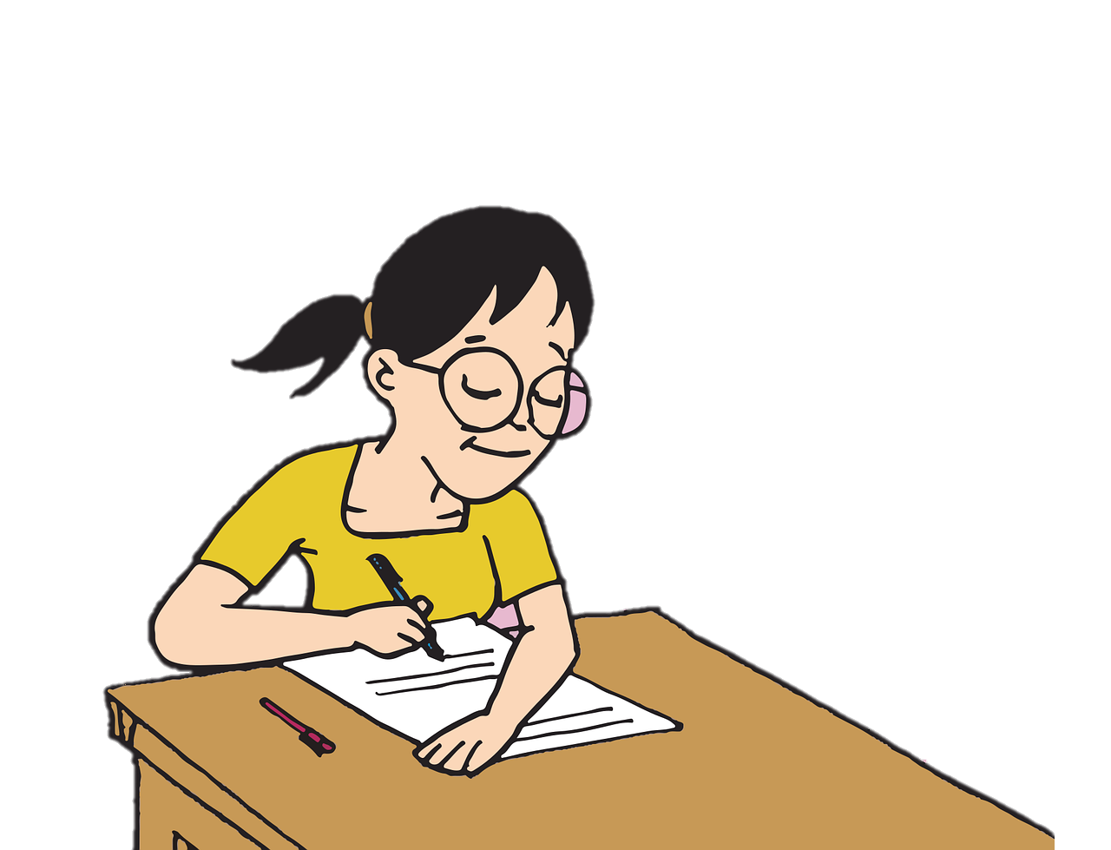
AQA English Language Paper 1 Section A – Q4: Critical Evaluation
Imagine you are about to sit Q4 in your exam.
How will you prepare yourself to answer this question effectively?
Write down a list of key points for answering Q4.
Create success criteria for answering Q4 effectively.
Explain how you can evaluate rather than just analyse a text with examples provided.

Slide 2
Learning outcomes
To describe ways of improving our Q4 answers
To explain how student answers can better meet the requirements of the mark scheme
To evaluate the effectiveness of our improved Q4 answers

Slide 3
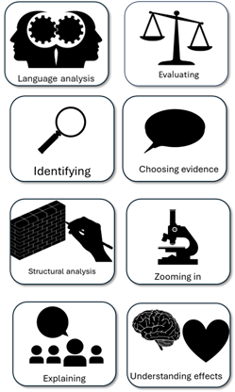
We will work in pairs to explore some example student Q4 answers
There are four different answers for you to explore.
Make notes on what skills the students have included.
Explain why each answer is different to each other through key skills included.
Evaluate which answer is the most successful and explain why, picking out specific examples.

Slide 4
I think the atmosphere is quite exciting because you can see the game being played and you don’t know what is going to happen.
The atmosphere is very exciting because of the description of the game being played. “Watch and wait” shows how tense the narrator is as the game begins.
At times the text creates an exciting atmosphere, including the description of the game in the present: “Watch and wait.” The writer employs a short sentence amongst longer descriptive sentences to evoke a sense of tension and excitement, given the uncertainty of the game.
Although there are moments of hope throughout the text, it is clear the writer intends for use to feel excitement throughout the second half of the extract. The writer employs a short sentence “Watch and wait” amongst many longer, descriptive sentences to reflect the growing sense of tension and to evoke excitement from the reader. The use of alliteration and the terse sentence enables the reader to feel a sense of empathy with the narrator, as if we are at the game as well.

Slide 5

I think the atmosphere is quite exciting because you can see the game being played and you don’t know what is going to happen.
Student’s answer
Evaluated the text based on the statement provided
Included examples to support ideas
Evaluated the writer’s use of methods (language and structure)
This student has evaluated the text based on the statement and they did include an example to support their evaluation. Although they explained the writer’s intention, they could have expanded on this in greater detail with language or structure analysis.

Slide 6
The atmosphere is very exciting because of the description of the game being played. “Watch and wait” shows how tense the narrator is as the game begins.
Student’s answer
Evaluated the text based on the statement provided
Included examples to support ideas
Evaluated the writer’s use of methods (language and structure)
This student has evaluated the text based on the statement and they did include an example to support their evaluation. They have explained the effect of the example on the reader, and they have started to make some language analysis.

Slide 7
At times the text creates an exciting atmosphere, including the description of the game in the present: “Watch and wait.” The writer employs a short sentence amongst longer descriptive sentences to evoke a sense of tension and excitement, given the uncertainty of the game.
Student’s answer
Evaluated the text based on the statement provided
Included examples to support ideas
Evaluated the writer’s use of methods (language and structure)
This student is thinking about the overall text and whether the atmosphere is exciting or hopeful. They analyse the use of short sentences and explain the writer’s intentions and the effects on the reader.

Slide 8
Although there are moments of hope throughout the text, it is clear the writer intends for use to feel excitement throughout the second half of the extract. The writer employs a short sentence “Watch and wait” amongst many longer, descriptive sentences to reflect the growing sense of tension and to evoke excitement from the reader. The use of alliteration and the terse sentence enables the reader to feel a sense of empathy with the narrator, as if we are at the game as well.
Student’s answer
Evaluated the text based on the statement provided
Included examples to support ideas
Evaluated the writer’s use of methods (language and structure)
You can see the student is evaluating the text well, considering the statement and how the atmosphere changes throughout the extract. They analyse language and explore both the writer’s intentions and the impact of the language on the reader.

Slide 9
When you are thinking about how to answer Q4 in the exam, you could think of a pie chart to show how much you agree or disagree with the statement provided.
You may think the atmosphere is presented as equally exciting and hopeful, or you make think it is more exciting or more hopeful, but you need to think about how you view the extract as a whole in relation to the statement.
80%
Exciting
20% Hopeful

Slide 10
Evaluative verbs
Verb | Meaning
Ridicules | Makes fun of or mocks something
Questions | To dispute or challenge something
Persuades | To convince us of something or to make us think in a certain way
Enhances | To increase or intensify something
Subverts | To undermine or alter opinions or perspectives on something
Do you remember in previous lessons on Q2 and Q3 we explored the power of analytical verbs in our answers?
You can also use evaluative verbs to boost your answers for Q4.
The writer wants to feel the narrator’s sense of excitement
The writer tries to persuade us that the atmosphere is more exciting than hopeful

Slide 11
Evaluative verbs
Verb | Meaning
Ridicules | Makes fun of or mocks something
Questions | To dispute or challenge something
Persuades | To convince us of something or to make us think in a certain way
Enhances | To increase or intensify something
Subverts | To undermine or alter opinions or perspectives on something
Go through your previous Q4 answer that we wrote in the previous lesson and add in at least one of these evaluative verbs to your answer.
The writer wants to feel the narrator’s sense of excitement
The writer tries to persuade us that the atmosphere is more exciting than hopeful

Slide 12
Last lesson we wrote our own Q4 answers
Drafting and redrafting is an important activity in English because it helps you to become a more effective English analyst.
Using your learning from today and the success criteria, rewrite your answer.
Your answer for Q4:
Evaluated the text based on the statement provided
Included examples to support ideas
Evaluated the writer’s use of methods (language and structure)
Bonus criteria:
Included evaluative verbs
Considered the whole extract overall when evaluating the text
Verb | Meaning
Ridicules | Makes fun of or mocks something
Questions | To dispute or challenge something
Persuades | To convince us of something or to make us think in a certain way
Enhances | To increase or intensify something
Subverts | To undermine or alter opinions or perspectives on something

Slide 13
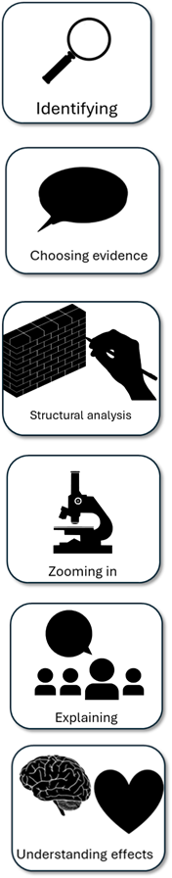
We will now peer assess our new answers
Swap your answers with another student.
Your answer for Q4: |  | What could they add or change to improve their answer?
Evaluated the text based on the statement provided
Included examples to support ideas
Evaluated the writer’s use of methods (language and structure)
Bonus criteria:
Included evaluative verbs
Considered the whole extract overall when evaluating the text

Slide 14
Your answer for Q4: |  | What could they add or change to improve their answer?
Evaluated the text based on the statement provided
Included examples to support ideas
Evaluated the writer’s use of methods (language and structure)
Bonus criteria:
Included evaluative verbs
Considered the whole extract overall when evaluating the text
Notes:
To print out for students

Slide 15

Plenary: 5 Steps To Success!
To describe ways of improving our Q4 answers
To explain how student answers can better meet the requirements of the mark scheme
To evaluate the effectiveness of our improved Q4 answers
What have you learnt today?
What do you still need to work on?
Write down five steps you will take to ensure you reach your potential for your Paper 1 Section A Q4 exam task.

