Slide 1









English Language Paper 2 Section A: Q1 and Q2
Choosing evidence
Language analysis
Identifying
Zooming in
Summarising
Inferencing
Explaining
Understanding effects
Comparing
We have already covered these skills and the requirements of Q1 to Q4. Let’s refocus on Q1 now.
What skills are needed for Q1?
How can you ensure you get all four marks in Q1?
Why is it wise to re-read the Q1 task carefully before answering it?

Slide 2
Learning outcomes
To describe how to answer Q1 effectively
To explain how Source A and Source B offer different perspectives
To evaluate how the two sources differ in terms of bias, perspectives and tone

Slide 3
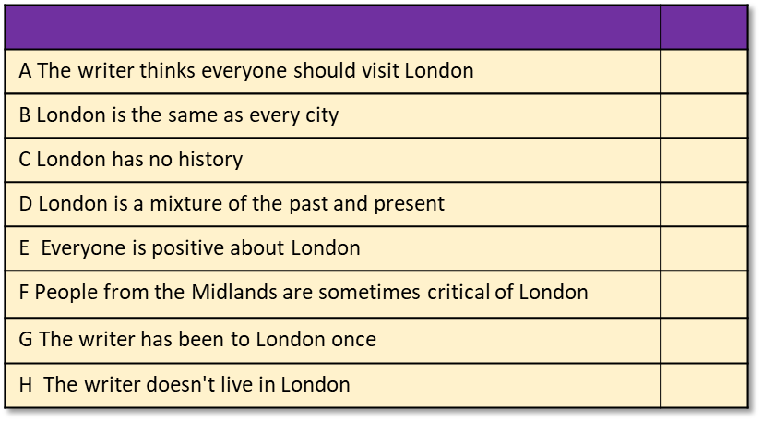
Q1 is about identifying information
You will be given eight statements about the text.
Four of the statements are true, while four are false.
You must shade in which four statements are true.
Do not shade in more than four boxes.
Q1 will normally focus on Source A.
The Q1 task will give you specific lines to focus on. In this question, we are asked to focus on lines 1 to 10 only.
Re-read each statement carefully to make sure you have interpreted it correctly.

Slide 4


Source A
Source A is an extract by journalist Elaine Marigold who wrote an article for a travel magazine in 2018. Marigold argues that London is a city everyone should visit at least once.
This is important information to keep in mind when answering the questions.
Give yourself 5-7 minutes to read through the extract.
Timed conditions: 5-7 minutes

Slide 5

Q1) Identifying and interpreting information
Q1) This question asks you to focus on the first ten lines of the extract.
You are then given eight statements: four are true, four are false. You are asked to shade to the four boxes next to the true statements.
Exam tip
In the exam you will need to read the text quickly but carefully and answer these questions as fast as you can.
Read each statement carefully as sometimes they can be worded to try and catch you out!
A The writer thinks everyone should visit London
B London is the same as every city
C London has no history
D London is a mixture of the past and present
E Everyone is positive about London
F People from the Midlands are sometimes critical of London
G The writer has been to London once
H The writer doesn't live in London
Timed conditions: 5 minutes

Slide 6
A The writer thinks everyone should visit London
B London is the same as every city
C London has no history
D London is a mixture of the past and present
E Everyone is positive about London
F People from the Midlands are sometimes critical of London
G The writer has been to London once
H The writer doesn't live in London
A The writer thinks everyone should visit London
B London is the same as every city
C London has no history
D London is a mixture of the past and present
E Everyone is positive about London
F People from the Midlands are sometimes critical of London
G The writer has been to London once
H The writer doesn't live in London
A The writer thinks everyone should visit London
B London is the same as every city
C London has no history
D London is a mixture of the past and present
E Everyone is positive about London
F People from the Midlands are sometimes critical of London
G The writer has been to London once
H The writer doesn't live in London
A The writer thinks everyone should visit London
B London is the same as every city
C London has no history
D London is a mixture of the past and present
E Everyone is positive about London
F People from the Midlands are sometimes critical of London
G The writer has been to London once
H The writer doesn't live in London

Slide 7
Q1) Answers
Q1) This question asks you to focus on the first ten lines of the extract.
You are then given eight statements: four are true, four are false. You are asked to shade to the four boxes next to the true statements.
Exam tip
In the exam you will need to read the text quickly but carefully and answer these questions as fast as you can.
Read each statement carefully as sometimes they can be worded to try and catch you out!
A The writer thinks everyone should visit London
B London is the same as every city
C London has no history
D London is a mixture of the past and present
E Everyone is positive about London
F People from the Midlands are sometimes critical of London
G The writer has been to London once
H The writer doesn't live in London
Timed conditions: 5 minutes

Slide 8
Statement | True or False? | Evidence to show why it is true or false:
A The writer thinks everyone should visit London |  | “I believe every person should take a trip to London at least once in their life.”
B London is the same as every city |  | “It’s a city like no other”
C London has no history |  | “filled with history”
D London is a mixture of the past and present |  | “a sort of perfect merging of past and present”
E Everyone is positive about London |  | “There are indeed many naysayers when it comes to Britain’s capital”
F People from the Midlands are sometimes critical of London |  | “particularly those from the Midlands or further north, and you’re just as likely to hear a tirade of criticisms and abuse”
G The writer has been to London once |  | “I have been to London a few times before”
H The writer doesn't live in London |  | “I wouldn’t ever want to be based in the city permanently”

Slide 9

Now, read through Source B.
Source B is an anonymous article called London Characters and the Humourous Side of London Life which was published in a magazine in 1871. The writer describes their experiences of living in London.
Just like Source A, it is important to consider this information when analysing the source.
Timed conditions: 5-7 minutes

Slide 10

Now, we’ll look at the two texts together
Working in a pair, complete your comparison worksheet.
1) Complete the speedometers above to compare the two texts.
2) Complete the table on the right to compare the use of language in both text.
3) Make notes on how the two texts are different.

Slide 11


Positive
Negative
One-sided
Balanced
Argumentative
Informative
Language techniques | Source A (Marigold) | Source B (Anonymous)
Adjectives
Facts
Opinions
Rhetorical questions
Repetition
Emotive language
Statistics
Triplets
Single viewpoint
Multiple perspectives
1) Complete the speedometers above to compare the two texts.
2) Complete the table on the right to compare the use of language in both text.
3) Make notes on how the two texts are different.

Slide 12
A
B
A
B
A
B
Positive
Negative
One-sided
Balanced
Argumentative
Informative
B
A
Language techniques | Source A (Marigold) | Source B (Anonymous)
Adjectives
Facts
Opinions
Rhetorical questions
Repetition
Emotive language
Statistics
Triplets
Single viewpoint
Multiple perspectives
Source A is largely positive in tone about London and the writer offers a wide range of their own views on why they love the city. In contrast, Source B is largely critical of the city and how difficult it is for people from outside of the city to adapt to its ways of life.
Source A does offer some counter-arguments about London, including how some people are critical of it outside of the city, but also that it is busy, expensive and overwhelming. In contrast, Source B offers no real praise for city living and mostly explains and informs how difficult it is for people to adapt to life there, given how competitive and alienating it is for outsiders.

Slide 13
Q2 involves writing a summary
You need to refer to Source A and Source B for this question.
The writers in Source A and Source B have spent time in different types of prison.
What can you infer about the differences between the cities?
What is a summary?
What are the key features or parts of a summary?
Why does the exam question mention about what you can “infer”? What does this mean and how can you show it in your summary?
Choosing evidence
Identifying
Summarising
Inferencing

Slide 14

This is what you are marked on in the summary question in Paper 2:
Assessment criteria:
Identify key information
Interpret information both explicitly and implicitly
Select evidence to support interpretations across different texts
This is an exam-style question:
You need to refer to Source A and Source B for this question.
The writers in Source A and Source B have spent time in different types of prison.
What can you infer about the differences between the cities?
Use the assessment objective and exam question above to complete one of the following activities:
Write down the five most important words from the assessment criteria.
What do you need to include in your summary to achieve a good mark?
How would you plan your answer to achieve a good mark in this exam question?

Slide 15
A summary contains a number of key features
It is written in your own words, not those of the original writers.
You should include lots of small quotes from both texts regularly to show you can provide evidence to support your interpretations.
In the exam, you must look at two texts and summarise key information from both on the same topic or area.
You must only pick out the relevant information and ignore anything not relevant to the topic.
A summary should be well-organised and include a clear structure.
Think of a summary as a bit like making lemonade. You’re squeezing the juice out of a lemon to make the drink. In the same way, you’re squeezing out the key information from a whole text to make a summary.

Slide 16
Next lesson we will explore the two texts in more detail and look at the other questions.
Choosing evidence
Identifying
Summarising
Inferencing

Slide 17

Plenary: Three Ideas
Write down three ideas you will take away from today’s lesson to better prepare you for…
To describe how to answer Q1 effectively
To explain how Source A and Source B offer different perspectives
To evaluate how the two sources differ in terms of bias, perspectives and tone

