Slide 1

AQA English Language Paper 2 Q4: Comparing Texts
In the previous lesson we focused on comparing the two texts and exploring the different feelings and experiences of being in prison.
What differences were there in the feelings and experiences between the two writers’ time in prison?
How can we compare the differences between the two texts?
Why is it so crucial to switch focus between the two sources in our Q4 answers? Provide examples.
Source A
Source B

Slide 2
Learning outcomes
To describe how contrast connectives, linking sentences and cherry-picking evidence can improve our Q4 answers
To explain how student answers can better meet the requirements of the mark scheme
To evaluate the effectiveness of our improved Q4 answers

Slide 3
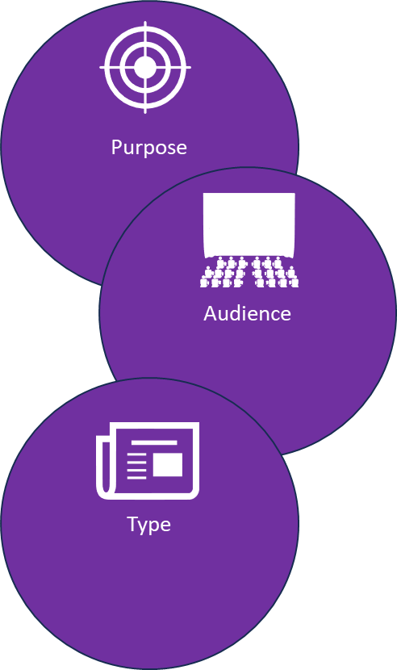
Let’s recap our ideas for this Q4 task
Source A:
Purpose: To describe, to explain, to inform
Audience: Readers with an interest in prison and prison reform in the 1980s.
Type: An extract from a diary.
Source B:
Purpose: To describe, to explain, to persuade
Audience: A newspaper editor and the newspaper readers
Type: A letter written to a newspaper editor.
Tone: Mostly neutral and detached, but the writer provides some positive and negative language.
Tone: Sad, angry, shocked, disgusted.
Language techniques: Anecdotes, statistics, metaphors, similes, adjectives
Language techniques: Imagery, metaphors, emotive language, adjectives
Why do they use these techniques? The statistics provide weight to the writer’s opinions on prisons and the need for reform. The anecdotes again add authority to what the writer is explaining, and the metaphors provide emphasis to his own views.
Why do they use these techniques? The imagery is particularly powerful in conveying how terrified the child inmates are and how harshly they are treated, particularly a simile such as “like a white wedge of terror.”

Slide 4
We can use contrast connectives to help us show clear comparisons in our Q4 answers
In comparison,
In contrast,
However,
Despite this,
Conversely,
On the other hand,
Nevertheless,
Whereas
Source A:
Purpose: To describe, to explain, to inform
Audience: Readers with an interest in prison and prison reform in the 1980s.
Type: An extract from a diary.
Source B:
Purpose: To describe, to explain, to persuade
Audience: A newspaper editor and the newspaper readers
Type: A letter written to a newspaper editor.
The perspectives are very different in both sources given their different audiences. Source A is written for readers interested in prisons and prison reform. In contrast, the audience for Source B is for newspaper readers with the intention of bringing attention to the treatment of children in prison. This means that the writer’s tone in Source A often neutral, whereas the tone in Source B is angry and sad.

Slide 5
It’s really important that we use linking sentences in Q4
In Source A, the writer offers praise for the rehabilitation programmes in place: “Hundreds of braille books are produced by inmates across the country every year” with inmates contributing positively to the wider world. In contrast, the writer of Source B is disgusted at the treatment of children in prison: it is “terrible”, “brutal”, creates “terror” in children in a system they do not understand.
Discuss: Why is this an effective comparison?
To get 16/16:
Compares ideas and perspectives in a perceptive way:
• analyses how writers’ methods are used
• selects a range of judicious supporting detail from both texts
• shows a detailed and perceptive understanding of the different ideas and
perspectives in both texts.

Slide 6
Look back at your answer to Q4 from the previous lesson
In comparison,
In contrast,
However,
Despite this,
Conversely,
On the other hand,
Nevertheless,
Whereas
Find at least one example where you could add in a contrast connective to help improve your comparisons between the two texts.
Go back over your answer and add in contrast connectives and linking sentences to make your comparisons clear.

Slide 7
We must also explore the writers’ methods in Q4
However, Farrell is also keen to highlight the issues with the prison: “Sadly, riots are still commonplace.” Here the writer shows some dissatisfaction, highlighted by his use of the adverb ‘sadly’, and also informs us of the prisoners’ own views: “the temperature in the summer rockets, with prisoners describing it as ‘worse than a boiler room’.” The metaphor ‘rockets’ and the comparison to boiler rooms amplifies the prisoners’ – and the writer’s – unhappiness at the conditions of the cell.
Although Wilde does touch on the conditions of the “dimly-let” cell, his central focus is the treatment of children inside. Wilde describes how the children respond to their treatment in detail, highlighting his sense of sadness and anger: “There was in his eyes the mute appeal of a hunted animal.” The simile works to compare the child to a “hunted animal”, highlighting how prison turns the children into “prey”, implying they are unaware of what they have done wrong and why they are in prison, therefore defeating the purpose of their imprisonment.
Discuss: Why is this an effective comparison?
To get 16/16:
Compares ideas and perspectives in a perceptive way:
• analyses how writers’ methods are used
• selects a range of judicious supporting detail from both texts
• shows a detailed and perceptive understanding of the different ideas and
perspectives in both texts.

Slide 8
Look back at your answer to Q4 from the previous lesson
This time, focus on where you have analysed the writers’ methods.
Highlight or circle any sections where you have analysed the writers’ methods.
Find any examples where you could add analysis of the writers’ methods. Add these in now.
Language techniques: Anecdotes, statistics, metaphors, similes, adjectives
Language techniques: Imagery, metaphors, emotive language, adjectives
Why do they use these techniques? The statistics provide weight to the writer’s opinions on prisons and the need for reform. The anecdotes again add authority to what the writer is explaining, and the metaphors provide emphasis to his own views.
Why do they use these techniques? The imagery is particularly powerful in conveying how terrified the child inmates are and how harshly they are treated, particularly a simile such as “like a white wedge of terror.”

Slide 9

Cherry-picking evidence is a great skill to have!
Rather than just using one longer quotation from the text you are analysing, you can look out for patterns that emerge with the use of language, for instance: how the writer uses adjectives throughout a text, or how one person or object is described and the techniques that are used for this description.

Slide 10
Can you see the differences between these two answers?
Additionally, Farrell offers some praise for the training boards, concluding that “the system is working to a degree in terms of rehabilitation.” Wilde offers no such praise – he refers to ‘brutality’, ‘cruelty’ and ‘stupidity’, using these emotive nouns to reinforce his message that the current treatment of children inmates is atrocious.
Additionally, Farrell offers some praise for the training boards, concluding that “the system is working to a degree in terms of rehabilitation.” Wilde offers no such praise – he refers to ‘brutality’, using emotive nouns to reinforce his message that the current treatment of children inmates is atrocious.
Discuss: How has ‘cherry-picking’ helped to improve the student’s answer?

Slide 11
Last lesson we wrote our own Q4 answers
Drafting and redrafting is an important activity in English because it helps you to become a more effective English analyst.
Using your learning from today and the success criteria, rewrite your answer.
Your answer for Q4
Compared the thoughts and feelings of the writers
Included examples to support ideas
Compared the methods (language) used to convey their thoughts and feelings
Bonus criteria:
Included contrast connectives and linking sentences
Included cherry-picked evidence

Slide 12
We will now peer assess our new answers
Swap your answers with another student.
Your answer for Q4 |  | What could they add or change to improve their answer?
Compared the thoughts and feelings of the writers
Included examples to support ideas
Compared the methods (language) used to convey their thoughts and feelings
Bonus criteria:
Included contrast connectives and linking sentences
Included cherry-picked evidence

Slide 13
Your answer for Q4 |  | What could they add or change to improve their answer?
Compared the thoughts and feelings of the writers
Included examples to support ideas
Compared the methods (language) used to convey their thoughts and feelings
Bonus criteria:
Included contrast connectives and linking sentences
Included cherry-picked evidence
Notes:
To print out for students

Slide 14

On a scale of 1-10, how well do you think you’ve met the learning outcomes today?
Plenary: 1-10
To describe how contrast connectives, linking sentences and cherry-picking evidence can improve our Q4 answers
To explain how student answers can better meet the requirements of the mark scheme
To evaluate the effectiveness of our improved Q4 answers

