Slide 1




AQA English Language Paper 2 – Q4: Comparing Texts
Last lesson we began to compare the two sources and explore their different purposes, audience, types, tones and language.
Let’s refocus on the use of tone again.
Which of these emojis best represents Source A and Source B?
How is the tone of Source A different to Source B?
Why is it important to consider the tones of the sources when comparing texts? Provide examples.
A
B
C
D

Slide 2
Source A has a few different tones. Often the writer tries to remain neutral and balanced in their views in order to best explain what the inside of a prison is like to his readers who are likely not to know.
For instance, the text begins with statistics about the rising prison population, but the writer is also keen to highlight the positives of prison: the prisoner “is positive about his own progress” when meeting with the training boards. The tone here is one of happiness that the system is helping some prisoners.
However, the writer is also keen to highlight the issues with the prison: “Sadly, riots are still commonplace.” Here the writer shows some dissatisfaction and also informs us of the prisoners’ own views: “the temperature in the summer rockets, with prisoners describing it as ‘worse than a boiler room’.”
The writer concludes by offering a balanced view that prisons have done good work but have many more improvements to make.

Slide 3
Source B is very different in tone because it is highly critical of the incarceration of children in the Victorian era.
Wilde offers a mixture of sadness and anger at how children are treated. He begins with the anecdote of a warden being dismissed for offering biscuits to a child inmate, referring to them as a “little hungry child”. He is both sad and angry at the child’s treatment and the sacking of the warden.
Additionally, Wilde is critical of the court system that keeps children in remand without being sentenced: “from people not understanding the peculiar psychology of a child's nature.” He argues that judges and magistrates don’t know (or care) about how imprisoning children affects their mental health.
Moreover, Wilde describes how the children respond to these treatments in detail, highlighting his sense of sadness and anger: “There was in his eyes the mute appeal of a hunted animal.”

Slide 4
Learning outcomes
To describe the thoughts and feelings of the writers in the two sources
To explain how the thoughts and feelings of the writers are different to each other and make comparisons
To evaluate the effectiveness of our Q4 drafts based on success criteria

Slide 5
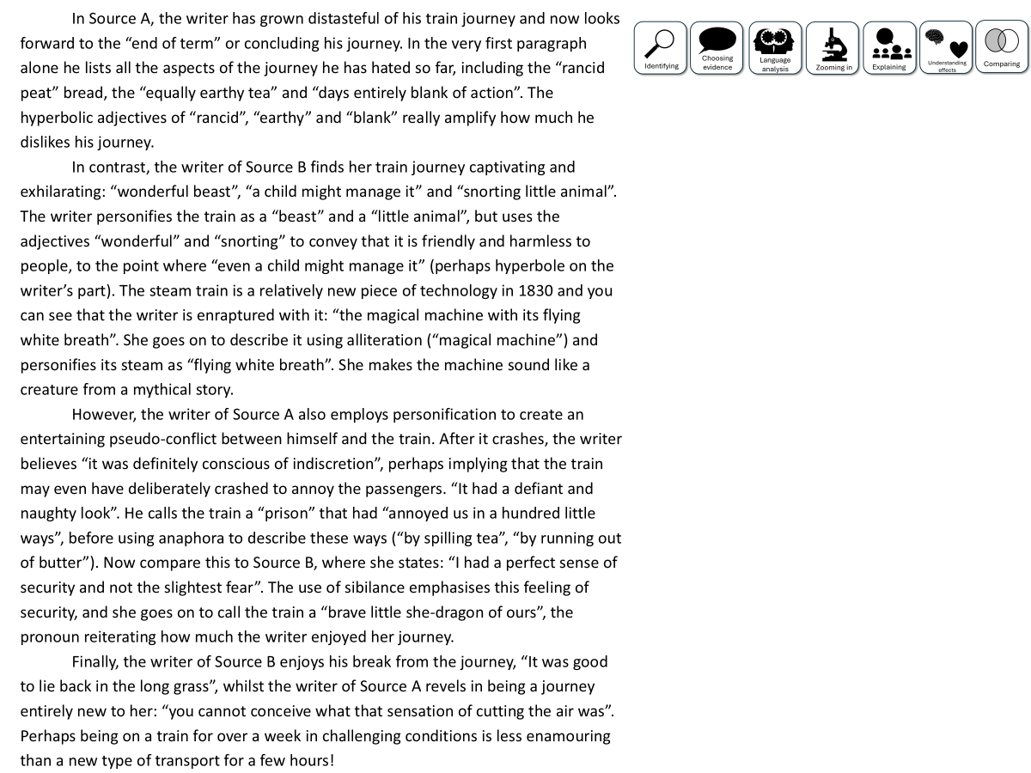

You have been given a good answer for Q4
Go through the answer and find good examples of how the student has compared the two texts. You could do this through arrows, annotations or highlighting.
Bonus Challenge: Find examples of language analysis.

Slide 6
In Source A, the writer tries to remain neutral and balanced in their views in order to best explain what the inside of a prison is like to his readers who are likely not to know. He was previously an outsider looking in (“It really has been an eye opener for me”) which reflects that he wants to reveal to us what the inside of a prison is really like.
Initially, the writer offers with statistics about the rising prison population: “The number of men on life imprisonment was 850 in 1972; by 1982 it has rocketed to 1750” which gives us some context with regards to prisons in the 1980s, but the writer is also keen to highlight the positives of prison: the prisoner “is positive about his own progress” when meeting with the training boards. He is keen to convey to us that prisons do offer positive changes to prisoners and therefore to society as a whole.
In contrast, in Source B the writer is highly critical of the incarceration of children in the Victorian era and therefore offers a very different perspective to that of Source A. Wilde offers a mixture of sadness and anger at how children are treated. He begins with the anecdote of a warden being dismissed for offering biscuits to a child inmate, referring to them as a “little hungry child”. The adjectives ‘hungry’ and ‘little’ are designed to evoke sympathy from the reader, and potentially anger at how both the child and the warder are treated for an act of kindness.
However, Farrell is also keen to highlight the issues with the prison: “Sadly, riots are still commonplace.” Here the writer shows some dissatisfaction, highlighted by his use of the adverb ‘sadly’, and also informs us of the prisoners’ own views: “the temperature in the summer rockets, with prisoners describing it as ‘worse than a boiler room’.” The metaphor ‘rockets’ and the comparison to boiler rooms amplifies the prisoners’ – and the writer’s – unhappiness at the conditions of the cell.
Although Wilde does touch on the conditions of the “dimly-let” cell, his central focus is the treatment of children inside. Wilde describes how the children respond to their treatment in detail, highlighting his sense of sadness and anger: “There was in his eyes the mute appeal of a hunted animal.” The simile works to compare the child to a “hunted animal”, highlighting how prison turns the children into “prey”, implying they are unaware of what they have done wrong and why they are in prison, therefore defeating the purpose of their imprisonment.
Additionally, Farrell offers some praise for the training boards, concluding that “the system is working to a degree in terms of rehabilitation.” Wilde offers no such praise – here refers to ‘brutality’, ‘cruelty’ and ‘stupidity’, using these emotive nouns to reinforce his message that the current treatment of children inmates is atrocious. However, Farrell also offers criticisms himself, suggesting that “Question marks still remain over how we are punishing and reforming criminals in this country.” The personification of ‘question marks’ helps reiterate that the system has much work to do in order to fully offer both rehabilitation and deterrent.

Slide 7
Let’s look at a good answer for Q4:
In Source A, the writer tries to remain neutral and balanced in their views in order to best explain what the inside of a prison is like to his readers who are likely not to know. He was previously an outsider looking in (“It really has been an eye opener for me”) which reflects that he wants to reveal to us what the inside of a prison is really like.
Initially, the writer offers with statistics about the rising prison population: “The number of men on life imprisonment was 850 in 1972; by 1982 it has rocketed to 1750” which gives us some context with regards to prisons in the 1980s, but the writer is also keen to highlight the positives of prison: the prisoner “is positive about his own progress” when meeting with the training boards. He is keen to convey to us that prisons do offer positive changes to prisoners and therefore to society as a whole.
In contrast, in Source B the writer is highly critical of the incarceration of children in the Victorian era and therefore offers a very different perspective to that of Source A. Wilde offers a mixture of sadness and anger at how children are treated. He begins with the anecdote of a warden being dismissed for offering biscuits to a child inmate, referring to them as a “little hungry child”. The adjectives ‘hungry’ and ‘little’ are designed to evoke sympathy from the reader, and potentially anger at how both the child and the warder are treated for an act of kindness.
However, Farrell is also keen to highlight the issues with the prison: “Sadly, riots are still commonplace.” Here the writer shows some dissatisfaction, highlighted by his use of the adverb ‘sadly’, and also informs us of the prisoners’ own views: “the temperature in the summer rockets, with prisoners describing it as ‘worse than a boiler room’.” The metaphor ‘rockets’ and the comparison to boiler rooms amplifies the prisoners’ – and the writer’s – unhappiness at the conditions of the cell.
Although Wilde does touch on the conditions of the “dimly-let” cell, his central focus is the treatment of children inside. Wilde describes how the children respond to their treatment in detail, highlighting his sense of sadness and anger: “There was in his eyes the mute appeal of a hunted animal.” The simile works to compare the child to a “hunted animal”, highlighting how prison turns the children into “prey”, implying they are unaware of what they have done wrong and why they are in prison, therefore defeating the purpose of their imprisonment.
Additionally, Farrell offers some praise for the training boards, concluding that “the system is working to a degree in terms of rehabilitation.” Wilde offers no such praise – here refers to ‘brutality’, ‘cruelty’ and ‘stupidity’, using these emotive nouns to reinforce his message that the current treatment of children inmates is atrocious. However, Farrell also offers criticisms himself, suggesting that “Question marks still remain over how we are punishing and reforming criminals in this country.” The personification of ‘question marks’ helps reiterate that the system has much work to do in order to fully offer both rehabilitation and deterrent.
Read through this answer and think about:
How the student has included:
Comparisons about how the perspectives are different in Source A and B
Quotations to support comparisons
Explanations about the methods both writers use to convey their different feelings and perspectives

Slide 8
Can you see how the student has mixed together quotations, comparisons about the writers’ perspectives and explanations about their methods used?
In Source A, the writer tries to remain neutral and balanced in their views in order to best explain what the inside of a prison is like to his readers who are likely not to know. He was previously an outsider looking in (“It really has been an eye opener for me”) which reflects that he wants to reveal to us what the inside of a prison is really like.
Initially, the writer offers with statistics about the rising prison population: “The number of men on life imprisonment was 850 in 1972; by 1982 it has rocketed to 1750” which gives us some context with regards to prisons in the 1980s, but the writer is also keen to highlight the positives of prison: the prisoner “is positive about his own progress” when meeting with the training boards. He is keen to convey to us that prisons do offer positive changes to prisoners and therefore to society as a whole.
In contrast, in Source B the writer is highly critical of the incarceration of children in the Victorian era and therefore offers a very different perspective to that of Source A. Wilde offers a mixture of sadness and anger at how children are treated. He begins with the anecdote of a warden being dismissed for offering biscuits to a child inmate, referring to them as a “little hungry child”. The adjectives ‘hungry’ and ‘little’ are designed to evoke sympathy from the reader, and potentially anger at how both the child and the warder are treated for an act of kindness.
However, Farrell is also keen to highlight the issues with the prison: “Sadly, riots are still commonplace.” Here the writer shows some dissatisfaction, highlighted by his use of the adverb ‘sadly’, and also informs us of the prisoners’ own views: “the temperature in the summer rockets, with prisoners describing it as ‘worse than a boiler room’.” The metaphor ‘rockets’ and the comparison to boiler rooms amplifies the prisoners’ – and the writer’s – unhappiness at the conditions of the cell.
Although Wilde does touch on the conditions of the “dimly-let” cell, his central focus is the treatment of children inside. Wilde describes how the children respond to their treatment in detail, highlighting his sense of sadness and anger: “There was in his eyes the mute appeal of a hunted animal.” The simile works to compare the child to a “hunted animal”, highlighting how prison turns the children into “prey”, implying they are unaware of what they have done wrong and why they are in prison, therefore defeating the purpose of their imprisonment.
Additionally, Farrell offers some praise for the training boards, concluding that “the system is working to a degree in terms of rehabilitation.” Wilde offers no such praise – here refers to ‘brutality’, ‘cruelty’ and ‘stupidity’, using these emotive nouns to reinforce his message that the current treatment of children inmates is atrocious. However, Farrell also offers criticisms himself, suggesting that “Question marks still remain over how we are punishing and reforming criminals in this country.” The personification of ‘question marks’ helps reiterate that the system has much work to do in order to fully offer both rehabilitation and deterrent.
Read through this answer and think about:
How the student has included:
Comparisons about how the perspectives are different in Source A and B
Quotations to support comparisons
Explanations about the methods both writers use to convey their different feelings and perspectives

Slide 9

There are many skills needed to answer Q4, but you need to use them all to answer Q4 effectively and try to hit the top marks.
One of the most challenging skills is comparing. You have to compare the two texts in order to get a good mark, so we will spend some time today focusing on this skill.

Slide 10
Let’s focus on one part of the student’s answer
but the writer is also keen to highlight the positives of prison: the prisoner “is positive about his own progress” when meeting with the training boards. He is keen to convey to us that prisons do offer positive changes to prisoners and therefore to society as a whole.
In contrast, in Source B the writer is highly critical of the incarceration of children in the Victorian era and therefore offers a very different perspective to that of Source A. Wilde offers a mixture of sadness and anger at how children are treated. He begins with the anecdote of a warden being dismissed for offering biscuits to a child inmate, referring to them as a “little hungry child”. The adjectives ‘hungry’ and ‘little’ are designed to evoke sympathy from the reader, and potentially anger at how both the child and the warder are treated for an act of kindness.
In contrast, in Source B the writer is highly critical of the incarceration of children in the Victorian era and therefore offers a very different perspective to that of Source A.
The student makes sure they make direct comparisons between the two sources. Source A shows the writer’s positivity towards rehabilitation, but Source B highlights the writer’s anger at how children are treated.

Slide 11
Let’s look at the mark scheme for Q4
AO3: Compare writers’ ideas and perspectives, as well as how these are conveyed,
across two or more texts.
To get 16/16:
Compares ideas and perspectives in a perceptive way:
• analyses how writers’ methods are used
• selects a range of judicious supporting detail from both texts
• shows a detailed and perceptive understanding of the different ideas and
perspectives in both texts.
Student’s answer
Compared the thoughts and feelings of the writers
Included examples to support ideas
Compared the methods (language) used to convey their thoughts and feelings
This is what we need to focus on next

Slide 12


Q4) Comparison
20 minutes to answer!
Q4) For this question, you need to refer to the whole of Source A, together with Source B.
The task asks you to compare how the writers convey their different experiences and feelings about their prison experiences.
In your answer, you could:
• compare their different thoughts and feelings and perspectives
• compare the methods they use to convey their thoughts and feelings and perspectives
• support your response with references to both texts.[16 marks]
Exam tip
This is the comparison question, so you must compare the two texts and how they convey their thoughts and feelings.
Compare the writers’ thoughts and feelings
Compare the use of language techniques to convey their thoughts and feelings
Include quotes or examples to support your comparison
Explain the effects of their methods on their readers

Slide 13
Plenary: We will now peer assess our own answers
Swap your answers with another student.
1) What skills did the student use well in their answer?
Example: They include examples from both sources to support their ideas.
2) What skills could the student improve on in their answer?
Example: They need to compare how the thoughts and feelings in one source are different to the other about the prisons.

