Slide 1



AQA English Language Paper 2 – Q4: Comparing Texts
Purpose
Q4 of Paper 2 is all about comparing the two sources.
In order to help us do this, let’s think about purpose, audience and type.
What are the purposes of Source A and Source B?
How are the audiences similar or different for the two sources?
Why might the type or form of the sources affect how the readers understand the texts? Provide examples.
Audience
Type
Purpose: What the writer is trying to achieve when writing their text (for example: writing to inform).
Audience: Who the writer is writing to with their text.
Type: The format of the text (speech, leaflet, article, letter and so on).

Slide 2
Learning outcomes
To describe the purposes, audiences and types for both sources
To explain how the tones of both sources are similar or different
To evaluate how the use of language is different in each text and why they affect the thoughts and feelings of the reader

Slide 3


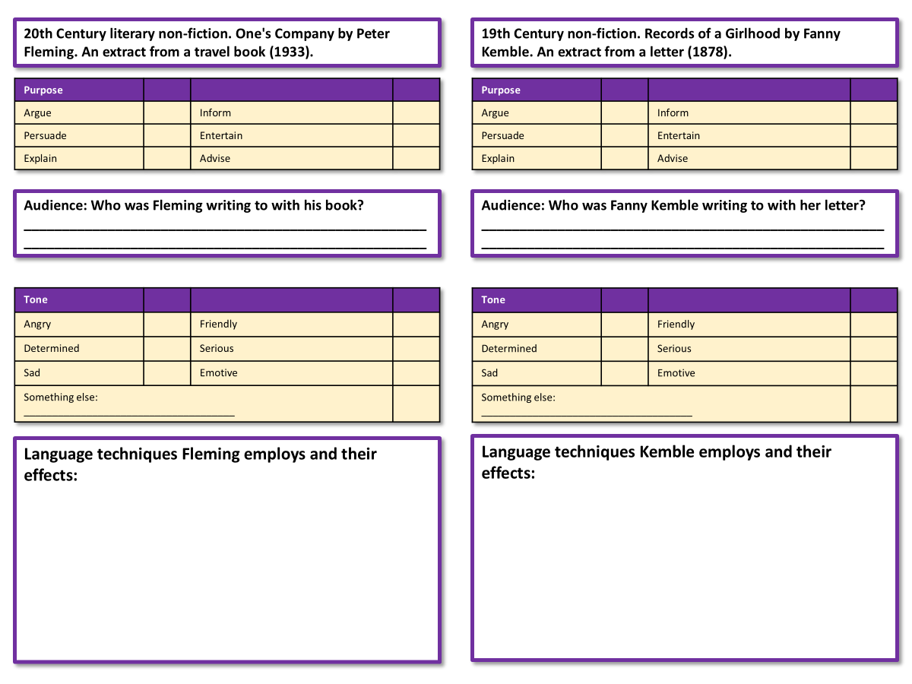
We’re going to compare the two sources now
Complete your worksheet for both sources.
Bonus Challenge: Use analytical verbs when making your notes on the language techniques used in both sources.
Notes:
For further biographical information: https://malala.org/malalas-story
By DFID - UK Department for International Development - Malala Yousafzai: Education for girls, CC BY 2.0, https://commons.wikimedia.org/w/index.php?curid=44613645

Slide 4
20th Century literary non-fiction. Life Inside and Out by Barry Farrell. An extract from a diary (1981).
19th Century non-fiction. Some Cruelties of Prison Life by Oscar Wilde. An extract from a letter to the editor of a newspaper (1890s).
Purpose
Argue |  | Inform
Persuade |  | Entertain
Explain |  | Advise
Purpose
Argue |  | Inform
Persuade |  | Entertain
Explain |  | Advise
Audience: Who was Farrell writing to with his book?
_____________________________________________________
_____________________________________________________
Audience: Who was Wilde writing to with his letter?
_____________________________________________________
_____________________________________________________
Tone
Angry |  | Friendly
Determined |  | Serious
Sad |  | Emotive
Something else: _____________________________________
Tone
Angry |  | Friendly
Determined |  | Serious
Sad |  | Emotive
Something else: _____________________________________
Language techniques Farrell employs and their effects:
Language techniques Wilde employs and their effects:

Slide 5





Source A
Who wrote it?
Barry Farrell, a journalist, wrote a diary when he spent time visiting prison. He later published his diary in a book.
Who were they communicating their ideas to?
Farrell’s ideas were written as a diary, but he later published his diary as a book, which shows his intended audience were people interested in prisons and prison reform.
Why did they write it?
It is likely Farrell wanted to inform his readers about the conditions inside prison and to explain what happens inside and suggest his own opinions on what works well and what could improve.
What were they trying to tell their audience?
The purpose of the diary is to explain what prison life is like, what works well in prison and what could be improved. Farrell provides a mostly balanced account where he shares different perspectives on prison life, as well as his own views.
When did they write it?
It was published in 1981, so a long time before our own, but with some similarities to modern prisons.
How do they tell their audience about their ideas?
Farrell provides a mostly neutral account and shows both positives and negatives of life in prison, but he also includes different perspectives from staff and inmates. He makes use of anecdotes, statistics and repetition to convey his ideas.

Slide 6
Source B
Who wrote it?
Oscar Wilde was a famous writer in the Victorian period who spent two years in prison because he was homosexual (and this was a crime during the Victorian era).
Who were they communicating their ideas to?
The letter was written to the editor of a newspaper, so it was intended for a mass audience to read (newspaper readers), with the hope of having some influence on its readers. Wilde was deeply unhappy at how children were treated in prison.
Why did they write it?
This was written to a newspaper editor in the hope it would be published and have some influence on their readers. Wilde wanted to persuade his readers that the treatment of children in prison was wrong.
What were they trying to tell their audience?
The purpose of the letter is to describe and explain the writer’s thoughts and feelings on the lives of children in prison, but also to persuade readers that their treatment was cruel. The tone of the writing is at times emotive in order to convey Wilde’s disgust at how children are treated in prisons.
When did they write it?
It was published in the 1890s, and young offenders are now placed in separate buildings from adult prisoners and given different programmes. Wilde’s experiences were based on what he saw at Reading prison.
How do they tell their audience about their ideas?
Wilde uses emotive language, metaphors, adjectives and evocative imagery to persuade his readers that the treatment of children in prison is cruel.

Slide 7
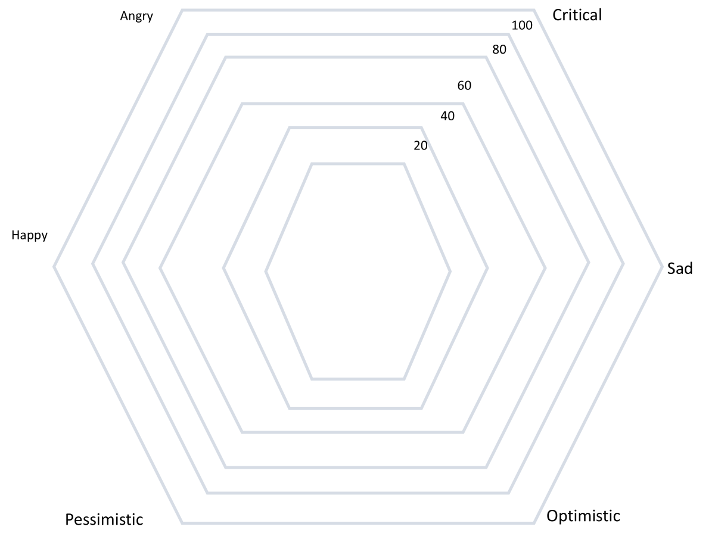
Tone: Radar Chart
It can be difficult to compare texts, but one way to make it easier is to use radar charts, like this one.
Create a radar chart for the Barry Farrell diary extract like the one on the board. This is just an example, don’t try to copy the shape.
Add in an ‘x’ for each of the six tones listed.
Link up the x’s together.
x
x
x
x
x
x
Bonus Challenges:
What is the overriding tone of the Barry Farrell diary extract?
How does the writer convey this tone to the reader? Provide specific examples.

Slide 8
Angry
Critical
100
80
60
40
20
Happy
Sad
Pessimistic
Optimistic

Slide 9
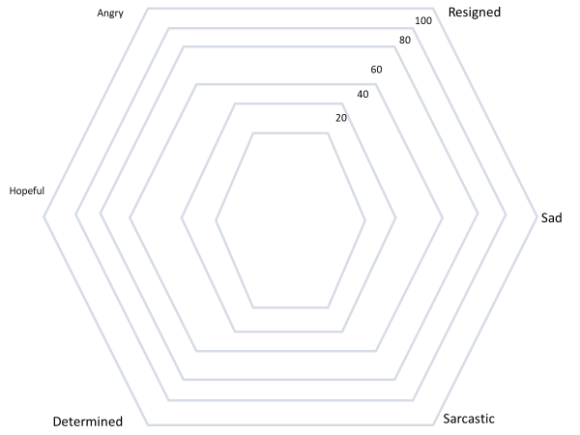
Tone: Radar Chart
Go back to your radar chart and add in the letter to the editor by Oscar Wilde.
x
x
x
x
Bonus Challenges:
What do you notice about the two texts you have analysed? How are they similar or different?
How are the writers able to convey different or similar tones?
x
x

Slide 10
Here is a Q6-style question which asks you to compare the two texts on the common theme of ‘experiences in prison’.
For this question, you need to refer to the whole of Source A, together with the whole of Source B.
Compare how the writers convey their different feelings and perspectives about their experiences in prison.
In your answer, you could:
• compare their different feelings and perspectives
• comment on the methods the writers use to convey their feelings and perspectives
• support your response with references to both texts.
[16 marks]
This is worth 16 marks – it involves a lot of skills.
What do you need to do to answer this question?
What elements need to be included in your answer?
Why is it so important to focus on the word ‘methods’?

Slide 11
You must compare the two texts. You cannot just write about both texts, you must discuss how their feelings and perspectives are different.
You must explore how the writers convey their ideas. In this case, we are looking at the diary extract and the letter to the editor extract.
You must analyse the ideas in each text, but also the perspectives or viewpoints about their experiences of being in prson. How do both writers present these experiences?
For this question, you need to refer to the whole of Source A, together with the whole of Source B.
Compare how the writers convey their different feelings and perspectives about their experiences in prison.
In your answer, you could:
• compare their different feelings and perspectives
• comment on the methods the writers use to convey their feelings and perspectives
• support your response with references to both texts.
[16 marks]
The word ‘methods’ is so important because it is asking you to look at the language and techniques used by both writers to convey or get across their ideas and views. You cannot get 16 marks unless you explore HOW the writers get across their ideas and how they affect the readers.
Finally, you must include examples or quotations from both texts to back up your interpretations about the writers’ ideas and perspectives. Without using examples, you cannot get 16/16.

Slide 12
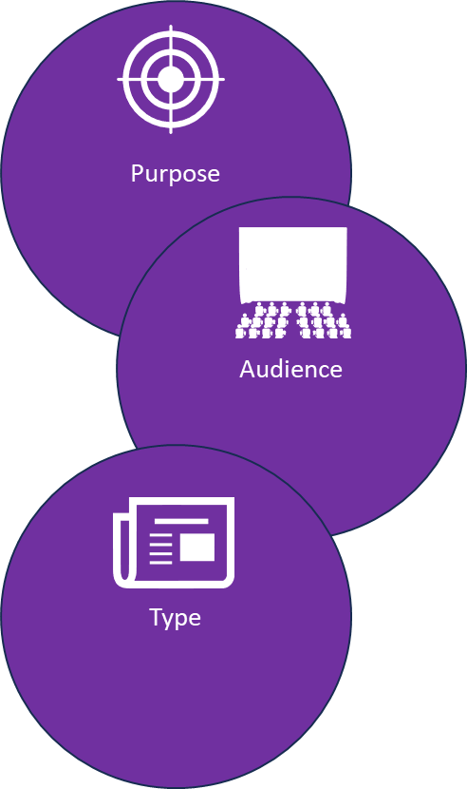
Let’s recap our ideas for this Q4 task
Source A:
Purpose: To describe, to explain, to inform
Audience: Readers with an interest in prison and prison reform in the 1980s.
Type: An extract from a diary.
Source B:
Purpose: To describe, to explain, to persuade
Audience: A newspaper editor and the newspaper readers
Type: A letter written to a newspaper editor.
Tone: Mostly neutral and detached, but the writer provides some positive and negative language.
Tone: Sad, angry, shocked, disgusted.
Language techniques: Anecdotes, statistics, metaphors, similes, adjectives
Language techniques: Imagery, metaphors, emotive language, adjectives
Why do they use these techniques? The statistics provide weight to the writer’s opinions on prisons and the need for reform. The anecdotes again add authority to what the writer is explaining, and the metaphors provide emphasis to his own views.
Why do they use these techniques? The imagery is particularly powerful in conveying how terrified the child inmates are and how harshly they are treated, particularly a simile such as “like a white wedge of terror.”

Slide 13




Plenary: Key Symbols
Which of these symbols best sums up your new knowledge and understanding from today’s lesson? Why?
To describe the purposes, audiences and types for both sources
To explain how the tones of both sources are similar or different
To evaluate how the use of language is different in each text and why they affect the thoughts and feelings of the reader

