Slide 1
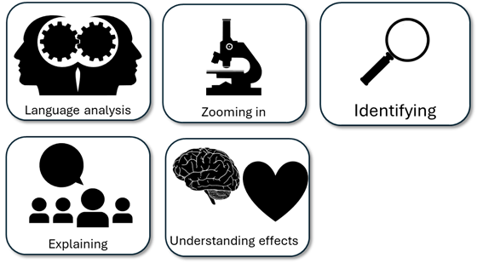
English Language Paper 2 – Q3: Improving Language Analyses
The writer tells us that the rehabilitation programmes are good and help the prisoner when they say he said it was positive for him.
The writer talks about the work the prisoners do to help blind people with the braille they make so that is positive.
Read the student answer to Q3 above.
What skills did they use in their answer?
How could they improve this answer?
Why does this answer not address AO3 effectively? Provide examples.
AO2
Explain, comment on and analyse how writers use language to achieve effects and
influence readers, using relevant subject terminology to support their views

Slide 2
Learning outcomes
To describe ways of improving our Q3 answers
To explain how student answers can better meet the requirements of the mark scheme
To evaluate the effectiveness of our improved Q3 answers

Slide 3


AO2
Explain, comment on and analyse how writers use language to achieve effects and influence readers, using relevant subject terminology to support their views
This is the mark scheme that examiners use to mark Q3:
Shows perceptive and detailed understanding of language:
• Analyses the effects of the writer’s choices of language
• Selects a range of judicious textual detail
• Makes sophisticated and accurate use of subject terminology
Student’s answer
Analysed the effects of the language
Included quotes to support ideas
Included subject terminology to support ideas

Slide 4
The student did include examples, but…
The writer tells us that the rehabilitation programmes are good and help the prisoner when they say he said it was positive for him.
The writer talks about the work the prisoners do to help blind people with the braille they make so that is positive.
• Selects a range of judicious textual detail
Judicious means showing good judgement and sense.
… They didn’t explain the effects of language on the reader, and one good way to do this is by using a range of quotes that back up your interpretations.

Slide 5
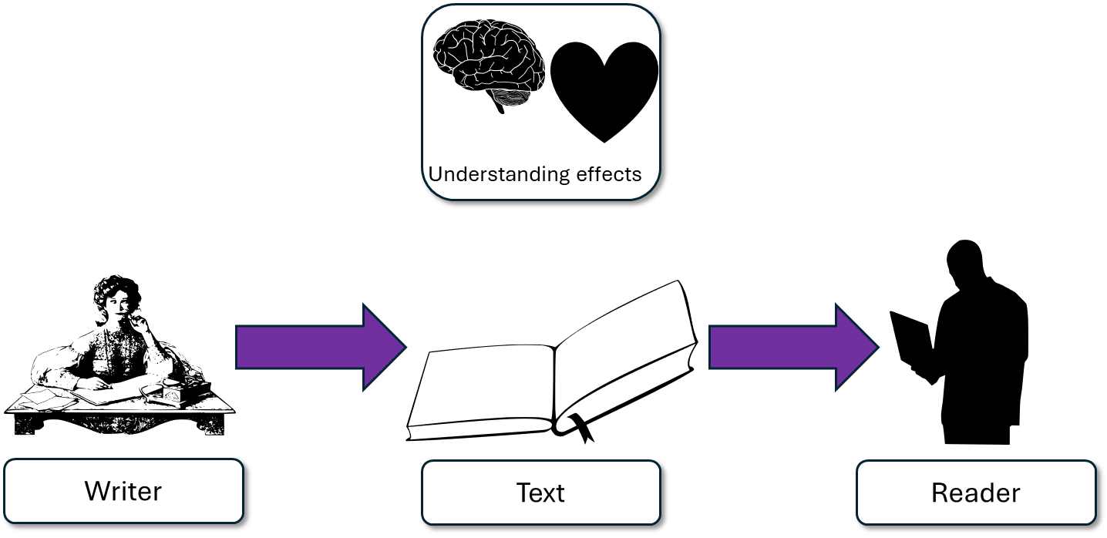
Furthermore, the writer continues to convey the positives of these programmes by providing different perspectives. The writer provides the anecdote of visiting several meetings with prisoners and the training boards. These examples give the audience insight into what goes on in the rehabilitation programmes and informs them as to what impact they can have on the prisoner. We are told the views of a prisoner and how he is positive about the impact of the meetings, and the board praise the prisoner’s behaviour and say what he is doing is helping towards setting a leaving date.
This student’s answer uses the same quote but look at how they’ve zoomed in on that quote and explained the effects on the reader.
We are not just told that the prisoner feels positive about the programme, the student explains how the writer includes different perspectives and an anecdote and they explain the impact on the audience: we learn what the programmes do and how make the prisoner feel as a result.

Slide 6
“I want to convey the positive impact of rehabilitation programmes on prisoners.”
“The prisoner is being given specific and tailored support to help them rehabilitate in prison.”
“He is currently receiving treatment from an allocated doctor and psychotherapist and is positive about his own progress.”

Slide 7
Non-fiction language techniques
Did you know there are many techniques that are often used in non-fiction texts? An easy way to remember some of these is the acronym DAFORREST.
Direct address (“you”)
A
F
O
R
R
E
S
T
Complete the ‘DAFORREST’ acronym (we explored these last lesson).

Slide 8
Non-fiction language techniques
Did you know there are many techniques that are often used in non-fiction texts? An easy way to remember some of these is the acronym DAFORREST.
Direct address (“you”)
Alliteration / Adjectives
Facts
Opinions
Rhetorical questions
Repetition
Exaggeration / Emotive language
Statistics
Tone / Triplets

Slide 9
Let’s help this student to improve part of their answer
The writer talks about the work the prisoners do to help blind people with the braille they make so that is positive.
“Hundreds of braille books are produced by inmates across the country every year. “
Student’s answer
Analysed the effects of the language
Included quotes to support ideas
Included subject terminology to support ideas
Using your understanding of the Q3 mark scheme, transform this into a more effective answer.

Slide 10
Let’s look at another student’s answer
In addition, the writer provides statistics to reinforce the idea that rehabilitation programmes are a positive for both prisoners and those outside. The writer cites statistics that highlight hundreds of braille books are made by prisoners “across the country every year”. The writer employs a metaphor to explain how the prisoners’ work ‘opens up the world’ to the blind through literature that previously would have not been accessible to them.
This student’s answer includes a range of evidence or quotes from the text that all help to support their idea: that the rehabilitation programmes are having a positive impact on the lives of prisoners and those outside prison. Using evidence from different parts of the extract can help to convince the examiner that you’re using evidence judiciously.

Slide 11
We should also include some language devices…
In addition, the writer provides statistics to reinforce the idea that rehabilitation programmes are a positive for both prisoners and those outside. The writer cites statistics that highlight hundreds of braille books are made by prisoners “across the country every year”. The writer employs a metaphor to explain how the prisoners’ work ‘opens up the world’ to the blind through literature that previously would have not been accessible to them.
In addition, the writer reinforices the idea that rehabilitation programmes are a positive for both prisoners and those outside. The writer highlighs hundreds of braille books are made by prisoners “across the country every year”. The writer explains how the prisoners’ work ‘opens up the world’ to the blind through literature that previously would have not been accessible to them.
Student 1
Student 2
Discuss: What has the Student 1 included that Student 2 has not?

Slide 12
You must explain your interpretations
Remember that it is crucial that you include explanations as to why the quotes and devices have effects on the reader.
How do those quotes make the reader think and feel?

Slide 13
Last lesson we wrote our own Q3 answers
Drafting and redrafting is an important activity in English because it helps you to become a more effective English analyst.
Using your learning from today and the success criteria, rewrite your answer.
Your answer for Q3
Analysed the effects of the language
Included quotes to support ideas
Included subject terminology (devices) to support ideas
Bonus criteria:
Included analytical verbs
Used a range of quotes to support your ideas

Slide 14



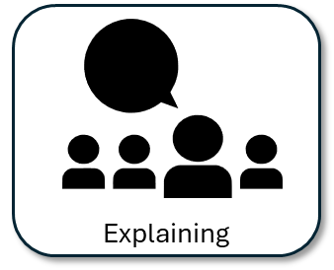
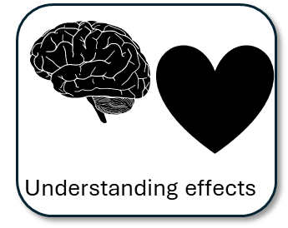
We will now peer assess our new answers
Swap your answers with another student.
Student’s Q3 answer |  | What could they add or change to improve their answer?
Analysed the effects of the language
Included quotes to support ideas
Included subject terminology (devices) to support ideas
Bonus criteria:
Included analytical verbs
Used a range of quotes to support your ideas

Slide 15
Student’s Q3 answer: |  | What could they add or change to improve their answer?
Analysed the effects of the language
Included quotes to support ideas
Included subject terminology (devices) to support ideas
Bonus criteria:
Included analytical verbs
Used a range of quotes to support your ideas
Notes:
To print out for students

Slide 16
Let’s recap Paper 1 Section A so far
Close your exercise books and cover up your notes.
What skills do you need to show for Q1? (4 marks)
What skills do you need to show for Q2? (8 marks)
What skills do you need to show for Q3? (12 marks)

Slide 17

Q1 Recap
Q1: You are given a short extract from the text.
You are given eight statements. Four of them are true, four are false.
Shade in the circles next for the four true statements.
Do not shade in more than four circles.
Identifying

Slide 18
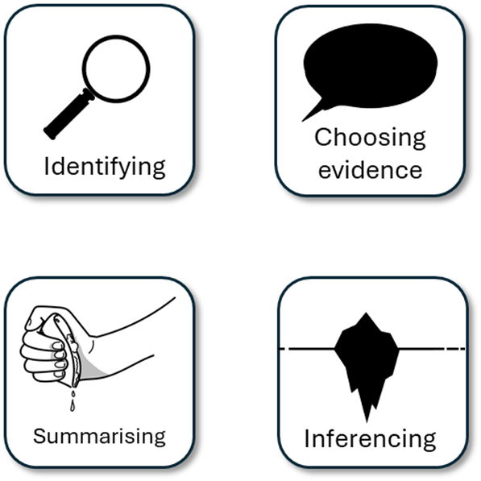
Q2 Recap
Q2: You are asked to write a summary about a key focus. In this example, it is the differences between the two prisons.
You must include examples or quotes from both texts.
You must include inferences (this suggests…) about both texts.
You must only write about the information relevant to the focus given to you in Q2.
You could include connectives.

Slide 19
Q3 Recap
This is the language analysis question.
It is worth 12 marks, so you will need to mark a good range of points to hit the top mark.
You will be asked to analyse the use of language in a small part of the source to explain how the writer uses language to describe something (in this case, the rehabilitation programmes).
You must include clear points that answer the task.
You must include quotes or examples to support your points.
You must analyse how the use of language affects the reader’s thoughts and feelings.
You should include specific language techniques to highlight your use of terminology.

Slide 20




Plenary: Head, Heart, Heave, Hold
Head: Write down one thing that has made you think in this lesson.
Heart: Write down what you have felt this lesson.
Heave: Write down one thing that you disagreed with in this lesson.
Hold: Write down one thing you will remember from this lesson.
To describe ways of improving our Q3 answers
To explain how student answers can better meet the requirements of the mark scheme
To evaluate the effectiveness of our improved Q3 answers

