Slide 1

AQA English Language Paper 2 – Q3: Language Analysis
We previously explored Q1 (identification) and Q2 (summary skills) for Paper 2.
We will look at Q3 today which is all about language analysis.
Let’s explore Source A in more detail.
What are the purpose and audience of Source A?
How do the purpose and audience of the text affect the writer’s language?
Why should we always consider the purpose and audience of a non-fiction text when analysing it? Provide examples.
Purpose: What the writer is trying to achieve when writing their text (for example: writing to inform).
Audience: Who the writer is writing to with their text.

Slide 2
Learning outcomes
To describe the use of language in the extract
To explain how we can improve our language analysis in Q3
To apply our understanding of Q3 skills to our own answers

Slide 3

What does non-fiction mean?
Writing that is informative or factual and not fictional. Fictional writing describes imaginary people and events.
There are lots of different types or formats of non-fiction writing, including speeches, letters, leaflets, essays, reports, articles, reviews, adverts, diaries and so on.
There are lots of different purposes for non-fiction texts, such as writing to argue, writing to advise, writing to explain, writing to persuade, writing to inform and more.

Slide 4
The blurb at the top of each source gives you clues into its purpose, audience and type
The source is from a diary, so instantly we know the audience will be people either interested in the writings of the journalist and have an interest in finding out what the writer thought about prison conditions.
Source A is an extract from the diary of Barry Farrell, a journalist who spent two weeks living in a men’s prison and investigating the conditions there in the 1980s. Prisons have historically been used as a deterrent for committing crimes and as a form of punishment for crimes committed.
We are told that the writer describes their time spent in living in a men’s prison We now have some understanding of the purpose. He will describe the prison and its conditions but also explain to us about how he thought and felt about the prison and its inmates, and that he may be trying to inform his readers about his experiences.
It’s also important to consider when the text was written. This one was written in the 1980s, meaning the conditions in prisons may have changed considerably in over 45 years. That’s important when you consider the writer’s style of language.

Slide 5
Q3 focuses on language analysis
It asks you to focus on specific lines. In this example, we are asked to explore lines 10 to 24.
Here is the question:
How does the writer use language to describe the rehabilitation programmes?

Slide 6



One easy way to remember some language techniques is DAFORREST
Direct address (“you”)
Alliteration / Adjectives
Facts
Opinions
Rhetorical questions
Repetition
Exaggeration / Emotive language / Examples
Statistics
Tone / Triplets
These are common features found in non-fiction texts, but there are many, many more and it’s best to know as many as you can before you sit an assessment or exam.
Sometimes you might hear your teachers talk about ‘technique spotting’. This is where a student just finds all the techniques they know without explaining what they are used for and how these specific examples have affected the readers.
Discuss: Why is it a bad idea to ‘technique spot’ in an exam?

Slide 7

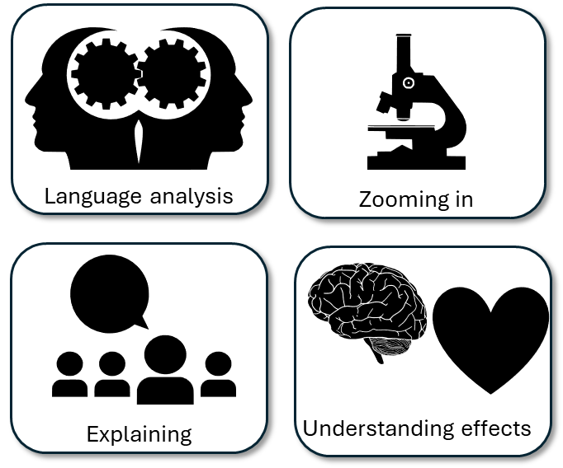

Re-read lines 10 to 24 of Source A
Around your picture:
Write down examples of how the rehabilitation programmes are described
How the writer has employed language techniques
Why this example affects how the reader understands the rehabilitation programmes.
“less familiar”
The adjective familiar is used to make the reader understand that ordinary people outside of prisons rarely see the positive work that is done inside them, such as the rehabilitation programmes that have a positive effect on inmates.

Slide 9
The extract begins with the writer emphasising that there are areas of prison work that go unnoticed or are “less familiar” to ordinary people outside of prisons. Here the adjective ‘less familiar’ reiterates that positive programmes such as these aren’t as reported or well known as the negative side of prison life.
The writer uses a triplet or rule of three to describe the purpose of training boards. Notice the repetition of “their” to amplify the important roles the boards play: “their attitude towards their crime, their rehabilitation”.
We are told every aspect of a prison’s life is monitored, implying that the prisoners are always being watched and nothing is missed out when the boards evaluate prisoners’ progress, emphasised through the use of the determiner ‘every’.
However, there are other areas that may be less familiar to the ordinary member of the public. Training boards are used to monitor an inmate’s behaviour, their attitude towards their crime, their rehabilitation and more. Every aspect of a prisoner’s life is checked. I was invited to attend a number of these meetings: one such prisoner spoken to was asked about his alcoholism, how it contributed to his crime and what he is doing now to combat his addiction. He is currently receiving treatment from an allocated doctor and psychotherapist and is positive about his own progress. The board praise his behaviour inside and comment that it is helping to contribute towards his eventual leaving date.
The writer provides the anecdote of visiting several meetings with prisoners and the training boards. These examples give the audience insight into what goes on in the rehabilitation programmes and informs them as to what impact they can have on the prisoner.
The writer includes different perspectives here: the prisoner himself tells the writer that he is positive about the impact of the meetings, and the board praise the prisoner’s behaviour and say what he is doing is helping towards setting a leaving date.

Slide 10
The writer is keen to reiterate the positive work of prisons in rehabilitating prisoners by citing statistics that highlight hundreds of braille books are made by prisoners across the country each year.
The writer employs a metaphor to explain how the prisoners’ work ‘opens up the world’ to the blind through literature that previously would have not been accessible to them.
Additionally, many prisons use their populations for positive work. Hundreds of braille books are produced by inmates across the country every year. They read a text and type it out in braille format to be bound together and published in order to open up the world of literature to the blind.
During my time in D Wing, I was also able to speak to a number of inmates who told me their own thoughts and feelings about the prison system. Some prisoners claim that the system simply ‘institutionalises’ individuals where inmates serve a five- or six-year sentence, are freed and then end up back in prison a short while later. A life of being repeatedly incarcerated and freed.
The writer provides different perspectives from various inmates, some of whom believes the prison system ‘institutionalises’ some prisoners by making them into repeat offenders. The writer comes the adverb “repeatedly” with the verbs “incarcerated” and “freed” to reinforce the endless cycles some prisoners find themselves in.

Slide 11

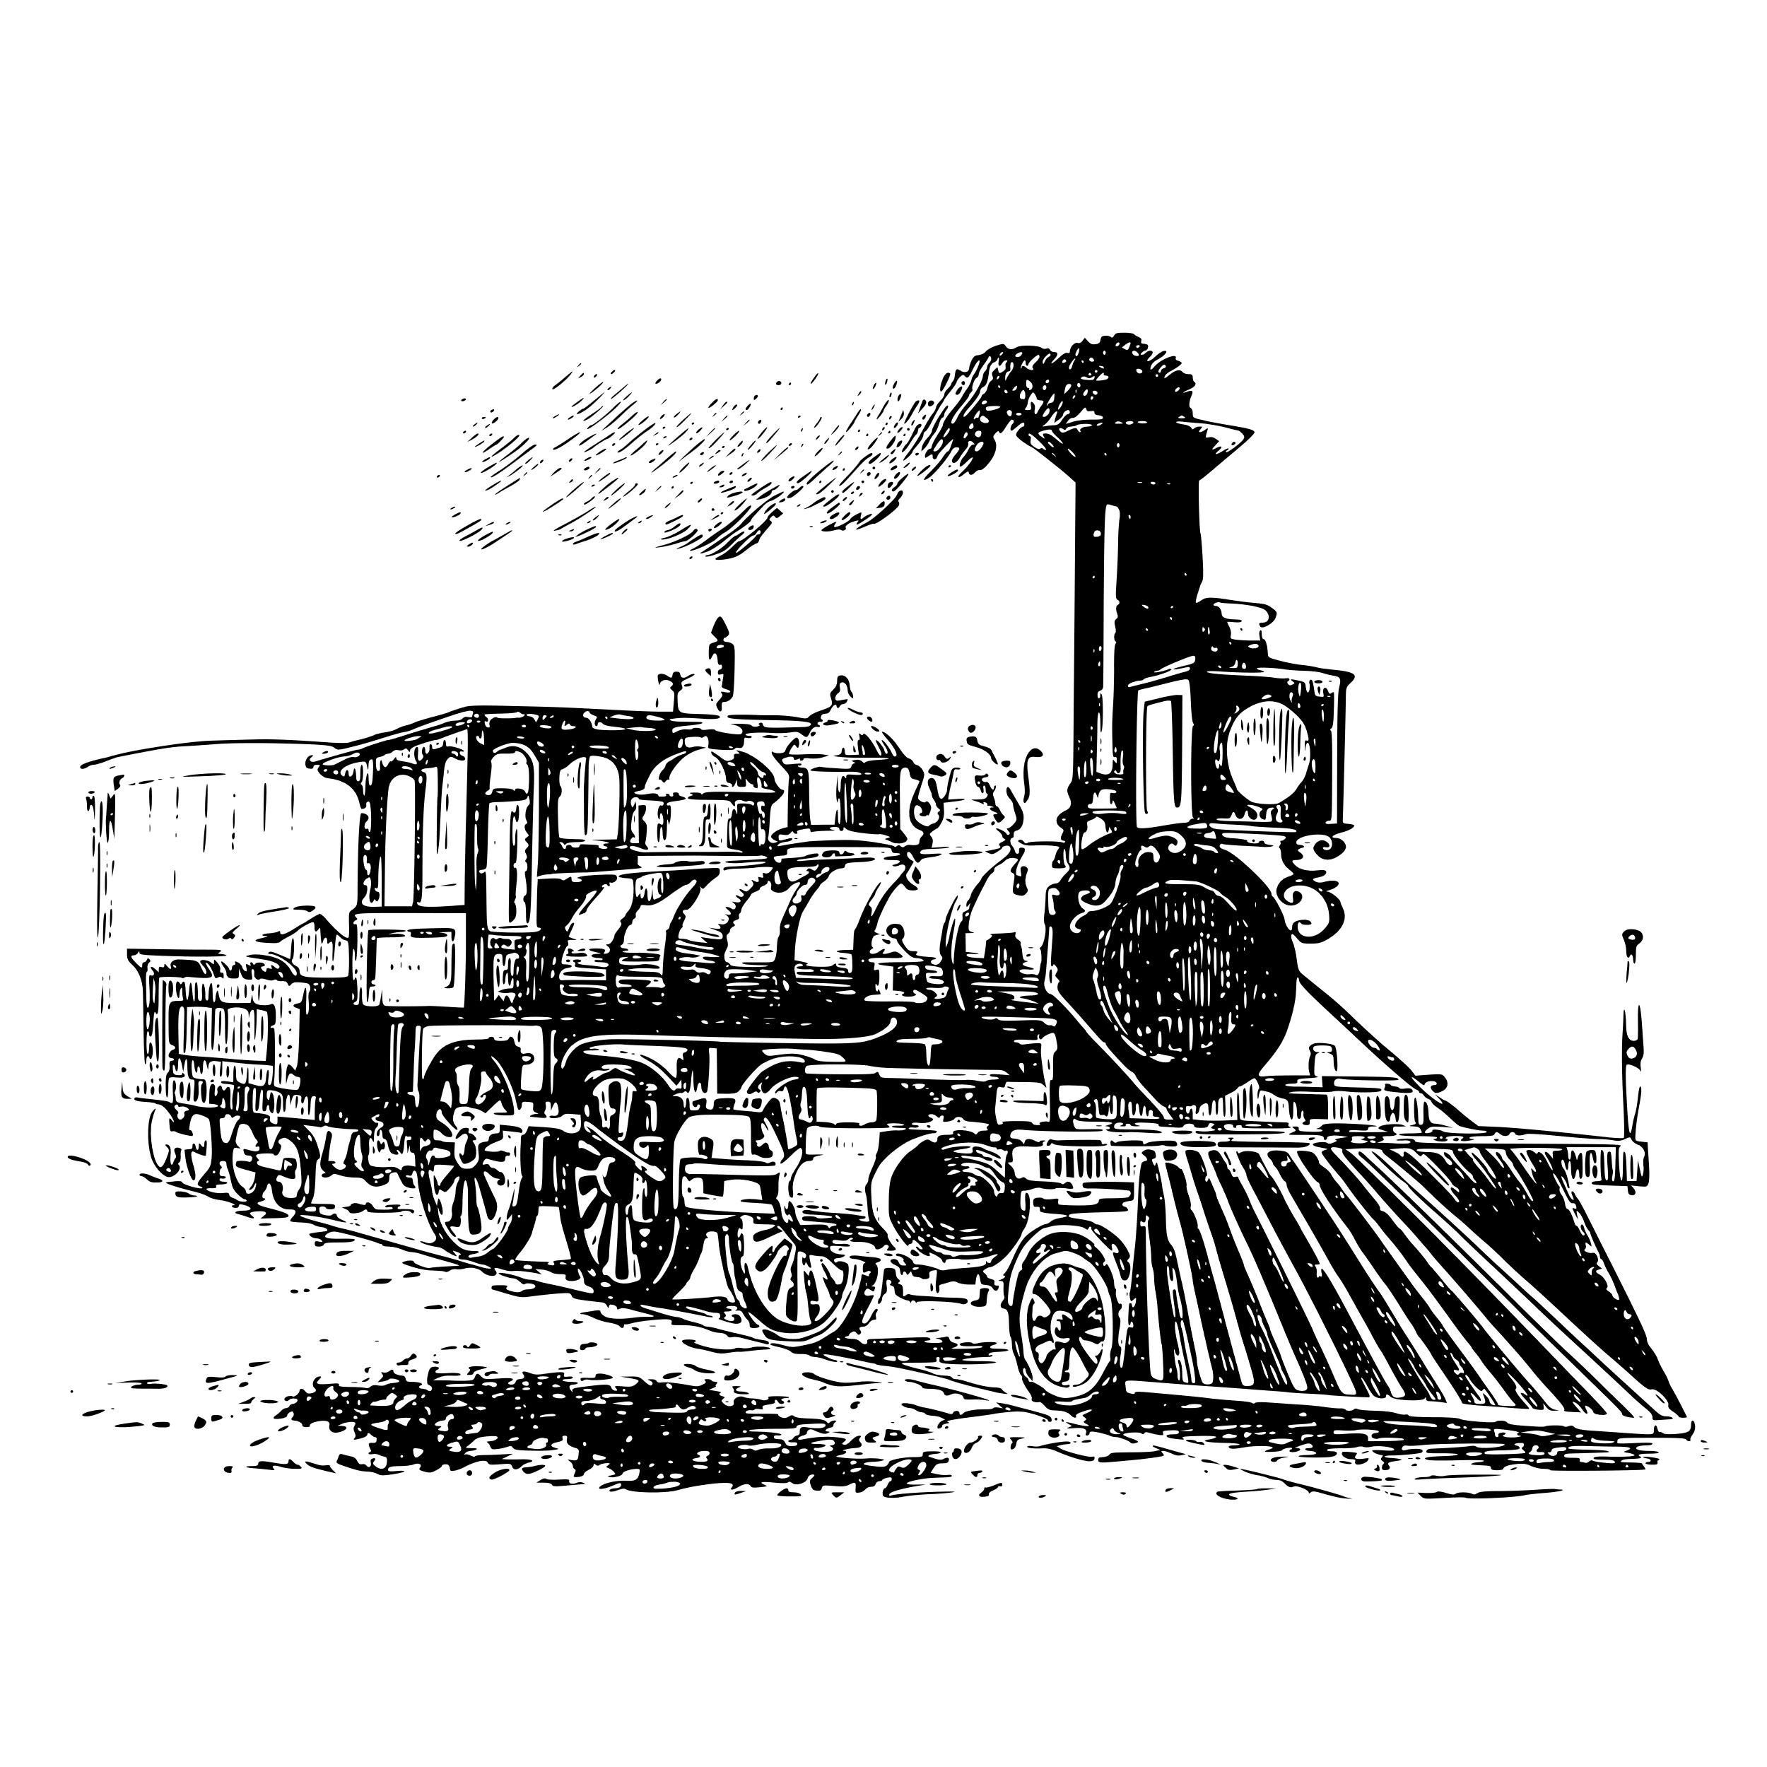


Q3) Language Analysis
15 minutes to answer!
Q3) You now need to refer only to Source A from lines 10 to 24.
The task asks you to explain how the writer uses language to describe the rehabilitation programmes.
[12 marks]
Exam tip
Make your point clear.
Use a quotation to support your idea.
Explain what technique the writer uses
Analyse how that technique describes the rehabilitation programmes. Zoom in on a particular word or phrase and explain its impact on the reader.
Link back to the question, e.g. Therefore the adjectives help to create a vivid description of the programme and its effects.
Plan and write out your answer to this question
Timed conditions: 15 minutes

Slide 12
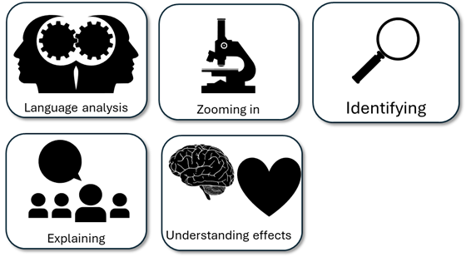
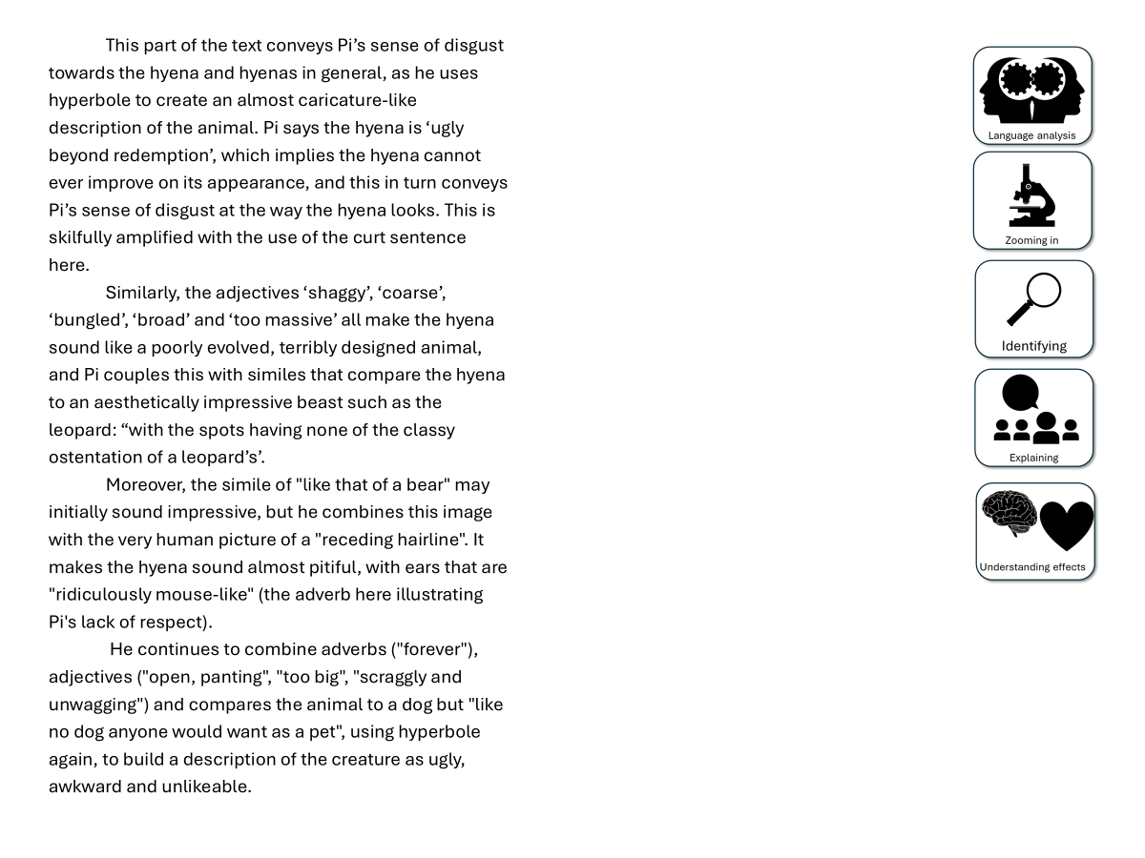
You have been given a good answer for Q3
Go through the answer and find one good example for each of the five skills shown. You could this through arrows, annotations or highlighting.
Bonus Challenge: The student has avoided using words like “shows” too often. What other analytical verbs have they used instead?

Slide 13
  While much of the beginning of the source was used to highlight some of the negatives of prison life, this extract emphasises the positive of work prisons do through rehabilitation programmes. The extract begins with the writer emphasising that there are areas of prison work that go unnoticed or are “less familiar” to ordinary people outside of prisons. Here the adjective ‘less familiar’ reiterates that positive programmes such as these aren’t as reported or well known as the negative side of prison life.
Additionally, The writer uses a triplet or rule of three to describe the purpose of training boards. Notice the repetition of “their” to amplify the important roles the boards play: “their attitude towards their crime, their rehabilitation”. Moreover, we are told every aspect of a prison’s life is monitored, implying that the prisoners are always being watched and nothing is missed out when the boards evaluate prisoners’ progress, emphasised through the use of the determiner ‘every’.
Furthermore, the writer continues to convey the positives of these programmes by providing different perspectives. The writer provides the anecdote of visiting several meetings with prisoners and the training boards. These examples give the audience insight into what goes on in the rehabilitation programmes and informs them as to what impact they can have on the prisoner. We are told the views of a prisoner and how he is positive about the impact of the meetings, and the board praise the prisoner’s behaviour and say what he is doing is helping towards setting a leaving date.
In addition, the writer provides statistics to reinforce the idea that rehabilitation programmes are a positive for both prisoners and those outside. The writer cites statistics that highlight hundreds of braille books are made by prisoners “across the country every year”. The writer employs a metaphor to explain how the prisoners’ work ‘opens up the world’ to the blind through literature that previously would have not been accessible to them.

Slide 14
Can you see how the student has mixed together quotations, explanations about how the writer describes the train journey and its effects on the reader?
  While much of the beginning of the source was used to highlight some of the negatives of prison life, this extract emphasises the positive of work prisons do through rehabilitation programmes. The extract begins with the writer emphasising that there are areas of prison work that go unnoticed or are “less familiar” to ordinary people outside of prisons. Here the adjective ‘less familiar’ reiterates that positive programmes such as these aren’t as reported or well known as the negative side of prison life.
Additionally, The writer uses a triplet or rule of three to describe the purpose of training boards. Notice the repetition of “their” to amplify the important roles the boards play: “their attitude towards their crime, their rehabilitation”. Moreover, we are told every aspect of a prison’s life is monitored, implying that the prisoners are always being watched and nothing is missed out when the boards evaluate prisoners’ progress, emphasised through the use of the determiner ‘every’.
Furthermore, the writer continues to convey the positives of these programmes by providing different perspectives. The writer provides the anecdote of visiting several meetings with prisoners and the training boards. These examples give the audience insight into what goes on in the rehabilitation programmes and informs them as to what impact they can have on the prisoner. We are told the views of a prisoner and how he is positive about the impact of the meetings, and the board praise the prisoner’s behaviour and say what he is doing is helping towards setting a leaving date.
In addition, the writer provides statistics to reinforce the idea that rehabilitation programmes are a positive for both prisoners and those outside. The writer cites statistics that highlight hundreds of braille books are made by prisoners “across the country every year”. The writer employs a metaphor to explain how the prisoners’ work ‘opens up the world’ to the blind through literature that previously would have not been accessible to them.
Read through this answer and think about:
How the student has included:
Explanations about how the writer describes the rehabilitation programmes
Quotations to support ideas
Techniques used
The effects of the techniques

Slide 15
Let’s take a look at a good answer for Q3:
  While much of the beginning of the source was used to highlight some of the negatives of prison life, this extract emphasises the positive of work prisons do through rehabilitation programmes. The extract begins with the writer emphasising that there are areas of prison work that go unnoticed or are “less familiar” to ordinary people outside of prisons. Here the adjective ‘less familiar’ reiterates that positive programmes such as these aren’t as reported or well known as the negative side of prison life.
Additionally, the writer uses a triplet or rule of three to describe the purpose of training boards. Notice the repetition of “their” to amplify the important roles the boards play: “their attitude towards their crime, their rehabilitation”. Moreover, we are told every aspect of a prison’s life is monitored, implying that the prisoners are always being watched and nothing is missed out when the boards evaluate prisoners’ progress, emphasised through the use of the determiner ‘every’.
Furthermore, the writer continues to convey the positives of these programmes by providing different perspectives. The writer provides the anecdote of visiting several meetings with prisoners and the training boards. These examples give the audience insight into what goes on in the rehabilitation programmes and informs them as to what impact they can have on the prisoner. We are told the views of a prisoner and how he is positive about the impact of the meetings, and the board praise the prisoner’s behaviour and say what he is doing is helping towards setting a leaving date.
In addition, the writer provides statistics to reinforce the idea that rehabilitation programmes are a positive for both prisoners and those outside. The writer cites statistics that highlight hundreds of braille books are made by prisoners “across the country every year”. The writer employs a metaphor to explain how the prisoners’ work ‘opens up the world’ to the blind through literature that previously would have not been accessible to them.
Read through this answer and think about:
How the student has included:
Explanations about how the writer describes the rehabilitation programmes
Quotations to support ideas
Techniques used
The effects of the techniques

Slide 16
Next lesson we will explore improving our answers for Q3

Slide 17
Plenary: Budding Students
You are a teacher. You have been asked to produce 3-5 ideas to help new students produce their own language analyses.
Based on what you’ve learnt today, write down 3-5 tips for new students on this.
To describe the use of language in the extract
To explain how we can improve our language analysis in Q3
To apply our understanding of Q3 skills to our own answers

