Slide 1
TRANSCRIPTION - Quick 10
Where does it take place?
What happens to the double helix?
What type of molecule is produced?
Which strand is used in the production of the new molecule?
Is this the sense or the antisense strand?
What is the new molecule built from?
What does every DNA triplet code give rise to?
What is important about the order of bases in the new molecule?
Which enzymes are involved in this synthesis?
What is a molecule that has charged areas but no overall charge?

Slide 2
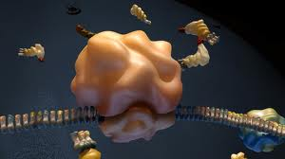
TRANSLATION
(Protein synthesis 2)
Show me your transcription hand dance.

Slide 3
Specification points:
Transcription and translation of genes to include the roles of:
messenger RNA, transfer RNA and ribosomal RNA

Slide 4
Homework:
Make a revision resource for protein synthesis. Be very clear to keep transcription and translation separate.
Describe two steps
Describe the molecules involved
Where is each step happening?
What is the purpose of protein synthesis? (what are proteins used for?)

Slide 5
TRANSLATION
The code is now used to put join amino acids in the correct order.
Uses transfer RNA (tRNA)
Each tRNA carries a specific, individual, amino acid.
Process is carried out in the RIBOSOME

Slide 6
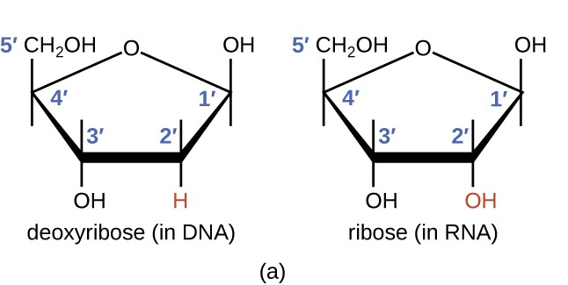
RNA structure
Single strand
Sugar + phosphate + base
Sugar is ribose
Bases are uracil, adenine, guanine, cytosine.
Spot the difference

Slide 7
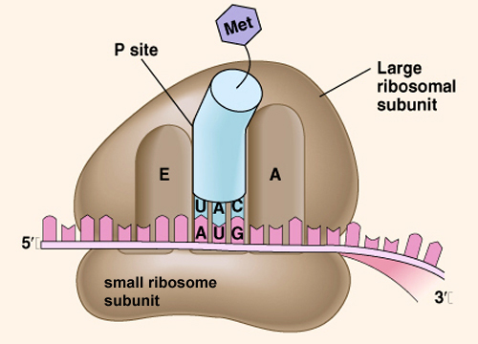


TRANSLATION
Once the mRNA reaches the cytoplasm, the sequence of bases needs to be translated into a sequence of amino acids in a polypeptide chain. This process involves several molecules:
Translation - YouTube
mRNA
Ribosome
Has binding sites for tRNA molecules.
This is measured as 80S, it is made from 2 subunits, 60S and 40S
tRNA attached to amino acids has anticodon
Watch the animation and make notes on:
The role of each of the molecules
How the amino acids are sequenced in the correct order

Slide 8
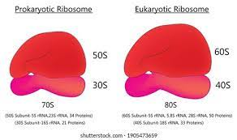
Prokaryotic ribosomes are smaller at 70S
Eukaryotic ribosomes are measured as 80S
Extra information:
S stands for sedimentation coefficient in Svedberg units. This is the amount of time taken to split into components when centrifuged.

Slide 9
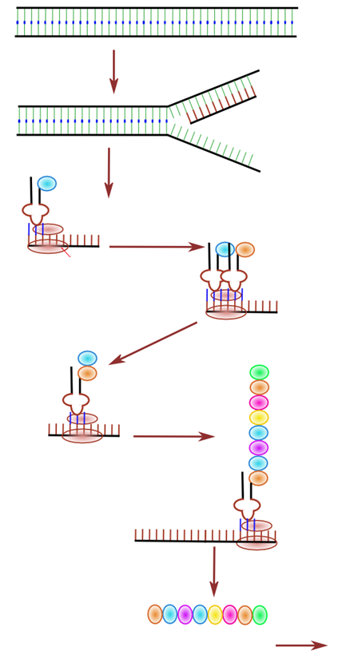
Annotate the protein synthesis poster
Amino acid
mRNA
Ribosome 5' to 3'
tRNA
DNA sense strand
Ribosomal sub units 40S and 60S
Polypeptide synthesis needs ATP
DNA antisense strand
Transcription
Translation
DNA helicase
RNA polymerase

Slide 10
DNA antisense strand
DNA sense strand
mRNA
Ribosome
tRNA
Amino acid
Polypeptide

Slide 11
Describe the process of translation
Molecules involved (describe)
How the amino acids are sequenced in the right order
The bonding involved
8 marking points
10 minutes
Include the following key words in your description:
Ribosome
Amino acid
Transfer RNA carrying specific amino acids
Anticodon
Peptide bond
Codon
mRNA
Optional help box available if required

Slide 12
The mRNA attaches/binds/eq to a ribosome
Two tRNA molecules are held in the ribosome at a time /eq
Each tRNA molecule carries one specific/ eq amino acid
The tRNA has an anticodon on the opposite end.
The anticodon binds to complementary bases/ codons on mRNA
(The amino acids are therefore held closely together) and a peptide bond forms between amino acids.
The ribosome moves relative to the mRNA (idea of)
This continues until a stop codon is reached.
Swap and peer assess your answers using the mark scheme

Slide 13
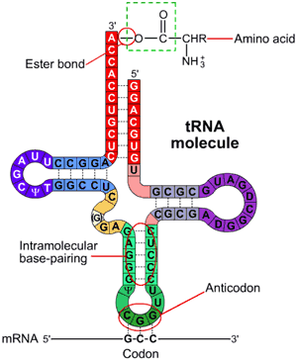
tRNA
Annotate your diagram with the information shown
Strand of RNA showing
2 key important areas:
Amino Acid Binding Site
Hydrogen bonds form between complementary base pairs
Anticodon

Slide 14
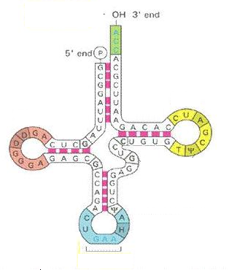
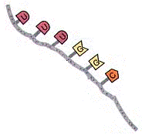
Compare and contrast mRNA and tRNA
mRNA | tRNA
4 minutes
This is only a small section.

Slide 15
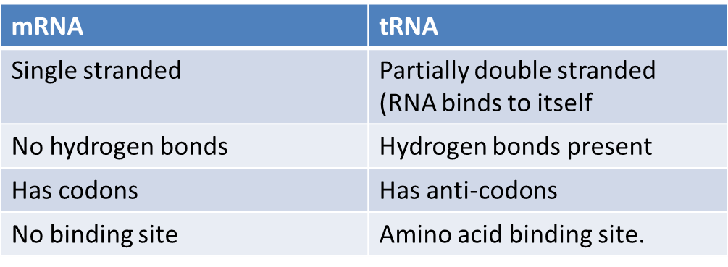
Compare and contrast mRNA and tRNA
This is only a small section.

