Slide 1




English Language Paper 2 – Q2: Improving Summaries
One prison is for adults and for people on life sentences. The other prison contains children as well as adults.
Choosing evidence
Identifying
Summarising
Inferencing
Read the student answer to Q2 above.
What skills did they use in their answer?
How could they improve this answer?
Why does this answer not address AO2 effectively? Provide examples.
AO1
Identify and interpret explicit and implicit information and ideas
Select and synthesise evidence from different texts

Slide 2
Learning outcomes
To describe ways of improving our Q2 answers
To explain how student answers can better meet the requirements of the mark scheme
To evaluate the effectiveness of our improved Q2 answers

Slide 3
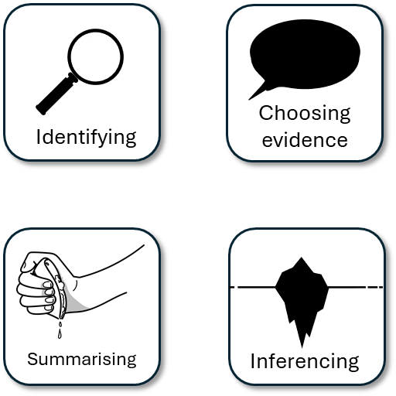


AO1
Identify and interpret explicit and implicit information and ideas
Select and synthesise evidence from different texts
This is the mark scheme that examiners use to mark Q2:
Shows perceptive or detailed synthesis and interpretation of both texts:
• makes perceptive inferences from both texts
• selects judicious references/use of textual detail relevant to the focus of the question
• statements show perceptive differences between texts.
Student’s answer
Made inferences from both texts
Included quotes or examples to support inferences and summary
Showed perceptive differences between texts

Slide 4
The student did include examples, but…
One prison is for adults and for people on life sentences. The other prison contains children as well as adults.
• makes perceptive inferences from both texts
Perceptive means to notice details or things that others may not
… They didn’t make inferences, just listed facts about the two prisons. The differences they found were obvious rather than perceptive.

Slide 5
The prison in Source A contains adult male life-term prisoners whose living conditions are challenging for them. The food is “state funded, mass-produced flavourless slop” which implies it is of a low-quality and for nutritional benefit rather than taste.
In contrast, the prison in Source B contains both adult and child inmates and the writer focuses on the treatment of the children. Whilst we are not told what food they are given, the writer says that a guard is dismissed for giving biscuits to a “little hungry child” which suggests the children are given little in the way of food.
This student’s answer uses similar examples but they have also made inferences. The writer doesn’t tell us that the food given to the prisoners is poor, but we infer that because he tells us it is “mass-produced”, state-funded and “flavourless slop”.
Similarly, this student explains that the writer implies the children are treated poorly via the dismissal of staff trying to be kind to child inmates by giving them biscuits.
Student’s answer
Made inferences from both texts
Included quotes or examples to support inferences and summary
Showed perceptive differences between texts

Slide 6

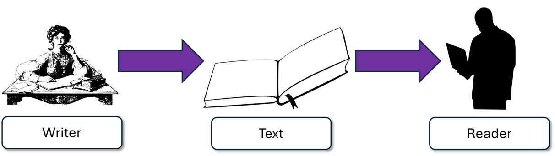
Source B: I want to convey how terribly the children are treated in prisons.
Although the writer doesn’t directly say the child is terrified, they suggest it through “a white wedge of sheer terror” which conveys how terrified the child was of its treatment in prison.
“The child's face was like a white wedge of sheer terror. “

Slide 7
Let’s help this student to improve part of their answer
One prison is for adults and for people on life sentences. The other prison contains children as well as adults.
Using your understanding of the Q2 mark scheme, transform this into a more effective answer.
Student’s answer
Made inferences from both texts
Included quotes or examples to support inferences and summary
Showed perceptive differences between texts

Slide 8
Let’s look at an upgraded answer
In Source A the writer describes the living conditions of adult prisoners on life sentences, suggesting the rooms are very uncomfortable at certain times of the year: “with prisoners describing it as ‘worse than a boiler room’”.
In contrast, the writer of Source B chooses to focus on the emotional turmoil children face in adult prisons: “There was in his eyes the mute appeal of a hunted animal.” This suggests children feel trapped and terrified when locked up in these conditions.
This student’s answer includes examples from the text that all help to support their inferences: that the rooms in Source A are uncomfortable for prisoners at certain times of the year, and then the children are terrified and feel trapped when put in adult prisons.

Slide 9
We should also include connectives to help structure our summaries
In contrast, the writer of Source B chooses to focus on the emotional turmoil children face in adult prisons: “There was in his eyes the mute appeal of a hunted animal.” This suggests children feel trapped and terrified when locked up in these conditions.
The writer of Source B chooses to focus on the emotional turmoil children face in adult prisons: “There was in his eyes the mute appeal of a hunted animal.” This suggests children feel trapped and terrified when locked up in these conditions.
Student 1
Student 2
Discuss: What has the Student 1 included that Student 2 has not?

Slide 10
We should also include connectives to help structure our summaries
In contrast, the writer of Source B chooses to focus on the emotional turmoil children face in adult prisons: “There was in his eyes the mute appeal of a hunted animal.” This suggests children feel trapped and terrified when locked up in these conditions.
The writer of Source B chooses to focus on the emotional turmoil children face in adult prisons: “There was in his eyes the mute appeal of a hunted animal.” This suggests children feel trapped and terrified when locked up in these conditions.
Student 1
Student 2
It is a small addition, but using some connectives can help improve our summaries.

Slide 11
You must include inferences in your summary (Q2)
Remember that it is crucial that you include inferences in your summary, or you will not be able to achieve a high mark or meet the AO1 requirements for Q2.
Always think about what the writer is suggesting and picture an iceberg in your head for Q2.

Slide 12
Last lesson we wrote our own Q2 answers
Drafting and redrafting is an important activity in English because it helps you to become a more effective English analyst.
Using your learning from today and the success criteria, rewrite your answer.
Your answer for Q2
Made inferences from both texts
Included quotes or examples to support inferences and summary
Showed perceptive differences between texts
Bonus criteria:
Included connectives in your summary

Slide 13
We will now peer assess our new answers
Swap your answers with another student.
Your answer for Q2 |  | What could they add or change to improve their answer?
Made inferences from both texts
Included quotes or examples to support inferences and summary
Showed perceptive differences between texts
Bonus criteria:
Included connectives in your summary

Slide 14
Your answer for Q2 |  | What could they add or change to improve their answer?
Made inferences from both texts
Included quotes or examples to support inferences and summary
Showed perceptive differences between texts
Bonus criteria:
Included connectives in your summary
Notes:
To print out for students

Slide 15
Let’s recap Paper 2 Section A so far
Close your exercise books and cover up your notes.
What skills do you need to show for Q1? (4 marks)
What skills do you need to show for Q2? (8 marks)

Slide 16
Q1 Recap
Q1: You are given a short extract from the text.
You are given eight statements. Four of them are true, four are false.
Shade in the circles next for the four true statements.
Do not shade in more than four circles.
Identifying

Slide 17
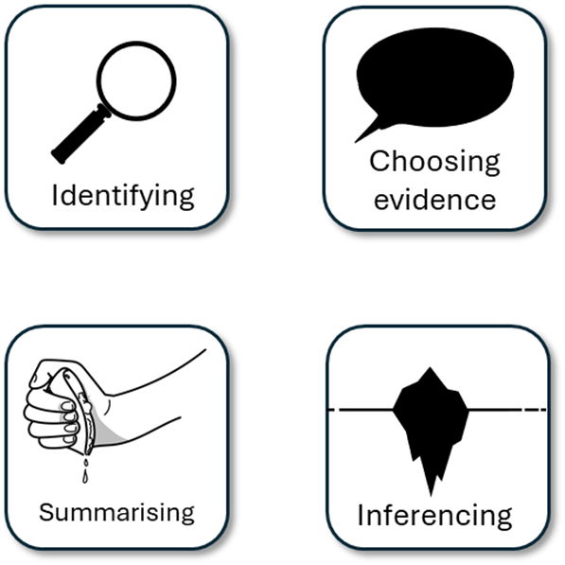
Q2 Recap
Q2: You are asked to write a summary about a key focus. In this example, it is the differences between the two prisons.
You must include examples or quotes from both texts.
You must include inferences (this suggests…) about both texts.
You must only write about the information relevant to the focus given to you in Q2.
You could include connectives.

Slide 18

Plenary: Insta!
What have you learnt today?
Write no more than 140 letters (you don’t need to count, just take a rough guess).
You may include #hashtags.
To describe ways of improving our Q2 answers
To explain how student answers can better meet the requirements of the mark scheme
To evaluate the effectiveness of our improved Q2 answers

