Slide 1
The big question……
Why do the messengers leave the boss in the office?
How do the messages get to the other parts of the factory?
Discuss and be ready to feedback.
Challenge:
What can you tell me about these four molecules:
DNA polymerase, helicase, gyrase, RNA polymerase?

Slide 2
Protein Synthesis
By the end of this lesson you should be able to:
Define what a gene is
Explain the genetic code
Interpret the genetic code to identify the amino acids coded for by different genes

Slide 3
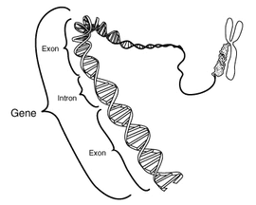
What is DNA for?
Discuss your answers to this question with the person next to you.
Different organisms have the same chemical make up. The main difference is the proteins that are present in the cell. Proteins can be regulatory, structural or enzymes. Most processes in living organisms are controlled by enzymes.
DNA is a set of genetic instructions.
A specific length of DNA that codes for a polypeptide is called a gene
The instruction tells the ‘cell machinery’ which amino acids are required and what order they go in.
DNA is found in the nucleus of cells. It is too large to move out through the nuclear pores.

Slide 4
Homework
Write up the process of transcription in steps.
Draw a diagram to illustrate each step.
Complete the L3a homework sheet
Today’s lesson is more about understanding than writing, that bit’s up to you later!

Slide 5
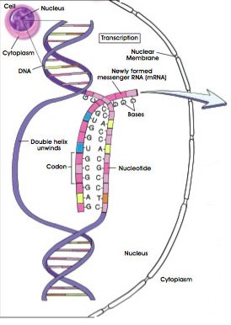
Protein synthesis part 1: Transcription
DNA contains genes which code for polypeptides. The cell apparatus needed to translate the gene into polypeptide chains is located in the cytoplasm. The DNA is found in the nucleus and is too large to leave.
An RNA copy is made of the gene while it is still in the nucleus. The messenger RNA (mRNA) is small enough to move out of the nucleus, via the nuclear pores, into the cytoplasm. Once in the cytoplasm, the RNA instructions are turned into polypeptides.
Using your current knowledge of DNA replication, work in pairs to suggest how mRNA is formed.
Write your ideas on a white board.

Slide 6
Steps you should have identified:
Helicase breaks down H bonds, DNA unwinds
Free RNA nucleotides line up opposite DNA bases in complimentary base pairs.
Phosphodiester bonds form between nucleotides.
Catalysed by RNA polymerase.
Things you may have forgotten/didn’t know:
In RNA there is no thymine. It is replaced by the base uracil.
Adenine codes for uracil. (Thymine codes for adenine. Cytosine codes for guanine.)
3. The DNA strand that is copied is known as the template or anti-sense strand.
4. The DNA that isn’t copied is known as the coding or sense strand.
5. Every 3 bases on a DNA strand is called a triplet code. This codes for 3 bases on the RNA strand known as a codon.
Now split into groups and invent a mime to demonstrate transcription

Slide 7
The Genetic Code – 3 terms to describe it
Genes are made of different sequences of bases
Polypeptides are made of amino acids linked together with peptide bonds.
There are 4 different bases and 20 different amino acids. How do you think the bases code for the different amino acids?
3 bases are needed to code for an amino acid.
There are 64 possible combinations (4 x 4 x 4)
More than one triplet may code for a particular amino acid. For this reason the genetic code is described as 1. Degenerate.
A triplet of bases is referred to as a codon

Slide 8
Interpreting the Genetic Code:
The letters below show the sequence of bases in part of a gene which codes for an enzyme
ATGGAAAAAAGC
Question 1:
Write out the sequence of bases for the mRNA molecule that would be created from this DNA sequence.
UAC CUU UUU UCG
Question 2:
The genetic code is a 2. non-overlapping code. Use the data table on the next slide to work out what the sequence of amino acids formed from this mRNA would be.

Slide 9
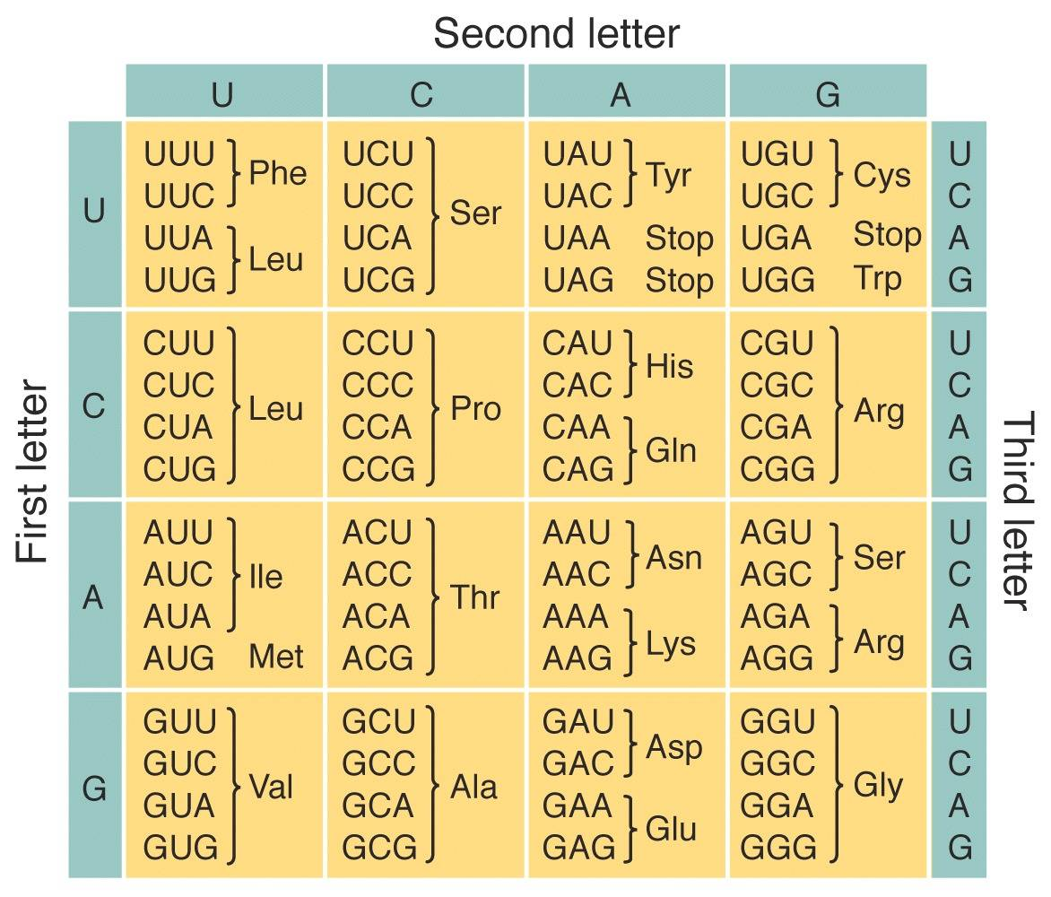
The Genetic Code:
Some of the codons are stop or start signals, rather than coding for an amino acid.
UAC CUU UUU UCG
Tyr
3. Universal – in almost all living organisms the same triplet of DNA bases codes for the same amino acid.
Leu Phe Ser

Slide 10
Key Words: Can you remember the definitions of these words? Test each other
Triplet code
Gene
Ribosomes
Transcription
Codon
Genome
Bases are read in threes, and not singularly or in twos
A specific section of DNA that has sufficient codons to create a polypeptide
In the cytoplasm of the cell, where polypeptides are assembled
The process of copying the code from DNA using messenger RNA
A sequence of three bases on mRNA which codes for one amino acid
The total set of genes in a cell

