Slide 1

AQA English Language Paper 2 Section A: Q2 - Summary
when it has been decided by the state that they have suffered enough for their crimes
This is a short quotation from Source A.
What does the writer mean?
How can we infer more information from this quote than what is written?
Why is inference such an important skill when writing a summary?
Words on the page
Meaning
Inference: Reaching a conclusion based on evidence and reason.

Slide 2
Learning outcomes
To describe the key facts about the prisons from the two sources.
To explain how we can improve our summaries in Q2
To apply our understanding of Q2 skills to our own answers

Slide 3
We will be using inference icebergs to help us see what the writer implies
when it has been decided by the state that they have suffered enough for their crimes
Discuss:
Why is it useful to think of icebergs when trying to infer meaning from a text?
The words the writer uses.
What the writer means.
This suggests that prisoners have no control over their fate and must wait to see what the state determines regarding their sentences.

Slide 4
We’ll re-read part of Source A
The prison population is big and it is getting bigger. The number of men on life imprisonment was 850 in 1972; by 1982 it has rocketed to 1750. The average life sentence served by a ‘lifer’ is 10.5 years, although there are individual cases of inmates staying for 30 years or longer. I’ve been staying in ‘D wing’ at a notorious incarceration centre in the UK which belongs to some of the country’s most violent and dangerous inmates. It really has been an eye opener for me.
Some aspects of time inside are exactly how outsiders perceive them. For instance, food served three times daily is basic and focuses on nutritional value rather than taste. It is state funded, mass-produced flavourless slop designed to keep a prisoner alive, not serve them up with gourmet delights.
Read through the text.
Highlight or circle up to five ideas the writer shares with us.
Look at the parts you have highlighted and make notes on what the writer is suggesting (icebergs).
Using the examples you have chosen, explain why using implication can be more powerful than simply saying something directly.

Slide 5
We can infer that the writer is concerned by the rising prison population.
We can infer that the writer is worried by the rising prison population given the use of the verb ‘rocketed’.
The prison population is big and it is getting bigger. The number of men on life imprisonment was 850 in 1972; by 1982 it has rocketed to 1750. The average life sentence served by a ‘lifer’ is 10.5 years, although there are individual cases of inmates staying for 30 years or longer. I’ve been staying in ‘D wing’ at a notorious incarceration centre in the UK which belongs to some of the country’s most violent and dangerous inmates. It really has been an eye opener for me.
Some aspects of time inside are exactly how outsiders perceive them. For instance, food served three times daily is basic and focuses on nutritional value rather than taste. It is state funded, mass-produced flavourless slop designed to keep a prisoner alive, not serve them up with gourmet delights.
We can infer that the writer wants to bring attention to how life sentences can stretch for multiple decades.
We can infer that the writer may be fearful or worried about staying in a section of the prison that is home to “the country’s most violent and dangerous inmates.”
We can infer that the writer believes people outside of prison have very specific ideas of what prison-life is like.
We can infer that the writer believes people see prison food as being of poor quality.
We can infer that the writer does not like the food in the prison given that he refers to it as “mass-produced, flavourless slop” that is more concerned with nutrition than taste.

Slide 6


It’s important to remember in your analyses…
A reader infers.
A writer implies.
If you struggle to remember this, you could say: “this suggests to the reader” or “the writer suggests that”.
Inferring
Implying

Slide 7

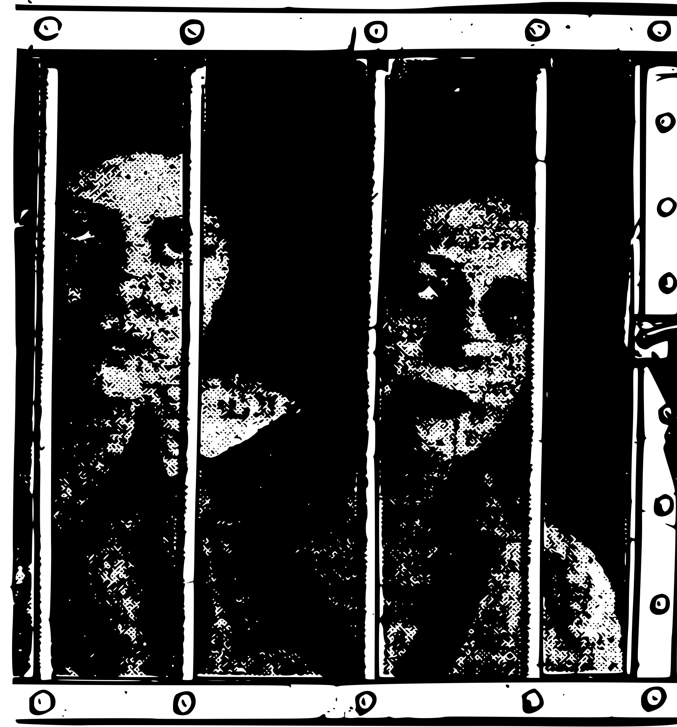
You need to refer to Source A and Source B for this question.
The writers in Source A and Source B are travelling on different types of trains.
What can you infer about the differences between the two prisons?
Complete your table.
Include examples to support your ideas.
Infer the writer’s thoughts and feelings about the prisons.
Areas to consider | Source A (Farrell) | Source B (Wilde)
What are the prisons like? | The rooms rocket in temperature during the summer, making the prisoners very uncomfortable. The cells are described as being small and austere.
How are the prisoners treated? |  | The children are kept inside their cells for 23 hours a day. The children are filled with terror and cannot comprehend what is happening to them and why. Wardens are not allowed to treat children with kindness – one was sacked for giving a child biscuits.
What does the writer think about how the prisoners treated?
What do the prisoners think about being in prison?

Slide 8
Areas to consider | Source A (Farrell) | Source B (Wilde)
What are the prisons like? | The rooms rocket in temperature during the summer, making the prisoners very uncomfortable. The cells are described as being small and austere.
How are the prisoners treated? |  | The children are kept inside their cells for 23 hours a day. The children are filled with terror and cannot comprehend what is happening to them and why. Wardens are not allowed to treat children with kindness – one was sacked for giving a child biscuits.
What does the writer think about how the prisoners treated?
What do the prisoners think about being in prison?
Areas to consider | Source A (Farrell) | Source B (Wilde)
What are the prisons like? | The rooms rocket in temperature during the summer, making the prisoners very uncomfortable. The cells are described as being small and austere.
How are the prisoners treated? |  | The children are kept inside their cells for 23 hours a day. The children are filled with terror and cannot comprehend what is happening to them and why. Wardens are not allowed to treat children with kindness – one was sacked for giving a child biscuits.
What does the writer think about how the prisoners treated?
What do the prisoners think about being in prison?

Slide 9
Areas to consider | Source A | Source B
What are the prisons like? | The rooms rocket in temperature during the summer, making the prisoners very uncomfortable. The cells are described as being small and austere. | The cells are dimly-lit, and the writer describes the prison system as being brutal. The rooms are described as being dark and lonely.
How are the prisoners treated? | The food is of poor quality that is designed for nutrition and not taste. Prisoners are given work to complete that benefits those on the outside, and there are rehabilitation programmes for them. They are given support via doctors and psychotherapists. | The children are kept inside their cells for 23 hours a day. The children are filled with terror and cannot comprehend what is happening to them and why. Wardens are not allowed to treat children with kindness – one was sacked for giving a child biscuits.
What does the writer think about how the prisoners treated? | The writer tries to be balanced and informative throughout their diary entry, but they suggest the prison is more successful at rehabilitation than acting as a deterrent. | The writer is horrified that children are sent to prison even when being on remand or before they know if they have a conviction. He argues wardens want to treat the children with kindness but cannot.
What do the prisoners think about being in prison? | Riots are commonplace, and inmates claim lockdown conditions affect their mental health, leading to anxiety and depression. | The children are clearly terrified by the conditions they are kept in. Wilde does not speak to the children directly, but observes their behaviour in response to their treatment.

Slide 10


Q2) Summary
10 minutes to answer!
Q2) You need to refer to Source A and Source B for this question:
Use details from both Sources. The writers in Source A and Source B are explaining the differences between the two prisons.
Use details from both sources to write a summary of what can you infer about the differences between the prisons.[8 marks]
Exam tip
Remember that this is a summary, so you need to include the following elements:
Relevant information on the same topic (the differences between the prisons).
Quotation to support your ideas.
Connectives to link your paragraphs.
Inference icebergs (what does each piece of information suggest to us).
Only facts, not your opinions.
Go through both sources quickly and find all the info related to the two prisons only. Any other information is not relevant to the task.
Plan and write your answer now.

Slide 11
Let’s take a look at a good answer for Q2:
In Source A the writer suggests that the prison cells are not comfortable. The rooms rocket in temperature during the summer, making the prisoners very uncomfortable. Additionally, the cells are described as being small and austere, suggesting there are basic and uncomfortable. In Source B the writer suggests that the cells are not suitable for young children. The cells are dimly-lit, and the writer describes the prison system as being brutal. The rooms are described as being dark and lonely.
In Source A the writer suggests the food is of poor quality that is designed for nutrition and not taste. The food is described as “flavourless slop”, suggesting it has no taste and is of poor quality. However, the prisoners are given work to complete that benefits those on the outside, and there are rehabilitation programmes for them. Moreover, they are given support via doctors and psychotherapists, with one prisoner being supported with his alcoholism. These programmes suggest work is done to improve the quality of life for prisoners.
In contrast, in Source B the children are left inside their cells for almost the entire day: “Every child is confined to its cell for twenty-three hours out of the twenty-four”. This treatment produces terror in the children: “The child's face was like a white wedge of sheer terror.” Moreover, wardens often feel sympathy for the children, but any form of kindness can result in being fired: “the warder Martin, of Reading Prison, has been dismissed” for giving sweet biscuits to a child. This suggests prison conditions are incredibly unkind and brutal towards children.
Read through this answer and think about:
How the student has included:
Quotations
Inference icebergs
Connectives.

Slide 12
Can you see how the student has mixed together quotations, inferences and connectives into a detailed and concise summary?
In Source A the writer suggests that the prison cells are not comfortable. The rooms rocket in temperature during the summer, making the prisoners very uncomfortable. Additionally, the cells are described as being small and austere, suggesting there are basic and uncomfortable. In Source B the writer suggests that the cells are not suitable for young children. The cells are dimly-lit, and the writer describes the prison system as being brutal. The rooms are described as being dark and lonely.
In Source A the writer suggests the food is of poor quality that is designed for nutrition and not taste. The food is described as “flavourless slop”, suggesting it has no taste and is of poor quality. However, the prisoners are given work to complete that benefits those on the outside, and there are rehabilitation programmes for them. Moreover, they are given support via doctors and psychotherapists, with one prisoner being supported with his alcoholism. These programmes suggest work is done to improve the quality of life for prisoners.
In contrast, in Source B the children are left inside their cells for almost the entire day: “Every child is confined to its cell for twenty-three hours out of the twenty-four”. This treatment produces terror in the children: “The child's face was like a white wedge of sheer terror.” Moreover, wardens often feel sympathy for the children, but any form of kindness can result in being fired: “the warder Martin, of Reading Prison, has been dismissed” for giving sweet biscuits to a child. This suggests prison conditions are incredibly unkind and brutal towards children.
Read through this answer and think about:
How the student has included:
Quotations/references
Inferences
Connectives.

Slide 13

Plenary: Mini Quiz
Come up with one question on what we have learnt today to test your peers.
What…?
How…?
Why…?
To describe the key facts about the prisons from the two sources.
To explain how we can improve our summaries in Q2
To apply our understanding of Q2 skills to our own answers

