Slide 1
1. The Cell Cycle
Topic 4 Cell division
Tuesday, 22 July 2025
Open the worksheet in lesson 1 the cell cycle
https://www.youtube.com/watch?v=Q6ucKWIIFmg
Nice to play as students enter

Slide 2
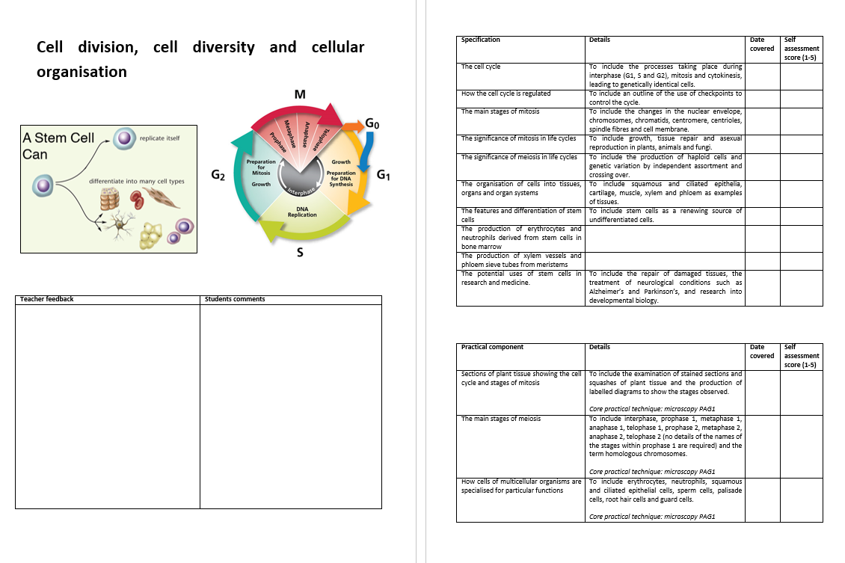

Slide 3
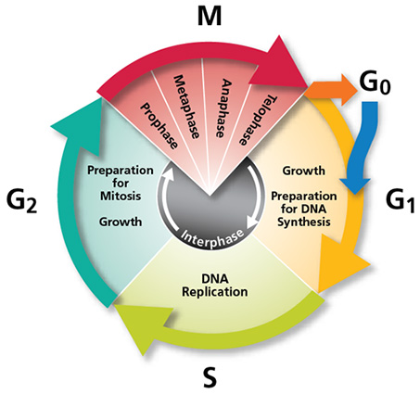

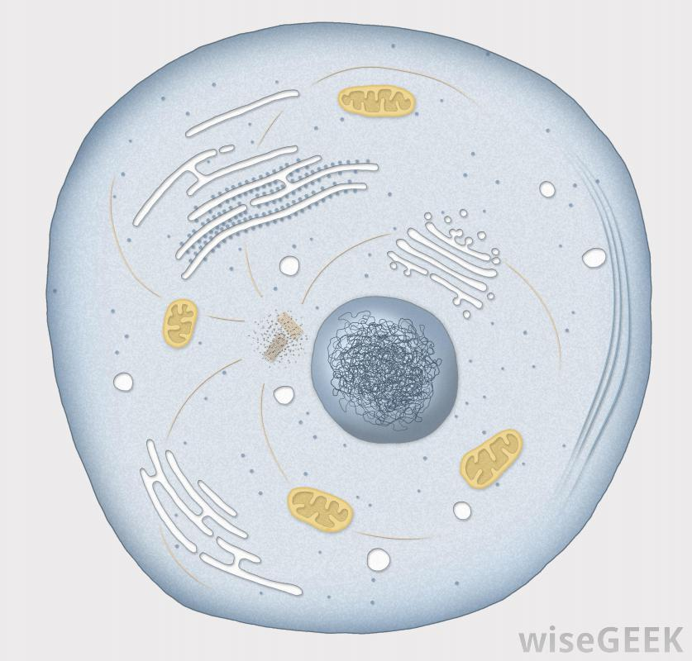
The Cell Cycle
Describe what the cell cycle is and explain why it is necessary.
Describe the stages involved in the cell cycle.
State how the cell cycle is regulated, including an outline of the different checkpoints in use.
Imagine you are a single cell: What happens in your average life?
Search for food, move, eat, grow, produce metabolic waste, excrete, reproduce…
A cells life can be condensed down as follows:
Growth, replication of DNA and organelles
Nuclear division
Cytoplasmic division
https://www.youtube.com/watch?v=lpAa4TWjHQ4
Amoeba sisters 7 minutes watch for consolidation

Slide 4
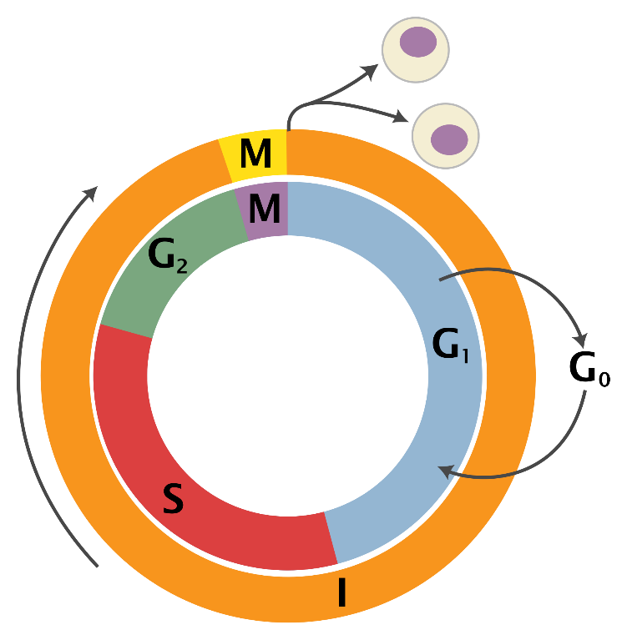
The Cell Cycle
I = interphase: All cell processes not including nuclear and cytoplasmic division (G₁, S, G₂), no cell division.
M = nuclear division and cytoplasmic division (mitosis and cytokinesis).
Interphase
G₁
G₀
S
G₂
Gap 1 phase
Cellular grow and increase in size
Biosynthesis and metabolic reactions
Protein synthesis occurs
Organelles duplicate
Permanent G0 cells:
Differentiated or damaged
Temporary: lymphocytes, memory cells involved in immune response
Gap 0 phase, temporary or permanent
Triggered by restriction point
Stay dormant
Senescent (senescence, cell is carrying out its function and ageing)
Differentiate (differentiation)
Apoptotic (apoptosis)
Synthesis phase (DNA replicates)
Most important genes first, less important/inactive genes second
Fast stage to limit damage to DNA, mutations occurring
Gap 2 phases (cell made ready for mitosis)
- Chemicals stimulate proteins production which cause chromatin condensation and spindle formation (in prophase)

Slide 5
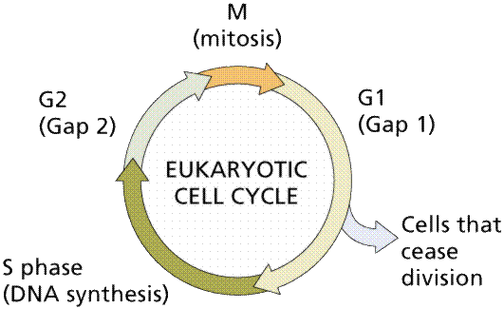
The cell cannot carry on with mitosis unchecked in case there has been replication errors. There are 3 points where this happens, add this to your diagram
CP 3
metaphase/anaphase
CP 2
Cells that don't pass the checkpoints enter the G0 phase
CP 1
The actual length of each stage depends on the organism and cell type

Slide 6
Cell cycle check points
(you don’t need to know the detail)
G1/S check point
  point between G₁ phase and the S phase in which the cell is cleared for progression into the S phase.
  Reasons the cell would not move into the S phase include insufficient cell growth, damaged DNA, or other preparations have not been completed.
  Many sources have linked irregularities in the G₁ phase or the G₁/S checkpoint to uncontrolled growth of tumours.
G2/M check point (DNA damage checkpoint)
  This checkpoint ensures that cells don't initiate mitosis before they have a chance to repair damaged DNA after replication. Cells that have a defective G2-M checkpoint enter mitosis before repairing their DNA, leading to death after cell division (apoptosis)
Spindle check point/metaphase
  Checks that all chromosomes are attached to the spindle and are aligned correctly.
Tumours are formed from a mass of abnormal cells. Suggest how this could occur.
Checkpoint proteins are called cyclins that are regulated by kinases. Overproduction of cyclins leads to disruption of checkpoints and uncontrolled cell division

Slide 7
Questions
1. At what stage of the cycle will:
  mitochondria be replicated
  Synthesis of proteins that lead to chromatin condensation
  DNA replicate
  Programmed cell death occur
  G₁ b. G₂ c. S d. G₀
2. Which is not part of interphase: G₂, G₁, M, S?
  M
3. What are the evolutionary advantages of having these checkpoints in the cell cycle?
  Detect and repair damaged DNA
  Prevent uncontrolled cell division which would lead to a tumour
  Those with the checkpoints are more likely to survive and reproduce
4. What does having a specific sequence mean for the cell cycle and for the DNA replication
  Cycle is non-reversible
  DNA replicated only once per cell cycle

Slide 8
Cell division quick 10
1. Name 3 different stages of the cell cycle
2. What does meiosis produce?
3. Name a cell which does not undergo mitosis.
4. How many daughter cells does mitosis produce?
5. What term describes the first cells formed after fertilisation.
6. How do we describe a cell that has reached the end of its differentiation?
7. How many chromosomes are there in a human daughter cell that has undergone meiosis?
8. What is the term for the complete number of chromosomes?
9. The body may destroy cells that have incorrectly copied DNA, suggest another reason for apoptosis.
10. Why are all gametes genetically different?

