Slide 1
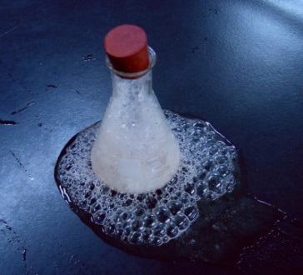
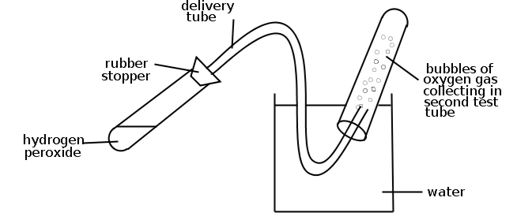
Starter:
Watch the demonstrations of the decomposition of hydrogen peroxide

Slide 2
Enzymes
Tuesday, 22 July 2025
Why are they important?

Slide 3
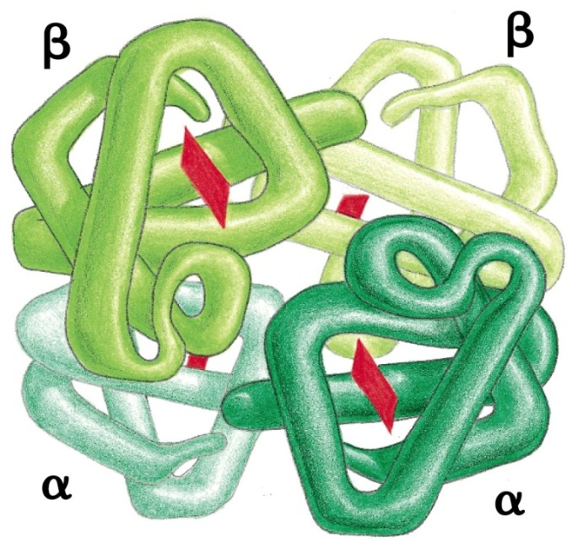
Enzymes
Know that enzyme action may be intracellular or extracellular.
Know that enzymes are globular proteins with a specific tertiary structure, which catalyse metabolic reactions in living organisms.
Describe, with the aid of diagrams, the mechanism of action of enzyme molecules.

Slide 4

Enzymes:
What do you remember from IGCSE?
Complete the first 2 questions on the GCSE enzyme review sheet. Complete for homework.
Let's get something written on the board

Slide 5
Enzymes are biological catalysts
Speeds up chemical reaction without being consumed themselves.
Enzymes
Catalyse chemical reactions
Proteins
Active site, lock and key mechanism
Affected by temperature, pH, concentration and surface area
Enzymes can be denatured
carbohydrase, lipase, protease, amylase
Lower the activation energy of reactions by providing an alternative pathway for a reaction

Slide 6
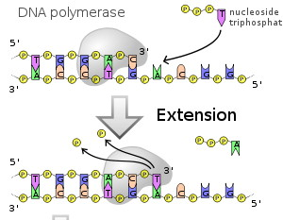
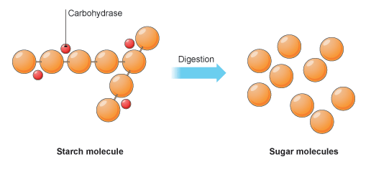
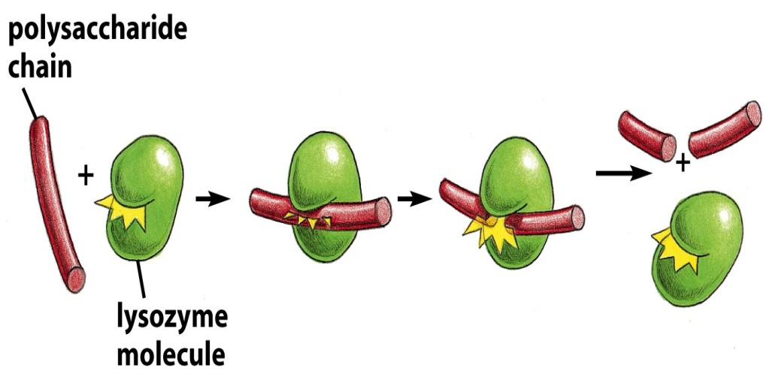
Uses of enzymes
Catalyse the metabolic reactions in your body (digestion and respiration).
e.g. amylase, lactase, DNAse, lipase, protease
Catalyse the building of useful molecules in the body.
e.g. DNA polymerase, RNA polymerase

Slide 7
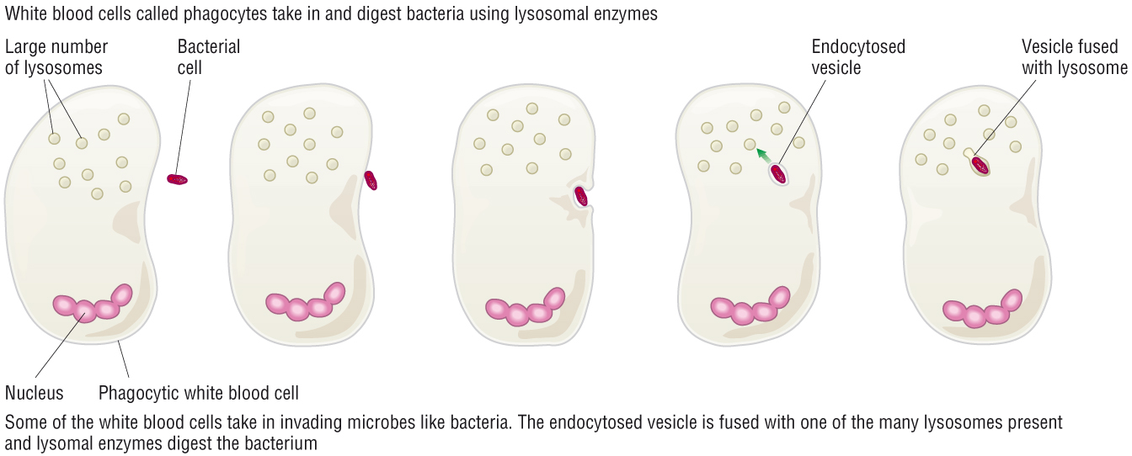
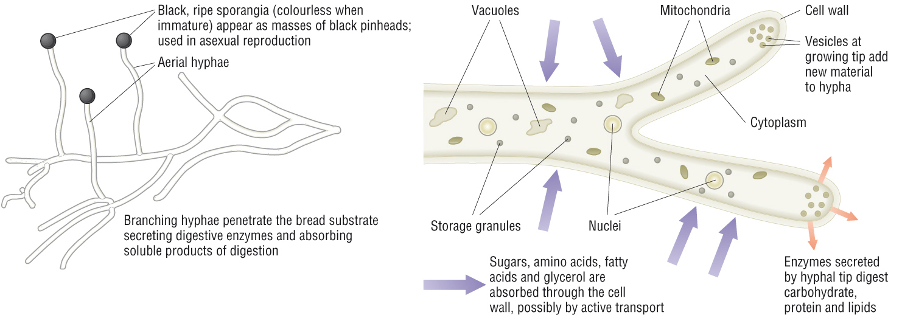
Intracellular and extracellular enzymes – can you name any examples?

Slide 8
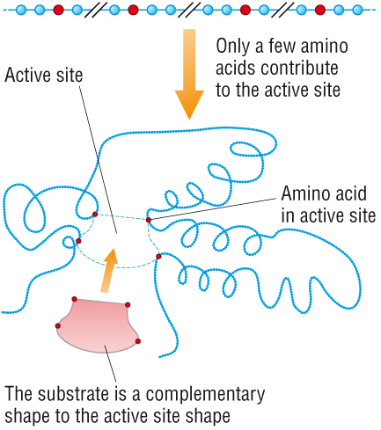
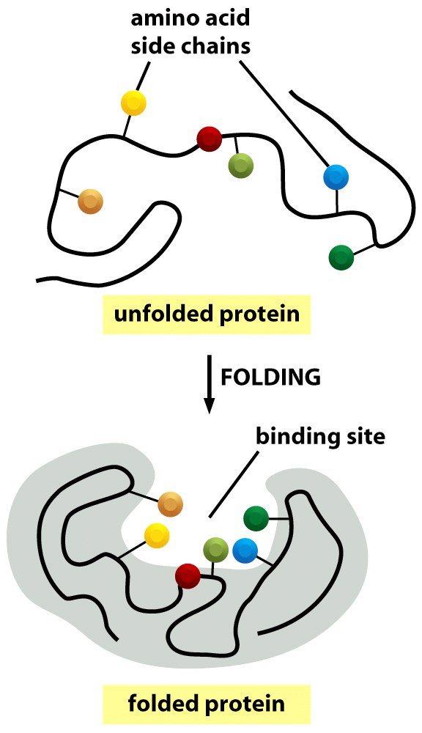
Enzyme structure explained
Enzymes are globular proteins, with an active site determined by the enzymes tertiary structure.
Why are enzymes specific to certain substrates?
Revision:
Explain the folding of the tertiary structure
Name the bonds involved

Slide 9
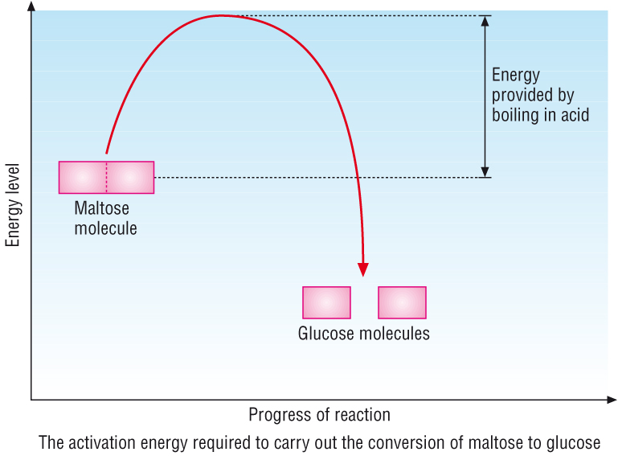
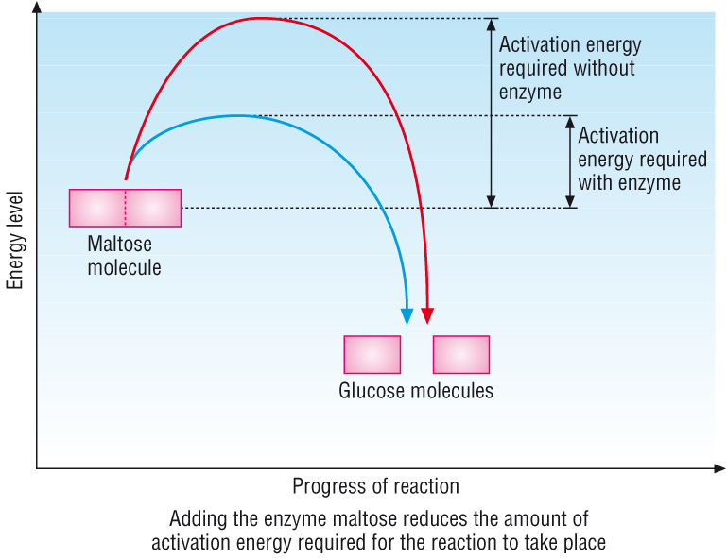
How enzymes speed up reactions.
Activation energy is needed before a reaction can begin.
Enzymes reduce the activation energy needed for a reaction to take place.
This increases the rate of reaction.
How do you think an enzyme does this?

Slide 10
How enzymes speed up reactions.
Substrates held close together in the active site, reducing repulsion between the molecules and helping them to bond together.
Fitting the substrates into the active site puts a strain on the configuration, making it easier for specific bonds to break.
Enzyme-substrate complex is lower in energy.
A* - how could the active site achieve this?
The enzyme forms bonds with the substrates and holds them closely together. The arrangement of atoms in the active site provides binding specificity.
What factors can you think of which affect enzyme activity? Why is this?

Slide 11
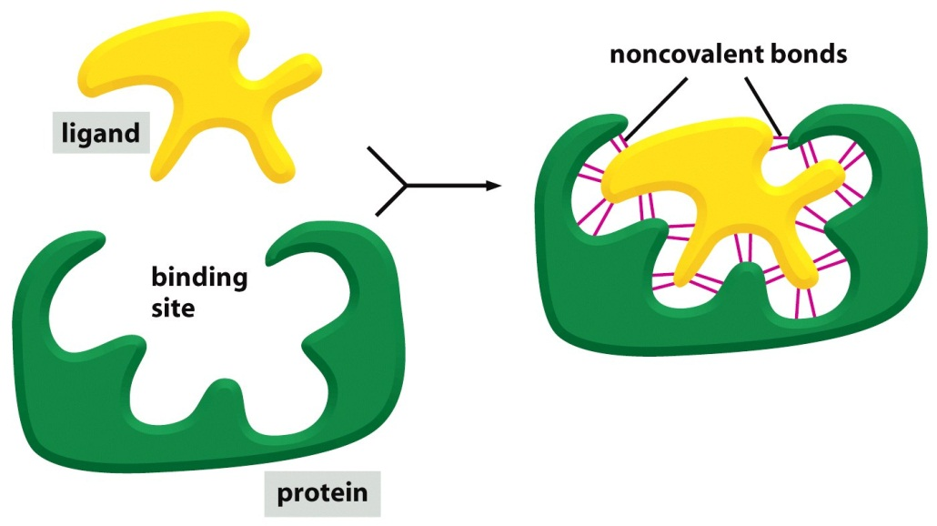
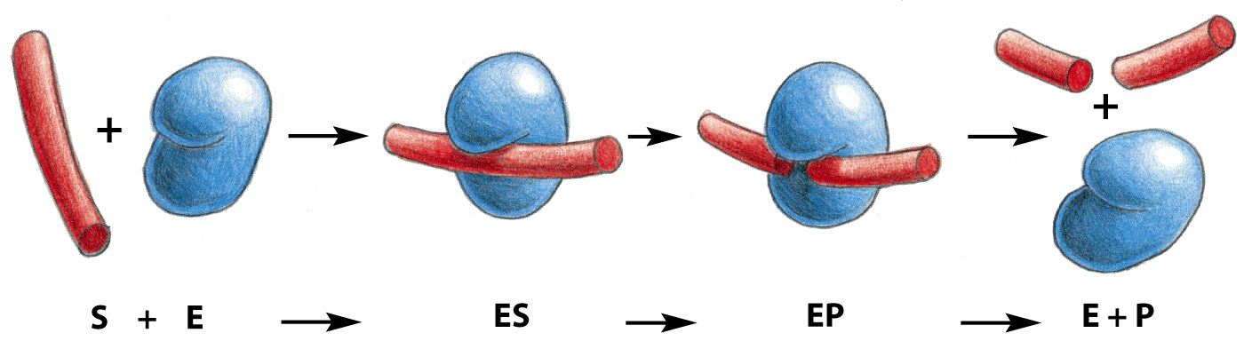
Enzyme structure explained
A ligand is any molecule that irreversibly binds to a protein receiver
A specific substrate can bind to the active site.
The substrate must have a complementary shape for it to bind.
If the substrate does not have a complementary shape to the active site, the reaction won’t be catalysed.
active
site
H bonds
Ionic
Hydrophilic
hydrophobic
Using the information on the slide, explain, using all key terms, what is happening in this diagram.
enzyme-substrate
complex
enzyme-product
complex

Slide 12
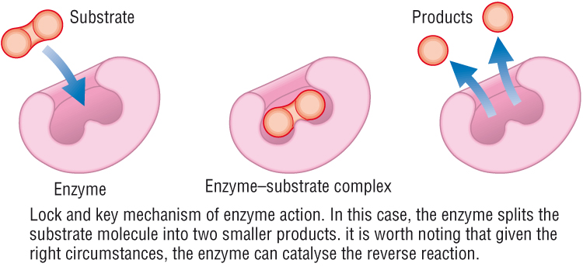
Models of how enzymes work
Lock and key model: Substrate fits into the active site of the enzyme only if it has a complementary shape.
However, this is not the full story. New evidence suggested that the substrate changes the shape upon binding to hold it more tightly bound.

Slide 13
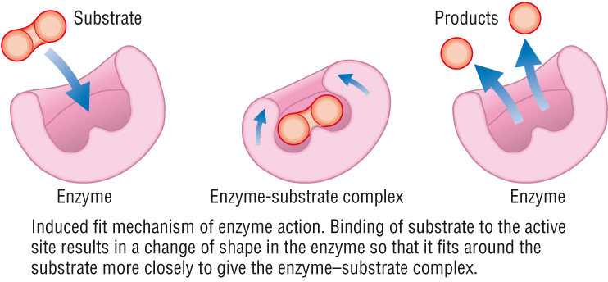
Models of how enzymes work
Induced fit model: explains why enzyme are so specific for only one substrate.
Substrate binds the active site of the enzyme in a complementary way (as before).
This causes a change in shape of the active site, ‘activating it’ to catalyse the reaction.
Think rubber glove here!

Slide 14
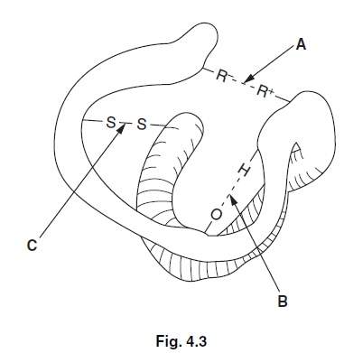
1. Explain the term biological catalyst.
2. Complete the passage below using the most appropriate terms
Enzymes are _____________________ proteins and are therefore soluble. They alter the rate of metabolic reactions and are described as biological _________. Some enzymes, such as those found in cytoplasm, are described as _______________enzymes. Other enzymes, such as those that digest food in the small intestine, are known as _________________ enzymes. Some medicinal drugs reduce enzyme activity. These are called enzyme _________________
3. Enzymes are globular proteins with a specific three-dimensional shape. The shape is determined by the primary structure. State the meaning of the term primary structure.
4. Fig. 4.3 shows some of the chemical bonds that hold the tertiary structure of a protein together. Name the bonds labelled A, B and C.
.

Slide 15
