Slide 1

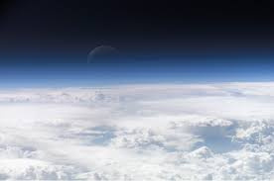
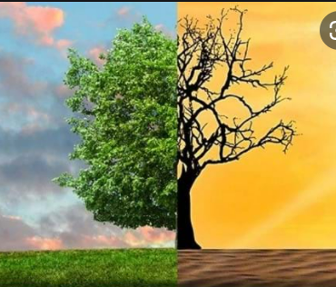
Diurnal energy budgets
LO: To explain the factors that affect the global energy budget.
STARTER
  What is the ‘atmosphere’?
  What are ‘weather’ and ‘climate’ and how are they different?
  What is an ‘energy budget’
  You have 5 minutes to familiarize yourself with these important terms.

Slide 2
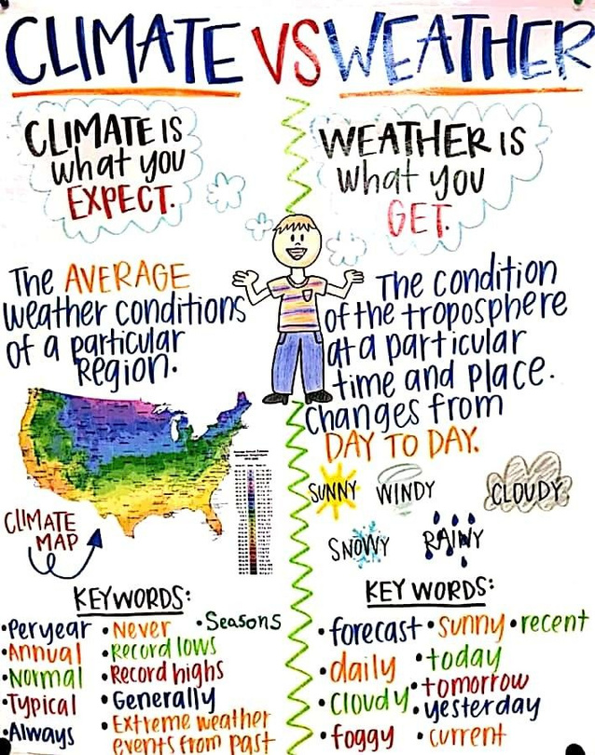
Weather and Climate
  Before we start this topic it is important you understand the difference between weather and climate.
Weather refers to short term atmospheric conditions while climate is the weather of a specific region averaged over a long period of time. Climate change refers to long-term changes.
https://www.youtube.com/watch?v=ePL-uOg9hSU

Slide 3
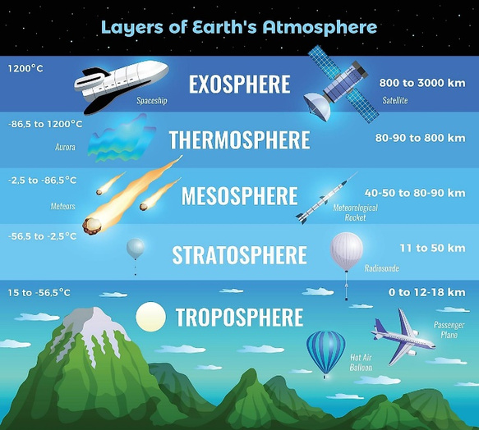

What is Atmosphere?
In the standard atmosphere model, the temperature at sea level at the bottom of the troposphere is 15° C. Of course, the atmosphere is always changing and is never "standard". Temperatures in the troposphere, both at the surface and at various altitudes, do vary based on latitude, season, time of day or night, regional weather conditions etc.
  The atmosphere is a layer of transparent gases surrounding the Earth.
  The gases stretch 500-1000km above the earths surface.
  There are several layers of the atmosphere.
  The area between the layers is called a pause.
  Weather occurs only in the lowest part of the atmosphere known as the troposphere – why?
  Nearly all atmospheric water vapor or moisture is found in the troposphere, so it is the layer where most of Earth's weather takes place. Additionally, heating has an important function in Earth’s weather phenomena and much of Earth’s temperature variations are within the troposphere – why?
Important video!!

Slide 4
What is the troposphere?
Study one of the two resources on this slide to learn about the troposphere. This is important as it will provide you with a good foundation for the rest of the unit.
Resource 1 – Higher level:
2.1.1 The Troposphere
The troposphere is the lowest layer of atmosphere of the Earth and the layer to which changes can greatly influence the floral and faunal environments. Atmosphere of the Earth: it extends from Earth's surface to an average height of approximately 12 km although this altitude actually varies from approximately 30,000 ft at the polar regions to 56,000 ft at the equator, with some variation due to weather. The troposphere is bounded above by the tropopause, a boundary marked in most places by a temperature inversion (i.e., a layer of relatively warm air above a colder one), and in others by a zone which is isothermal with height.
Although variations do occur, the temperature usually declines with increasing altitude in the troposphere because the troposphere is mostly heated through energy transfer from the surface. Thus, the lowest part of the troposphere (i.e., Earth's surface) is typically the warmest section of the troposphere, which promotes vertical mixing. The troposphere contains approximately 80% of the mass of the atmosphere of the Earth. The troposphere is denser than all its overlying atmospheric layers because a larger atmospheric weight sits on top of the troposphere and causes it to be most severely compressed. Fifty percent of the total mass of the atmosphere is located in the lower 18,000 ft of the troposphere.
Nearly all atmospheric water vapor or moisture is found in the troposphere, so it is the layer where most of Earth's weather takes place. It has basically all the weather-associated cloud genus types generated by active wind circulation although very tall cumulonimbus thunder clouds can penetrate the tropopause from below and rise into the lower part of the stratosphere. Most conventional aviation activity takes place in the troposphere, and it is the only layer that can be accessed by propeller-driven aircraft.
In addition, the atmosphere is generally described in terms of layers characterized by specific vertical temperature gradients. The troposphere is characterized by a decrease of the mean temperature with increasing altitude. This layer, which contains approximately 85–90% (v/v) of the atmospheric mass, is often dynamically unstable with rapid vertical exchanges of energy and mass being associated with convective activity. Globally, the time constant for vertical exchanges is of the order of several weeks. Much of the variability observed in the atmosphere occurs within this layer, including the weather patterns associated, for example, with the passage of fronts or the formation of thunderstorms. The planetary boundary layer is the region of the troposphere where surface effects are important, and the depth is on the order of 3300ft but varies significantly with the time of day and with meteorological conditions. The exchange of chemical compounds between the surface and the free troposphere is directly dependent on the stability of the boundary layer.
Resource 2 – https://web.physics.ucsb.edu/~lgrace/chem123/troposphere.htm
What is a temperature inversion?
a reversal of the normal decrease of air temperature with altitude, or of water temperature with depth. So, an example of inversion is when cold air is found underneath warm air, common in valleys or basins where cold air sinks.

Slide 5
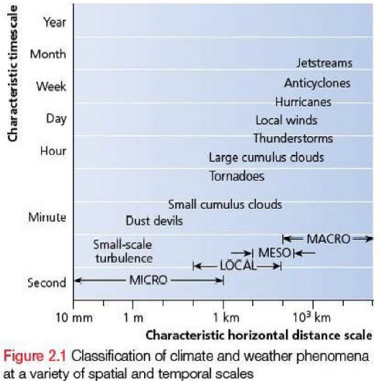
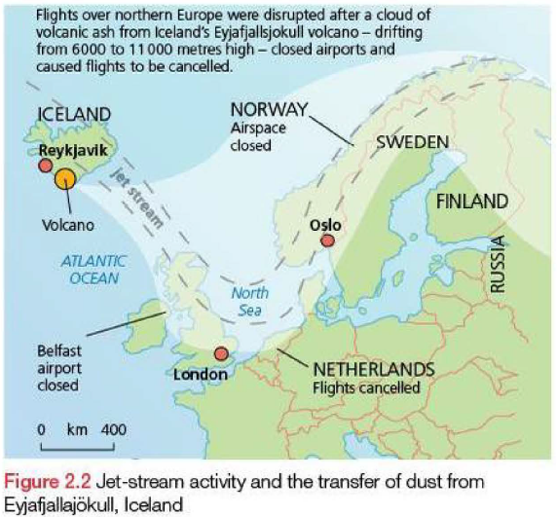
Classification of climate & weather phenomena at a variety of spatial and temporal scales.
Weather phenomena vary from…
  … a small-scale turbulence and eddying (e.g. dust devils) that cover a small area and last for a very short time..
  … to large-scale anticyclones (high pressure zones) and jet streams that affect a large area and may last for weeks.
  The jet stream that carried volcanic dust from the eruption of the Eyjafjallajokull volcano in Iceland to northern Europe in 2010 is a good example of jet-stream activity.
  These different scales should not be considered as separate scales, but a hierarchy of scales in which smaller phenomena may exist within larger ones.
  For example, the temperature surrounding a building will be affected by the nature of the building and the processes that are taking place within the building. However, it will also be affected by wider weather conditions (wind, precipitation, temperature, humidity, cloud cover), which are affected by latitude, altitude, cloud cover and season, for example.

Slide 6
Some Key Terms: What do you think each of these mean? Think, Pair, Share, Research
  Global energy budget
  Earth’s energy budget describes the balance between the radiant energy that reaches Earth from the sun and the energy that flows from Earth back out to space.
  Diurnal energy budget
  The individual energy budget for a specific place on a daily basis.
  Reflection
  The throwing back of light or heat by a body or surface without absorbing it.
  Albedo
  The proportion of the incident light or radiation that is reflected by a surface, typically a planet or moon.
  Difference between ‘reflection’ and ‘albedo’?
  The concepts are very similar, there are important differences. Check out this link to learn more!
  Sensible heat transfer (conduction, convection & radiation)
  When two substances with different temperatures are brought into contact with each other, the substance with the higher temperature transfers heat to the substance with the lower temperature in a process called "sensible heat transfer." For example, when the sun sets, the air gets colder and becomes cooler than the ground (land retains more heat). The ground transfers some of its heat to the air causing the ground to get colder and the air to get warmer.
  Latent heat transfer (evaporation and condensation)
  At the point where one of the substances is ready to change state or phases (solid to liquid, liquid to gas, etc.), heat is transferred from one substance without a corresponding temperature shift in the other substance. This process of giving off or absorbing heat without changing temperature is known as "latent heat transfer."
  Conduction, convection & radiation
  Conduction: The transfer of heat by direct contact of matter due to the temperature gradient (differences in temperature). Common in solids.
  Convection: The transfer of heat by movement of molecules from a hot temperature to a cold temperature. Common in liquids & gases.
  Radiation: Radiation is energy that comes from a source and travels through space at the speed of light. This energy has an electric field and a magnetic field associated with it, and has wave-like properties. You could also call radiation “electromagnetic waves”.
  Short wave radiation
  Shortwave radiation is a radiant energy produced by the sun with wavelengths ranging from infrared through visible to ultraviolet. Shortwave radiation is therefore exclusively associated with daylight hours for a particular location on the Earth's surface. Hot bodies such as the sun produce shortwave radiation.
  Long wave radiation
  Longwave radiation represents the electromagnetic energy that is radiated outward by the earth. Heat resulting from the absorption of incoming shortwave radiation is emitted as longwave radiation. Cold bodies such as the earth produce longwave radiation which is easily absorbed by greenhouse gases and clouds.
These terms will be used a lot in this unit, so it’s important you are confident in your understanding of them and your ability to use them.

Slide 7
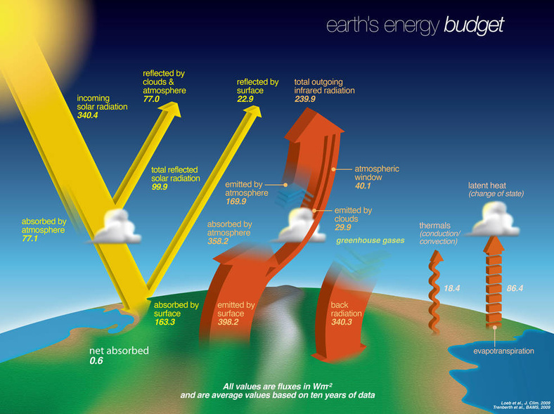
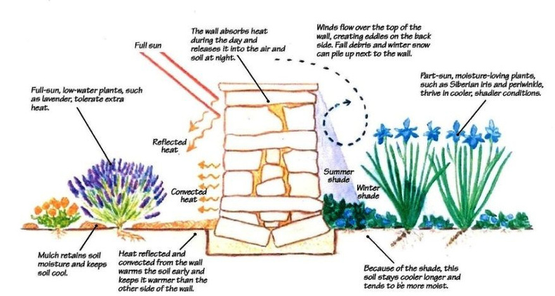
Energy budgets
  An energy budget refers to the amount of energy entering a system, the amount leaving a system and the transfer of energy within the system.
  Earth’s climate is determined by these energy flows.
  Energy budgets are commonly considered at a global scale (marco-scale) and a local scale (micro-scale).
  The term ‘microclimate’ is sometimes used to describe regional climates, such as those associated with large urban areas, coastal areas and mountainous regions.

Slide 8
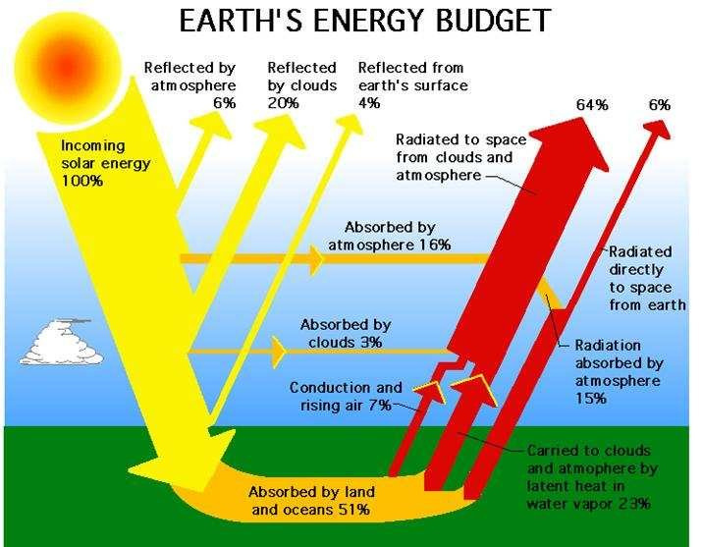

Slide 9
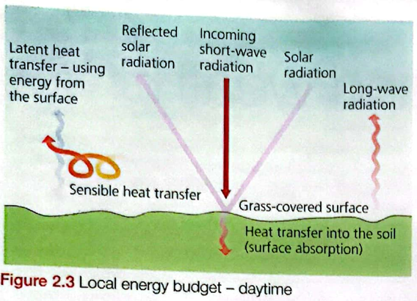
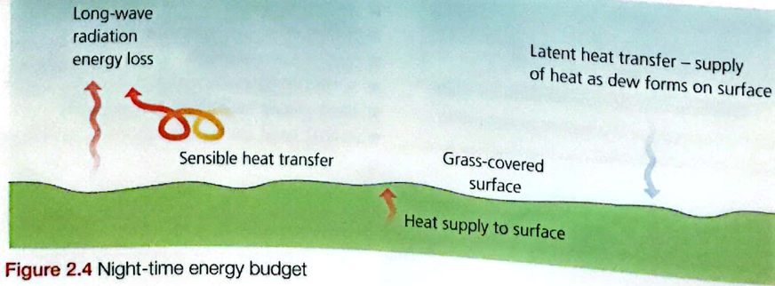
Diurnal energy budgets
  ‘Diurnal’ means ‘daily’ – we need to consider that a location’s energy budget will vary from day to night.
  What do you think are the components to Earth’s daytime energy budget?
  What do you think are the components to Earth’s night-time energy budget?
  What components are the same?
  What components are different?

Slide 10
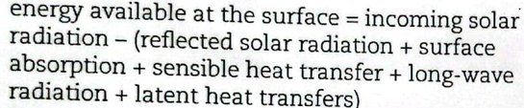
Diurnal energy budgets
There are 6 components to the daytime energy budget:
  Incoming (shortwave) solar radiation (insolation).
  Reflected solar radiation.
  Surface absorption.
  Sensible heat transfer.
  Long-wave radiation.
  Latent heat (evaporation and condensation).
  These components influence the gain or loss of energy for a point at the Earth’s surface. The daytime budget assumes a horizontal surface with grass-covered soil and can be expressed by the formula on the right.
  How might the components of the night-time energy budget be different?
There are 4 components of the night-time energy budget.
  Long-wave Earth radiation.
  Latent heat transfer (condensation).
  Absorbed energy returned to Earth (sub-surface supply).
  Sensible heat transfer.
Slides 11-16 look at each of these components in more detail. Study them to ensure you understand each of them and can answer exam questions on them. Ensure you are taking notes to support your learning – mind-map, PPT etc.

Slide 11
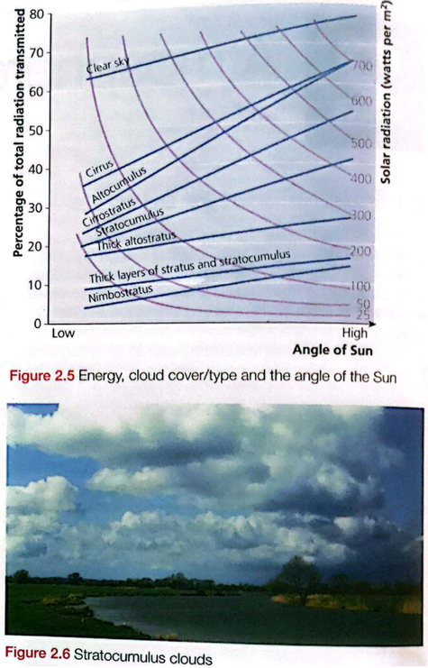
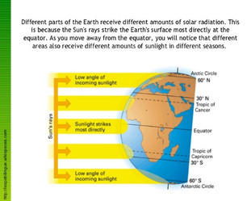
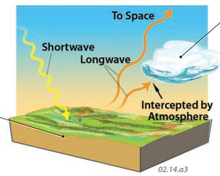
Global Energy Budget Components: Shortwave solar radiation
  Incoming solar radiation (insolation) is the main energy input & is affected by latitude, season (time of year) and cloud cover.
  Fig. 2.5 shows how the amount of insolation received varies with the angle of the sun and with cloud type.
  For example: With stratocumulus clouds & a low angle of sun, about 23% of the total radiation transmitted by the sun is received at the Earth’s surface – about 250 watts per m2. The rest is absorbed/reflected by the clouds. When the sun is high in the sky (high angle), about 40% is received, just over 450 watts per m2.
  The less cloud cover there is, and/or the higher the cloud, the more radiation reaches the Earth’s surface.
  Angle of sun will vary throughout the day, and with latitude.
  The sun’s rays are more concentrated at the Equator, so these areas receive more insolation.

Slide 12
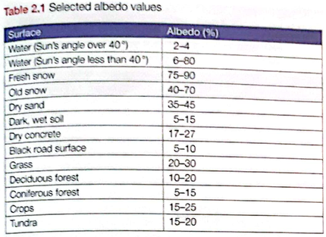
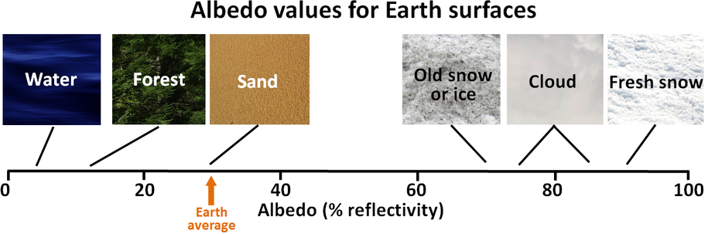
Global Energy Budget Components: Reflected solar radiation
  The proportion of energy that is reflected back to the atmosphere from Earth is known is the albedo.
  The albedo varies with colour – light materials are more reflective than dark materials.
  Grass has an average albedo of 20-30%, meaning it reflects 20-30% of the energy it receives.
  Albedo can be expressed as a %, or on a scale from 0-1 (0, corresponding to a black body that absorbs all incident radiation, to 1, corresponding to a body that reflects all incident radiation).
What is arctic amplification
Arctic warming 2 or 3 times as fast as other areas on Earth. Ice melting = turns to water. Water has much higher albedo than ice = increased Arctic warming. Positive feedback loop!
https://www.youtube.com/watch?v=xZLX59FXr5w

Slide 13
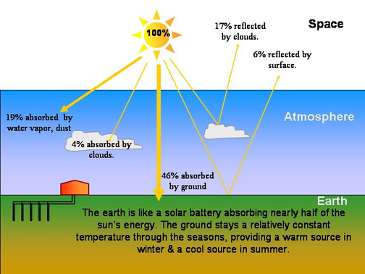
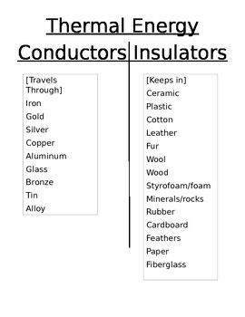
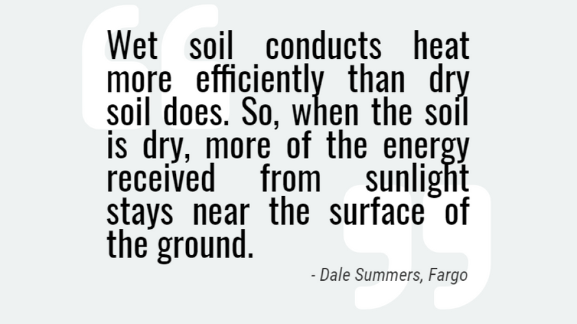
Global Energy Budget Components: Surface absorption & sub-surface supply
  Energy that reaches the Earth’s surface has the potential to heat it – much depends on the nature of the surface.
  E.G. If the surface can conduct heat to lower layers, the surface will remain cool. If the energy is concentrated at the surface, the surface warms up.
  Metals and some minerals are considered good conductors since they can speedily transfer heat, whereas materials like wood, paper, air, and cloth are poor conductors of heat.
  Gravel, soil and rock do conductive and radiative fairly well, but not convective.
  Water is a poor conductor of heat (i.e. it doesn’t easily allow heat energy to pass through it. Water is actually considered to be an insulator of heat i.e. it keeps energy).

Slide 14
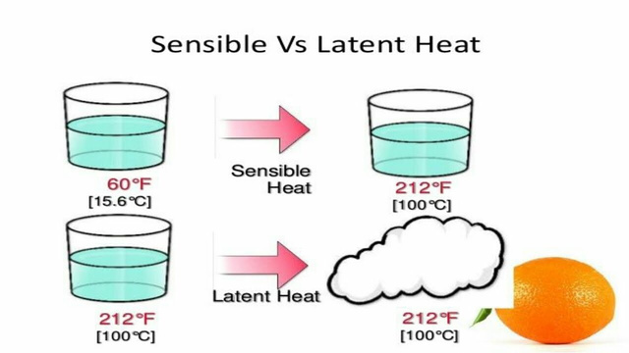
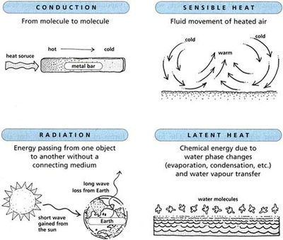
Global Energy Budget Components: Sensible heat transfer
  Sensible heat – We can ‘sense’ because of temperature difference e.g. touching a block of ice.
  When two substances with different temperatures are brought into contact with each other, the substance with the higher temperature transfers heat to the substance with the lower temperature in a process called "sensible heat transfer."
  For example, when the sun sets, the air gets colder (due to reduced solar radiation) and becomes cooler than the ground (the ground has better heat retention). The ground transfers some of its heat to the air causing the ground to get colder and the air to get warmer.
  Air parcels are also affected by sensible heat transfer – e.g. air that is warmed by the surface may begin to rise (convection) and be replaced by cooler air. This is known as convective transfer, and is very common in warm areas in the early afternoon.
  Sensible heat transfer is also part of the night-time energy budget – cold air moving into an area may reduce temperatures, whereas warm air may supply energy and raise temperatures.
This is an excellent video - Latent heat v Sensible heat

Slide 15
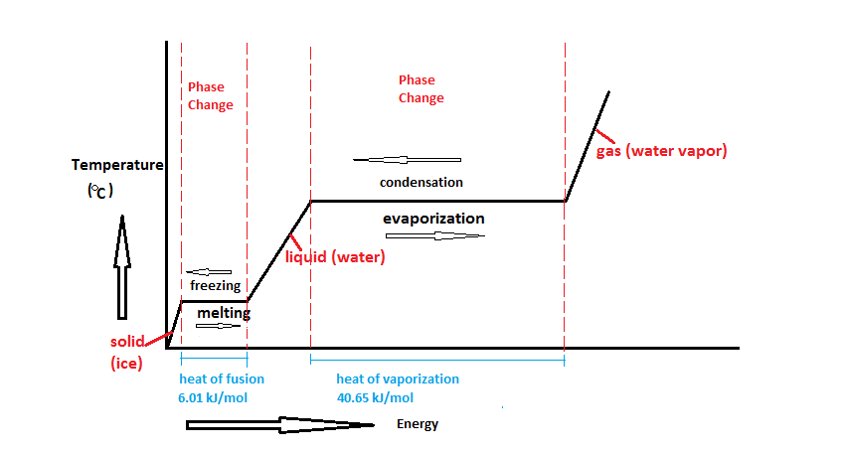
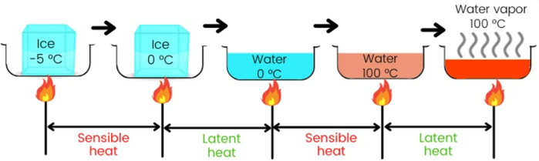
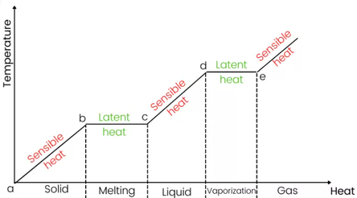
Global Energy Budget Components: Latent heat transfer
  Latent heat is energy absorbed or released by a substance during a change in its physical state (phase) that occurs without changing its temperature.
  Occurs at the point where a substance is ready to change state or phases (solid to liquid, liquid to gas, etc.), as with evaporation or condensation. Heat is transferred from one substance without a corresponding temperature shift in the other substance.
  This process of giving off or absorbing heat without changing temperature is known as "latent heat transfer.“
  There is no temperature change because the heat energy is either used up, or released, to enable the phase change.
  What does this have to do with global energy budget?
  Energy (in the form of heat), is being transferred within the system!
  In evaporation, liquid water is turned to water vapour. This uses up latent heat energy.
  In condensation, water vapour becomes a liquid. This releases latent heat.
  So, when water is present at a surface, a proportion of the energy available will be used to evaporate it, meaning less energy will be available to raise local energy levels & temperature. This occurs during the day time and night-time, but is the process is much more effective during the day, because of shortwave solar radiation. Some evaporation may occur at night, especially when there is a local source of heat.
  During the night, water vapour in the air close to the surface can condense to form water, since the air has been cooled by the cold surface. When water condenses, latent heat is released. This affects the cooling process at the surface.
What is dew?
Dew is tiny drops of water that form on cool surfaces at night, when atmospheric water vapour condenses. The air is saturated, generally because the temperature of the surface has dropped enough to cause condensation (cold air can ‘hold’ less water vapour than warm air – explains why humidity is generally higher in summer). Thus, the water vapour, through the process of condensation, becomes liquid water.
The dew point is the temperature the air needs to be cooled to (at constant pressure) in order to achieve a relative humidity (RH) of 100%. At this point the air cannot ‘hold’ more water in the gas form. If the air were to be cooled even more, water vapor would have to come out of the atmosphere in the liquid form, usually as fog or precipitation.
Condensation happens one of two ways: Either the air is cooled to its dew point or it becomes so saturated with water vapor that it cannot hold any more water.

Slide 16
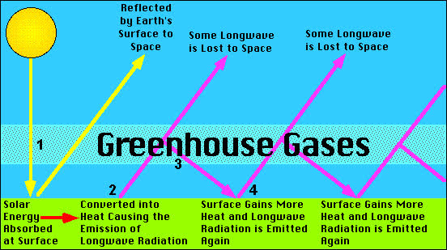
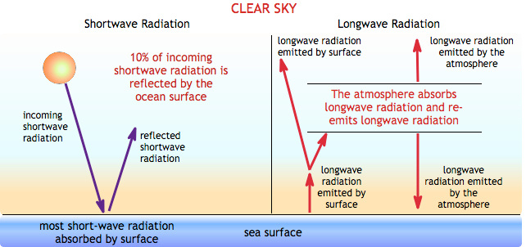
Global Energy Budget Components: Long-wave radiation
  Long-wave radiation refers to the radiation of energy from the Earth (a cold body) into the atmosphere and, for some of it, into space.
  Some long-wave radiation is re-emitted back to Earth by the atmosphere.
  The difference between the two flows is known is the net long-wave radiation balance.
  During the day, the outgoing long-wave radiation transfer is greater than the incoming long-wave radiation transfer, so there is a net loss of energy from the surface.
  Cloudless night = large loss of long-wave radiation from Earth. Because there is very little return of long-wave radiation from the atmosphere. Hence there is a net loss of energy from the surface.
  Cloudy nights = Some long-wave radiation is returned to the surface = overall loss of energy is reduced.
  In hot deserts on cloudless nights, energy loss is maximised & there is large diurnal temperature difference.
  In contrast, energy loss is less noticeable in cloudy areas and the change in day-time and night-time temperature is reduced.

Slide 17
What is the role of clouds in local energy budgets?
  Clouds are reflectors, scatterers and absorbers of heat/light.
  Cloud cover can affect refection and absorption of shortwave radiation and longwave radiation depending on (what are the factors/cloud characteristics which affect the amount/rate of reflection/absorption?):
  • thickness of clouds
  • density of clouds
  • type of cloud
  • altitude of cloud
  • presence or absence of clouds
  • composition of the particles within clouds
  Study the following examples…..
  Clouds play a fundamental role in maintaining the Earth's energy balance, or "radiation budget," the amount of radiation that enters and leaves the Earth. Through a process known as "shortwave cooling," clouds reflect some of the sun's radiation back into space, which has a net cooling effect on the Earth's surface-atmosphere system. At the same time, clouds help contain the radiation that would otherwise be emitted to space, through "longwave warming," which has a net warming effect on the climate system.
  Low, thick stratocumulus clouds primarily reflect solar radiation and cool the surface of the Earth. High, thin cirrus clouds primarily transmit incoming solar radiation; at the same time, they trap some of the outgoing infrared radiation emitted by the Earth and radiate it back downward, thereby warming the surface of the Earth. Whether a given cloud will heat or cool the surface depends on several factors, including the cloud's altitude, its size, and the make-up of the particles that form the cloud. The balance between the cooling and warming actions of clouds is very close although, overall, averaging the effects of all the clouds around the globe, cooling predominates.
  Clouds have an important effect on albedo too. They have a high albedo (generally higher than the surface beneath it) and reflect a large amount of solar energy (shortwave radiation) out to space than the surface would in the absence of the cloud, thus leaving less solar energy available to heat the surface and atmosphere. Hence, this "cloud albedo forcing," taken by itself, tends to cause a cooling or "negative forcing" of the Earth's climate. . Different types of clouds reflect different amounts of solar energy. If there were no clouds, Earth’s average albedo would drop by half.
  When a cloud absorbs longwave radiation emitted by the Earth's surface, the cloud reemits a portion of the energy to outer space and a portion back toward the surface. The intensity of the emission from a cloud varies and depends upon several other factors, such as the cloud's thickness and the makeup of the particles that form the cloud.

Slide 18
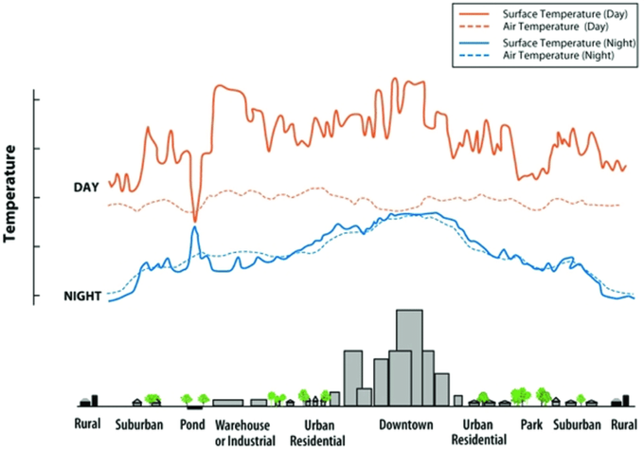
Temperature changes close to the surface
  Ground surface temperatures can vary considerably diurnally.
  During the day, the ground heats the air by radiation, conduction & convection.
  The ground radiates energy and as the air receives more radiation than it emits, the air is warmed.
  Air close to the ground is warmed through conduction. Air movement at the surface is slower due to friction with the surface, so there is more time for it to be heated.
  The combined effect of radiation and conduction is that the air becomes warmer, and rises as a result of convection.
  At night, the ground is cooled as a result of radiation. Air close to the surface now emits more radiation than it receives. Heat is transferred from the air to the ground.

Slide 19
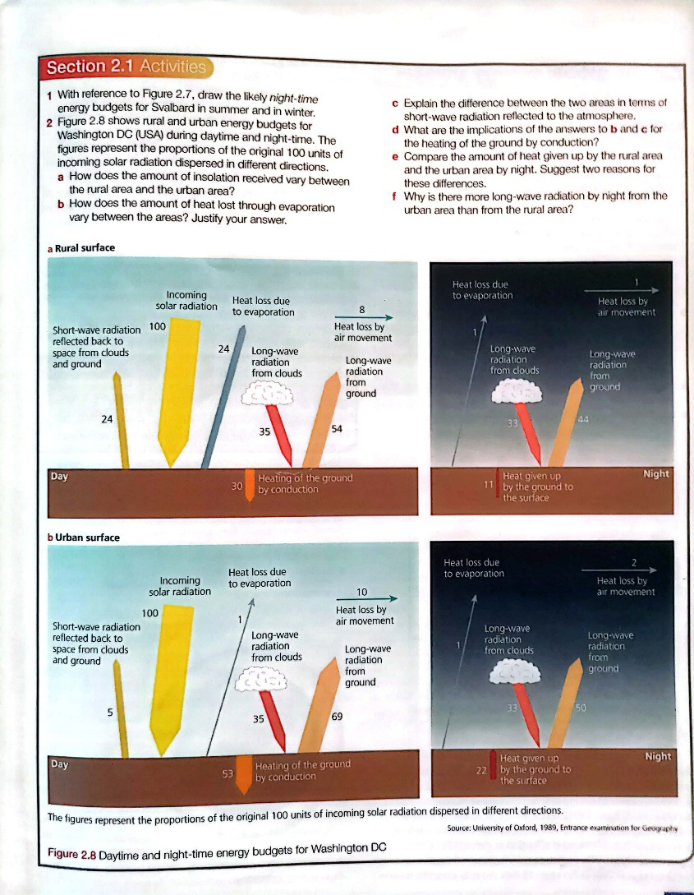

Slide 20
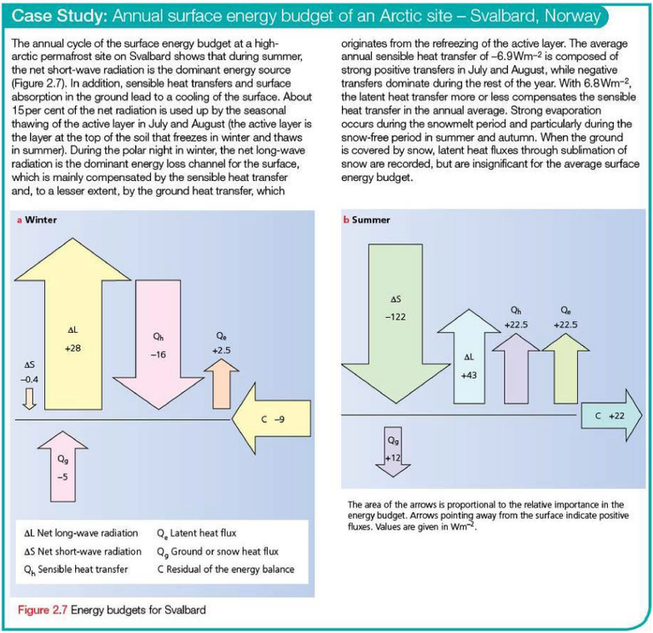
Case Study: Annual surface energy budget of an Arctic site – Svalbard, Norway
Can you describe and explain the following:
  The surface energy budget of Svalbard in summer.
  The surface energy budget of Svalbard in winter.
  Can you compare the differences between summer & winter and account for them (explain why the differences exist)?
(c) With the aid of examples, assess the extent to which albedo is the most important factor in determining the diurnal energy budget. [15]

Slide 21
5(c) With the aid of examples, assess the extent to which albedo is the most important factor in determining the diurnal energy budget.
Candidates are free to develop their own approach to the question and responses will vary depending on the approach chosen. Whichever route is chosen, essays which discuss the extent to which albedo is the most important factor and support their argument with relevant examples will be credited. There may be detailed consideration of one or more examples, or a broadly conceived response, drawing on several examples to illustrate the factors involved.
The emphasis should be on the energy budget thus the main components of the diurnal energy budget (incoming solar radiation, outgoing radiation, reflected solar radiation, absorption, sensible heat transfer, latent heat transfer) could be discussed. Albedo will have an effect on all except incoming solar radiation. Daytime and night time need to be considered.
However, it is not just the albedo which has a significant influence on the diurnal energy budget. Candidates may mention pollution and cloud cover, which also helps to alter the diurnal energy budget. Or a variety of other factors in the diurnal energy budget – Diagrams of the energy budget can be credited where they help to illustrate their answer.
Award marks based on the quality of the response using the marking levels below.
Level 4 (12–15) Response thoroughly discusses the extent that albedo is the most important factor in determining the diurnal energy budget, with clear assessment of other factors. Response has good contextual understanding of the concepts and the energy budget. Candidates consider the significance of the albedo in determining the diurnal energy budget, and are able to draw examples from different surface materials. Response is well founded in detailed knowledge and strong conceptual understanding of the topic.
Level 3 (8–11) Response discusses the extent that albedo is the most important factor in determining the diurnal energy budget, with some assessment of other factors but may be unbalanced. Examples may lack detail or development. Response develops on a largely secure base of knowledge and understanding.
Level 2 (4–7) Response shows general knowledge and understanding of the extent that different albedo levels affect the diurnal energy budget. Response is mainly descriptive or explanatory with limited use of examples and understanding of the topic may be partial or inaccurate. Some concluding remarks. General responses without the use of example(s) will not get above the middle of Level 2 (6 marks).
Level 1 (1–3) Response may broadly discuss the albedo and diurnal energy budget but does not address the question and does not come to a convincing conclusion. Response is descriptive, knowledge is basic and understanding is poor.
Level 0 (0) No creditable response. 15
Notes:
9696_s19_qp_11
21

Slide 22
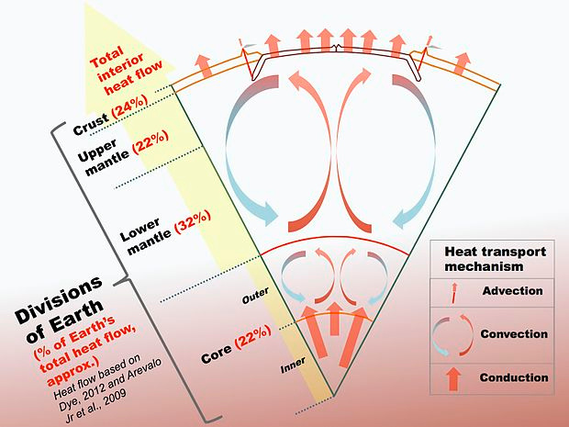

Slide 23
Atmosphere and weather
5 (a) (i) Define the terms latent heat transfer and albedo. [4]
(b) Explain the diurnal energy budget. [8]
5(a)(i) Define the terms latent heat transfer and albedo.
Latent heat transfer: the heat transferred without a change of temperature (1) following a change of state, such as gas to a liquid or liquid to gas (1).
Albedo: the percentage or equivalent of solar radiation (1) that is reflected back into space from a surface (1). 4
5(b) Explain the diurnal energy budget.
The diurnal budget includes both daytime and night time budgets. Description and explanation will be in terms of incoming short wave radiation, radiation absorption, latent heat transfer, sensible heat transfer and outgoing longwave radiation. The first two components will be missing at night time.
Award marks based on the quality of explanation and breadth of the response using the marking levels below.
Level 3 (6–8) Response clearly describes and explains the diurnal energy budget. Any diagram used will be accurate and detailed. Response is well founded in detailed knowledge and strong conceptual understanding of the topic. Any examples used are appropriate and integrated effectively into the response.
Level 2 (3–5) Response describes and explains the diurnal energy budget but is unbalanced. Any diagrams used will cover the main elements but may lack detail. Response develops on a largely secure base of knowledge and understanding. Examples may lack detail or development.
Level 1 (1–2) Response contains some understanding of the diurnal energy budget but is unbalanced. Any diagrams used will be rudimentary or inaccurate. Knowledge is basic and understanding may be inaccurate. Examples are in name only or lacking entirely.
Level 0 (0) No creditable response. 8
Notes:
9696_w20_qp_12
23

