Slide 1
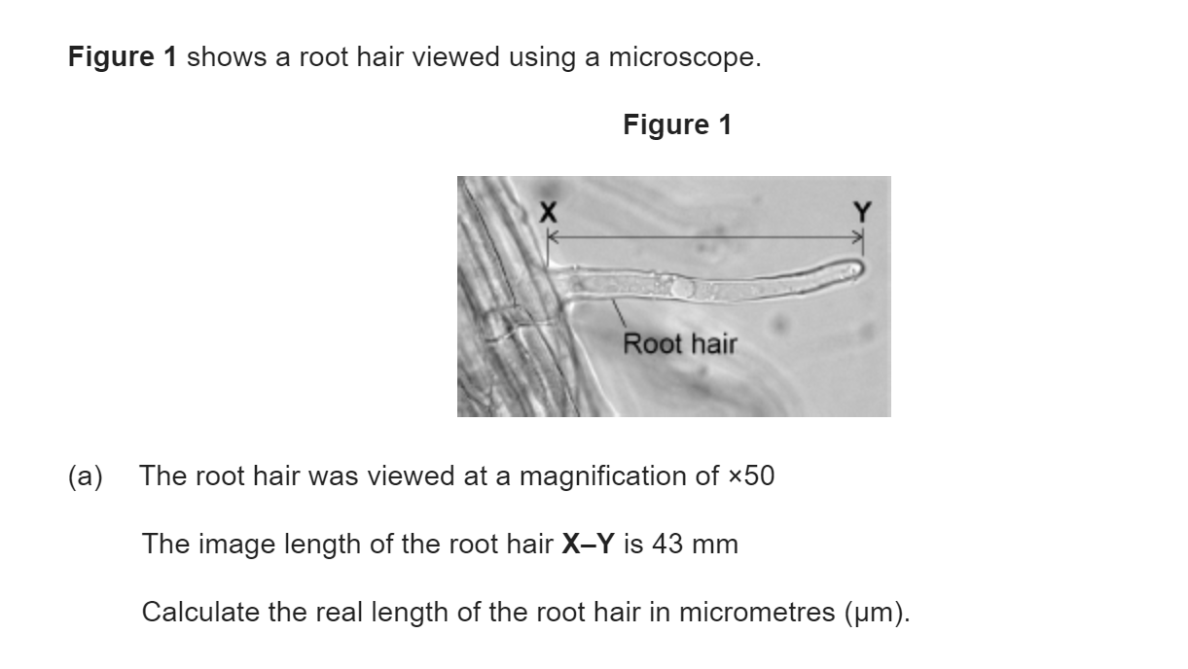
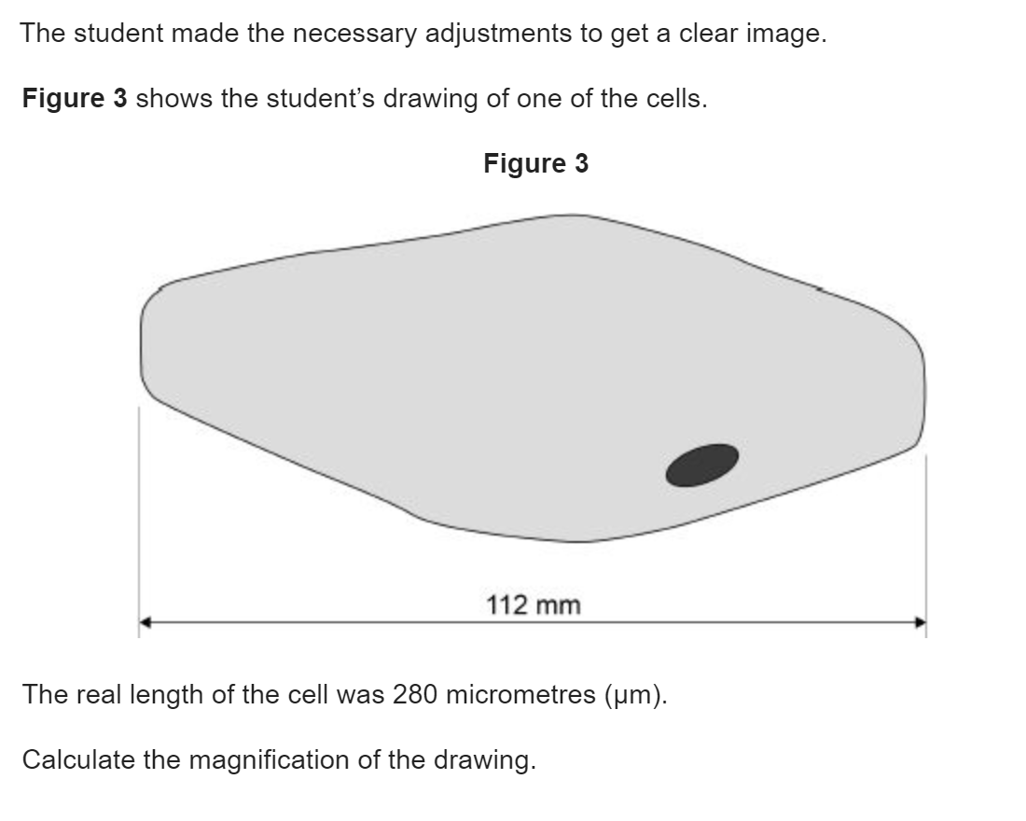
Knowledge retrieval questions

Slide 2
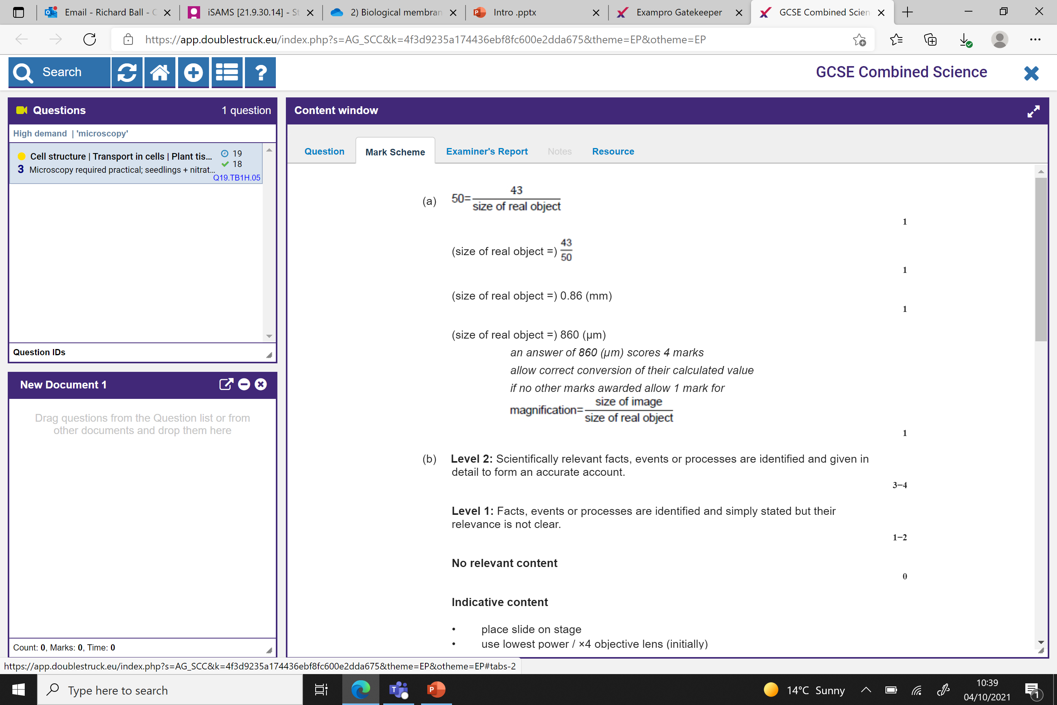
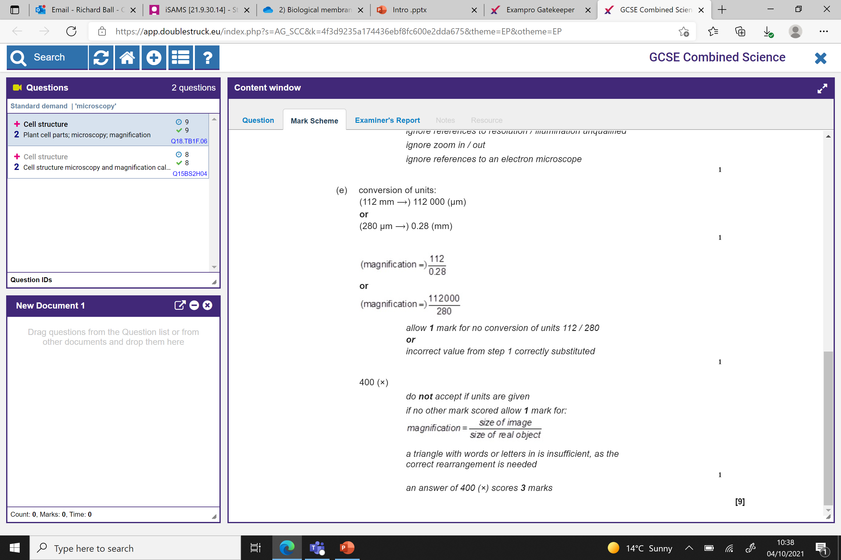
400x

Slide 3
Cell surface Membranes Structure and Function
Tuesday, July 22, 2025

Slide 4
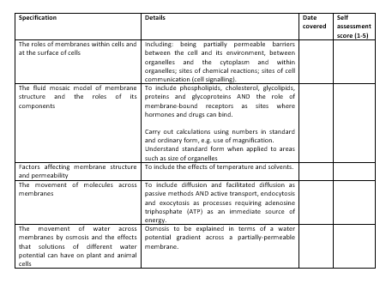
Learning Outcomes
Describe the roles of membranes within cells and at the surface of cells.
Identify the components of cell membranes.

Slide 5

science1s478's presentation | Poll Everywhere

Slide 6
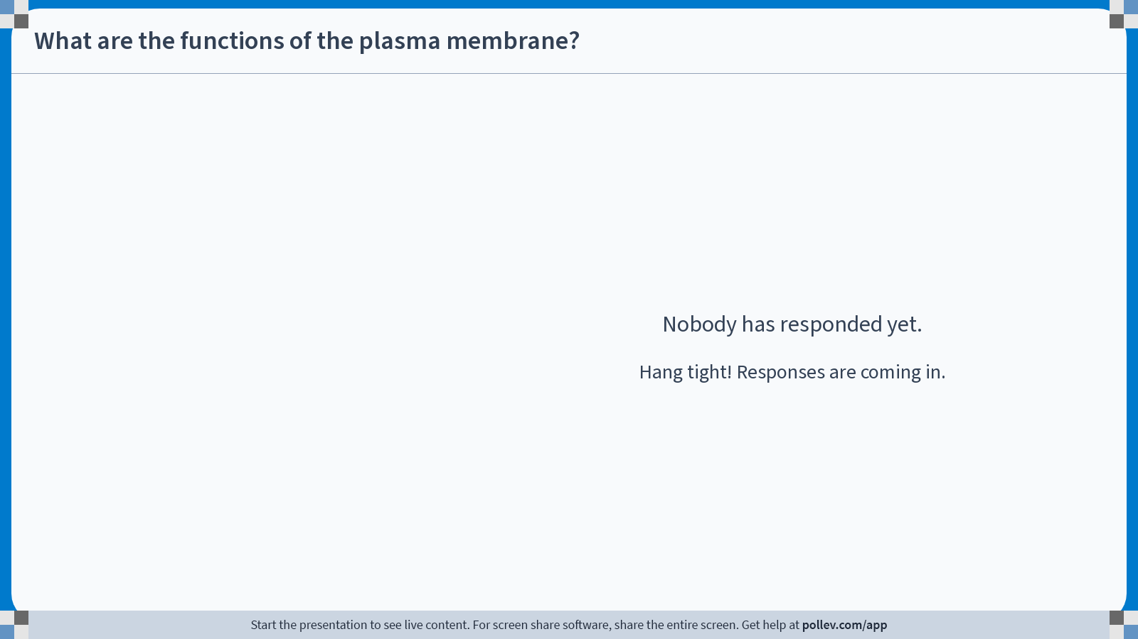
Notes:
Poll Title: Do not modify the notes in this section to avoid tampering with the Poll Everywhere activity.
More info at polleverywhere.com/support
What are the functions of the plasma membrane?
https://www.polleverywhere.com/free_text_polls/a1vPvPDbNw0KD8uqGTm98

Slide 7
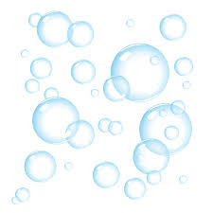
Investigating cell membranes
Can break and reform
Can have specialised functions like allowing molecules into a cell
Fluid and flexible
Membranes can exist within membranes

Slide 8
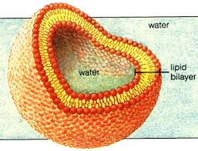
Importance and function of the cell surface membranes
1. Acts as barrier / separates the internal contents of the cell from the external environment:
Stops chemical reactions/damage
Maintains a high substrate conc.
Maintains internal environment
Partially permeable
2. Regulates transport of substances into and out of cell.
3. Contains receptors for chemical signalling:
Important for cell communication
Allows binding of hormones
Site of chemical reactions
4. Contains antigens used for self recognition
5. Releases chemicals for cell signalling

Slide 9
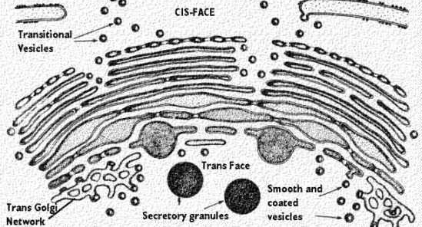
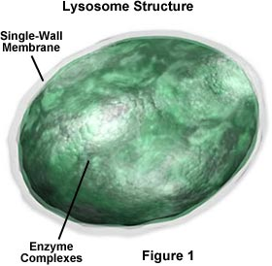
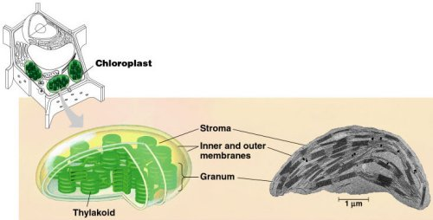
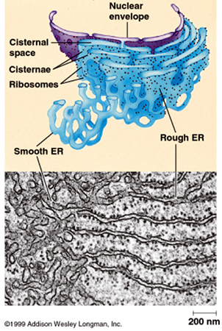
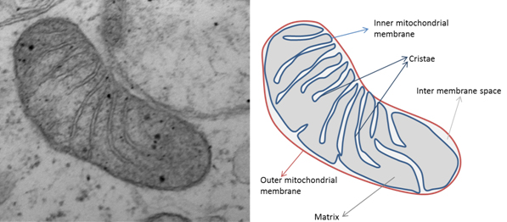
Internal membranes
Brainstorm with a partner
Why are internal membranes so important in a cell?
What might their functions be?
science1s478's presentation | Poll Everywhere

Slide 10
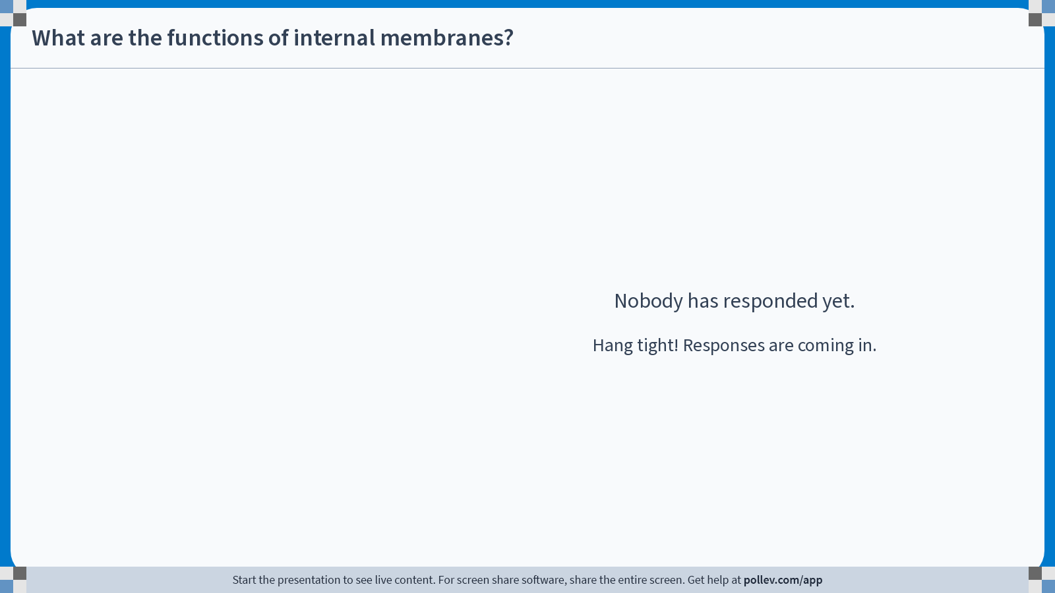
Notes:
Poll Title: Do not modify the notes in this section to avoid tampering with the Poll Everywhere activity.
More info at polleverywhere.com/support
What are the functions of internal membranes?
https://www.polleverywhere.com/free_text_polls/KUkPpgMPCVt8C6Mxzt1s1

Slide 11
Internal Membrane Functions
1. Compartmentalisation
Separates the internal contents of the organelle from the substances/chemicals in the cytoplasm.
Allows organelles to carry out their function separately from the cell.
Separates/localises damaging chemicals e.g. digestive enzymes
2. Increases surface area
Allows more proteins and reaction centres to embed in membranes, meaning more reactions possible (eg many folds in the mitochondria)

Slide 12

Learning Outcomes
Describe the roles of membranes within cells and at the surface of cells.
Identify the components of cell membranes.

Slide 13
The cell surface membrane
Under a light microscope a cross section of the plasma membrane looks like a simple line.
Is this what the plasma membrane really looks like?
No – it wasn’t until the invention of the electron microscope that we found out exactly what the plasma membrane looked like

Slide 14
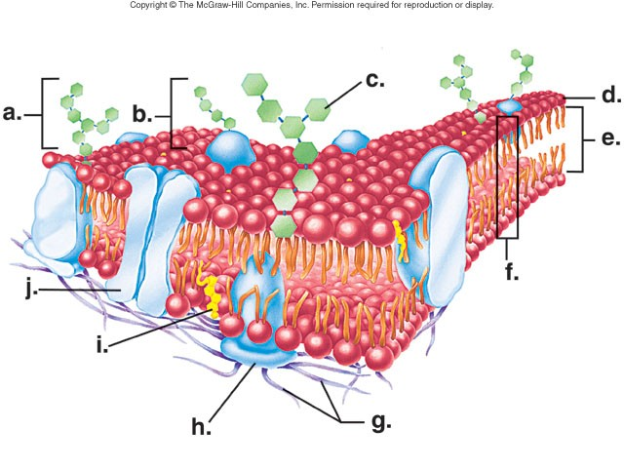
Identify
Name
Structure
Function
Adaptation

Slide 15
Label your diagram
Cytoskeleton
External protein
Cholesterol
Channel protein
Glycoprotein
Phospholipid bilayer
Glycolipid / Glucose
Carbohydrate chain
Fatty acid tails
Phosphate head

Slide 16
Label your diagram
Cytoskeleton G
External protein H
Cholesterol I
Channel protein J
Glycoprotein B
Phospholipid bilayer F
Glycolipid / Glucose C
Carbohydrate chain A
Fatty acid tails E
Phosphate head D

Slide 17
Discuss the following structures and possible function with the person next to you
Phospholipid bilayer
Fluid mosaic model

Slide 18
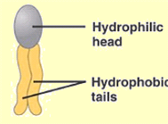

The plasma membrane (cell surface membrane) mostly consists of these!

Slide 19
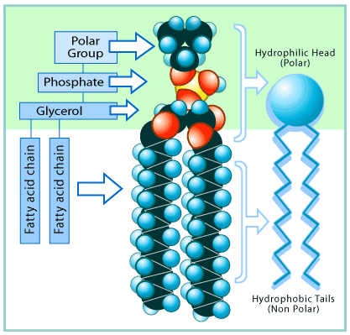
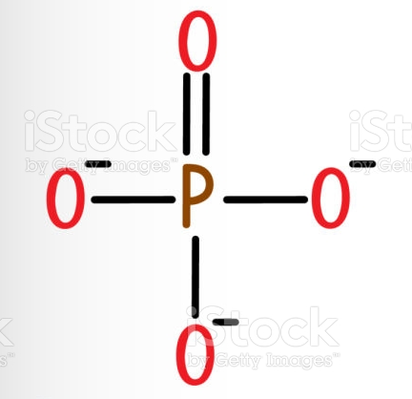
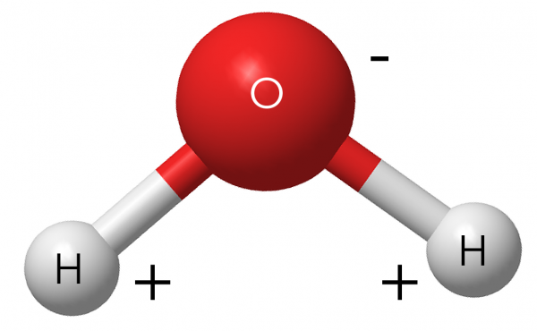
Phospholipids
Phospholipids are made from:
Glycerol
two fatty acids,
A phosphate group (head)
Phosphate ‘Head’ is HYDROPHILLIC
Polar (negative)
Fatty Acid Tails are HYDROPHOBIC
Non–polar (neutral)
phosphate groups have a negative charge
- this makes them water soluble (hydrophilic)
fatty acids are uncharged & non-polar
- this makes them water repelling (hydrophobic)

Slide 20
How are phospholipids arranged in the plasma membrane?
The inside of a cell contains cytoplasm and cell organelles. It is an aqueous environment
The outside of a cell (the extracellular matrix) is also an aqueous environment.
Use this information to suggest how phospholipids may be arranged in a cell membrane.
Draw your ideas on your whiteboard

Slide 21
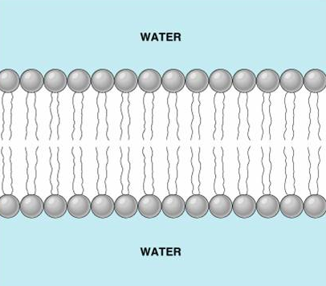
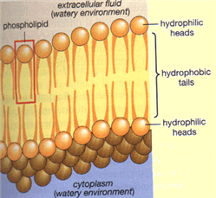
In the phospholipid bilayer of the membrane, the non-polar tails face inwards and the polar heads face outwards.
hydrophilic heads exposed to watery extracellular fluid (on outside of cell)
hydrophobic tails sandwiched between hydrophilic heads
hydrophilic heads exposed to watery cytoplasm (on inside of cell)

Slide 22
Unsaturated fats have more kinks in the non-polar tails.
Challenge question:
What problem will a diet rich in saturated fats cause?
A stiffened plasma membrane, making transport of substances in/out of cell difficult
The kinks in the fatty acids are really important. They prevent the molecules from packing closely together.

Slide 23
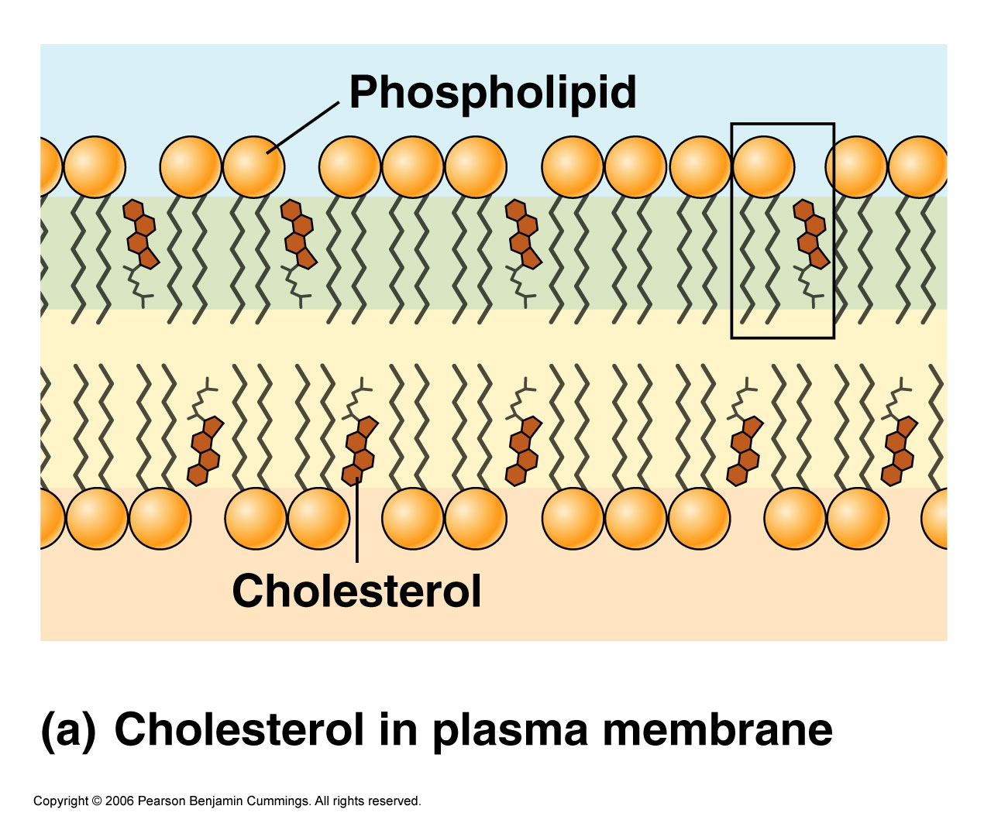
Cholesterol is found in all cell membranes (except bacteria)
It fits between the phospholipids and binds to the hydrophobic tail, causing them pack more closely.
This makes the membrane less fluid and provides stability

Slide 24
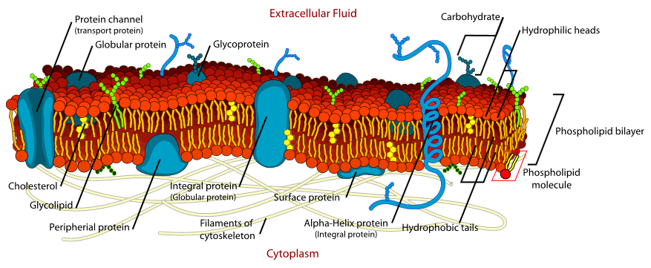
The Fluid Mosaic Model:
The model of plasma membrane structure is known as the fluid mosaic model
thickness of bilayer = 7nm
43 seconds start
(4) Fluid mosaic model | Cells | Biology | FuseSchool - YouTube

Slide 25


Slide 26
Discuss the following structures and possible function with the person next to you
Channel protein
Carrier protein

