Slide 1


Welcome to Year 12 Biology!
For more help, please visit www.exampaperspractice.co.uk
© 2025 Exams Papers Practice. All Rights Reserved

Slide 2
Biochemistry side topics to cover:
Biological Molecules
Nucleic Acid
Enzymes
Cell division and Stem cells
Communicable disease
Classification and evolution
Biotechnology
All your lesson notes and homework must be saved in the relevant folders in notebook so that I can check what you are doing. It is really important that you keep everything filed and up to date as you progress through the course.
Link to specification
Current topic: B 2.1: Foundations in Biology
B 2.1.2: Biological Molecules

Slide 3
Biological molecules – can you work backwards?
Carbon, hydrogen, oxygen, nitrogen, sulphur, phosphorus, calcium….
Organ
lungs
Cell
(eukaryote)
Plant cell
(eukaryote)
Bacterium
(Prokaryote)

Slide 4
Biological Molecules
Pour the exact same volume of water into 2 beakers and put one in the freezer
Spec point for today: How hydrogen bonding occurs between water molecules, and relate this, and other properties of water, to the roles of water for living organisms
For more help, please visit www.exampaperspractice.co.uk
© 2025 Exams Papers Practice. All Rights Reserved

Slide 5
Biological molecules
What is a molecule?
A substance which contains at least two elements chemically bonded together.
Proteins, carbohydrates, lipids and nucleic acids are 4 key groups of macromolecule (large molecule) essential for life.
What examples of molecules found in the body can you name?
Water
Amino acids
Proteins
Carbohydrates (sugars)
Lipids (fats)
Nucleic acids (DNA/RNA)
You need to be familiar with structure and function of these molecules.
For more help, please visit www.exampaperspractice.co.uk
© 2025 Exams Papers Practice. All Rights Reserved

Slide 6
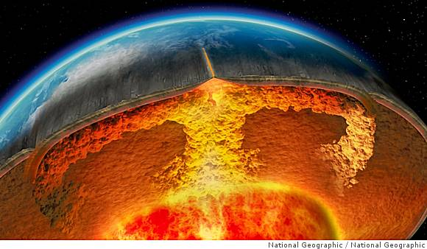
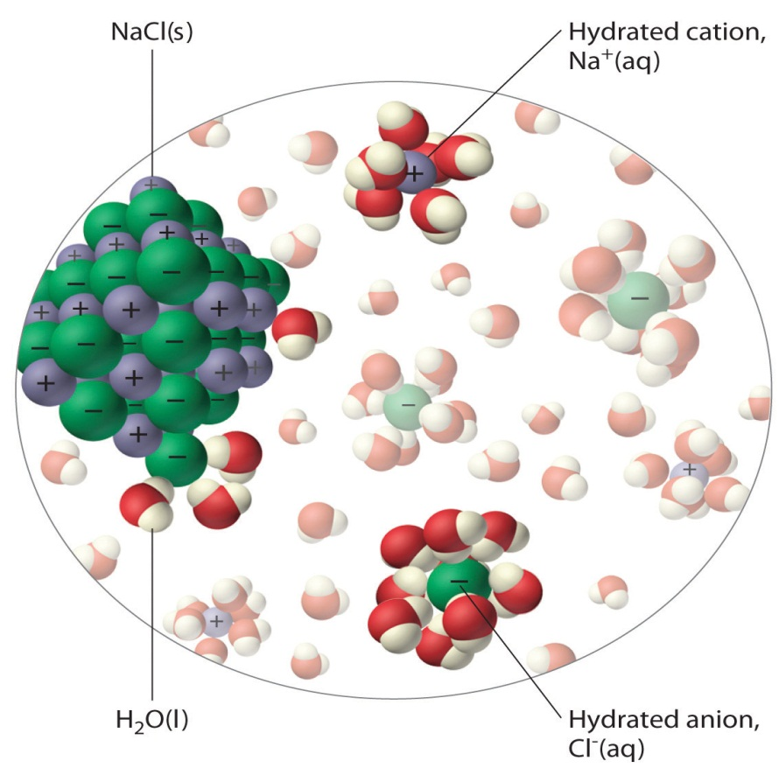
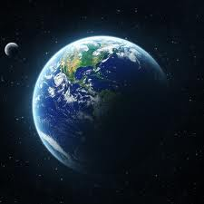
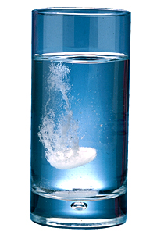
What is the importance of water to the world?
Where water does not exist, life does not exist!
It is the solvent of life; chemical reactions take place in it.
It helps to create convection currents in the Earth’s mantle, which helps to warm the planet.
Water is a habitat organisms can survive and reproduce in it.
Water forms the transport mechanism for all organisms.
There is more water locked up in the rocks of the Earth than on the Surface.
For more help, please visit www.exampaperspractice.co.uk
© 2025 Exams Papers Practice. All Rights Reserved

Slide 7
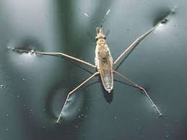
Let's play!
1. Water on the penny
2. Paper clips in the beaker

Slide 8
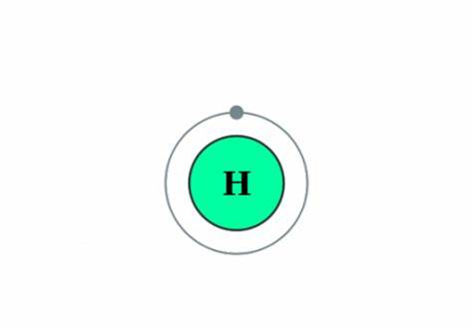
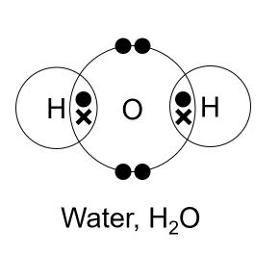
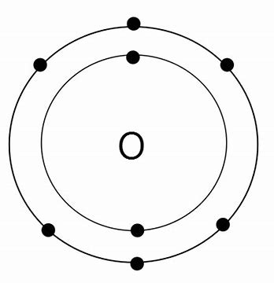
Structure of water.
What can you remember? Mini whiteboards.
Draw dot and cross diagrams for oxygen and hydrogen atoms.
Show the number of protons for each one.
How does the proton number affect the electron arrangement?
As the oxygen and hydrogen atoms share the electrons these are covalent bonds.
Next show how a water molecule is arranged.
Name the bonds that form

Slide 9
Structure of water.
As the oxygen atom contains more protons the shared electrons are more attracted to it.
This means that a water molecule has a partial (slight) negative charge at the oxygen atom and partial positive charges at the hydrogen atoms.
A polar molecule has a partial positive charge on one side and a partial negative charge on the other side.
δ-
δ-
δ+
O
δ+
H
H
For more help, please visit www.exampaperspractice.co.uk
© 2025 Exams Papers Practice. All Rights Reserved

Slide 10
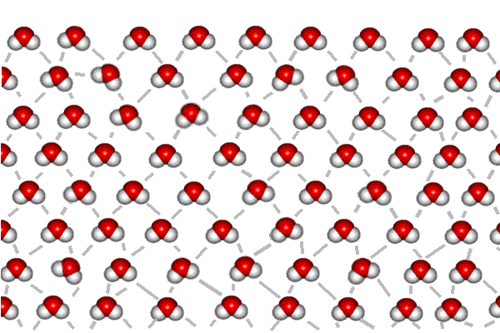
Importance of the partial charges.
These partial charges allow for the formation of hydrogen bonds between the polar water molecules.
δ-
δ-
O
O
O
O
δ+
δ+
δ+
δ+
H
H
H
H
Partial negative charge
δ-
δ-
δ-
O
O
O
O
O
δ+
O
δ+
δ+
δ+
δ+
δ+
H
H
H
H
H
H
Partial positive charge
δ-
Hydrogen bond
δ-
O
O
O
δ+
O
δ+
δ+
δ+
H
H
H
H
For more help, please visit www.exampaperspractice.co.uk
© 2025 Exams Papers Practice. All Rights Reserved

Slide 11
Hydrogen bonding.
Hydrogen bonds are weak bonds formed between a partially positively charged hydrogen atom in one molecule and a partially negatively charged atom in another molecule. However, when thousands of H bonds form the polymer structure becomes stable.
Hydrogen bonding gives water some of its useful properties.
δ-
O
O
δ+
δ+
H
H
δ-
Hydrogen bond
δ-
O
O
O
δ+
O
δ+
δ+
δ+
H
H
H
H
For more help, please visit www.exampaperspractice.co.uk
© 2025 Exams Papers Practice. All Rights Reserved

Slide 12
Definitions.
Specific heat capacity; the energy needed to raise the temperature of 1 gram by 1 ºC.
Latent heat of evaporation; the energy needed to change a substance from one state to another (e.g. liquid to gas).
Cohesion; the attraction between molecules of the same type.
Latent heat of fusion; the energy needed to change state from one state to another e.g.liquid to solid .
Solvent; a substance used to dissolve something else.
For more help, please visit www.exampaperspractice.co.uk
© 2025 Exams Papers Practice. All Rights Reserved

Slide 13
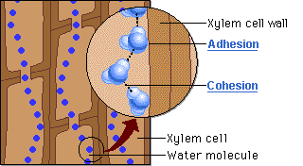
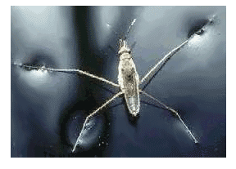
Cohesion: is the attraction between molecules of the same type. Water molecules are very cohesive because they are polar (H-bonding).
Helps water to flow, making it great for transporting substances.
Makes columns of water harder to break.
Creates surface tension.
For more help, please visit www.exampaperspractice.co.uk
© 2025 Exams Papers Practice. All Rights Reserved

Slide 14

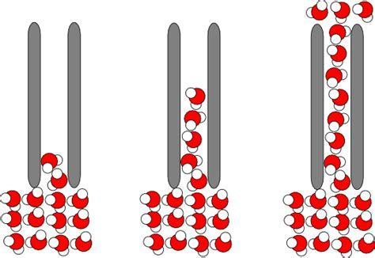
Adhesion occurs between water molecules and other polar molecules and surfaces. This results in capillary action.
Why is this so important for life?

Slide 15
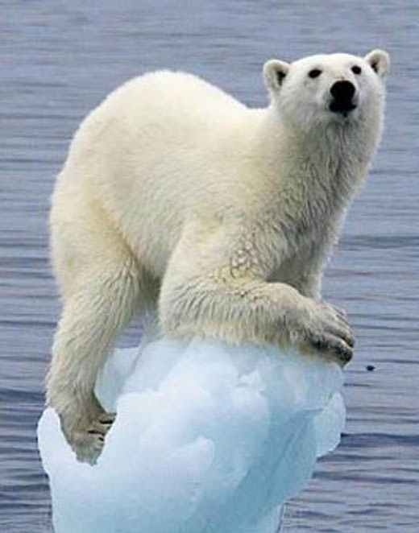
Why does ice float?
Get your beakers out of the freezer

Slide 16
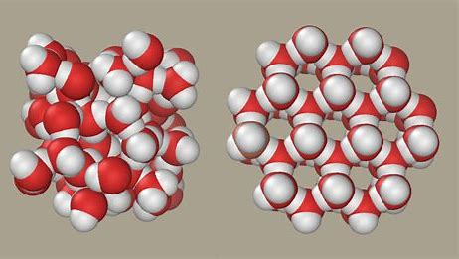
Water Ice
At low temperatures, polar water molecules have less energy and so move around less.
This helps to create more hydrogen bonds and the liquid water becomes more solid (ice).
Polar water molecules are held further apart in ice than water, hence a lower density.
This creates an insulating layer on top of the ice, so the water below doesn’t freeze.

Slide 17

Good solvent: if a substance is ionic (charged), or is polar, it will dissolve in water. When an ionic compound dissolves in water the ions separate and can then react more easily with other ions and molecules. Many reactions only take place in water.
Water’s polarity makes it a good solvent. Living organisms can take up useful substances (minerals, ions) dissolved in water and these substances can be transported around the body.
+
H
H
O
O
+
H
-
H
-
_
Whiteboard task:
Draw two models to show a sodium and a chloride ion in solution
Na+
+
H
H
-
O
-
O
+
H
H

Slide 18
Property | Importance to life | Link to hydrogen bonding | Examples where it is used
Good solvent
Cohesion
Low density when solid
High specific heat capacity
High latent heat of evaporation
Low viscosity
High latent heat of fusion

Slide 19
Name the useful property of water.
Glucose dissolved in water
Good solvent
Dogs panting
Latent heat of evaporation
Small organisms walking on water
Cohesion
Polar bears walking on ice bergs
Low density of ice
Large bodies of water have constant temperature
High specific heat capacity
Water molecules used in hydrolysis or photosynthesis
Metabolic, takes part in biochemical reactions

Slide 20
Write down three numbers between one and ten, these are the questions you must answer – you can trade only one question with a member of the class!
Q1 Give 3 functions of water that are important to living organisms.
Q2 Why is water a polar molecule?
Q3 Fully label a diagram of a water molecule.
Q4 What is a hydrogen bond?
Q5 Draw a diagram showing four water molecules bonded together.
Q6 Explain why water has a high specific heat capacity.
Q7 Explain why water is good at cooling things.
Q8 Give two reasons why the polarity of water makes it good for transporting substances.
Q9 Explain how the formation of ice can be beneficial for organisms.
Q10 Describe how a Mg²⁺ ion dissolves in water.

Slide 21
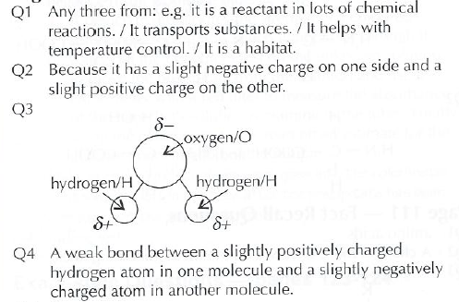
Answers

Slide 22
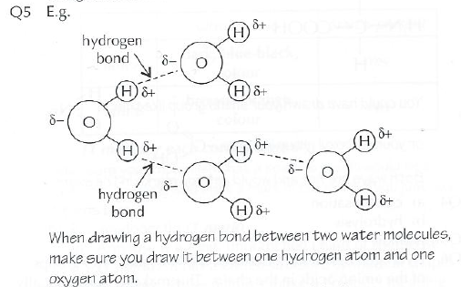
Answers

Slide 23
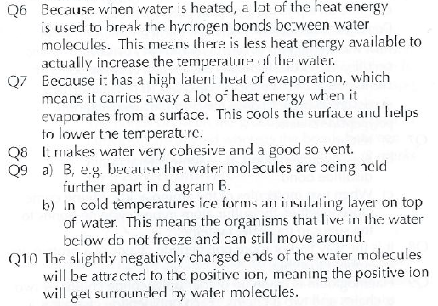
Answers

Slide 24
Biological Molecules
Spec point for today: How hydrogen bonding occurs between water molecules, and relate this, and other properties of water, to the roles of water for living organisms

