Slide 1

WELCOME TO BIOLOGY A LEVEL!!

Slide 2

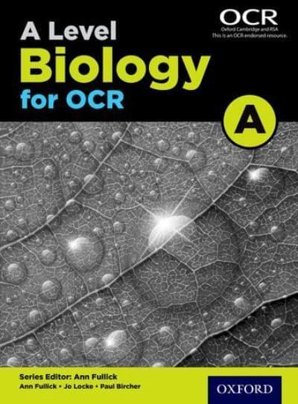

Slide 3
Attending lessons and being attentive will get you a D at A-Level
Majority of the work is done outside this room

Slide 4
Lesson format
You will be working in class notebook.
Each unit has a cover sheet and the pages required
All PAG’s will be complete electronically in your class notebook
Each lesson starts with a “Knowledge retrieval” task
Pro tip: Do not fall behind!! It’s all in the detail.

Slide 5
Taboo.

Slide 6
Ready….

Slide 7
Xylem

Slide 8
Stomata

Slide 9
Fermentation

Slide 10
Translocation

Slide 11
Palisade

Slide 12
Urea

Slide 13
C₆H₁₂O₆

Slide 14
Respiration

Slide 15
Transpiration

Slide 16
Osmosis

Slide 17
Phloem

Slide 18
Waxy cuticle

Slide 19
Spongy mesophyll

Slide 20
Quadrat

Slide 21
Epidermis

Slide 22
biotic

Slide 23
Community

Slide 24
Amylase

Slide 25
Mutualism

Slide 26
abiotic

Slide 27
Apex

Slide 28
Omnivore

Slide 29
Trophic level

Slide 30
Final slide

Slide 31
Biomass

Slide 32
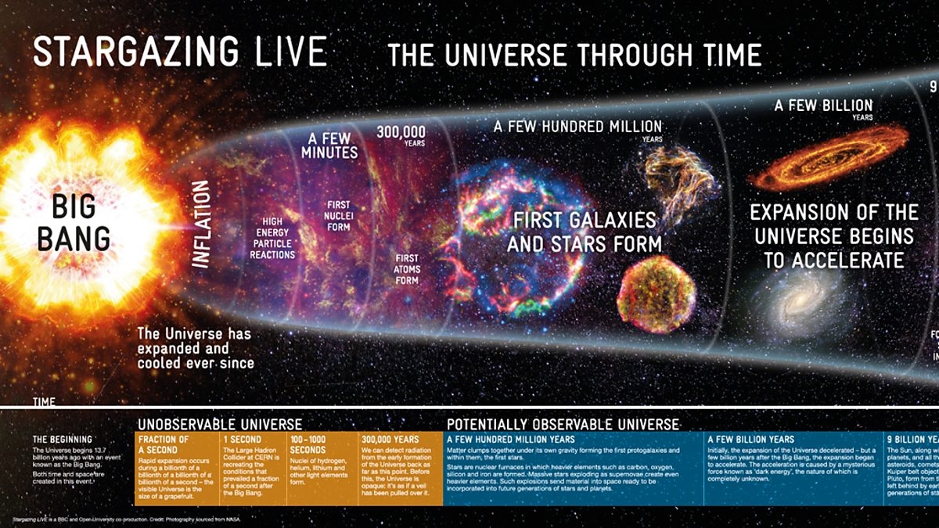
Notes:
13.7 or 26.7 billion years ago
Overt time the particles coalesce due to gravity and begin forming the first atoms
Atoms then being to form the first stars and Universe turn on!
Plants begin to form around the stars from the swirling excretion discs and the early universe is born!

Slide 33
So when did the first cells arrive and what were they?

Slide 34
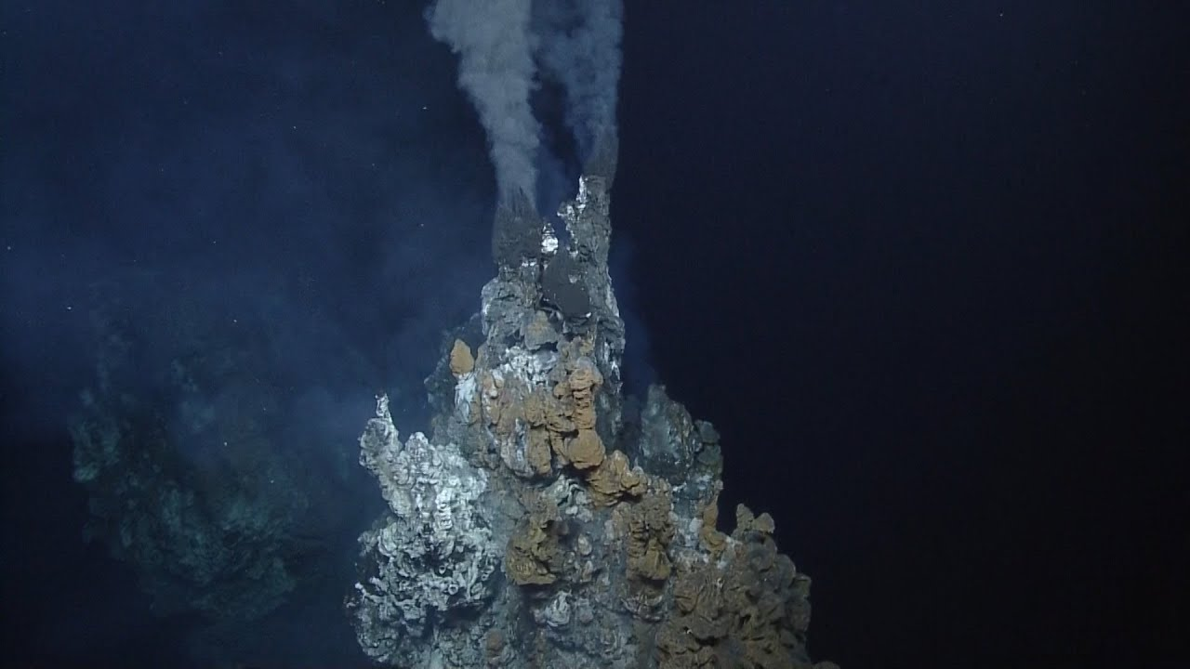
Black smokers – 4 billion years ago
The vents provided the chemicals and energy required to create some of the first amino acids to form – these would create the first RNA molecules
Fatty molecules coated in iron spontaneously formed around these vents to create the first protocells (cells without organelles)
We believe the first bacteria and archaea formed around these vents.
Some bacteria could create their own energy (ATP) and no longer relied on the vents!
Notes:
Bacteria and archaea have different cell walls and the genome of archaea are more closely related to eukarytore

Slide 35
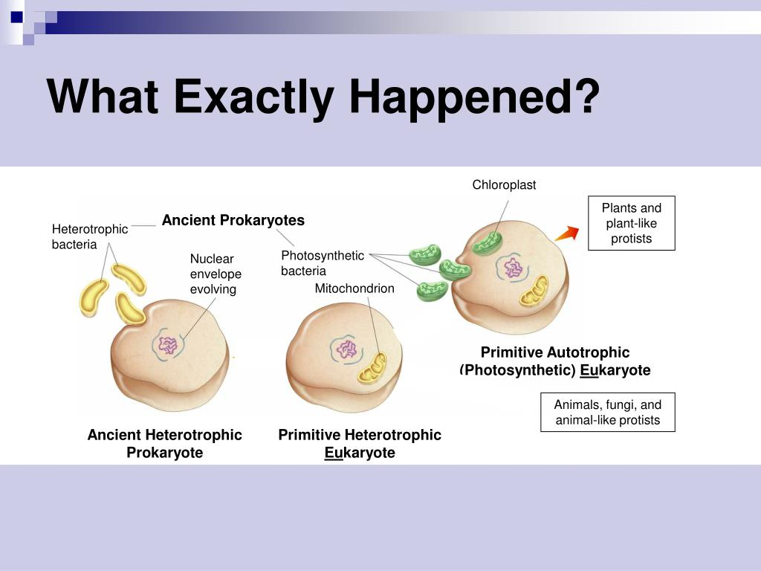
So how did eukaryotes arrive?
Around 2 billion years ago – Endosymbiosis

Slide 36
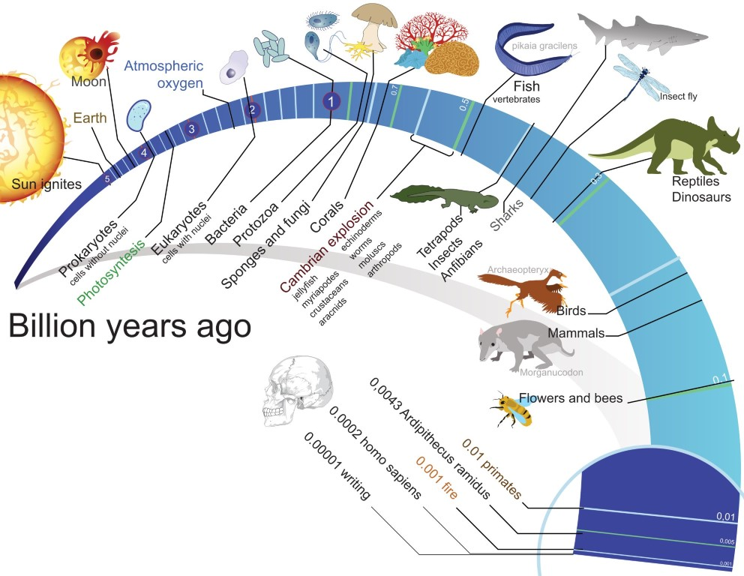

Slide 37
Complex cells then go on to change to Earth…

Slide 38
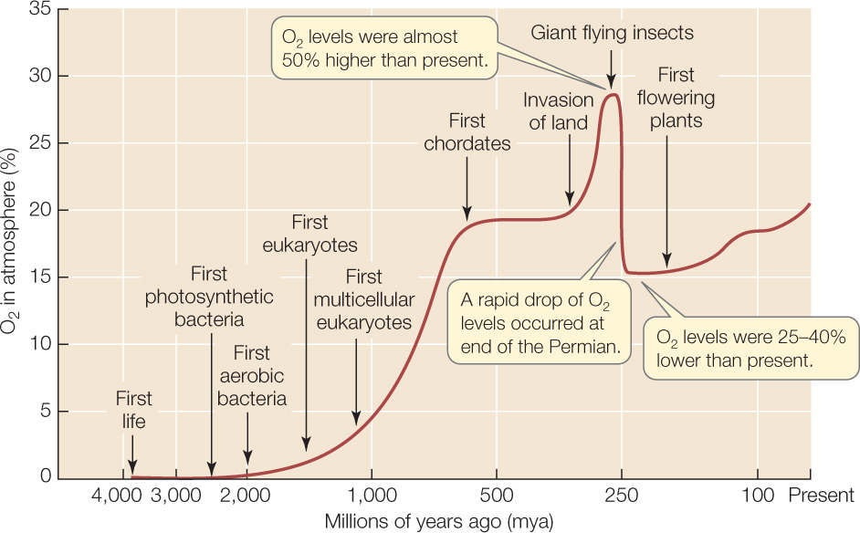
Notes:
An explosion of atmospheric O2 gave rise to even more complex animals

Slide 39
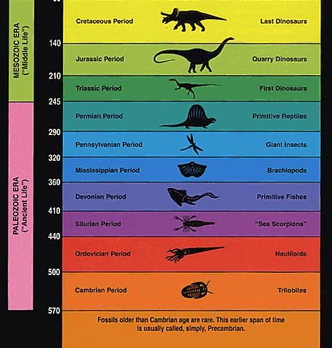
The rise in plants, lowered the levels of oxygen slightly.
Over the next 500 millions years the Earth support ever increasing complex life!

Slide 40
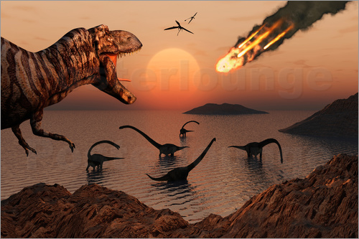

Slide 41
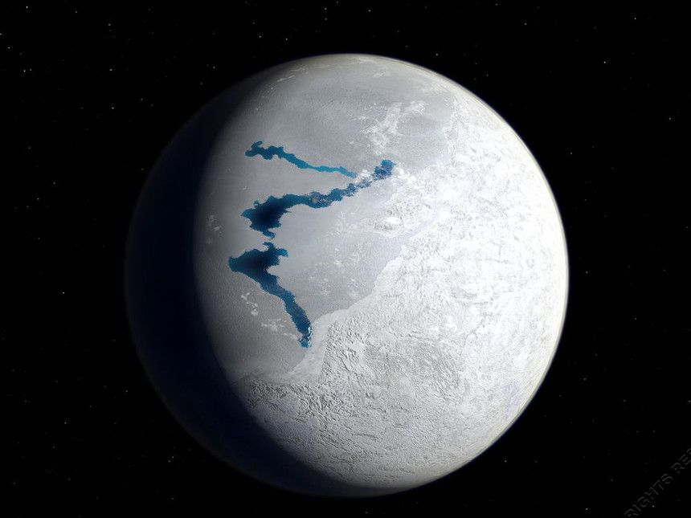

Slide 42
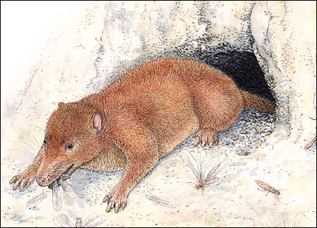

Slide 43
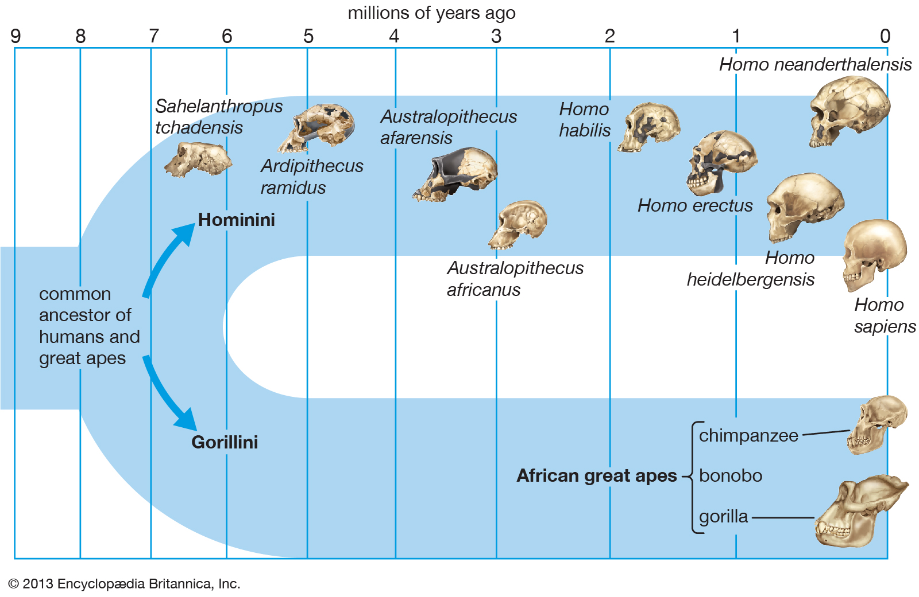

Slide 44
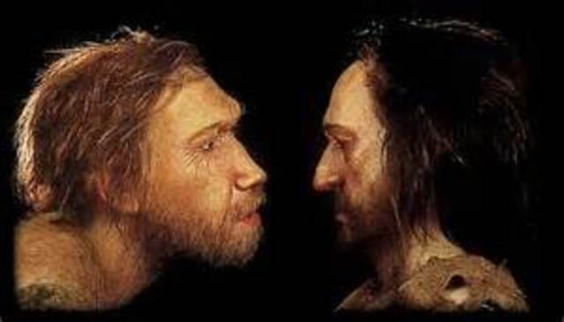
So why did survive?

Slide 45
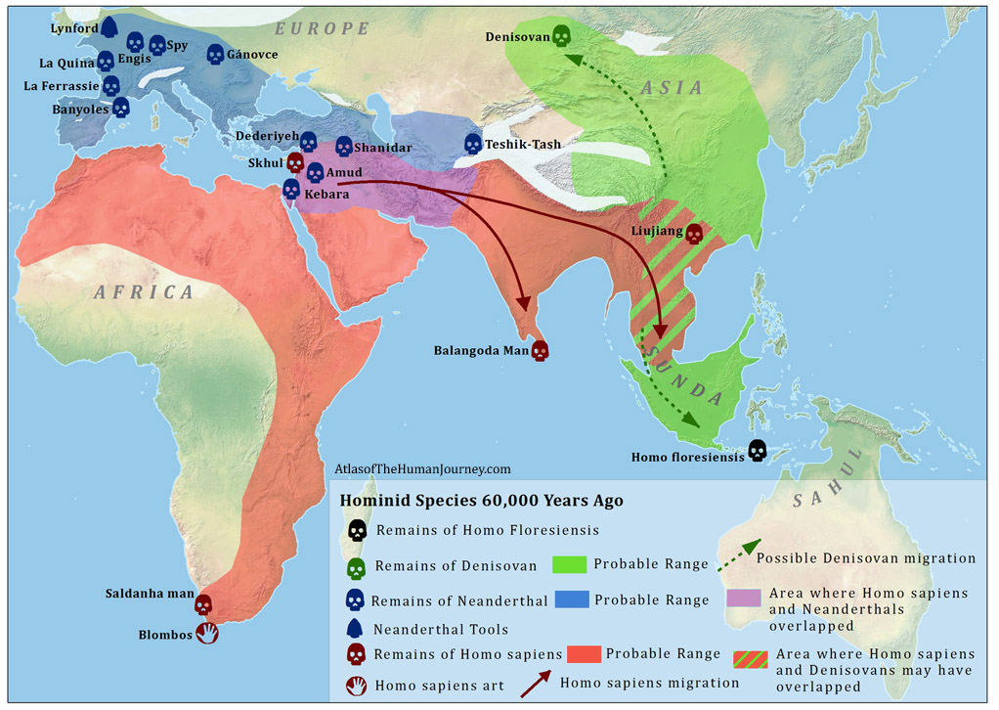

Slide 46
Homo sapiens are now the most influential species to ever walk the earth.
We have influenced it in ways that no other species has before us.
We were the first species to leave our planet and understand our place in the universe
Yet like every species before us, will eventually become extinct. How? We don’t know!

Slide 47
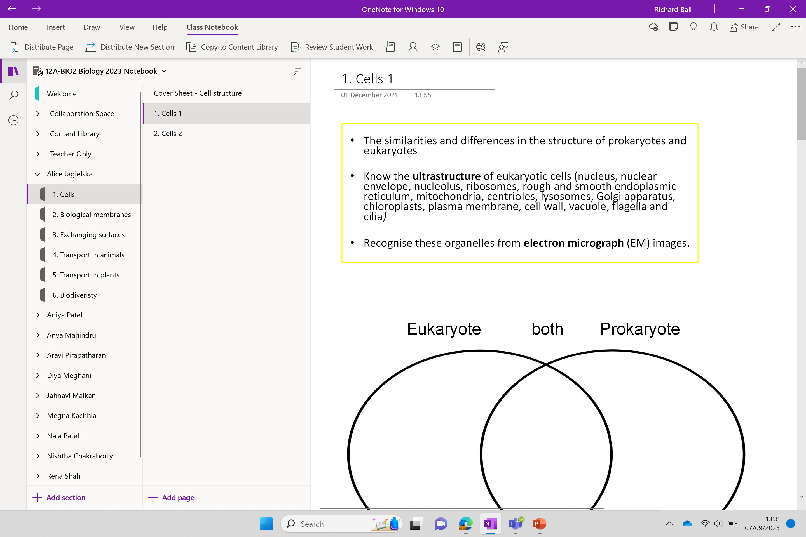

Slide 48
Cells
The similarities and differences in the structure of prokaryotes and eukaryotes
Know the ultrastructure of eukaryotic cells
Recognise these organelles from electron micrograph (EM) images.

Slide 49
KEY VOCABULARY LIST
Please record key vocabulary as you go – you may want to have an additional page for key vocabulary you add too
Electron micrograph - a picture from an electron microscope
Ultra structure - something too small to be seen under a light microscope

Slide 50
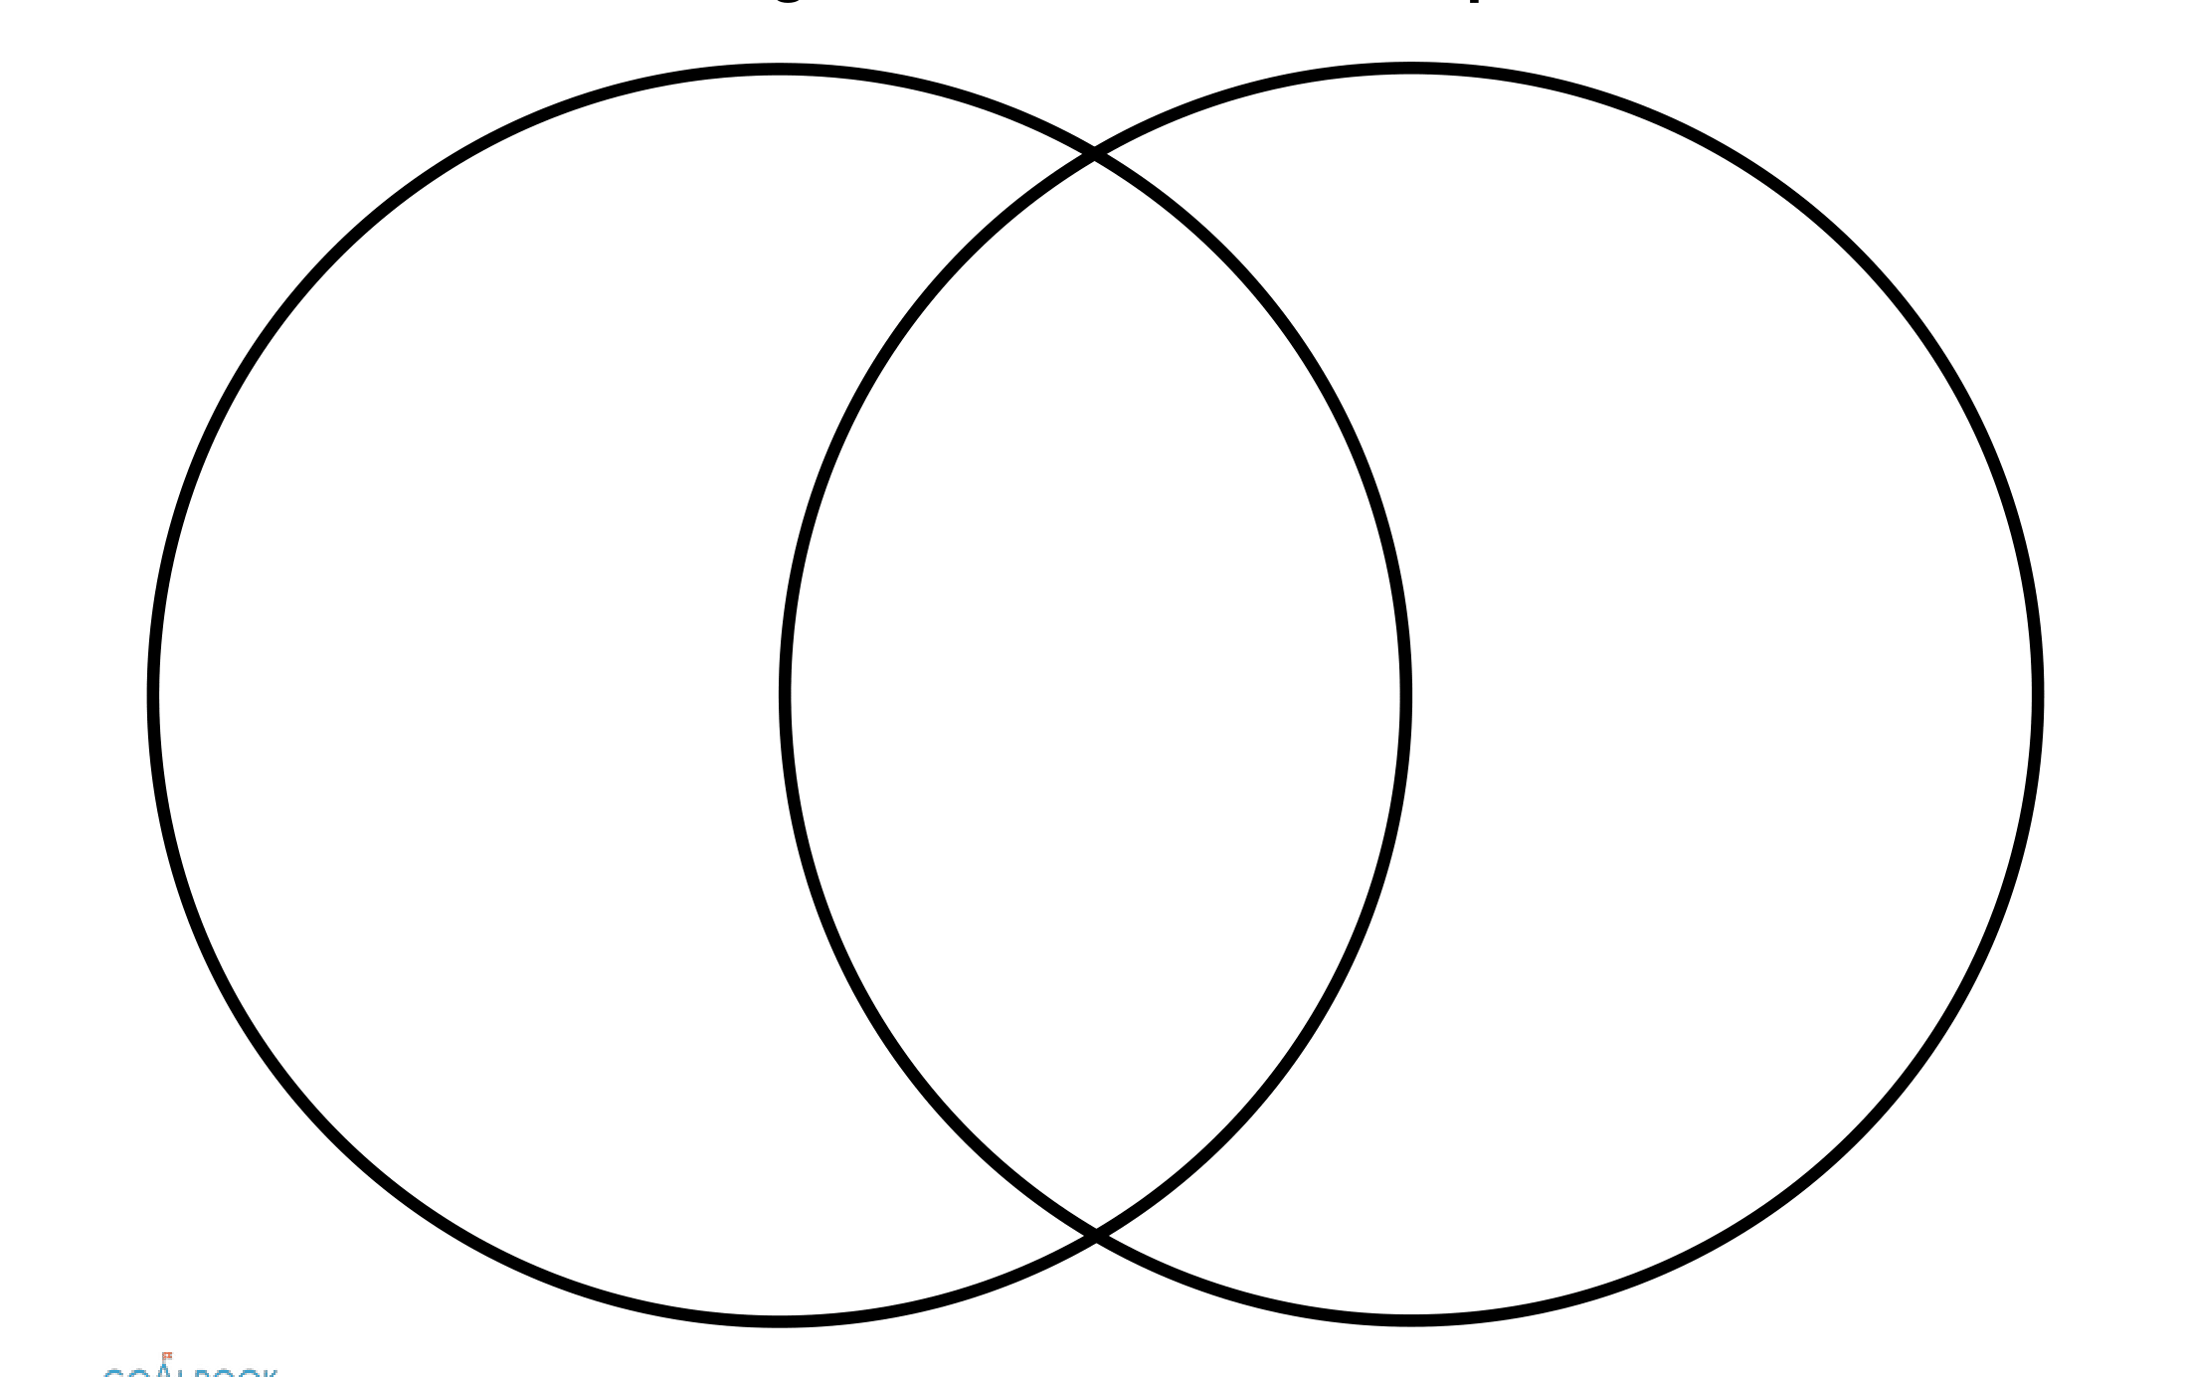
Complete a Venn diagram to compare the two types of cell below
Eukaryote both Prokaryote

Slide 51
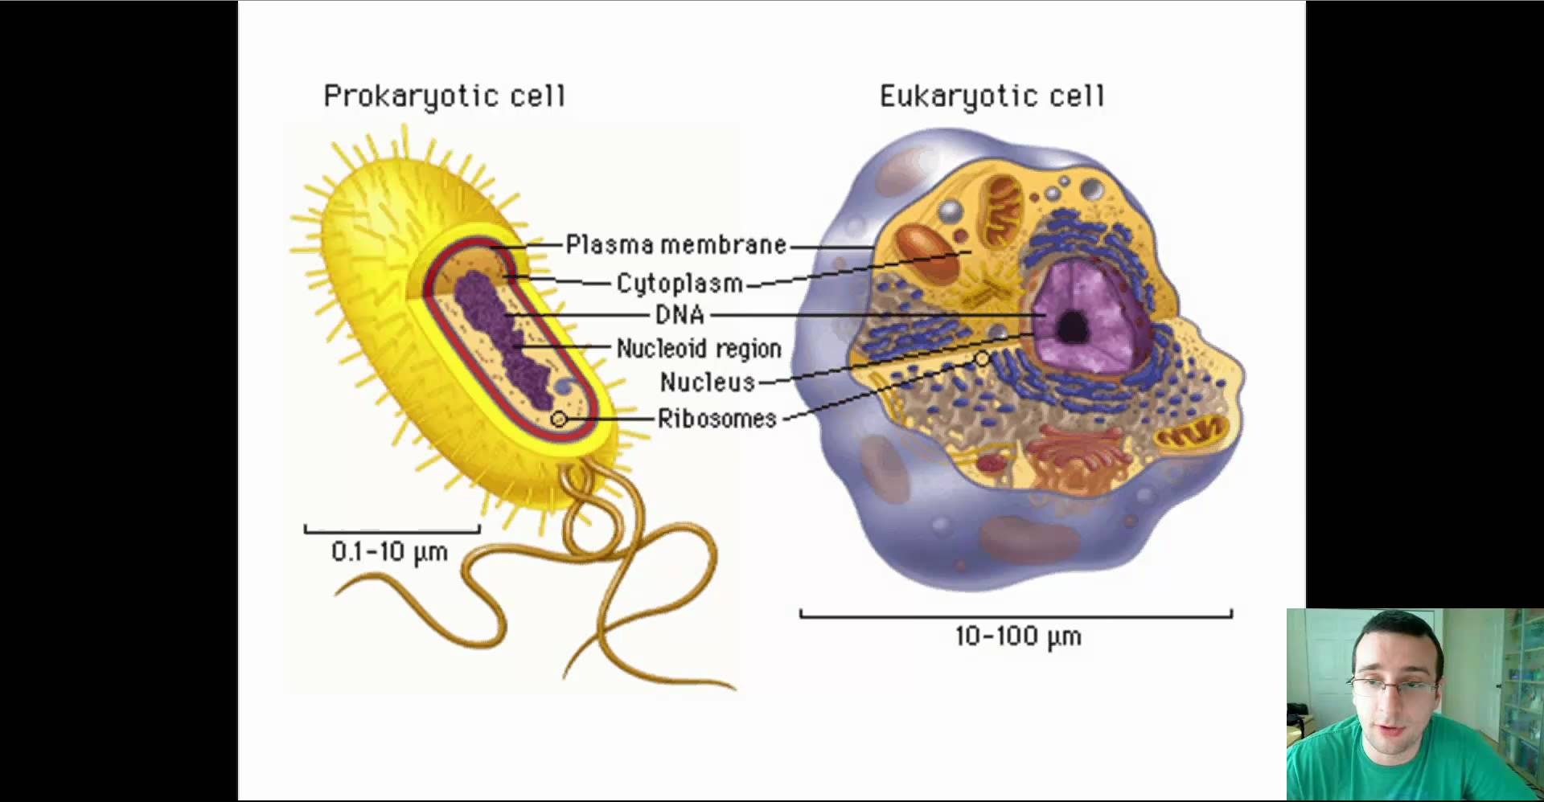
Spot the differences between these two cells

Slide 52
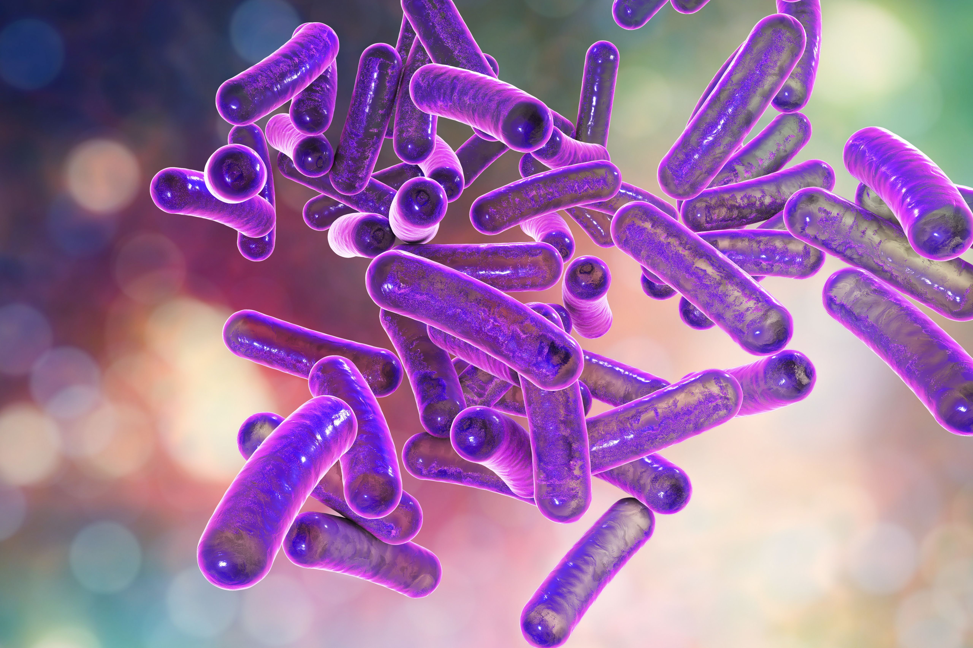
Prokaryotes – key points
…………-celled organisms, with no …………….. -bound organelles
Simple structures containing a single undivided internal area called the ……………...
The cytoplasm contains cytosol, which contains …………. and ………….
Most prokaryotic cells are extremely small with diameters between 0.5 and 5 …..
μm = micrometer / micron (1/1000 of a mm)

Slide 53
Prokaryotes – key points
Single-celled organisms, with no membrane-bound organelles
Simple structures containing a single undivided internal area called the cytoplasm.
The cytoplasm contains cytosol, which contains water and salts.
Most prokaryotic cells are extremely small with diameters between 0.5 and 5 μm.
μm = micrometer / micron (1/1000 of a mm)

Slide 54
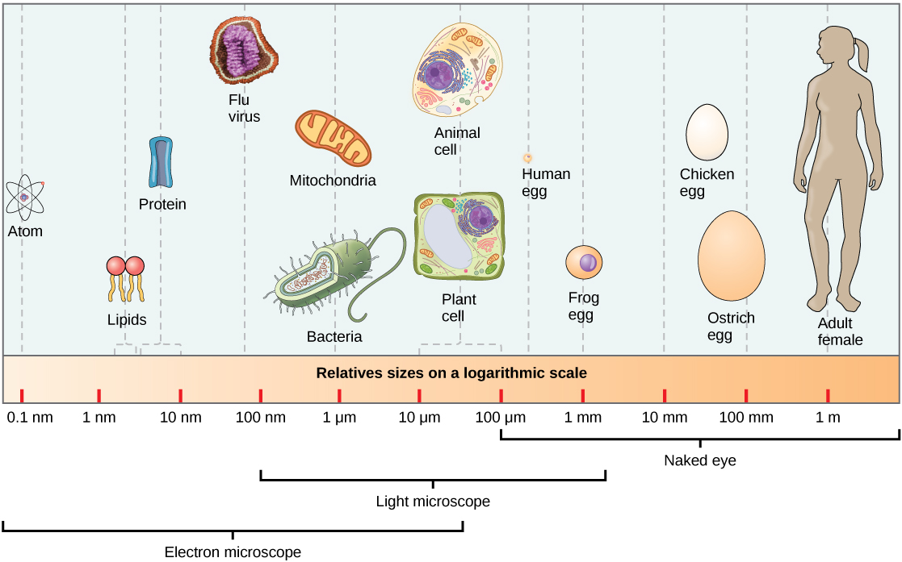
Perspective

Slide 55
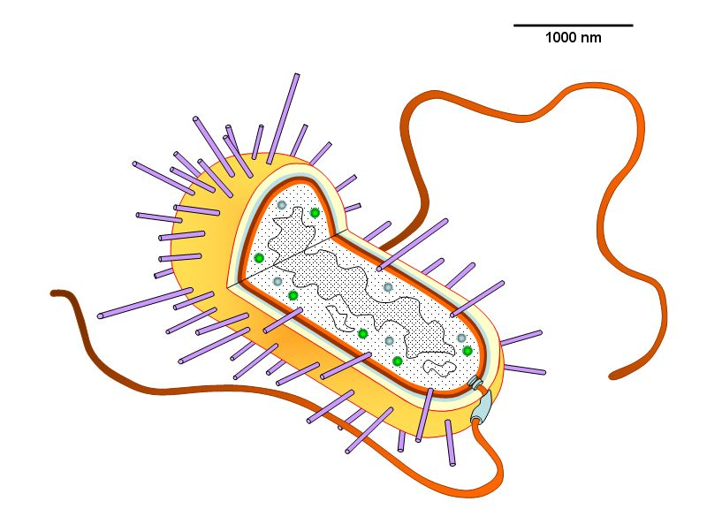
Prokaryote
Pili
Plasma membrane
Try to label the following onto you diagram:
Flagellum (flagella pl)
Pili
Circular DNA
Plasmid
Cell wall
Inner membrane
Capsule
Cytoplasm (contains ribosomes 70S – small dots)
Plasma membrane
Genetic material
(slime) Capsule
Cell wall
Inner membrane
Flagellum
Cytoplasm
(the dots are ribosome 70S)
Genetic
material
Circular DNA
Plasmid
}

Slide 56
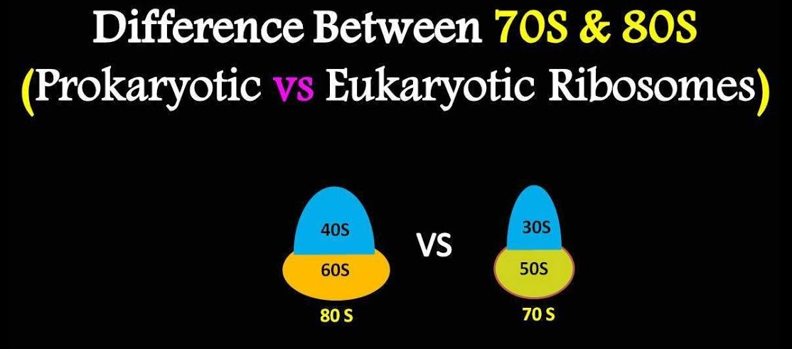

Slide 57
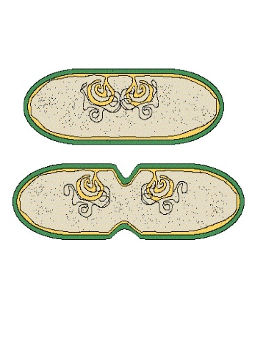
How do prokaryotic cells divide?
Mesosome
Mesosome
Prokaryotic cells divide via binary fission
The mesosome is an inward fold on the membrane to evenly divide the chromosomes during division (binary fission)

Slide 58
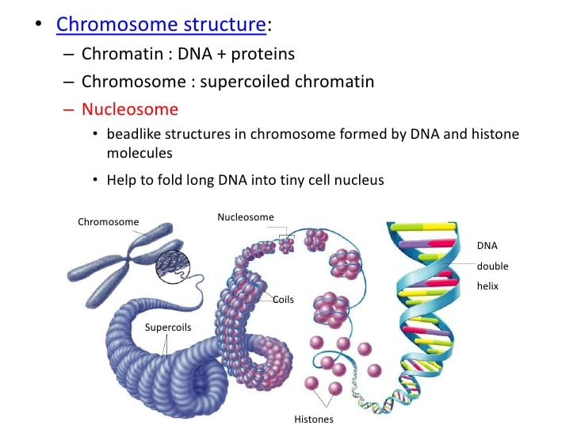
Eukaryotes – key points
Contains membrane-bound …………….. and a nucleus.
The DNA associates with proteins called …………. to form a complex called chromatin.
The chromatin …..... and form structures called chromosomes.
Eukaryotes contain many ultrastructure's, which can only be seen using …………… microscopy.
Eukaryotic cells are larger with ………… of 20 μm or more

Slide 59
Eukaryotes – key points
Contains a membrane-bound organelles and nucleus.
The DNA associates with proteins called histones to form a complex called chromatin.
The chromatin coil and form structures called chromosomes.
Eukaryotes contain many ultrastructure's, which can only be seen using electron microscopy.
Eukaryotic cells are larger with diameters of 20 μm or more

Slide 60
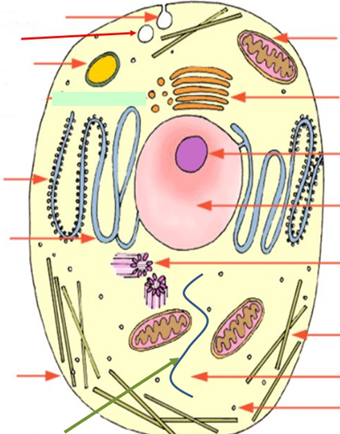
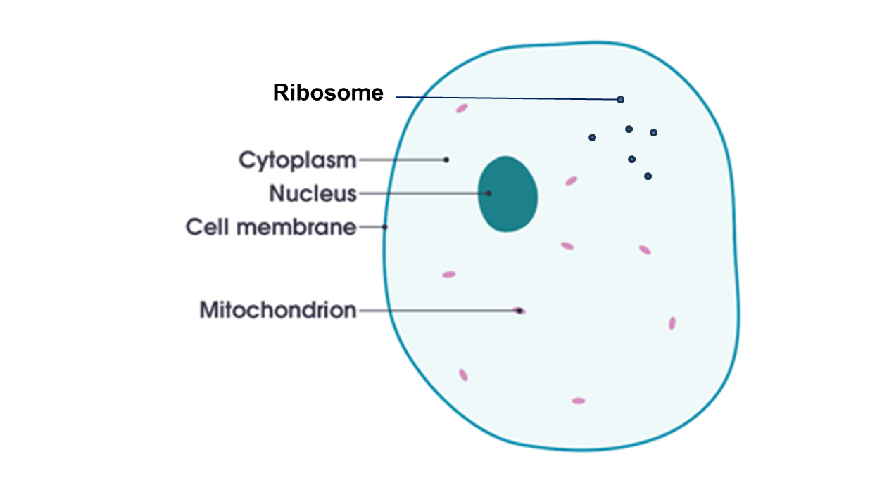
Did you really think this was everything?!?!

Slide 61
How much can you label first?

Slide 62
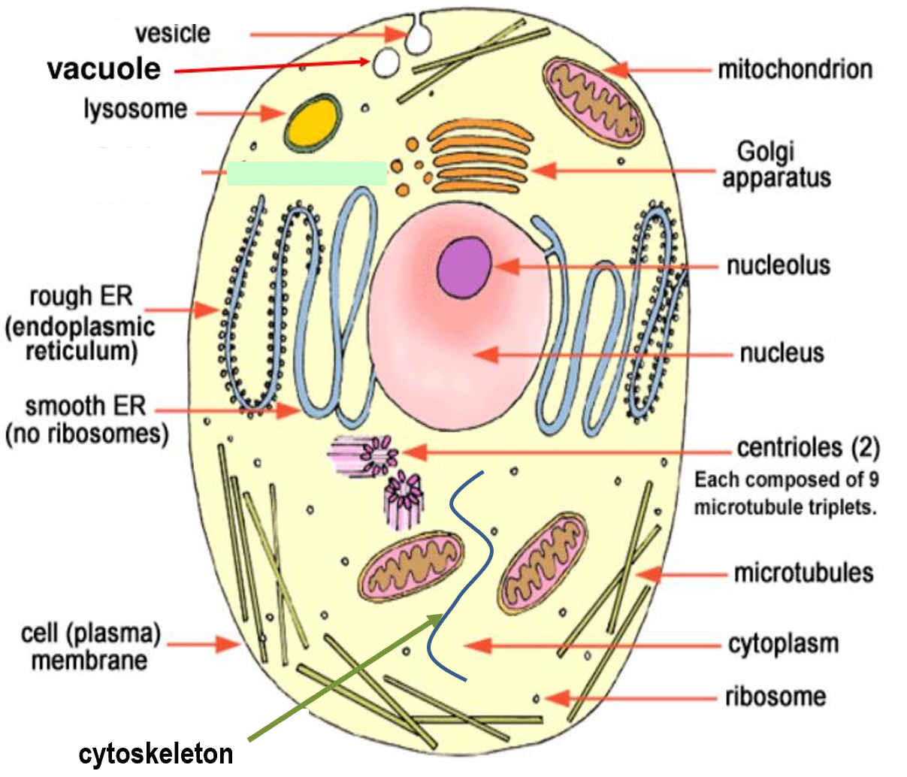
Eukaryote – ultrastructure's
Microtubules
Vacuole
Vesicle
Lysosome
Nucleolus
Nucleus
Golgi apparatus
Cell-surface membrane
Cytopplasm / Cytosol
Centriole
Ribosome 80S
Rough endoplasmic reticulum
Smooth endoplasmic reticulum
Cytoskeleton
Mitochondria

Slide 63
Eukaryote – ultrastructure's
Microtubules
Vacuole
Vesicle
Lysosome
Nucleolus
Nucleus
Golgi apparatus
Cell-surface membrane
Cytosol
Centriole
Ribosome
Rough endoplasmic reticulum
Smooth endoplasmic reticulum
Cytoskeleton
Mitochondria
Lysosome are specialised vesicles

Slide 64
Please open notebook “2. Cells 2”

Slide 65
Knowledge retrieval questions
Q1. What size do prokaryotic cells usually fall between? (1 marks)
Q2. What does cytosol contain? (1 marks)
Q3. What type of microscopy is required to see ultrastructures? (1 marks)
Q4. Give one reasons why bacteria do not contain mitochondria (1 mark)
0.5 and 5 μm
Water and salts
Electron microscopy
Too large for cell / no membrane-bound organelles in prokaryotic cells

Slide 66
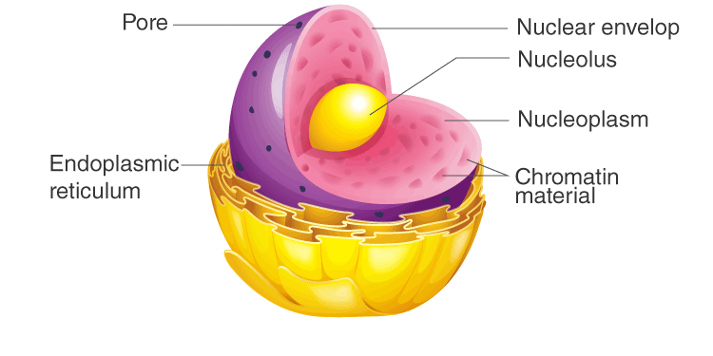
The Nucleus
Nucleus

Slide 67
The Nucleus
Nucleus

Slide 68
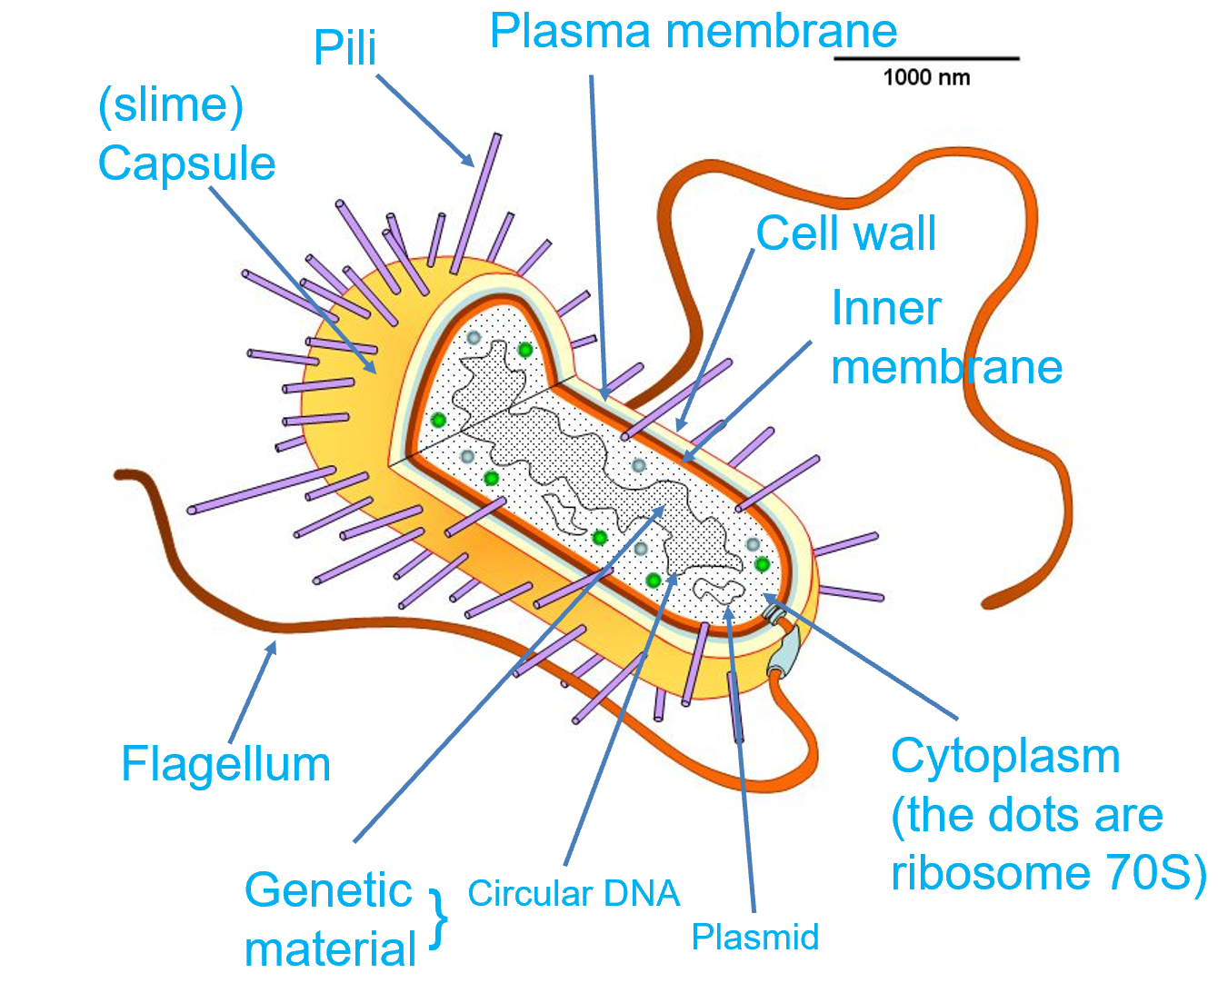

Slide 69

You have 3/4 minutes to revise with the person next to you the locations and names of each structure/ultrastructure in eukaryote/prokaryote cells
I will then put you to the test!!

Slide 70
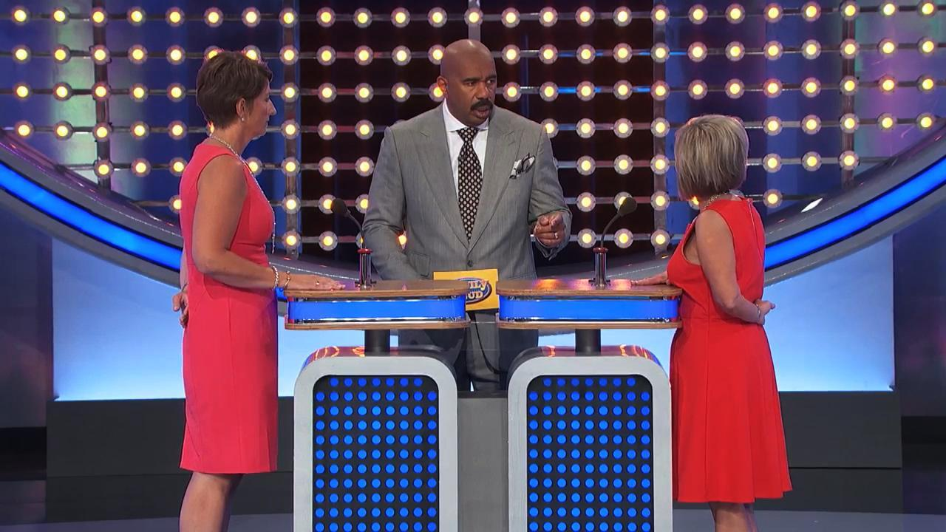
Family fortunes

Slide 71
Part of the cell will be highlighted or an arrow will be present
Ready….?

Slide 72
Eukaryote – ultrastructure's
Microtubules
Vacuole
Vesicle
Lysosome
Nucleolus
Nucleus
Golgi apparatus
Cell-surface membrane
Cytosol
Centriole
Ribosome
Rough endoplasmic reticulum
Smooth endoplasmic reticulum
Cytoskeleton
Mitochondria

Slide 73
Eukaryote – ultrastructure's
Microtubules
Vacuole
Vesicle
Lysosome
Nucleolus
Nucleus
Golgi apparatus
Cell-surface membrane
Cytosol
Centriole
Ribosome
Rough endoplasmic reticulum
Smooth endoplasmic reticulum
Cytoskeleton
Mitochondria

Slide 74
Prokaryote
Try to label the following onto you diagram:
Flagellum (flagella pl)
Pili
Circular DNA
Plasmid
Cell wall
Inner membrane
Capsule
Cytoplasm (contains ribosomes – small dots)
Plasma membrane
(slime) Capsule

Slide 75
Eukaryote – ultrastructure's
Microtubules
Vacuole
Vesicle
Lysosome
Nucleolus
Nucleus
Golgi apparatus
Cell-surface membrane
Cytosol
Centriole
Ribosome
Rough endoplasmic reticulum
Smooth endoplasmic reticulum
Cytoskeleton
Mitochondria

Slide 76
Eukaryote – ultrastructure's
Microtubules
Vacuole
Vesicle
Lysosome
Nucleolus
Nucleus
Golgi apparatus
Cell-surface membrane
Cytosol
Centriole
Ribosome
Rough endoplasmic reticulum
Smooth endoplasmic reticulum
Cytoskeleton
Mitochondria

Slide 77
Prokaryote
Try to label the following onto you diagram:
Flagellum (flagella pl)
Pili
Circular DNA
Plasmid
Cell wall
Inner membrane
Capsule
Cytoplasm (contains ribosomes – small dots)
Plasma membrane
Flagellum

Slide 78
Eukaryote – ultrastructure's
Microtubules
Vacuole
Vesicle
Lysosome
Nucleolus
Nucleus
Golgi apparatus
Cell-surface membrane
Cytosol
Centriole
Ribosome
Rough endoplasmic reticulum
Smooth endoplasmic reticulum
Cytoskeleton
Mitochondria

Slide 79
Eukaryote – ultrastructure's
Microtubules
Vacuole
Vesicle
Lysosome
Nucleolus
Nucleus
Golgi apparatus
Cell-surface membrane
Cytosol
Centriole
Ribosome
Rough endoplasmic reticulum
Smooth endoplasmic reticulum
Cytoskeleton
Mitochondria

Slide 80
Prokaryote
Try to label the following onto you diagram:
Flagellum (flagella pl)
Pili
Circular DNA
Plasmid
Cell wall
Inner membrane
Capsule
Cytoplasm (contains ribosomes – small dots)
Plasma membrane
Cell wall

Slide 81
Eukaryote – ultrastructure's
Microtubules
Vacuole
Vesicle
Lysosome
Nucleolus
Nucleus
Golgi apparatus
Cell-surface membrane
Cytosol
Centriole
Ribosome
Rough endoplasmic reticulum
Smooth endoplasmic reticulum
Cytoskeleton
Mitochondria

Slide 82
Eukaryote – ultrastructure's
Microtubules
Vacuole
Vesicle
Lysosome
Nucleolus
Nucleus
Golgi apparatus
Cell-surface membrane
Cytosol
Centriole
Ribosome
Rough endoplasmic reticulum
Smooth endoplasmic reticulum
Cytoskeleton
Mitochondria

Slide 83
Prokaryote
Try to label the following onto you diagram:
Flagellum (flagella pl)
Pili
Circular DNA
Plasmid
Cell wall
Inner membrane
Capsule
Cytoplasm (contains ribosomes – small dots)
Plasma membrane
Plasmid

Slide 84
Eukaryote – ultrastructure's
Microtubules
Vacuole
Vesicle
Lysosome
Nucleolus
Nucleus
Golgi apparatus
Cell-surface membrane
Cytosol
Centriole
Ribosome
Rough endoplasmic reticulum
Smooth endoplasmic reticulum
Cytoskeleton
Mitochondria

Slide 85
Eukaryote – ultrastructure's
Microtubules
Vacuole
Vesicle
Lysosome
Nucleolus
Nucleus
Golgi apparatus
Cell-surface membrane
Cytosol
Centriole
Ribosome
Rough endoplasmic reticulum
Smooth endoplasmic reticulum
Cytoskeleton
Mitochondria

Slide 86
Prokaryote
Try to label the following onto you diagram:
Flagellum (flagella pl)
Pili
Circular DNA
Plasmid
Cell wall
Inner membrane
Capsule
Cytoplasm (contains ribosomes – small dots)
Plasma membrane
Pili

Slide 87
Eukaryote – ultrastructure's
Microtubules
Vacuole
Vesicle
Lysosome
Nucleolus
Nucleus
Golgi apparatus
Cell-surface membrane
Cytosol
Centriole
Ribosome
Rough endoplasmic reticulum
Smooth endoplasmic reticulum
Cytoskeleton
Mitochondria

Slide 88
Eukaryote – ultrastructure's
Microtubules
Vacuole
Vesicle
Lysosome
Nucleolus
Nucleus
Golgi apparatus
Cell-surface membrane
Cytosol
Centriole
Ribosome
Rough endoplasmic reticulum
Smooth endoplasmic reticulum
Cytoskeleton
Mitochondria

Slide 89
Eukaryote – ultrastructure's
Microtubules
Vacuole
Vesicle
Lysosome
Nucleolus
Nucleus
Golgi apparatus
Cell-surface membrane
Cytosol
Centriole
Ribosome
Rough endoplasmic reticulum
Smooth endoplasmic reticulum
Cytoskeleton
Mitochondria

Slide 90
Eukaryote – ultrastructure's
Microtubules
Vacuole
Vesicle
Lysosome
Nucleolus
Nucleus
Golgi apparatus
Cell-surface membrane
Cytosol
Centriole
Ribosome
Rough endoplasmic reticulum
Smooth endoplasmic reticulum
Cytoskeleton
Mitochondria

Slide 91
Eukaryote – ultrastructure's
Microtubules
Vacuole
Vesicle
Lysosome
Nucleolus
Nucleus
Golgi apparatus
Cell-surface membrane
Cytosol
Centriole
Ribosome
Rough endoplasmic reticulum
Smooth endoplasmic reticulum
Cytoskeleton
Mitochondria

Slide 92
Eukaryote – ultrastructure's
Microtubules
Vacuole
Vesicle
Lysosome
Nucleolus
Nucleus
Golgi apparatus
Cell-surface membrane
Cytosol
Centriole
Ribosome
Rough endoplasmic reticulum
Smooth endoplasmic reticulum
Cytoskeleton
Mitochondria

Slide 93
Eukaryote – ultrastructure's
Microtubules
Vacuole
Vesicle
Lysosome
Nucleolus
Nucleus
Golgi apparatus
Cell-surface membrane
Cytosol
Centriole
Ribosome
Rough endoplasmic reticulum
Smooth endoplasmic reticulum
Cytoskeleton
Mitochondria

Slide 94
Eukaryote – ultrastructure's
Microtubules
Vacuole
Vesicle
Lysosome
Nucleolus
Nucleus
Golgi apparatus
Cell-surface membrane
Cytosol
Centriole
Ribosome
Rough endoplasmic reticulum
Smooth endoplasmic reticulum
Cytoskeleton
Mitochondria

Slide 95
Eukaryote – ultrastructure's
Microtubules
Vacuole
Vesicle
Lysosome
Nucleolus
Nucleus
Golgi apparatus
Cell-surface membrane
Cytosol
Centriole
Ribosome
Rough endoplasmic reticulum
Smooth endoplasmic reticulum
Cytoskeleton
Mitochondria

Slide 96
Eukaryote – ultrastructure's
Microtubules
Vacuole
Vesicle
Lysosome
Nucleolus
Nucleus
Golgi apparatus
Cell-surface membrane
Cytosol
Centriole
Ribosome
Rough endoplasmic reticulum
Smooth endoplasmic reticulum
Cytoskeleton
Mitochondria

Slide 97
Eukaryote – ultrastructure's
Microtubules
Vacuole
Vesicle
Lysosome
Nucleolus
Nucleus
Golgi apparatus
Cell-surface membrane
Cytosol
Centriole
Ribosome
Rough endoplasmic reticulum
Smooth endoplasmic reticulum
Cytoskeleton
Mitochondria

Slide 98
Eukaryote – ultrastructure's
Microtubules
Vacuole
Vesicle (secretory)
Lysosome
Nucleolus
Nucleus
Golgi apparatus
Cell-surface membrane
Cytosol
Centriole
Ribosome
Rough endoplasmic reticulum
Smooth endoplasmic reticulum
Cytoskeleton
Mitochondria

Slide 99
Eukaryote – ultrastructure's
Microtubules
Vacuole
Vesicle
Lysosome
Nucleolus
Nucleus
Golgi apparatus
Cell-surface membrane
Cytosol
Centriole
Ribosome
Rough endoplasmic reticulum
Smooth endoplasmic reticulum
Cytoskeleton
Mitochondria

Slide 100
Eukaryote – ultrastructure's
Microtubules
Vacuole
Vesicle (secretory)
Lysosome
Nucleolus
Nucleus
Golgi apparatus
Cell-surface membrane
Cytosol
Centriole
Ribosome
Rough endoplasmic reticulum
Smooth endoplasmic reticulum
Cytoskeleton
Mitochondria

Slide 101
Final slide

Slide 102
Prokaryote
Try to label the following onto you diagram:
Flagellum (flagella pl)
Pili
Circular DNA
Plasmid
Cell wall
Inner membrane
Capsule
Cytoplasm (contains ribosomes – small dots)
Plasma membrane
Cytoplasm
(the dots are ribosome)

Slide 103
Prokaryotes | Eukaryotes
Bacteria and *blue-green bacteria are prokaryotes. | Animals, plants, fungi and protoctists are eukaryotes.
Nucleus or no nucleus?
Use your labelled diagrams to write a comparison summary table for the two cell types.
Structure of DNA
Are organelles membrane bound?
Sizes
Cell walls
Size of ribosomes (big or small)
*Cyanobacteria, also called blue-green algae, are microscopic organisms found naturally in all types of water.

Slide 104
Prokaryotes | Eukaryotes
Bacteria and blue-green bacteria are prokaryotes. | Animals, plants, fungi and protoctists are eukaryotes.
Cell does not have a nucleus. | Cell contains a nucleus.
DNA is not associated with any proteins and lies free in the cytoplasm. | DNA is associated with proteins and is in the nucleus.
Do not contain membrane-bound cell organelles. | Contain discrete membrane-bound organelles such as nuclei, mitochondria and chloroplasts (plants only).
Most prokaryotic cells are extremely small with diameters between 0.5 and 5 μm. | Eukaryotic cells are larger with diameters of 20 μm or more.
A cell wall is always present. | Not all eukaryotes have a cell wall.
Smaller ribosomes 70S | Larger ribosomes 80S
Nucleus
DNA structure
Membrane bound
Size
Cell walls
Ribosome

Slide 105
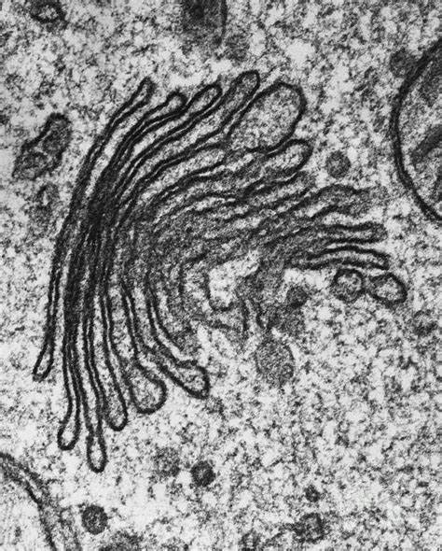
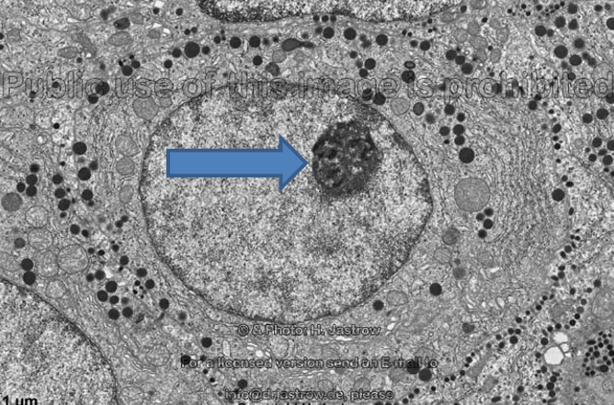
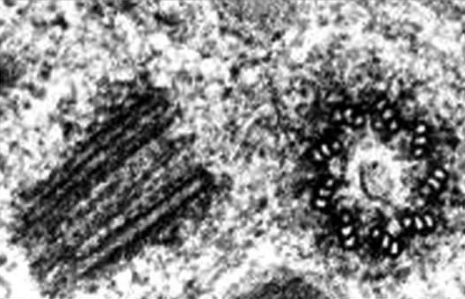
Electron micrograph
Write the name of each organelle next to each micrograph image
Golgi apparatus
Nucleolus
Centrioles

Slide 106
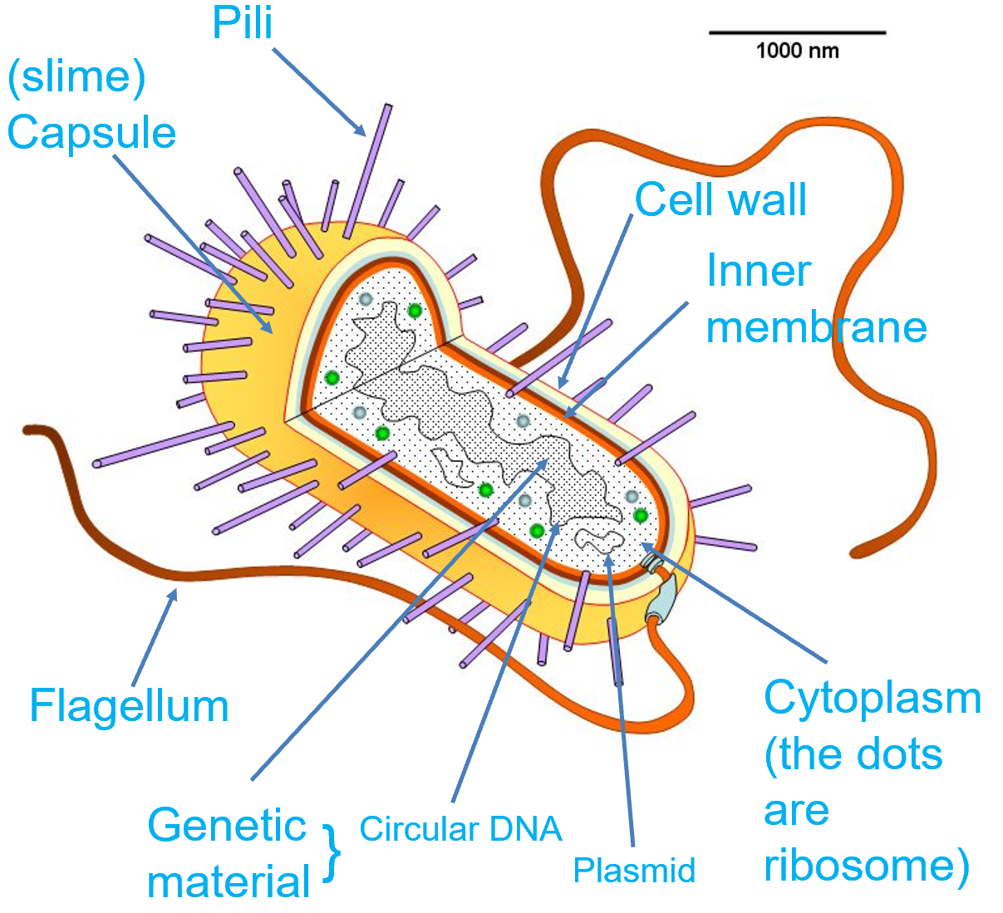
So we know the location and names of the organelles
Now lets looks at:
Structure
Function

Slide 107
Make a full table: use the spec statement to make sure you cover all the organelles.
Name and structure | Function and EM image | Prokaryotic | Eukaryotic
 |  |  | Plant | Animal
Nucleus |  | ✗ | ✓ | ✓
I have done the first one for you!!
Lets read!

Slide 108
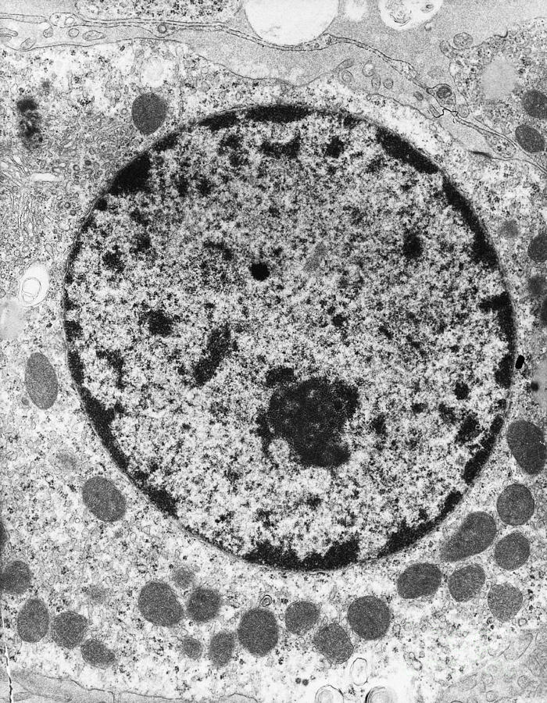
Name and structure | Function and EM image | Prokaryotic | Eukaryotic
 |  |  | Plant | Animal
Nucleus Surrounded by double membrane called nuclear envelope. Contain nucleoplasm and chromatin Nuclear pores are small gaps in the nuclear envelope Dark area is called the nucleolus. This is made up of RNA and genes coding for RNA. Contains Chromatin, which is DNA wrapped around histone proteins. This is the genetic material | Separates/protects contents of nucleus from cytoplasm. Allow substances in to reach DNA/genes. Allows substances made in nucleus out into the cytoplasm. Is where ribosomes are made Genetic material stored here | ✗ | ✓ | ✓

Slide 109
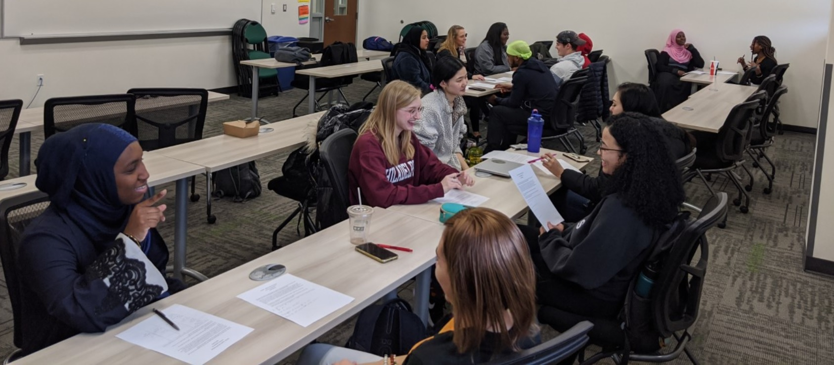
Continue gathering your information about each ultrastructure, Don’t forget the electron micrograph image.
(we will cover anything you miss – don’t worry!)
You will be speeding dating using your information once complete!!

Slide 110
Structures and ultrastructure's to include:
The nucleus (Done for you)
Ribosome.
Mitochondrion (x2 handouts)
Endoplasmic reticulum (rough and smooth x2 handouts).
Golgi apparatus (x2 handouts).
Lysosomes.
Vacuoles.
Cell wall.
Chloroplast (x2 handouts).
Cytoskeleton – we will go through this together next lesson
Cilia – we will go through this together next lesson
Small test/quiz on images, structures and functions next lesson

Slide 111
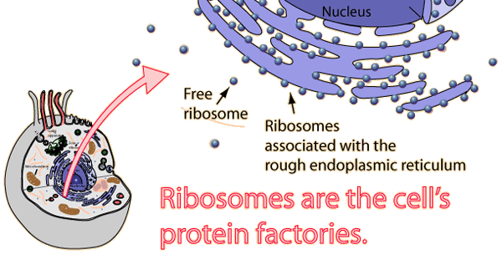
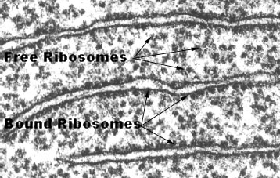
ribosomes
Doesn’t have a membrane Synthesised from ribosomal RNA in the nucleolus, into two sub units. Travels through nuclear pore and assembled in the cytoplasm. Some found free in cytoplasm, others bind to endoplasmic reticulum. | R.E.R bound ribosomes synthesise proteins to be exported from the cell. Free ribosomes make proteins to be used internally (inside cell).

Slide 112
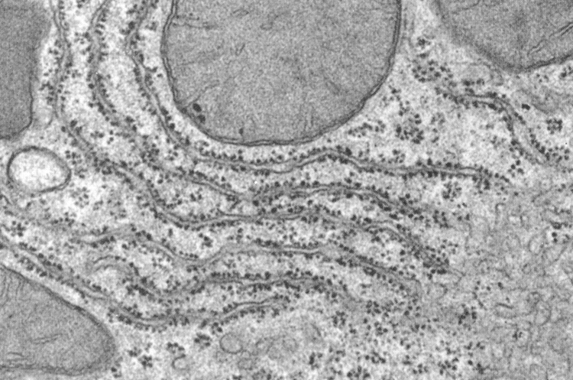
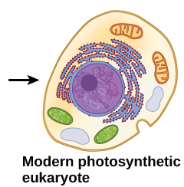
Enabled the nuclear envelope to form.
Limiting effects of jumping genes
Rough endoplasmic reticulum (R.ER)
System of membranes which is continuous with the nuclear membrane (envelope). Fluid filled cavities called cisternae. Coated with ribosomes. | Intracellular transport system, allowing transport of proteins out of the cell. Folds and packages proteins into vesicles Protein synthesis happens inside the ribosomes. The synthesised protein is actively transported (AT) into cisternae. Transported to golgi apparatus for modification and packaging. Proteins transported outside of the cell via exocytosis.

Slide 113
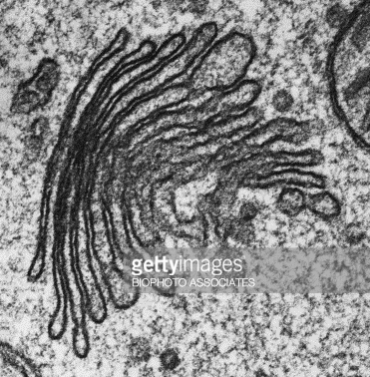
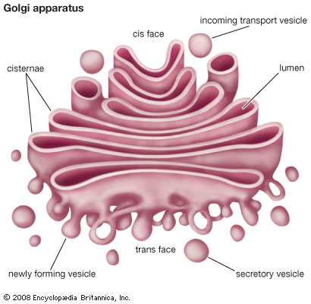
Part of the pathway linking protein production in R.ER to outside of the cell.
Golgi apparatus
Stack of membrane bound flattened sacs Secretory vesicles bring substances to and from the golgi aparatus | Proteins are modified here. Proteins are packaged into vesicles and then transported into the plasma membrane or outside of the cell (exocytosis).

Slide 114
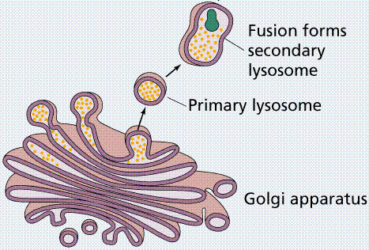
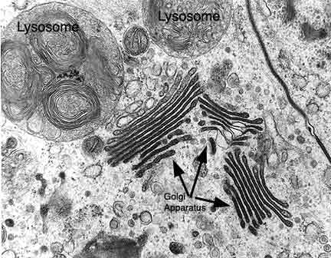
Lysosomes
Small vesicles, formed from Golgi apparatus Contain digestive/hydrolytic enzymes Lots are found in phagocytic cells (neutrophils and macrophages – type of WBC) | Powerful digestive enzymes are thus kept separate from rest of the cell. Lysosomes fuse/engulf old cellular organelles, foreign matter. Digested material can then be reused.
*Hydrolase is a class of enzyme that commonly perform as biochemical catalysts that use water to break a chemical bond

Slide 115
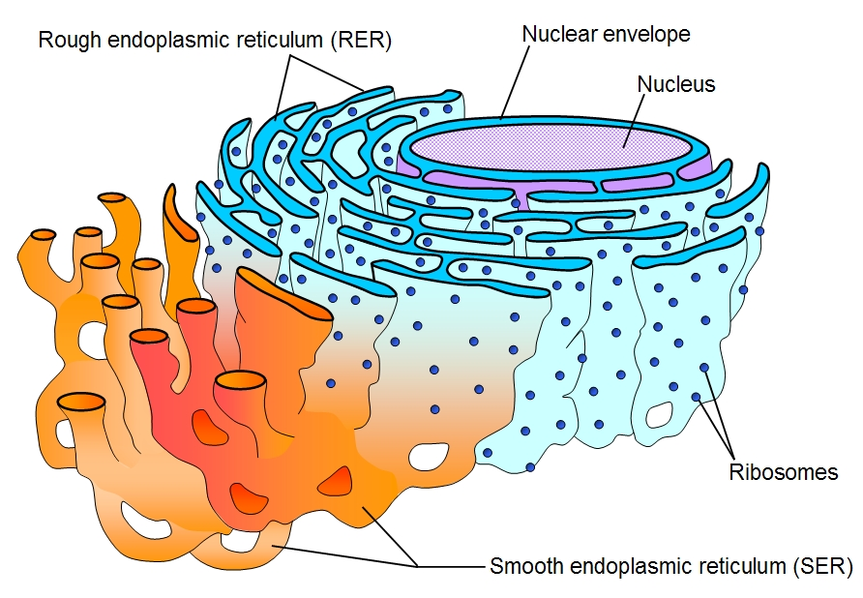
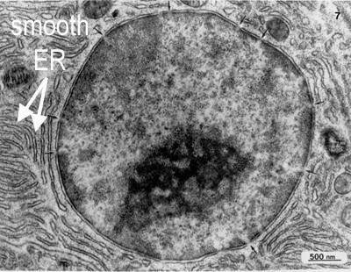
Smooth endoplasmic reticulum (S.ER)
System of membranes which is continuous with the nuclear membrane (envelope). Fluid filled cavities called cisternae. NO RIBOSOMES. | Responsible for the synthesis of essential lipids such as phospholipids and cholesterol. Responsible for the production and secretion of steroid hormones. It is also responsible for the metabolism of carbohydrates. Involved in absorption, synthesis and transport of substances from the gut.

Slide 116
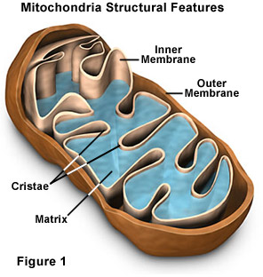
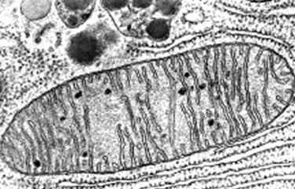
Loosened the energy constraints to allow cells to increase in size and become more complex.
Drove evolution of prokaryotic cells through into eukaryotes.
Mitochondria
Spherical, rod shaped or branched Surrounded by two membrane. Inner membrane folded into cristae. Filled with matrix (like cytoplasm but inside the mitochondria). | Site of aerobic respiration where ATP is produced. Are self replicating Have their own internal DNA, as well as genes found in the nuclear genome. More abundant in cells with high energy demands.

Slide 117
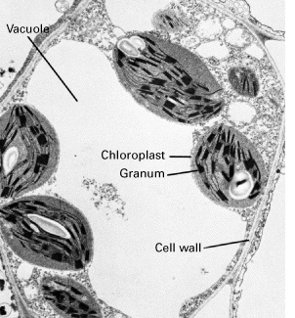
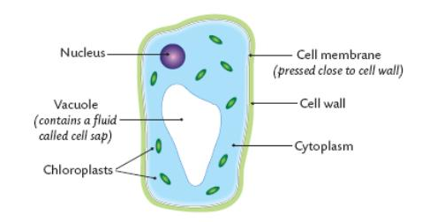
Vacuole
Surrounded by a membrane called a tonoplast. Contains fluid. | Only plant cells have large permanent vacuole. Filled with water and solutes Maintains cell stability Keeps plant cell turgid

Slide 118
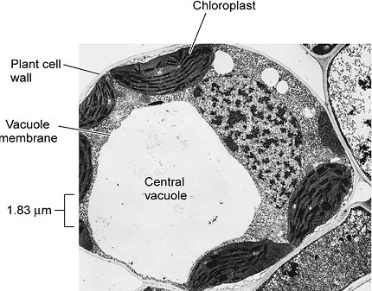
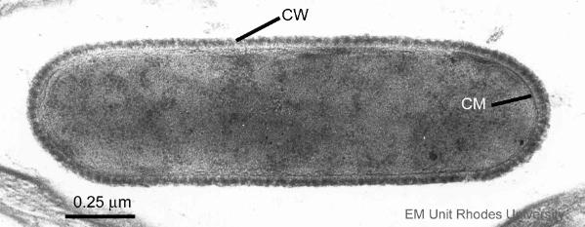
Cell wall
In plants is made of cellulose. In fungi is made of chitin In prokaryotes is made of peptidoglycan | Not found in animal cells. Is strong and prevents plant cell from bursting. Provides strength and support Maintains cell shape Is freely permeable

Slide 119



NOT FOUND IN PLANT CELLS!!
Centrioles
Consist of bundles of microtubules (small tubes) which are stuck together to give a fibre/rope like substance. | Before cell division, spindles come up of the ends which attach to chromosomes and pull them to opposite poles (ends) of the cell. Microtubules from centrioles sprout out from cell surface membrane to form cilia and undulipodia.

Slide 120

Led to the development of plant cells unique ability to synthesise own food (autotrophic)
Chloroplasts
Found in plant cells and some protoctists. Surrounded by double membrane Contain stacks of flattened stacks called thylakoids which contain chlorophyll. Fluid filled matrix is called stroma. Contain their own DNA and starch grains. | Site of photosynthesis. 1st stage of photosynthesis (light dependent stage) happens in thylakoid stack membranes, 2nd stage of photosynthesis (light independent stage – fixation of carbon) happens in stroma.

Slide 121


Cytoskeleton
Network of proteins criss-crossing through the cytoplasm. Made from three parts Microfilaments Microtubules intermediate fibres | Give support and mechanical strength, keeps cell shape stable. Allows cells to move. Act as tracks for organelles. Organelles attach and get moved to different parts of the cell (like a train line). Anchors the nucleus in the cytoplasm.

Slide 122


Cilia (undulipodia)
Protrusions from all cells, surrounded by cell surface membrane. Formed from centrioles Contain microtubules | E.g. cilia on epithelial cells Single cilia act as an antenna, detecting immediate surrounding environment. Spermatozoon (sperm cells) have an undulipodia (long cilium), enabling movement.

Slide 123
Make a pack of the names of each organelle – the person takes a card and must talk to partner for 30 seconds about it
Partner then does the same

Slide 124
You will be speeding dating using your information once complete!!

Slide 125

How does a modern cell work?
https://www.youtube.com/watch?v=JufLDxmCwB0

Slide 126
Next lesson we will see how each ultrastructure interreacts with each other

Slide 127
Teach each other… organelles
Nucleus
Endoplasmic reticulum (rough and smooth)
Golgi Body
Ribosome
Lysosome
Chloroplast and mitochondria
Vacuole
Cilia and undulipodia
Cytoskeleton and centrioles
Cell wall (made from cellulose)
Diagram
Structure
Size
Job - detail
Links

