Slide 1




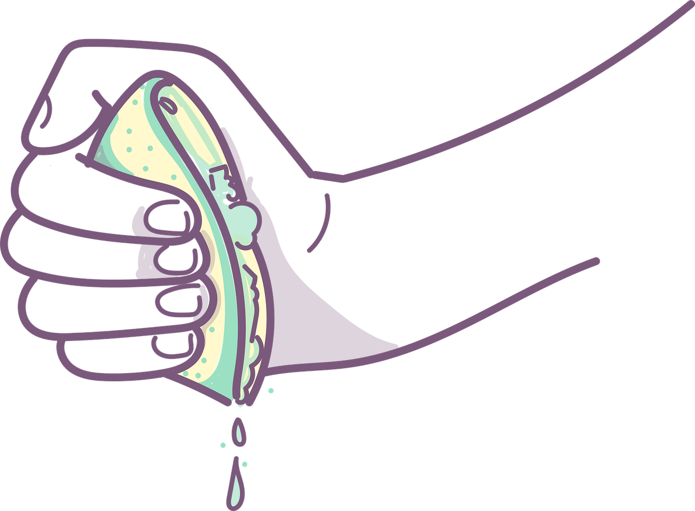
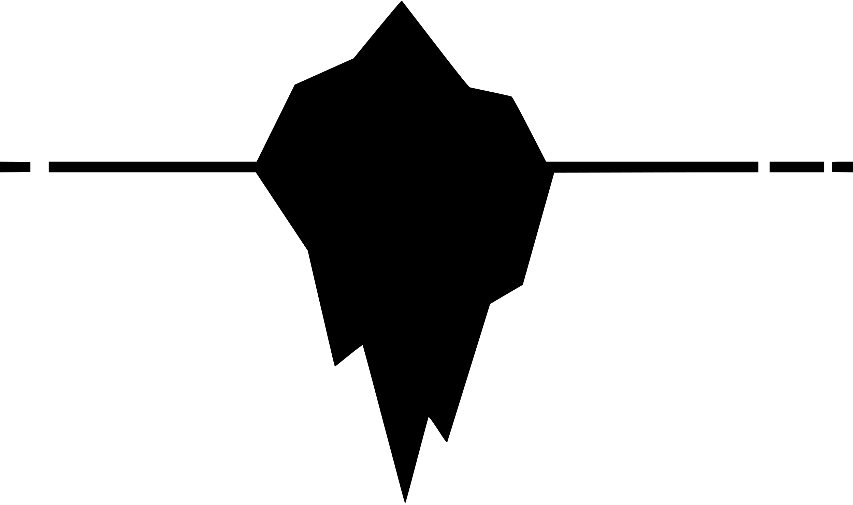



Introduction to English Language Paper 2 Section A
Choosing evidence
Language analysis
Identifying
Zooming in
Summarising
Inferencing
Explaining
Understanding effects
Comparing
These are some of the main skills you will need to master the Paper 2 Section A exam.
What does each of these skills mean?
How can you compare non-fiction texts?
Why is summarising a different skill to language analysis?

Slide 2
Learning outcomes
To describe the key skills required for Paper 2 Section A
To explain how to answer Q1
To evaluate what skills are needed for Q2

Slide 3
Paper 2 skills
Identifying
Choosing evidence
Identifying information is important because you need to read through texts and find the information you need to answer questions successfully.
Choosing evidence ensures you can back up your interpretations and support your ideas with examples from the text.

Slide 4
Paper 2 skills
Language analysis
Zooming in
Language analysis shows you can see the effects a text has on a reader and why.
Zooming in on key parts of the text improves your ability to analyse that text and master your analytical skills.

Slide 5


Paper 2 skills
Writing a summary means taking out unimportant information from a text and focusing on key parts related to the question.
Summarising involves providing information and facts from a text rather than offering opinions.
Inferencing is where you read the words of a text and find the information that is hidden or implied by the writer within the words.

Slide 6

Paper 2 skills
Explaining
Comparing texts is an important skill in Paper 2 as there is a whole question devoted to comparing the two non-fiction texts. This involves exploring purpose, audience and types of writing to understand the similarities and differences between texts.
Explaining is important because you will need to explain your own interpretations for most of Paper 2.

Slide 7



Understanding effects
Writer
Text
Reader
A writer will choose every single word carefully when creating a text. Every adjective, every sentence, every paragraph – each will be designed to have specific effects on the reader.
We need to explore how the text has effects on the reader: how it makes them think and feel. If we can do that successfully, we will master Paper 2 Section A.

Slide 8
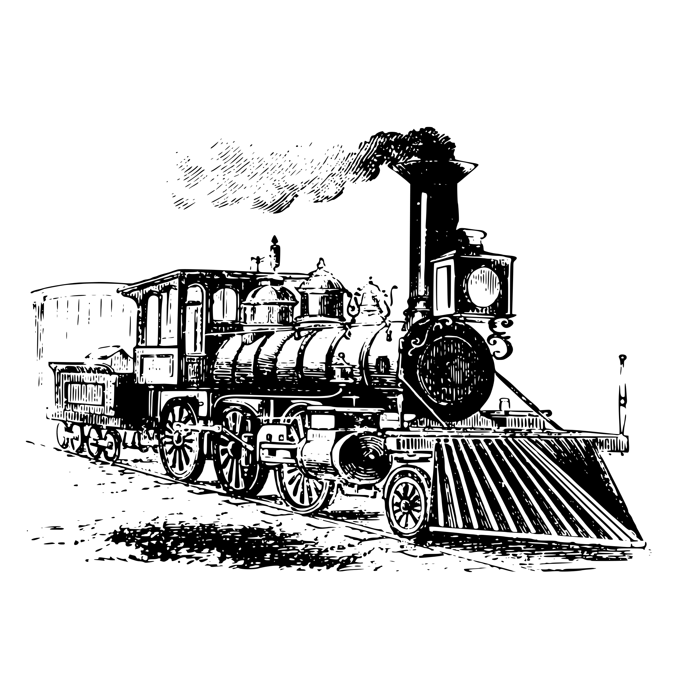
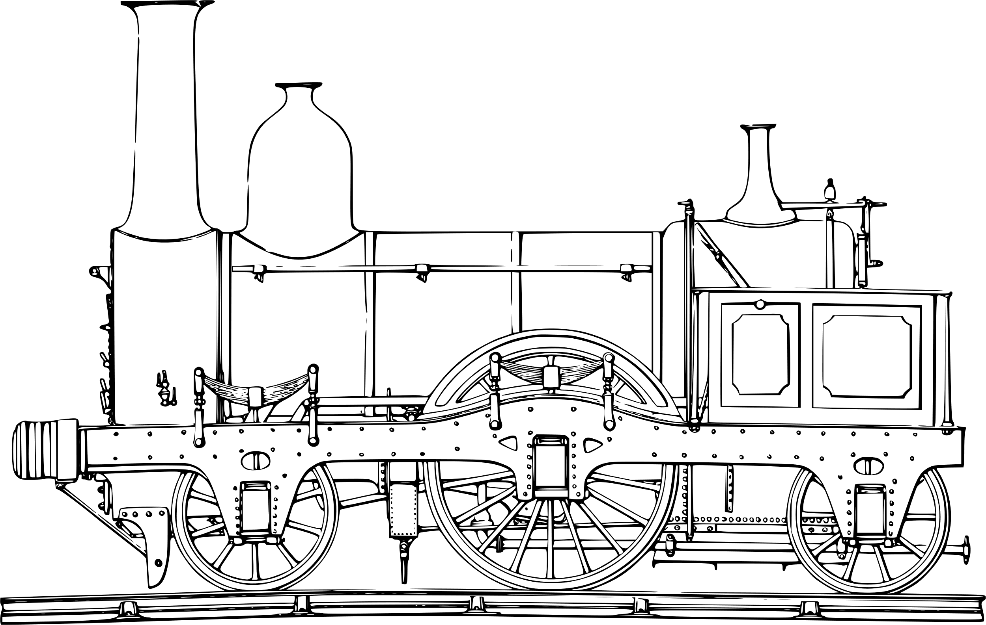

Source A
Read through the extract from the travel book by Peter Fleming.
Read the information about the extract carefully. It was published around 1933 and it is a travel account of Fleming’s train journey on the Trans-Siberian Railway.
This is important information to keep in mind when answering the questions.
Give yourself 5-7 minutes to read through the extract.
Timed conditions: 5-7 minutes

Slide 9

Q1) Identifying and interpreting information
Q1) This question asks you to focus on the first seven lines of the extract.
You are then given eight statements: four are true, four are false. You are asked to shade to the four boxes next to the true statements.
Exam tip
In the exam you will need to read the text quickly but carefully and answer these questions as fast as you can.
Read each statement carefully as sometimes they can be worded to try and catch you out!
A The writer is at the start of his journey.
B The writer is looking forward to leaving the train.
C The writer will be on the train for three more days.
D The train has a carriage where meals are served.
E The writer thinks the bread has been delicious.
F The writer feels that he has been cut off from society while on the train.
G The writer has had many activities to keep him busy on the train.
H The writer does not have any plans for when he leaves the train.
Timed conditions: 5 minutes

Slide 10
A The writer is at the start of his journey.
B The writer is looking forward to leaving the train.
C The writer will be on the train for three more days.
D The train has a carriage where meals are served.
E The writer thinks the bread has been delicious.
F The writer feels that he has been cut off from society while on the train.
G The writer has had many activities to keep him busy on the train.
H The writer does not have any plans for when he leaves the train.
A The writer is at the start of his journey.
B The writer is looking forward to leaving the train.
C The writer will be on the train for three more days.
D The train has a carriage where meals are served.
E The writer thinks the bread has been delicious.
F The writer feels that he has been cut off from society while on the train.
G The writer has had many activities to keep him busy on the train.
H The writer does not have any plans for when he leaves the train.
A The writer is at the start of his journey.
B The writer is looking forward to leaving the train.
C The writer will be on the train for three more days.
D The train has a carriage where meals are served.
E The writer thinks the bread has been delicious.
F The writer feels that he has been cut off from society while on the train.
G The writer has had many activities to keep him busy on the train.
H The writer does not have any plans for when he leaves the train.
A The writer is at the start of his journey.
B The writer is looking forward to leaving the train.
C The writer will be on the train for three more days.
D The train has a carriage where meals are served.
E The writer thinks the bread has been delicious.
F The writer feels that he has been cut off from society while on the train.
G The writer has had many activities to keep him busy on the train.
H The writer does not have any plans for when he leaves the train.

Slide 11
Q1) Answers
Q1) This question asks you to focus on the first seven lines of the extract.
You are then given eight statements: four are true, four are false. You are asked to shade to the four boxes next to the true statements.
Exam tip
In the exam you will need to read the text quickly but carefully and answer these questions as fast as you can.
Read each statement carefully as sometimes they can be worded to try and catch you out!
A The writer is at the start of his journey.
B The writer is looking forward to leaving the train.
C The writer will be on the train for three more days.
D The train has a carriage where meals are served.
E The writer thinks the bread has been delicious.
F The writer feels that he has been cut off from society while on the train.
G The writer has had many activities to keep him busy on the train.
H The writer does not have any plans for when he leaves the train.
Timed conditions: 5 minutes

Slide 12
Statement | True or False? | Evidence to show why it is true or false:
A The writer is at the start of his journey. |  | “And now the journey was almost over.”
B The writer is looking forward to leaving the train. |  | “There is no more luxurious sensation than what may be described as the ‘end of term’ feeling.” “But I knew what I was going to stop doing, and that, for the moment, was enough.”
C The writer will be on the train for three more days. |  | “After tomorrow there would be no more trips to the dining-car”
D The train has a carriage where meals are served. |  | “the dining-car”
E The writer thinks the bread has been delicious. |  | “no more of that black bread, in consistency and flavour suggesting rancid peat”
F The writer feels that he has been cut off from society while on the train. |  | “no more of a monk’s existence”
G The writer has had many activities to keep him busy on the train. |  | “no more days entirely blank of action”
H The writer does not have any plans for when he leaves the train. |  | “t was true that I did not know what I was going to do, that I had nothing very specific to look forward to”

Slide 13
Now, read through Source B.
It was written in 1830 by Fanny Kemble. It is a letter to a friend about her first ride on a steam train. She was 21 at the time.
Just like Source A, it is important to consider this information when analysing the source.
Timed conditions: 5-7 minutes

Slide 14
Q2 involves writing a summary
You need to refer to Source A and Source B for this question.
The writers in Source A and Source B are travelling on different types of trains.
What can you infer about the differences between the two trains?
What is a summary?
What are the key features or parts of a summary?
Why does the exam question mention about what you can “infer”? What does this mean and how can you show it in your summary?
Choosing evidence
Identifying
Summarising
Inferencing

Slide 15

This is what you are marked on in the summary question in Paper 2:
Assessment criteria:
Identify key information
Interpret information both explicitly and implicitly
Select evidence to support interpretations across different texts
This is an exam-style question:
You need to refer to Source A and Source B for this question.
The writers in Source A and Source B are travelling on different types of trains.
What can you infer about the differences between the two trains?
Use the assessment objective and exam question above to complete one of the following activities:
Write down the five most important words from the assessment criteria.
What do you need to include in your summary to achieve a good mark?
How would you plan your answer to achieve a good mark in this exam question?

Slide 16
A summary contains a number of key features
It is written in your own words, not those of the original writers.
You should include lots of small quotes from both texts regularly to show you can provide evidence to support your interpretations.
In the exam, you must look at two texts and summarise key information from both on the same topic or area.
You must only pick out the relevant information and ignore anything not relevant to the topic.
A summary should be well-organised and include a clear structure.
Think of a summary as a bit like making lemonade. You’re squeezing the juice out of a lemon to make the drink. In the same way, you’re squeezing out the key information from a whole text to make a summary.

Slide 17

The topic is “the differences between the two trains”
That is all we need to focus on. Any other information is not relevant in our summary.
On your diagram:
Draw two lines – one for Source A and one for Source B.
Explain your interpretations – why did you place the lines where you did?
Are these two texts similar or different? Why? Provide specific examples.
Source B
Source A
Positive
Negative
Think about the perspectives of the two texts. Are they positive or negative? This is a good way of starting out your analysis of both texts.

Slide 19


Source A is very negative about the train journey, whereas Source B is very positive.
The writer in Source A offers negative descriptions of his time on the train, the food, the conditions and the crash that occurs.
In contrast, the writer of Source B offers very positive descriptions of the journey, the scenery, the movement of the train and the writer’s experiences overall.
Positive
Negative

Slide 20
Next lesson we will explore the two texts in more detail and write out full answers for Q2
Choosing evidence
Identifying
Summarising
Inferencing

Slide 21

Plenary: Blind Vote
Put your heads on the table and close your eyes.
I will read out the learning outcomes and you need to put your thumbs up or down to judge how far you think you have progressed. Do not look up!
To describe the key skills required for Paper 2 Section A
To explain how to answer Q1
To evaluate what skills are needed for Q2

